Slide 1

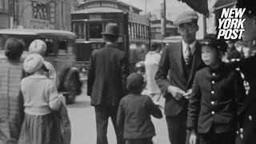
Hiroshima Before the Bombing - 1935

Slide 2
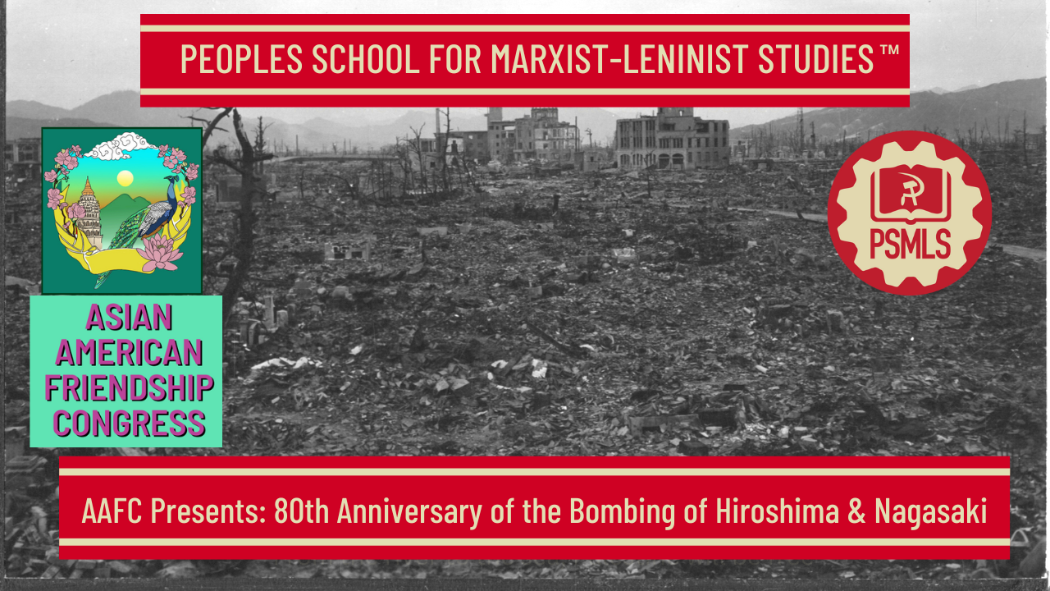
PSMLS 8/5/25

Slide 3
What we’ll be learning today:
The Manhattan Project, Operation Unthinkable and the truth about the justification to drop the bombs
Actual event of the bombings, effects on civilians, racism against Japanese people
Atomic aftermath and the present day nuclear threat

Slide 4
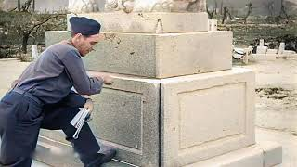
Atomic Bombing of Hiroshima, Japan, on August 6th, 1945

Slide 5
Atomic Bombing of Hiroshima, Japan, on August 6th, 1945

Slide 6
The Decision to Use the Atom Bomb

Slide 7
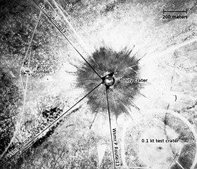
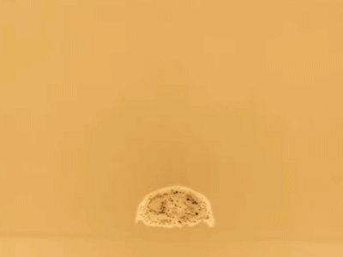
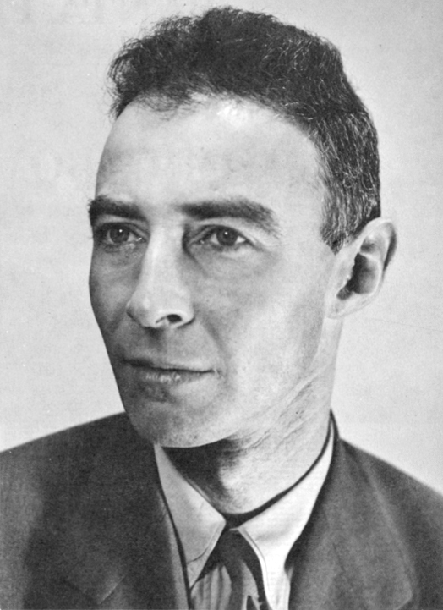
Manhattan Project
In the early 1930’s, British scientists split lithium atoms with protons and an era of nuclear science began. By 1938, with the discovery of neutrons earlier in the decade, scientists Otto Hahn and Fritz Straussman shocked the world by splitting a uranium atom with neutrons, creating fission of the nucleus of the atom, which could result in a nuclear chain reaction.
Politically, the world was beginning to see more and more the threat of Nazi fascism and though research was kicked off at different times in several different countries, many atomic scientists, such as Albert Einstein, came to the United States and requested to FDR that nuclear weapons be developed to beat the Nazis in the race for a successful nuke, which Nazis would’ve used indiscriminately.
Nazis had been trying to develop nuclear weaponry, but gave up in 1942 to focus on V-1 and V-2 rocketry, but this wasn’t known until 1944 and Nazis could have begun research again at any point. However, the first US bomb, Trinity, developed in part by American communists like J. Robert Oppenheimer, was tested successfully in July 1945, just 1 month before the bombing of Hiroshima and Nagasaki.

Slide 8
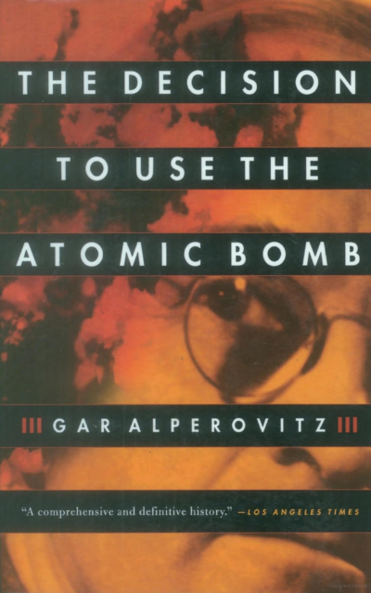
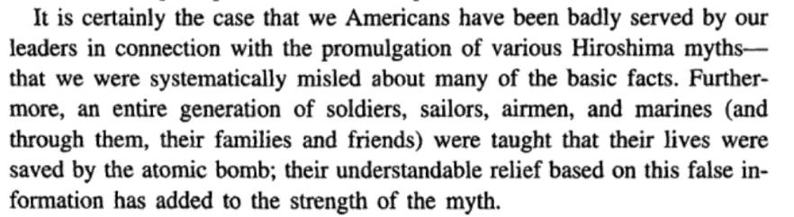
The Decision to Use the Atom Bomb
- Gar Alperovitz

Slide 9
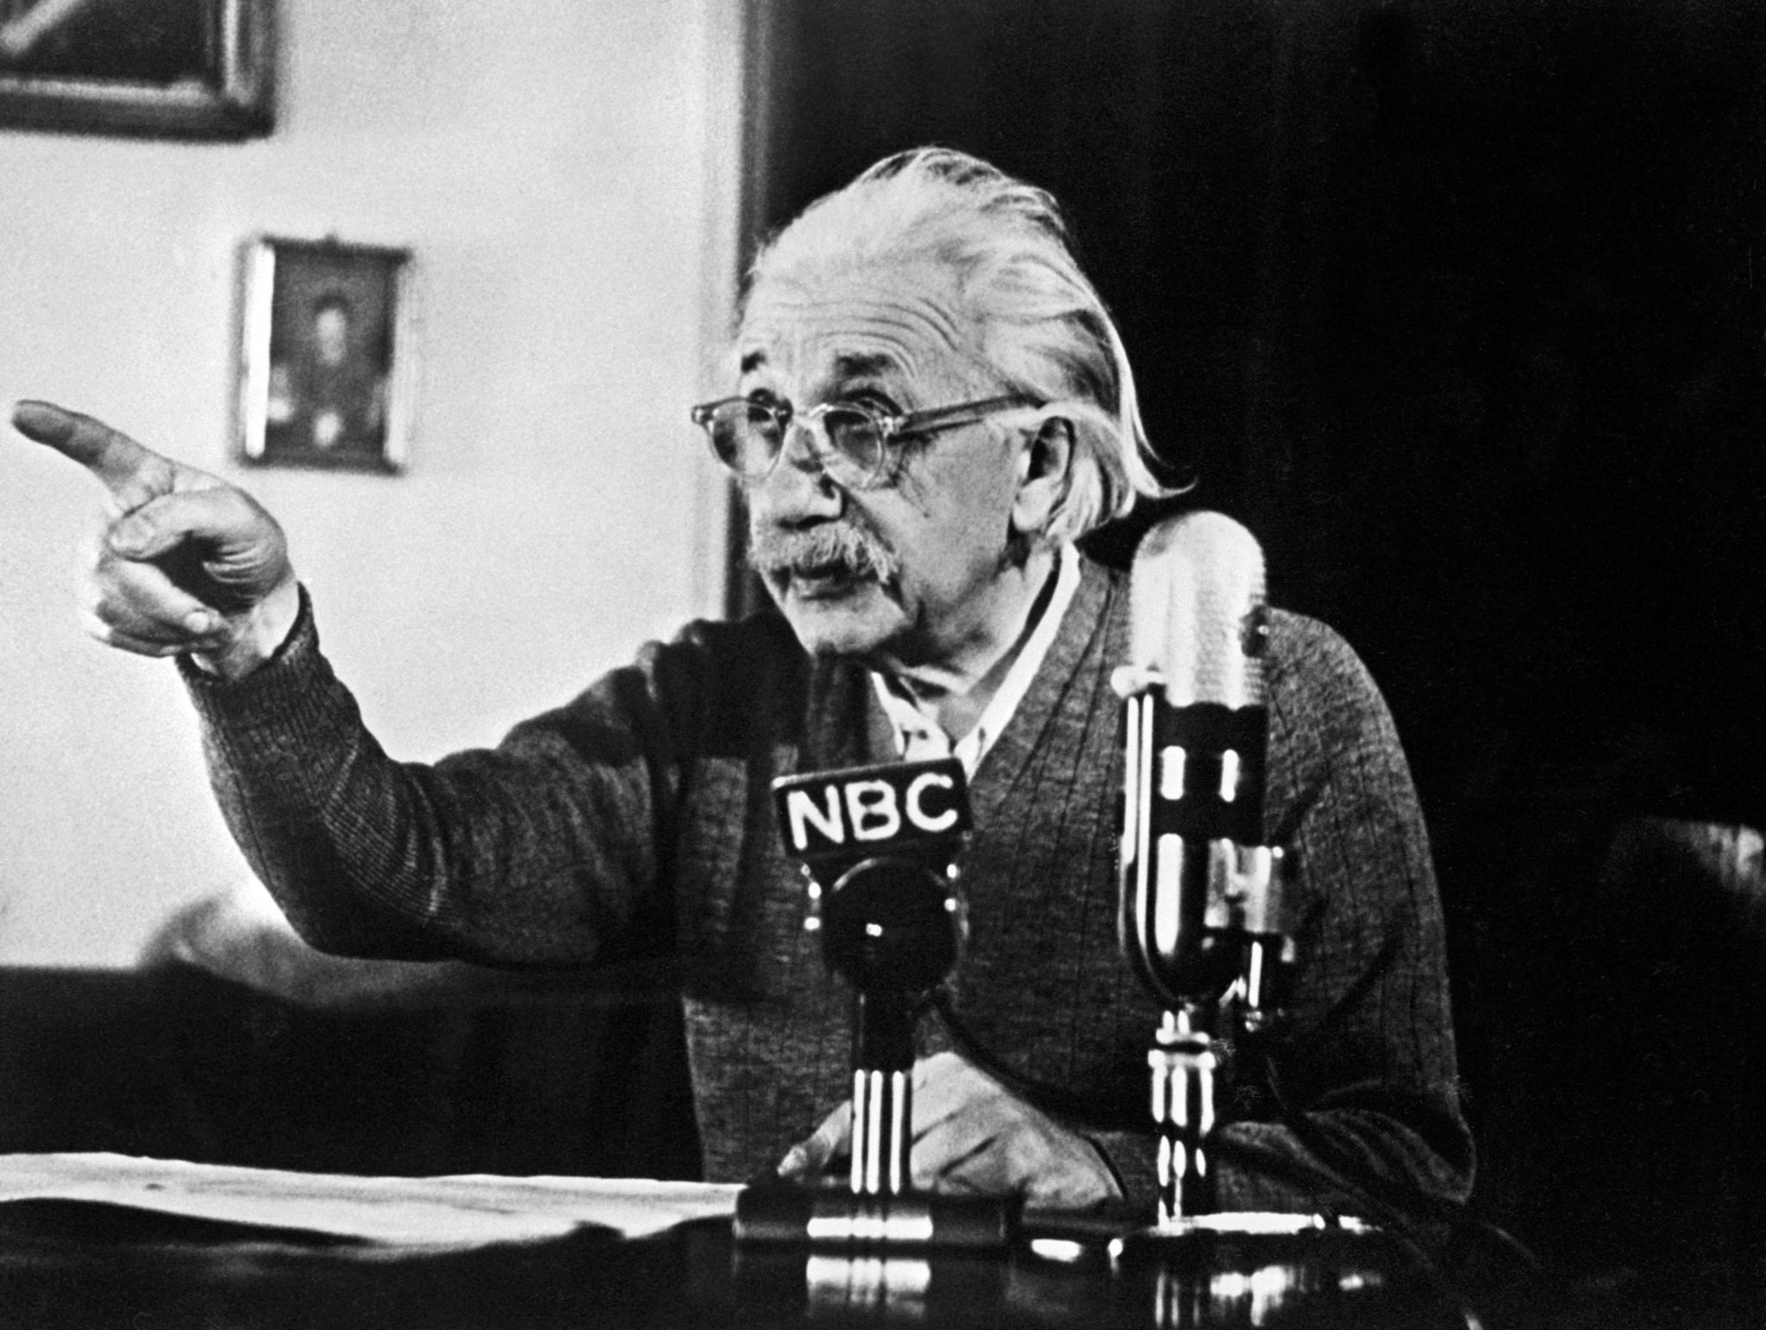
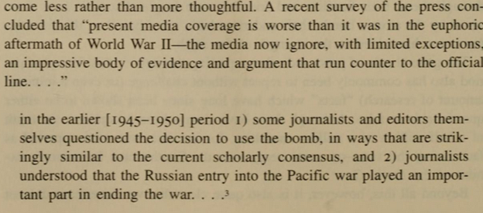
The Complicity of Silence
"Had I known that the Germans would not succeed in developing an atomic bomb, I would have done nothing for the bomb." -Albert Einstein

Slide 10
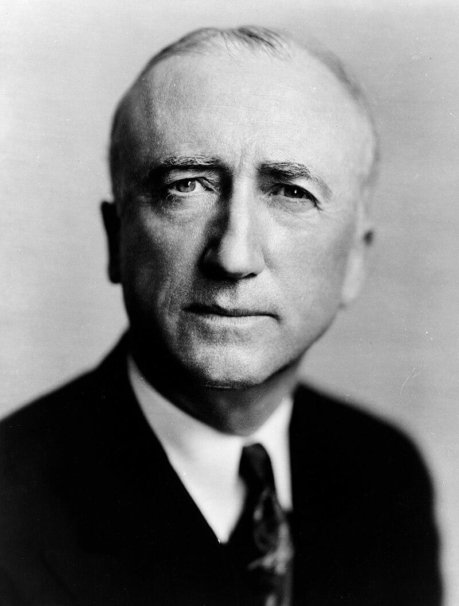

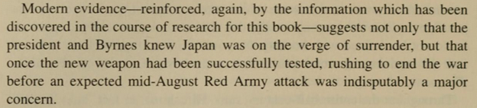

The Decision to Use the Atom Bomb
- Gar Alperovitz
James F. Byrnes was the Secretary of State under Truman. According to Alperovitz he was pushing the president to use the atomic bomb more than anyone else that was close to the president.

Slide 11
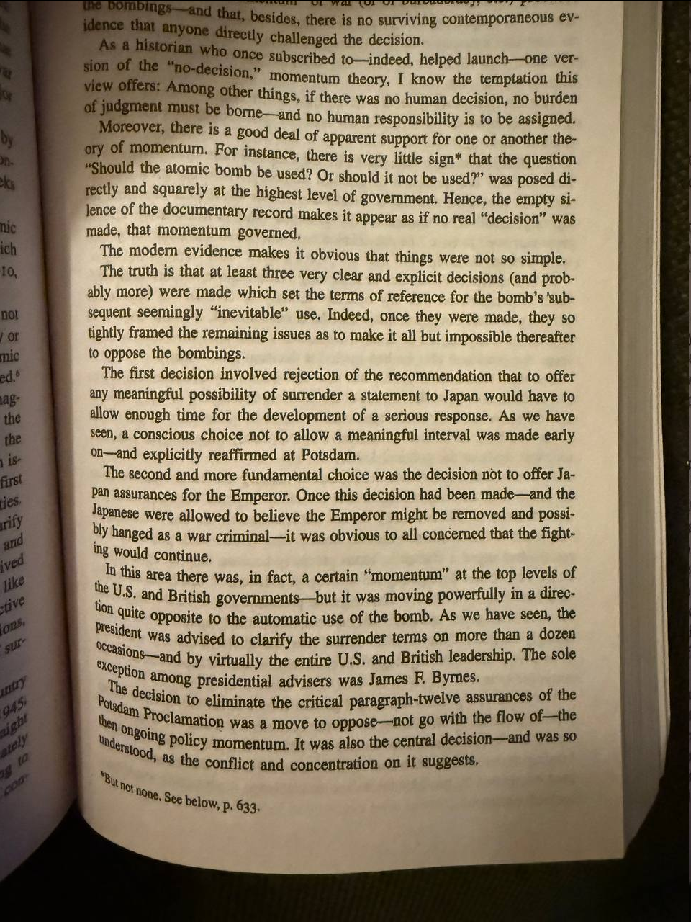
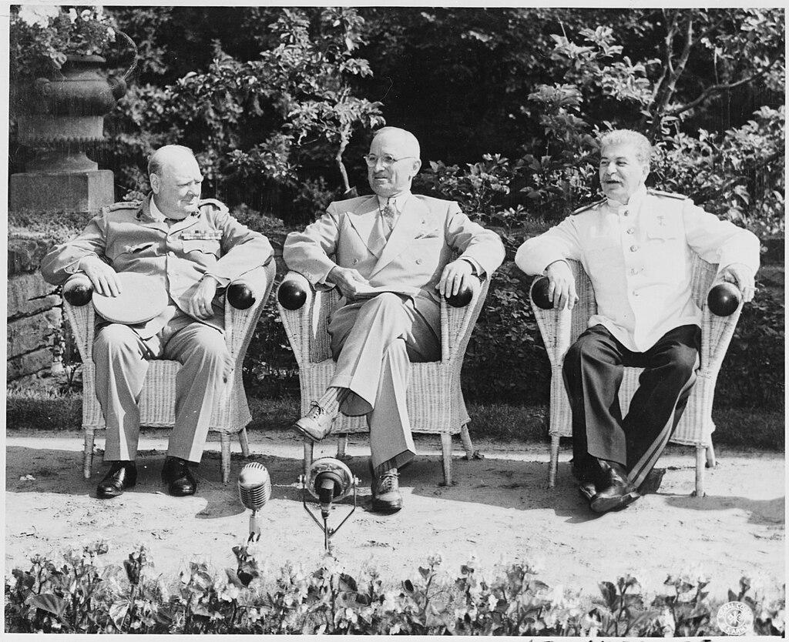
The Decision to Use the Atom Bomb
- Gar Alperovitz
The Potsdam Conference was held at Potsdam in the Soviet occupation zone from 17 July to 2 August 1945, to allow the three leading Allies to plan the postwar peace.Truman was secretly informed that the Trinity test of the first atomic bomb on 16 July had been successful. He hinted to Stalin that the U.S. was about to use a new kind of weapon against the Japanese.

Slide 12
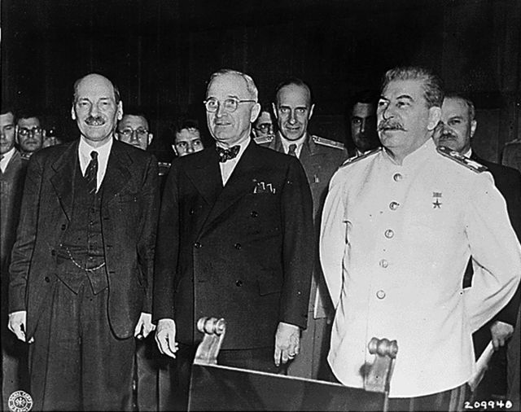
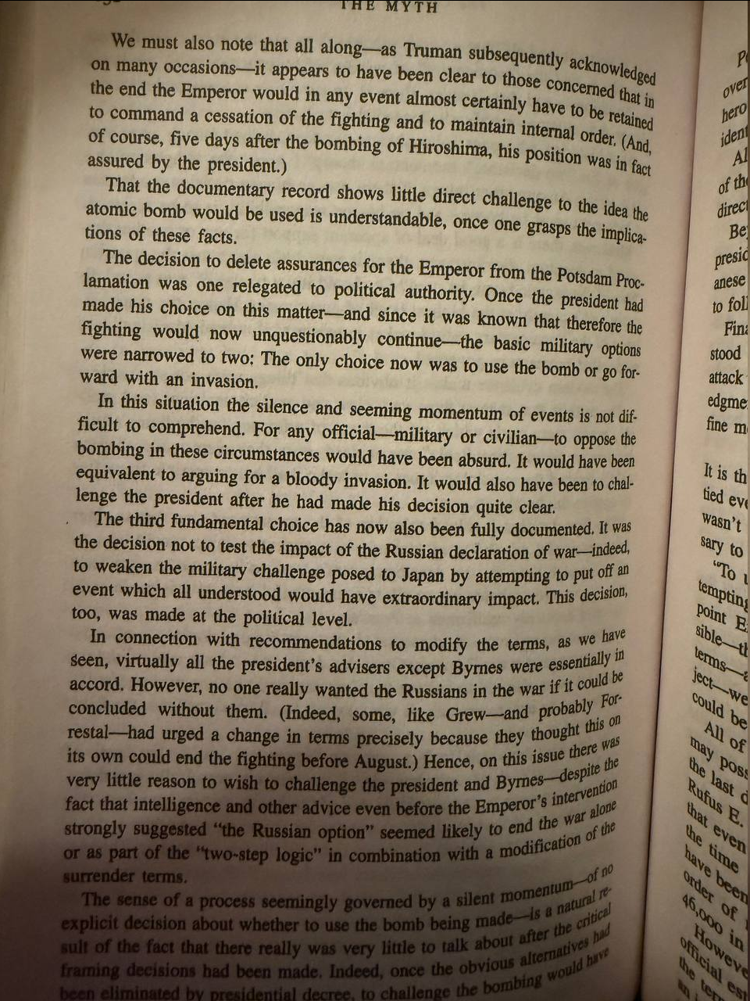
The Decision to Use the Atom Bomb
- Gar Alperovitz
The Potsdam Conference issued the Potsdam Declaration, the Proclamation Defining Terms for Japanese Surrender (26 July 1945) wherein the Western Allies (UK, US, USSR) and the Nationalist China of General Chiang Kai-shek asked Japan to surrender or be destroyed.

Slide 13
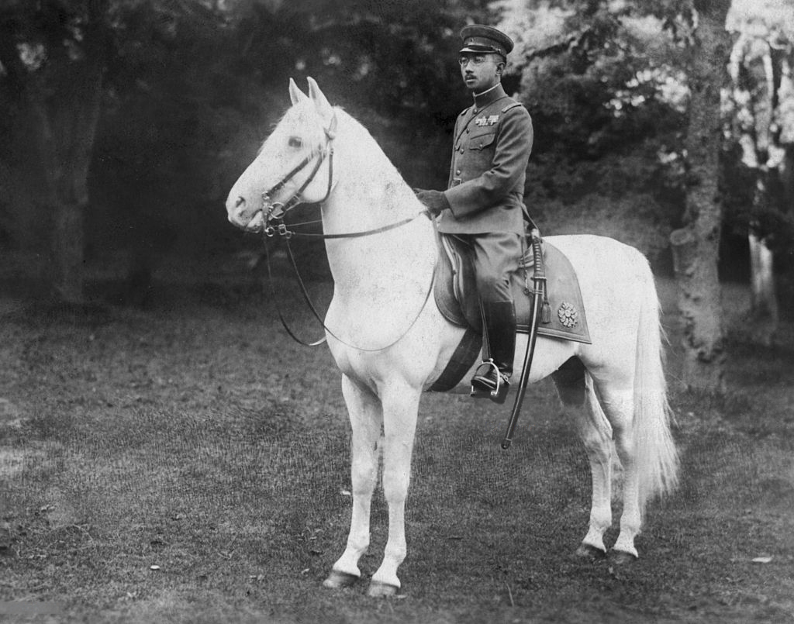
The Decision to Use the Atom Bomb
- Gar Alperovitz
Hirohito (Emperor Showa) - As emperor during the Shōwa era, Hirohito oversaw the rise of Japanese militarism, Japan's expansionism in Asia, the outbreak of the Second Sino-Japanese War and World War II

Slide 14
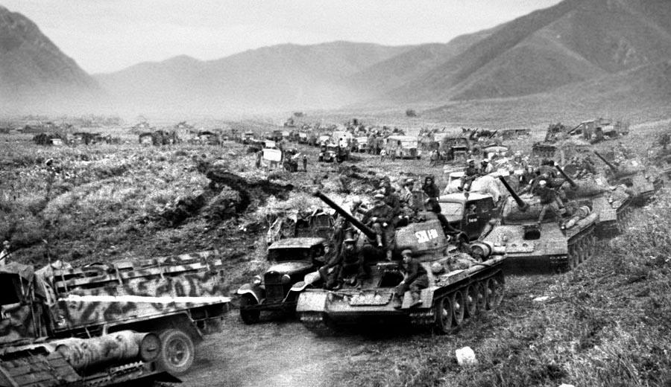
The Decision to Use the Atom Bomb
- Gar Alperovitz
A huge motorized Soviet convoy advances across the Grand Khingan Mountain Range in south central Manchuria.

Slide 15
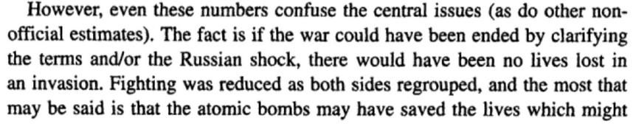
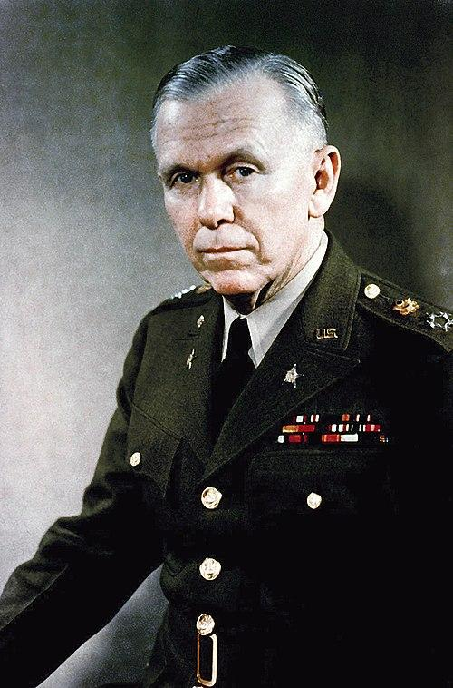
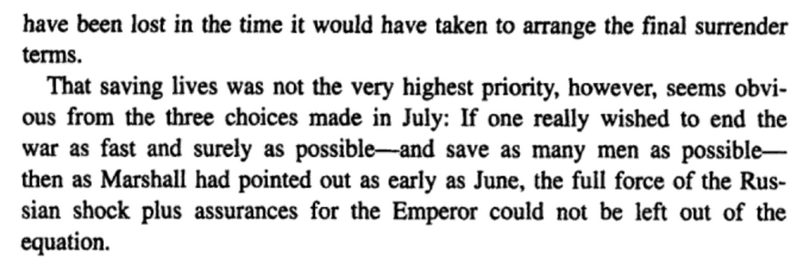
The Decision to Use the Atom Bomb
- Gar Alperovitz
George Marshall - Secretary of Defense in 1945

Slide 16
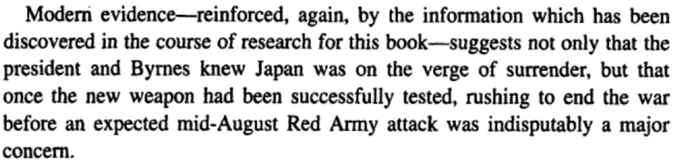
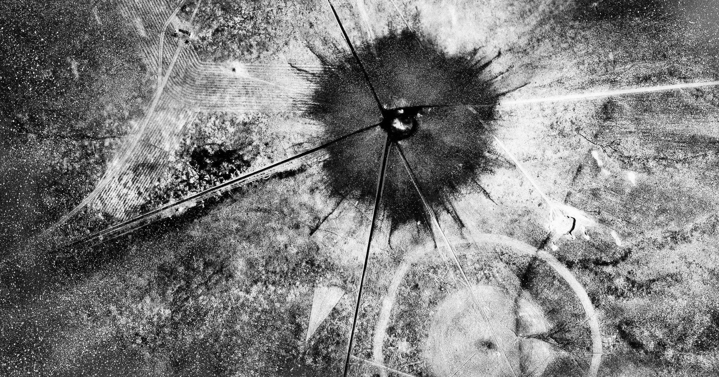
The Decision to Use the Atom Bomb
- Gar Alperovitz
“I have become death, the destroyer of worlds'' Robert Oppenheimer said this after the 1st A bomb was tested successfully at Trinity Site, New Mexico

Slide 17
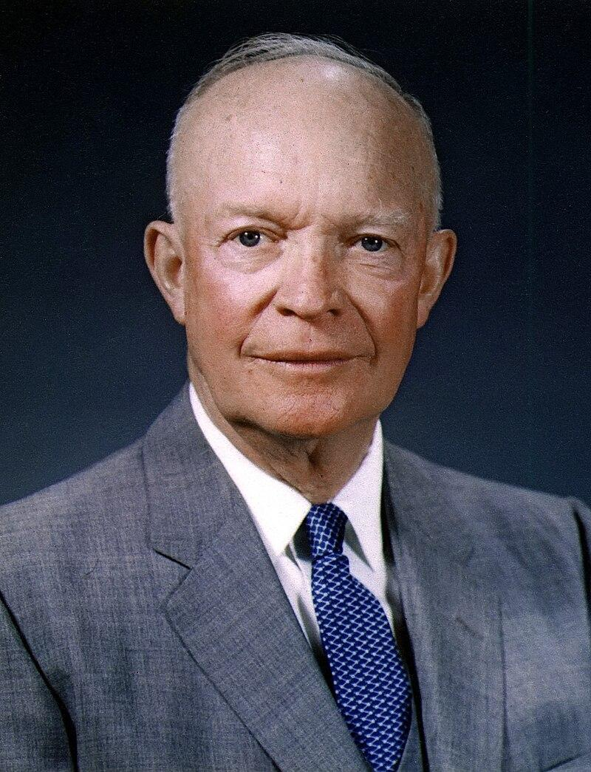
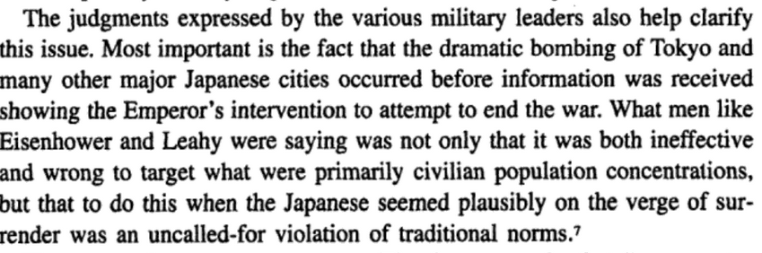
The Decision to Use the Atom Bomb
- Gar Alperovitz
Dwight D. Eisenhower - 1st Supreme Allied Commander Europe and 34th President

Slide 18
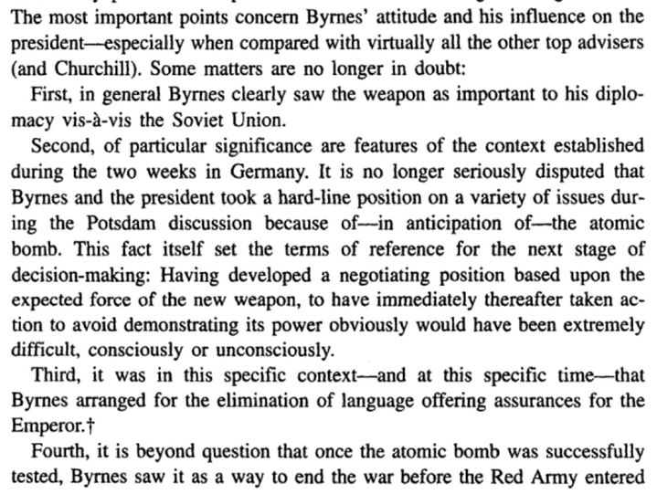
The Decision to Use the Atom Bomb
- Gar Alperovitz

Slide 19
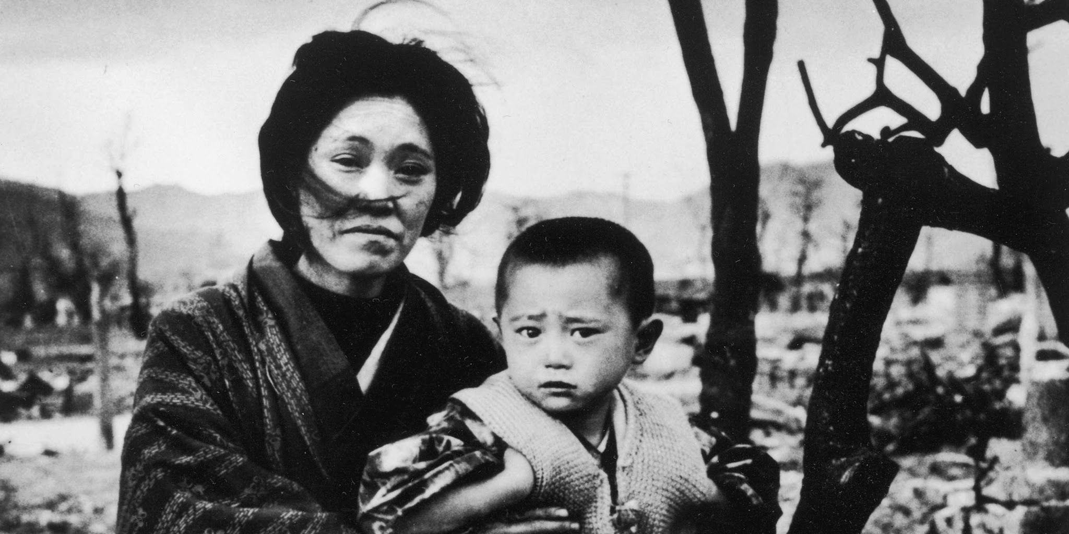
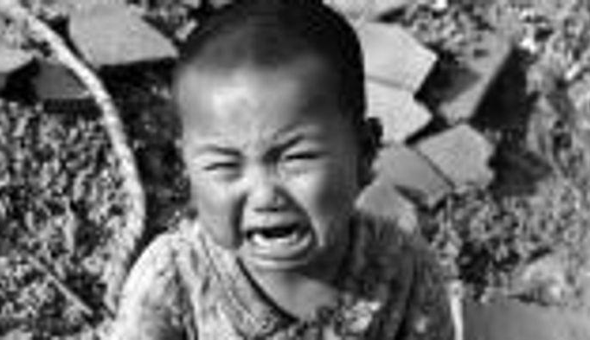
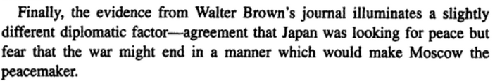
The Decision to Use the Atom Bomb
- Gar Alperovitz

Slide 20
The Truth about Hiroshima and Nagasaki

Slide 21
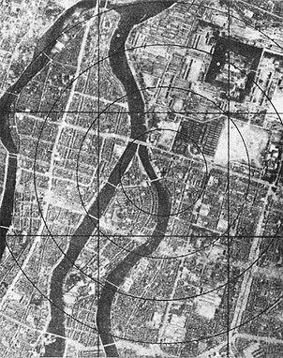
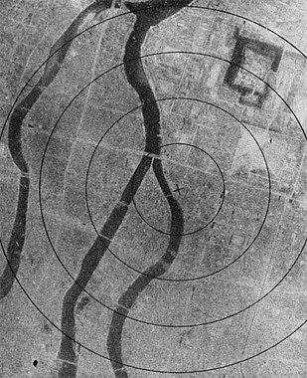
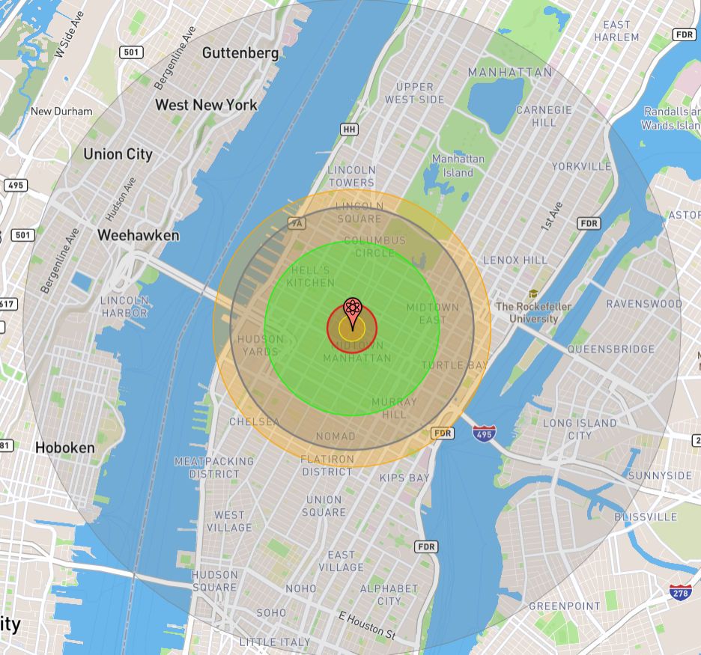
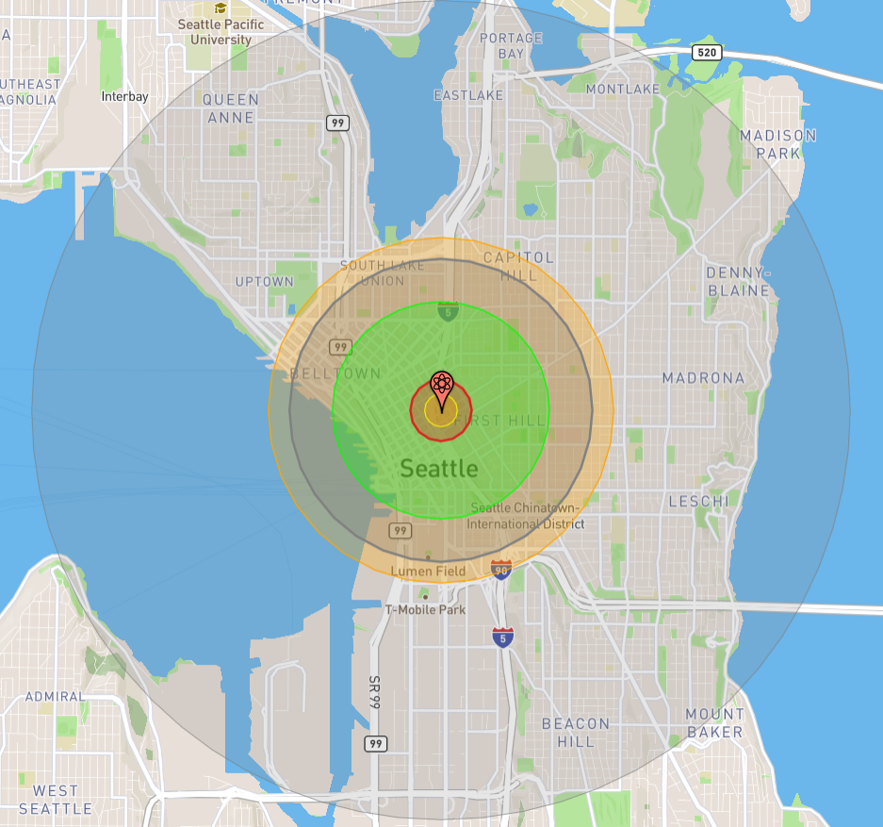
The Atomic Bombings
Hiroshima
On August 6th, 1945, at 08:15 Hiroshima time, a enriched uranium fission bomb called “Little Boy”, was dropped from the Enola Gay B-29 Bomber over Hiroshima. It detonated at about 2,000 meters above the city.
The intended target area was the Aioi Bridge in the middle of the city, but winds caused the bomb to detonate over Shima Surgical Clinic. It detonated with a force of ~16 kilotons of TNT, or about 15,000 tons of TNT. 1 mile in all directions was completely destroyed, and fires spread for about 4.6 miles.
Over 140,000 people were killed by this bomb, including in the months following the attack. Over 60% of the city was destroyed. Wood and paper homes were vaporized and only concrete buildings built to withstand earthquakes remained, albeit heavily damaged.
Hiroshima before and after
Blast compared to NYC and Seattle

Slide 22
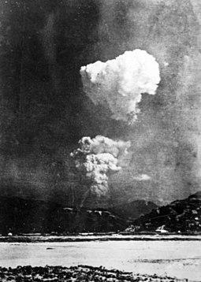
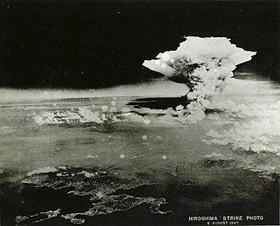
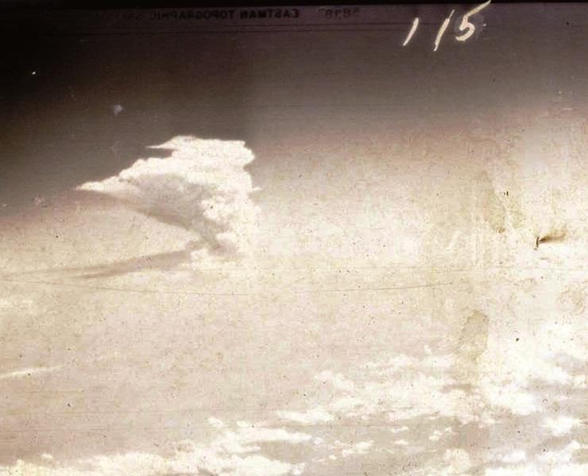
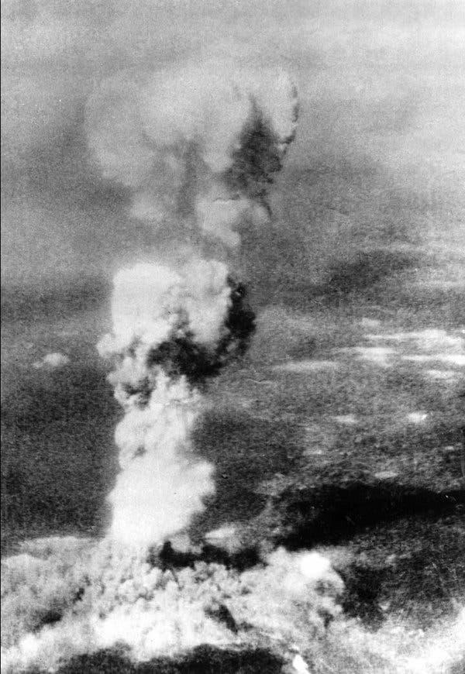
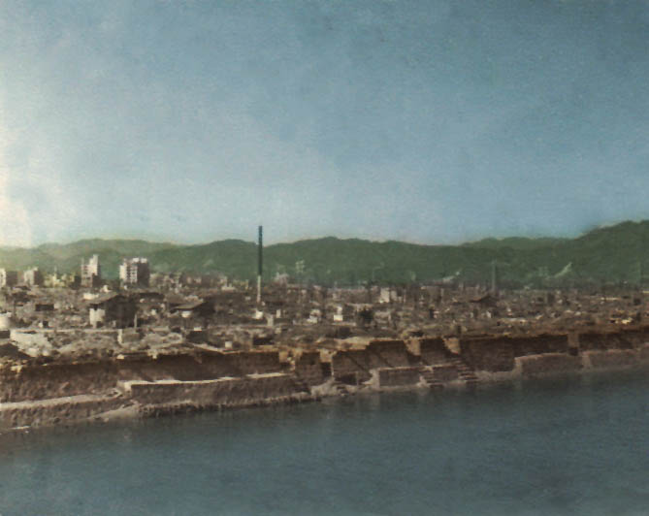
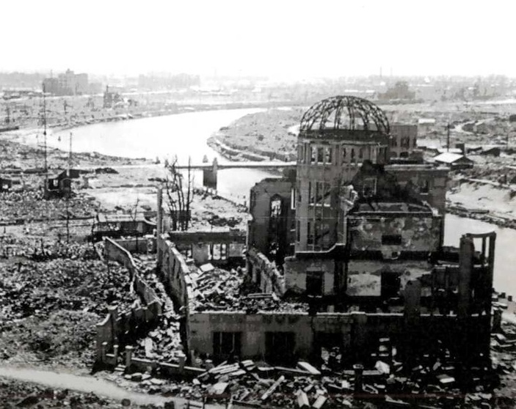
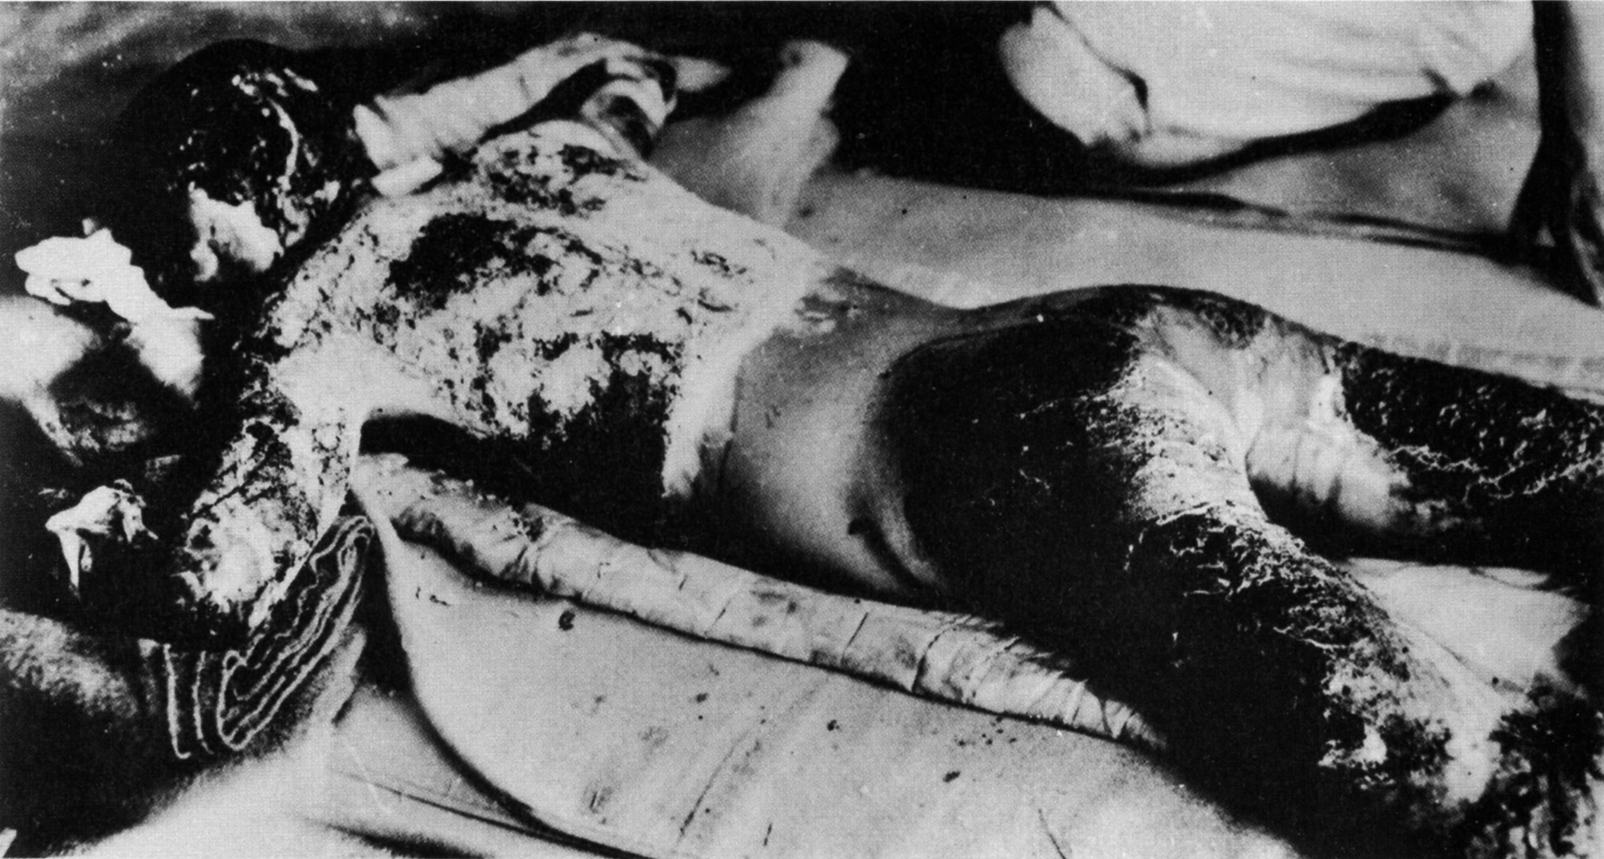
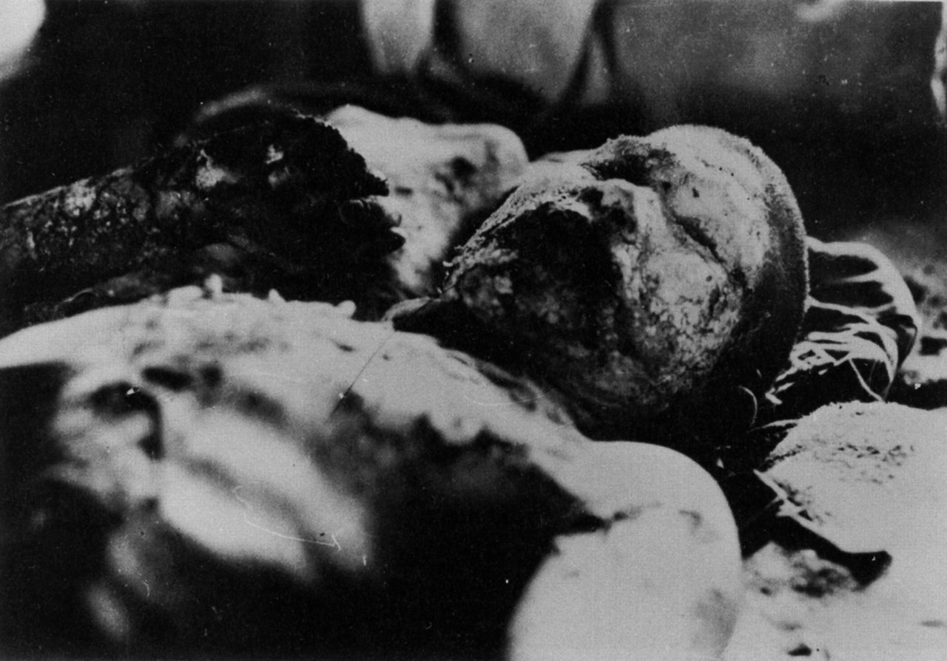
Atomic Bombing of Hiroshima

Slide 23
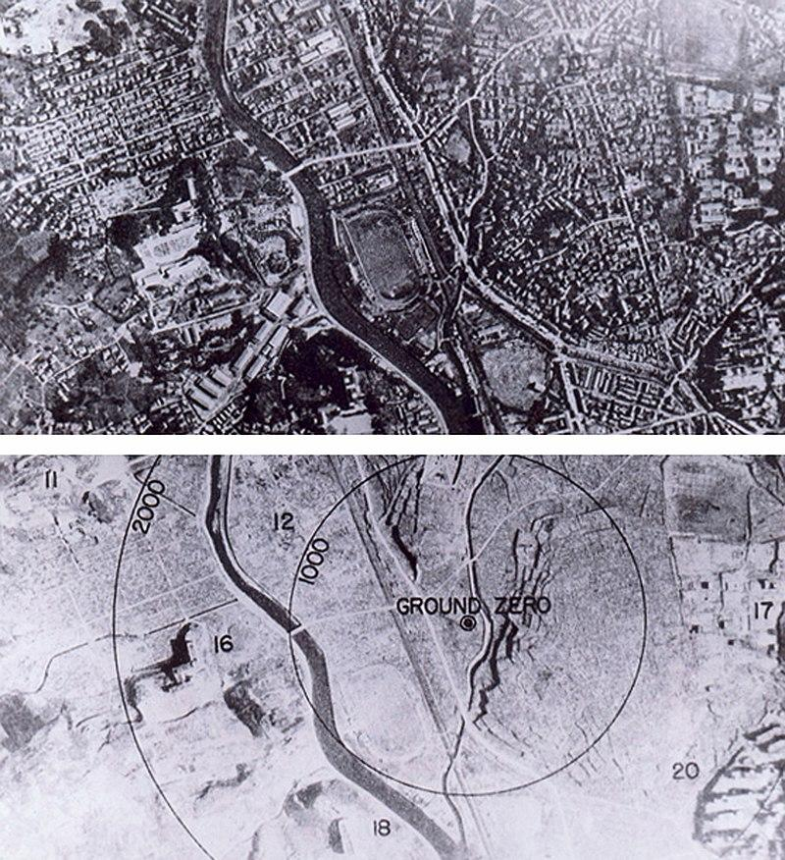
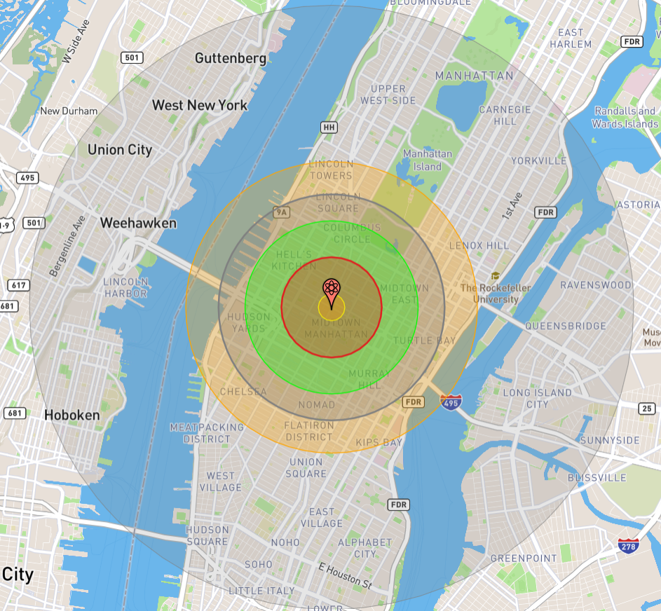
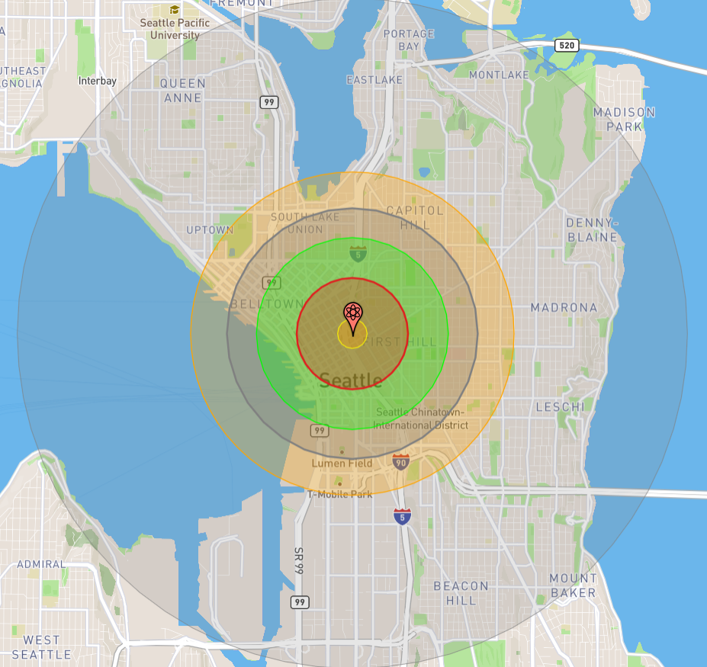
The Atomic Bombings
Nagasaki
On August 9th, 1945, the B-29 bomber Bockscar flew to Kokura, Japan, the intended target for the bomb. Kokura however was clouded by clouds and smoke from a firebombing at Yahata the previous day. These conditions saved Kokura from an atomic bombing.
The secondary target, Nagasaki, was flown to and at 11:01 Japanese time, the plutonium bomb known as “Fat Man” was released after a break in the clouds, and detonated at 11:02 with a force of ~21 kilotons of TNT, or 21,000 tons of TNT. Total destruction occurred for 1 mile in all directions and fires spread ~2 mi south.
Over 80,000 people were killed in the attack and much of the valley was destroyed. Ironically, the explosion occurred over the Urakami Tenshudo Catholic Church, the largest Catholic Cathedral in Asia.
Nagasaki before and after
Blast compared to NYC and Seattle

Slide 24
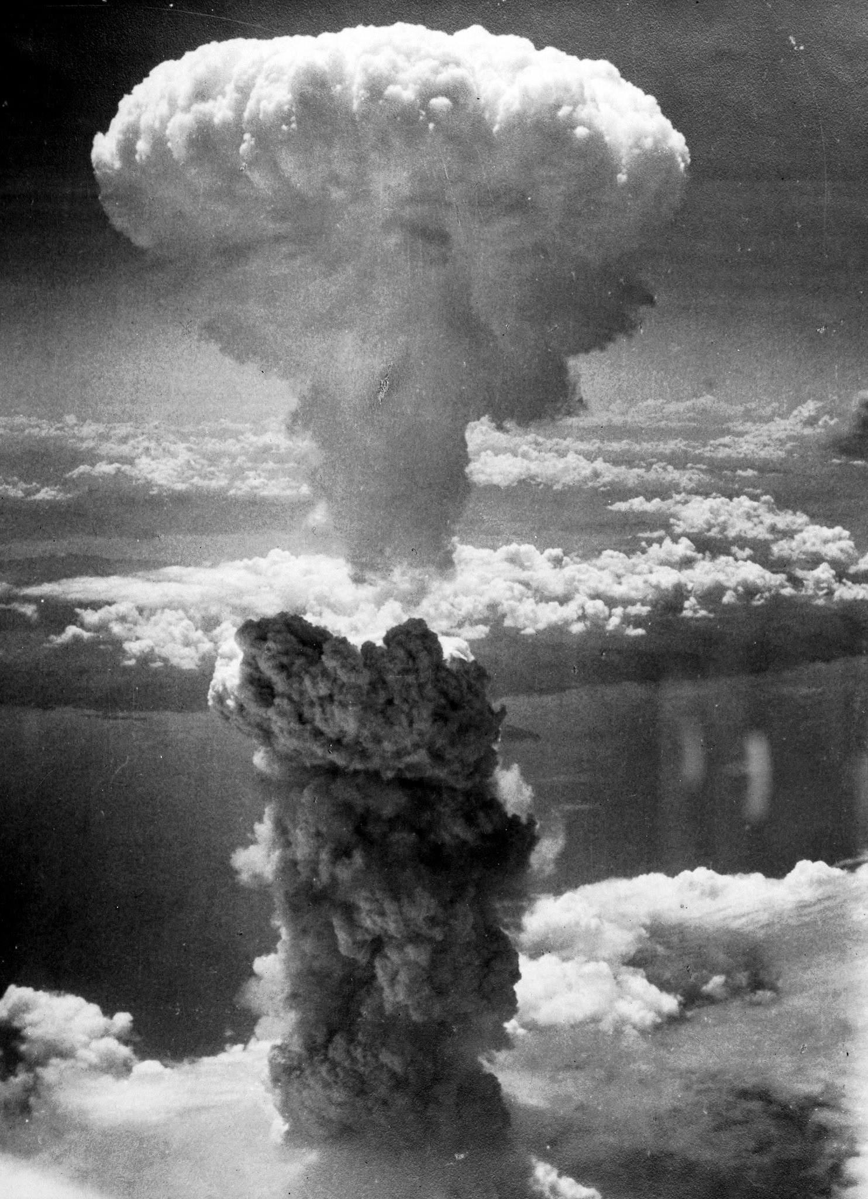
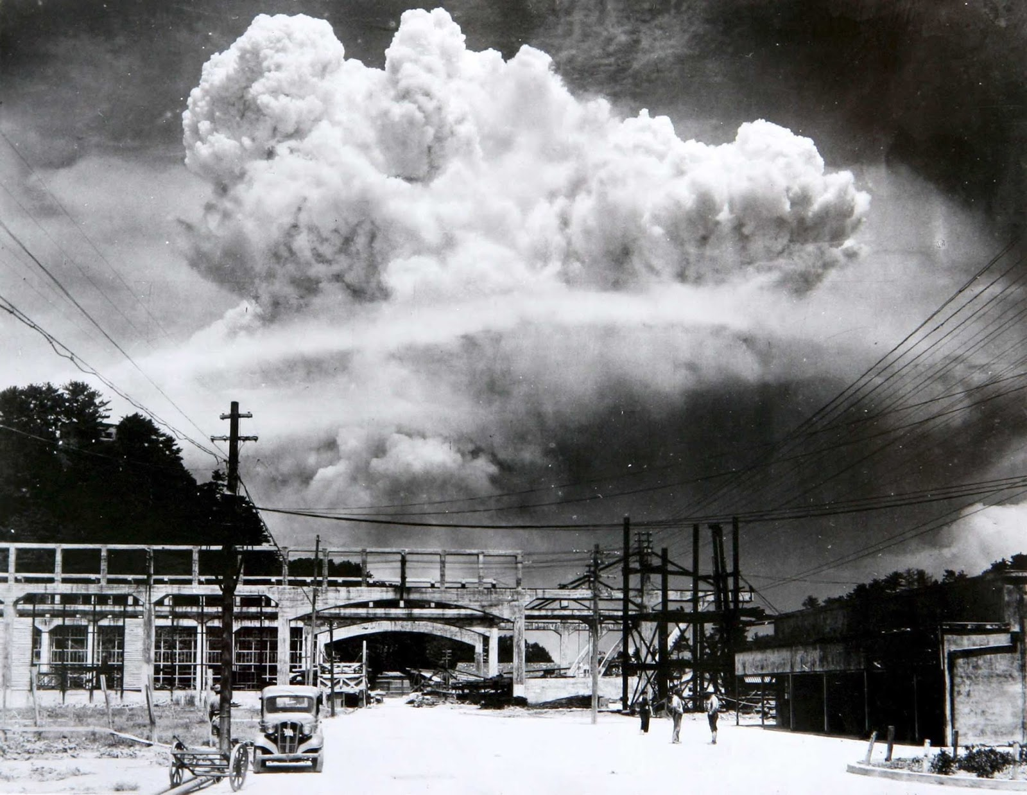
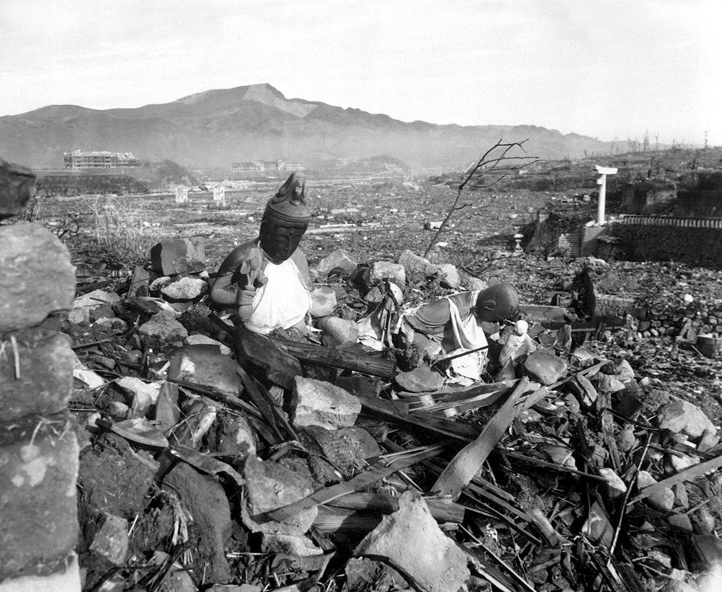
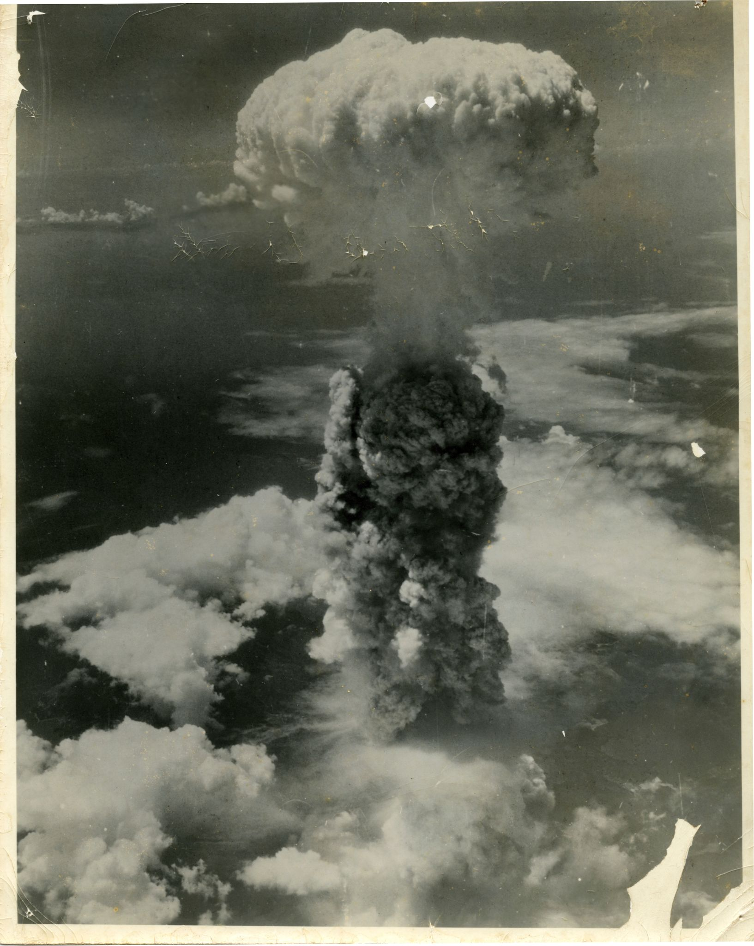
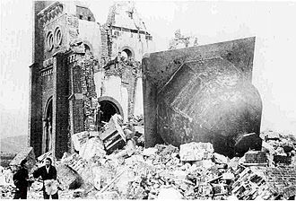
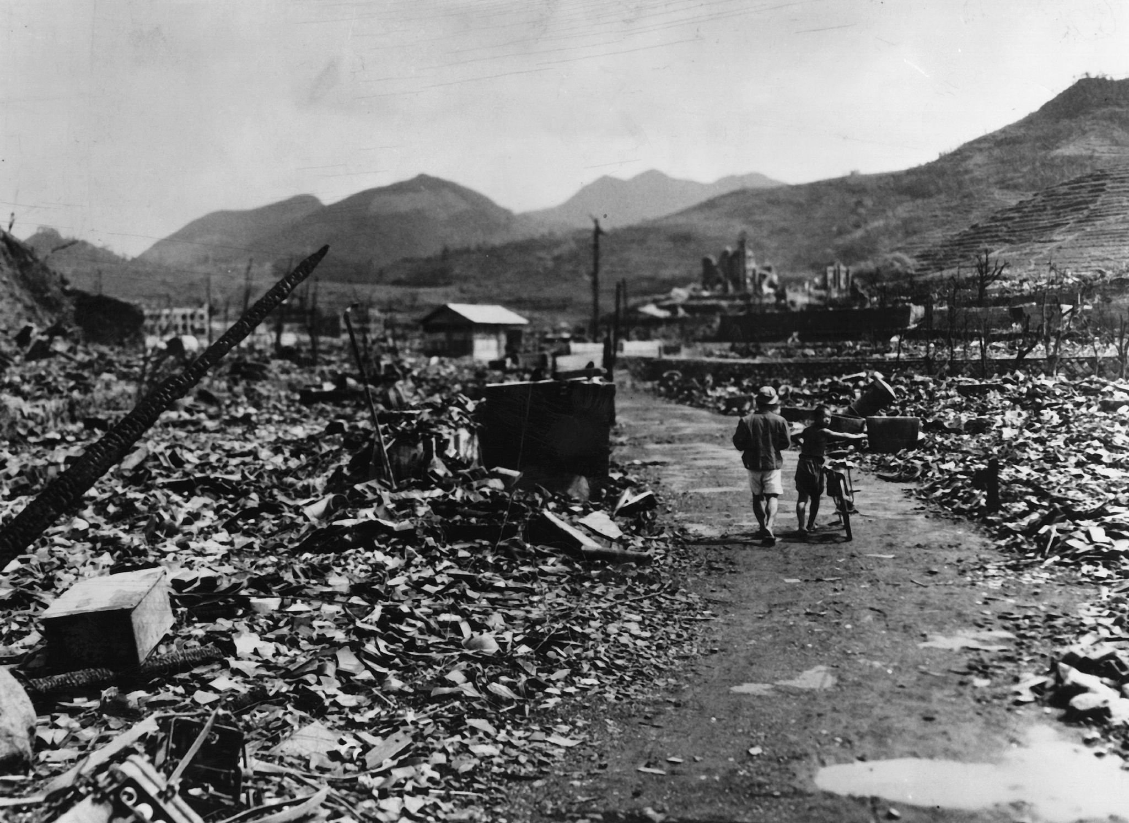


Atomic Bombing of Nagasaki

Slide 25



Wilfred Burchett’s Report on Hiroshima

Slide 26
Wilfred Burchett’s Report on Hiroshima
General MacArthur had imposed restrictions on journalists' access to bombed cities, and had censored reports of the destruction caused by the bombing of Hiroshima and Nagasaki. Civilian casualties were downplayed and the deadly lingering effects of radiation were dismissed. The New York Times published a front-page story with the headline 'No radioactivity in Hiroshima ruin'. Military censors suppressed a story about the bombing of Nagasaki submitted by George Weller of the Chicago Daily News.
US military encouraged the journalist William L. Laurence of The New York Times to write articles dismissing the reports of radiation sickness as part of Japanese efforts to undermine American morale. Laurence, who was also being paid by the US War Department, wrote the articles the US military wanted even though he was aware of the effects of radiation after observing the first atomic bomb test on 16 July 1945, and its effect on local residents and livestock.
Burchett's report was the first in the Western media to mention the effects of radiation and nuclear fallout and was a major embarrassment for the US military. In response, US officials accused him of being under the sway of Japanese propaganda. Burchett lost his press accreditation and he was ordered to leave Japan, although this order was later withdrawn. In addition, his camera, containing photos of Hiroshima, was confiscated while he was documenting persistent illness at a Tokyo hospital. The film was sent to Washington and classified secret before being released in 1968.

Slide 27


Why did we drop the A-bombs on Japan?
Preemptive Nuclear War
As the Second World War approached its end, FDR died in April of 1945 and the Nazis surrendered in May of 1945, the imperialists in the United States and United Kingdom were already looking to subvert the diplomacy made with the USSR during the war and was preparing to fight a war with the Soviet Union following WW2, and to use the end of WW2 to do so.
Hiroshima and Nagasaki were bombed with nuclear weapons to test them on a civilian center. Cities like Tokyo or Osaka were ash at that point, but an untouched city like Hiroshima would provide the US with a civilian center to assess the impacts of an atomic weapon on.
Leslie R. Groves, the director of the Manhattan Project, ordered a post-attack assessment report, which confirmed Hiroshima was chosen because it was “relatively untouched by previous bombing, in order that the effect of a single atomic-bomb could be determined.”

Slide 28


Why did we drop the A-bombs on Japan?
No Military Significance, No US-led Victory
The military significance of Hiroshima and Nagasaki was very low. In Hiroshima, there was the Second General Army Headquarters and Chugoku Military Police Headquarters and only ~7k-20k troops were killed in this attack. Nagasaki had Mitsubishi factories, including arms manufacturing, but only ~9,000 troops were killed in this attack.
Neither bombing brought about the Japanese surrender, even with atomic blackmail following Hiroshima and Nagasaki. Nor did they noticeably impair what was left of the Japanese war machine.
Japan was trying to figure out a way to surrender to the Soviets before Hokkaido was invaded and the foundation of Japan was broken. They were losing the war and had suffered catastrophic incendiary bombing in 67 cities. Losing 2 more to big bombs rather than thousands of smaller ones didn’t seem to make much difference at that point.

Slide 29

Truman’s Justification
President Harry S. Truman's justification for using the atomic bomb on Japan was supposedly, to save American lives and end the war quickly. He claimed that an invasion of Japan would result in massive Allied casualties, potentially exceeding half a million. The use of the bomb, he reasoned, would force Japan's surrender and avoid a protracted and bloody conflict.
Another supposed reason was that the Manhattan Project, which developed the atomic bomb, had been incredibly expensive. Using the bomb, even with its devastating consequences, justified the enormous investment of resources.
This justification relied on the racist narrative that dropping the bomb on a military target would not be enough to force a surrender as “the Japanese were willing to go to any lengths to save their empire.” Wars of imperial conquest necessitates racism, if Americans thought of the Japanese as just like them, they would be far less accepting of this justification.

Slide 30


Racism Towards Japanese People
This justification relied on the racist narrative that dropping the bomb on a military target would not be enough to force a surrender as “the Japanese were willing to go to any lengths to save their empire.” Wars of imperial conquest necessitates racism, if Americans thought of the Japanese as just like them, they would be far less accepting of this justification.
Soldiers who fought in the Pacific during WWII would use racist terms to refer to different groups of Asian people - even their own allies, the Chinese.
At this time, Japanese people in the United States were being systematically targeted and put into internment camps following Executive Order 9066. Ordinary Japanese people, even those who had no political or military connections or affiliations, were viewed as potential spies who could not be trusted.

Slide 31

The Decision to Use the Atom Bomb
Gar Alperovitz

Slide 32

The Decision to Use the Atom Bomb
Gar Alperovitz

Slide 33

Public Opinion
This justification is still taught in schools to this day.
In a 2015 Pew Research Center survey, 56% of Americans said the use of the atomic bomb on Hiroshima and Nagasaki was justified, while 34% said it was not. Unlike in the 2025 survey, the 2015 survey question did not include an explicit “Not sure” response option.
As previously suppressed information has been made public, the public opinion has begun to shift, especially in the past few years.
The movie “Oppenheimer” was released last year, covering the life of scientist J. Robert Oppenheimer during the time of the Manhattan Project, the dropping of the bomb and the framing of Oppenheimer as a communist and Soviet spy. This film may have influenced public opinion, showing glimpses of the US government’s callousness in bombing innocent civilians.

Slide 34
Discussion & New Members Introductions

Slide 35
New Member Introductions
What is your name, pronouns and state (or country/territory)?
Where do you work? Is it unionized?
How did you find out about the People’s School?
What do you think about tonight's class?

Slide 36
Atomic Aftermath & The Present Day Nuclear Threat

Slide 37

Excerpts From “Democracy With a Tommy Gun” by Wilfred Burchett
Walking through those Hiroshima streets one had a feeling of having been transplanted into some death stricken other planet. There was nothing but awful devastation and desolation. Lead-grey clouds hung low over the waste that had been a city of more than a quarter of a million people. Mists seemed to issue forth from fissures in the soil. There was a dank, acrid, sulphurous smell, and people hurried past without pausing or speaking to each other, white masks covering mouths and nostrils. Buildings had been pounded into grey and reddish dust, solidified into ridges and banks by the frequent rains.
Australian Communist and Journalist, Wilfred Burchett

Slide 38
Excerpts From “Democracy With a Tommy Gun” by Wilfred Burchett
The Domei man, who was four miles from the centre of Hiroshima when the bomb fell, described the event as follows:
"We had an alarm early in the morning, but only two aircraft appeared. We thought they were reconnaissance planes and nobody took much notice. The 'All Clear' sounded and everybody started on their way back to work. Then at 8.20 a.m. one plane came back. We thought it was another photo plane, and alarms weren't even sounded. I was just about to leave for work when there was a blinding light, as if from a giant flash of lightning. At the same time I felt a scorching heat on my face and the house dropped about me. While I was still on the ground there sounded a booming explosion as if a two ton bomb had dropped alongside me. When I looked out there was a tremendous pillar of black smoke, shaped like a parachute, drifting upwards with a scarlet thread in the middle of it. As I watched the scarlet was diffused through the smoke pillar until the whole thing was glowing red. Hiroshima had disappeared. I knew something new to our experience had occurred. I tried to phone our office, then the police and fire brigade, to find out what had happened, but I couldn't even raise the exchange."

Slide 39

The Years of U.S. Atomic Monopoly
Months before the end of the Second World War British Prime Minister Winston Churchill ordered the British Armed Forces’ Joint Planning Staff to develop a strategy targeting the USSR. The first edition of the plan was prepared on May 22, 1945. In accordance with the plan the invasion of Russia-held Europe by the Allied forces was scheduled on July 1, 1945. The plan, dubbed Operation Unthinkable, stated that its primary goal was “to impose upon Russia the will of the United States and the British Empire.”
British generals warned Churchill that the “total war” would be hazardous to the Allied armed forces. However, after the United States “tested” its nuclear arsenal in Hiroshima and Nagasaki in August 1945, Churchill and right-wing American policy makers started to persuade the White House to bomb the USSR.
British Prime Minister Winston Churchill and American President Franklin D, Roosevelt at a special meeting of the Pacific War Council during World War Two

Slide 40

Nuclear War Plans Targeting Soviet Russia
Churchill’s plan won the hearts and minds of US policy makers and military officials. Between 1945 and the USSR’s first detonation of a nuclear device in 1949, the Pentagon developed at least nine nuclear war plans targeting Soviet Russia. The names given to these plans graphically portray their offensive purpose: Bushwhacker, Broiler, Sizzle, Shakedown, Offtackle, Dropshot, Trojan, Pincher, and Frolic.
The 1949 Dropshot plan envisaged that the US would attack Soviet Russia and drop at least 300 nuclear bombs and 20,000 tons of conventional bombs on 200 targets in 100 urban areas, including Moscow and Leningrad (St. Petersburg). In addition, the planners offered to kick off a major land campaign against the USSR to win a “complete victory” over the Soviet Union together with the European allies. According to the plan Washington would start the war on January 1, 1957.
Recently declassified Top Secret documents trace how U.S. policy makers have threatened nuclear attack in over a dozen episodes.

Slide 41
“We’re just going to have to wipe it out”
The detonation of the first nuclear bomb by the Soviet Union dealt a heavy blow to US militarists’ plans. “The Soviet atomic bomb test on August 29, 1949 shook Americans who had believed that their atomic monopoly would last much longer, but did not immediately alter the pattern of war planning. The key issue remained just what level of damage would force a Soviet surrender,” Professor Donald Angus MacKenzie
Eventually, in 1960 the US’ nuclear war plans were formalized in the Single Integrated Operational Plan (SIOP). At first, the SIOP envisaged a massive simultaneous nuclear strike against the USSR’s nuclear forces, military targets, cities, as well as against China and Eastern Europe. It was planned that the US’ strategic forces would use almost 3,500 atomic warheads to bomb their targets. According to US generals’ estimates, the attack could have resulted in the death of about 285 to 425 million people. Some of the USSR’s European allies were meant to be completely annihilated.
“We’re just going to have to wipe it [Albania] out,” US General Thomas Power remarked at the 1960 SIOP planning conference, as quoted by MacKenzie.

Slide 42

“The Cuban Missile Crisis: On the Brink of Armageddon”
The Cuban Missile Crisis, also known as the October Crisis in Cuba, was a 13-day confrontation between the governments of the United States and the Soviet Union, centered around Soviet deployments of nuclear missiles in Cuba and is widely considered the closest the Cold War came to escalating into full-scale nuclear war. Khrushchev had good reasons for placing nuclear weapons in Cuba. First, he was certain a U.S. invasion of Cuba was imminent and wanted to protect the island. He was also alarmed that in the previous year, the U.S. had placed nuclear missiles in Turkey, on the border of the Soviet Union. These missiles could have delivered a nuclear warheads to many strategic targets in Soviet territory, including Moscow.
(Left) A U.S. Jupiter Missile stationed in Turkey, emblazoned with Turkish Flag.

Slide 43

“Disaster Averted”
Khrushchev's intention for putting similar missiles in Cuba was to give the United States “a little of their own medicine.” Khrushchev made it known that he was willing to withdraw his forces from Cuba if the United States agreed to never invade Cuba and to remove its missiles from Turkey. Kennedy was willing to accept. With the agreements in place on October 28, Khrushchev began removing Soviet missiles, equipment, and personnel from Cuba. Although the crisis appeared to be over, there were several weeks of wrangling to assure all sides that the agreements had been upheld. The United States did not fully stand down until late November.
'Cuba is not alone!' — Soviet cartoon published during the Cuban Missile Crisis (1962) showing Castro shaking hands with workers from around the world, crushing the A-bomb-toting arm of the US.

Slide 44

Fighting and Winning a Nuclear War
In the early 1980s, the Reagan administration also spoke of fighting and winning a nuclear war, and the arms race was in full throttle, with each side adding more threatening strategic weapons to arsenals already brimming with tens of thousands of warheads. Deployments of intermediate-range nuclear forces in Europe threatened to turn the continent into an atomic battleground. Few people remember the extraordinary levels of existential fear that gripped the public in those years and drove millions of people to support the nuclear freeze movement in the United States and disarmament campaigns in Europe. According to a Gallup poll in September 1981, 70 percent of U.S. respondents felt that nuclear war was a real possibility, with 30 percent considering the chances of such a conflict to be “good” or “certain.” U.S. President Ronald Reagan and senior officials in his administration stoked these fears with hostile anti-Soviet rhetoric and a policy of rejecting arms control in favor of more weapons.
In the 1980s, many schools continued to conduct "duck and cover" drills to prepare for a nuclear attack.

Slide 45

A Million People March to Stop the Arms Race
In the face of such insanity, people took to the streets in unprecedented numbers and organized politically to demand a halt to the arms race. Many rallied to the proposal for a mutual, verifiable freeze on the production, testing, and deployment of nuclear weapons by the United States and the Soviet Union. The resulting movement for a bilateral nuclear freeze sparked one of the largest waves of popular protest in U.S. history. On June 12, 1982, an estimated one million people marched to New York’s Central Park for a rally to freeze and reverse the arms race. The proposition to freeze U.S. and Soviet weapons was on the ballot in 10 states and the District of Columbia. Hundreds of national professional organizations endorsed the freeze, as did 25 of the nation’s largest trade unions. The movement shaped popular culture, most dramatically in the broadcast of the 1983 television film on the effects of a nuclear attack, “The Day After,” watched by 100 million viewers.
Demonstrators from Vermont march in New York to demand disarmament

Slide 46

Two Steps Back: the ABM and INF Treaties are Nullified
The now-defunct Anti-Ballistic Missile (ABM) Treaty was signed on May 26, 1972, and entered into force on October 3, 1972. The United States and the Soviet Union negotiated the ABM Treaty as part of an effort to control their arms race in nuclear weapons. The two sides reasoned that limiting defensive systems would reduce the need to build more or new offensive weapons to overcome any defense that the other might deploy. Without effective national defenses, each superpower remained vulnerable, even at reduced or low offensive force holdings, to the other's nuclear weapons, thereby deterring either side from launching an attack first because it faced a potential retaliatory strike that would assure its own destruction.
On December 13, 2001, U.S. President George W. Bush, announced that the United States would withdraw from the ABM Treaty, claiming that it prevented U.S. development of defenses against possible terrorist or "rogue-state" ballistic missile attacks. The U.S. withdrawal took effect June 13, 2002, and the treaty is no longer in force.
President George W. Bush announcing his intentions to withdraw from the Anti-Ballistic Missile Treaty (ABM) on December 13, 2001.

Slide 47
Two Steps Back: the ABM and INF Treaties are Nullified
The 1987 Intermediate-Range Nuclear Forces (INF) Treaty required the United States and the Soviet Union to eliminate and permanently forswear all of their nuclear and conventional ground-launched ballistic and cruise missiles with ranges of 500 to 5,500 kilometers. The treaty marked the first time the superpowers had agreed to reduce their nuclear arsenals, eliminate an entire category of nuclear weapons, and employ extensive on-site inspections for verification. As a result of the INF Treaty, the United States and the Soviet Union destroyed a total of 2,692 short-, medium-, and intermediate-range missiles by the treaty's implementation deadline of June 1, 1991.
On Oct. 20, 2018, President Donald Trump announced his intention to “terminate” the INF Treaty, citing Russian noncompliance and concerns about China’s intermediate-range missile arsenal. On Feb. 2, the Trump administration declared a suspension of U.S. obligations under the INF Treaty and formally announced its intention to withdraw from the treaty in six months. Shortly thereafter, Russian President Vladimir Putin also announced that Russia will be officially suspending its treaty obligations as well. On Aug. 2, 2019, the United States formally withdrew from the INF Treaty.

Slide 48
The Struggle Continues
In recent years the U.S. and Nato have shown an ever increasing willingness to risk open conflict with the world’s two other largest nuclear powers, Russia and China. The United States, Russia, and China, hold the largest stockpiles of nuclear warheads among all nations. Russia has approximately 5,459 nuclear weapons, the U.S. has around 5,177, and China has an estimated 600, with the U.S. and Russia together possessing the vast majority of all nuclear weapons globally. The combined power of these nuclear doomsday devices is enough to end the world many times over and humanity has understood since the invention of the atomic bomb and its first barbaric use against a civilian target that in a nuclear war, the whole world loses. Already in Ukraine, the United States and NATO have come to the brink of war with Russia. Pentagon and government officials such as CIA Director Bill Burns have publicly confirmed their belief we must be prepared for war with China over Taiwan by 2027, the so-called “Davidson’s Window.” Communists have been in the forefront of the movement for peace and nuclear disarmament since nuclear weapons were invented. Now more than ever it is imperative we help unite the people against imperialist war, all the more so in an era when a war between nuclear powers threatens all of humanity.

Slide 49

Scene from “The Day After”

Slide 50
Discussion & Wrap Up

Slide 51
Announcements
PCUSA Cell Chairs need to call members of their cells to remind them about attendance.
The next issue of New Masses (2025) has begun production. If you have art you want us to feature, email it to info@partyofcommunistsusa.net.

Slide 52

https://aafc.us.org/
The Asian American Friendship Congress (AAFC) is an organization dedicated to struggling against racism and negative perception of Asian peoples.
We recognize that the prejudice experienced by Asian Americans and Pacific Islanders (AAPI) is exacerbated by the corporate elites to create a wedge between working AAPI people and the rest of the American population.
We aim to educate the American people on AAPI history in order to demystify prejudices, stereotypes, and negative perceptions of the AAPI community. We also hope to foster closer bonds between the American people and the nations of East Asia and Southeast Asia. The AAFC seeks to normalize relations with these emerging Asian economies, including the Democratic People’s Republic of Korea and the People’s Republic of China.
The AAFC also seeks to promote and preserve the diverse cultures which Asian immigrants have brought to our shores. These rich cultural aspects include cuisine, music, art, and languages

Slide 53





New Outlook Publishers
newoutlookpublishers.store
Relevant Releases
Latest Releases

Slide 54

Future NOP Class Collaborations!
We will do the following classes upcoming in collaboration with New Outlook Publishers:
August 12, 2025 - Organizing Methods in the Steel Industry by William Z. Foster. Book can be ordered here: https://www.lulu.com/shop/william-z-foster/organizing-methods-in-the-steel-industry/paperback/product-q6kndkq.html?q=Organizing+Methods+of+Steel+Industry&page=1&pageSize=4
Find more NOP books at: https://www.lulu.com/spotlight/newoutlookpublishers/

Slide 55



Harry Bridges School of Labor
luel.us/laborschool/
The Harry Bridges School of Labor is a monthly class held 2x per month. Classes cover a variety of topics aimed at building class conscious among union members.
August’s class will be a viewing of “Salt of the Earth.” Class will be Wednesday August 6, 2025 at 8pm EST/6pm PST and Saturday August 9, 2025 at 7pm EST/4pm PST.

Slide 56

May There Always be Sunshine - Pete Seeger

