Slide 1


The Road is Open Again - American New Deal song

Slide 2
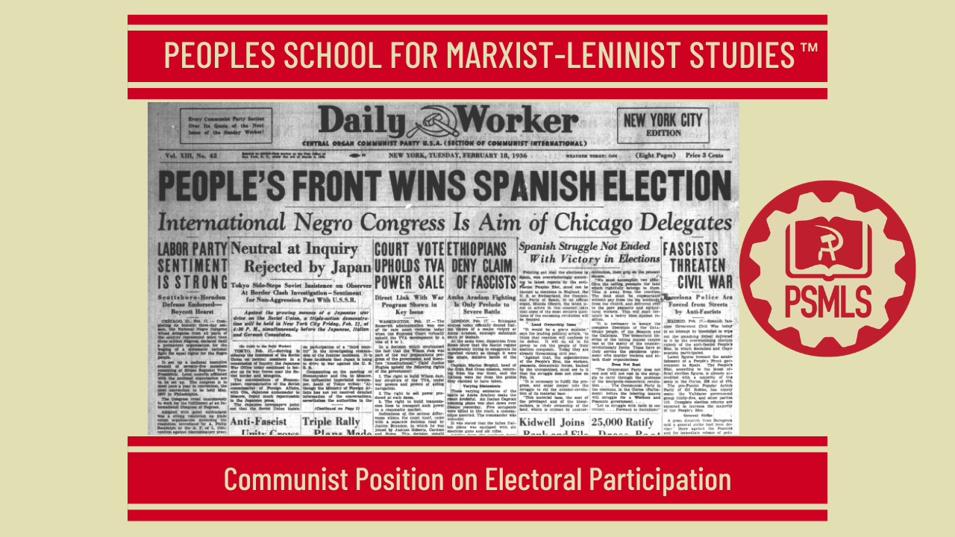
PSMLS 8/18/26

Slide 3
What we’ll be learning today:
Communist Position on Electoral Participation
Ultraleft and rightwing deviationist mistakes about electoralism
How Communists have used elections and legislation in their workplace

Slide 4
Marx and Lenin on Electoral Politics

Slide 5
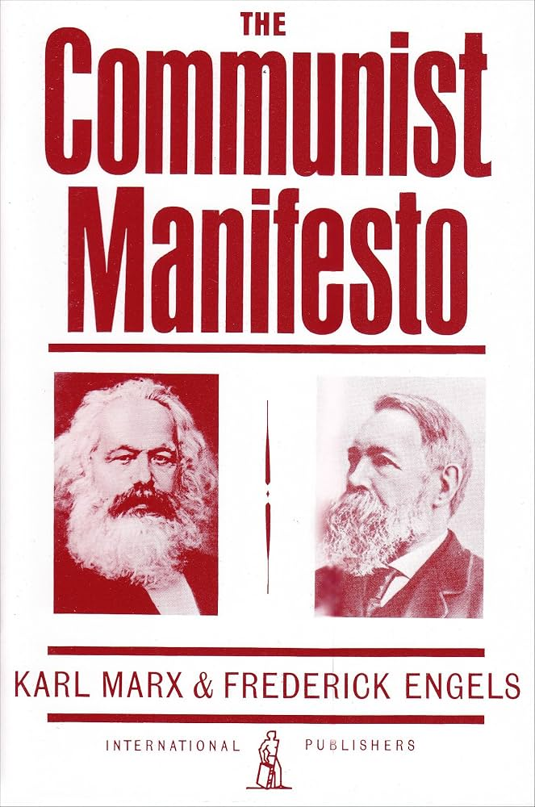
Marxism and Electoral Politics
The question of whether Revolutionaries should participate in elections was being debated when Marx and Engels wrote the Communist Manifesto. In Chapter IV we find examples of Socialists working within the existing electoral system along with a dialectical perspective of the aims of this strategy.
“The Communists fight for the attainment of the immediate aims, for the enforcement of the momentary interests of the working class; but in the movement of the present, they also represent and take care of the future of that movement. In France, the Communists ally with the Social-Democrats against the conservative and radical bourgeoisie, reserving, however, the right to take up a critical position in regard to phases and illusions traditionally handed down from the great Revolution.”
“In Switzerland, they support the Radicals, without losing sight of the fact that this party consists of antagonistic elements, partly of Democratic Socialists, in the French sense, partly of radical bourgeois.”

Slide 6
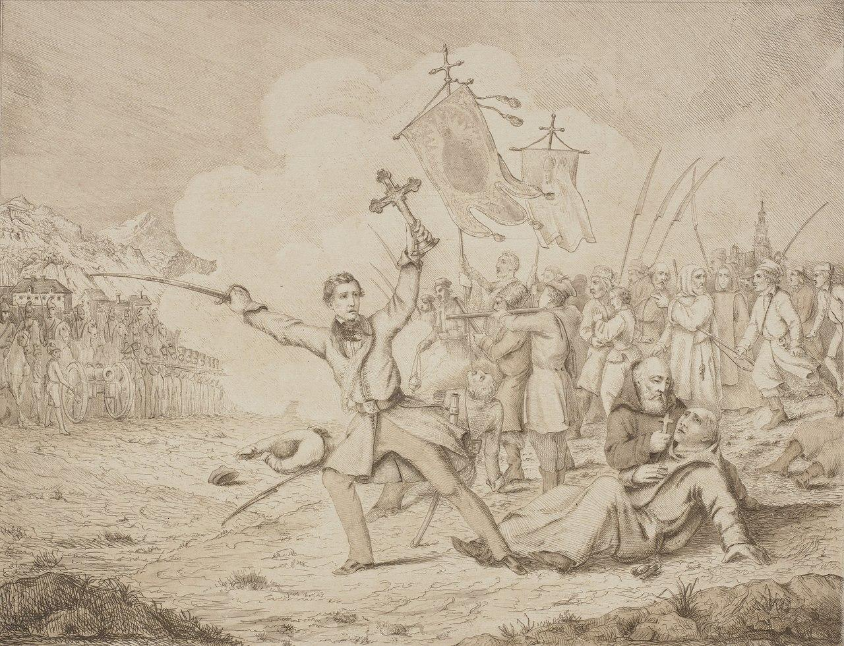
Marxism and Electoral Politics Cont.
“In Poland, they support the party that insists on an agrarian revolution as the prime condition for national emancipation, that party which fomented the insurrection of Cracow in 1846.”
“In Germany, they fight with the bourgeoisie whenever it acts in a revolutionary way, against the absolute monarchy, the feudal squirearchy, and the petty bourgeoisie.”
“But they never cease, for a single instant, to instill into the working class the clearest possible recognition of the hostile antagonism between bourgeoisie and proletariat, in order that the German workers may straightway use, as so many weapons against the bourgeoisie, the social and political conditions that the bourgeoisie must necessarily introduce along with its supremacy, and in order that, after the fall of the reactionary classes in Germany, the fight against the bourgeoisie itself may immediately begin.”
Polish Insurgent Leader Edward Dembowski Leading a Rebel Attack and Brandishing a Crucifix, Moments Before His Death - Anonymous Artist

Slide 7
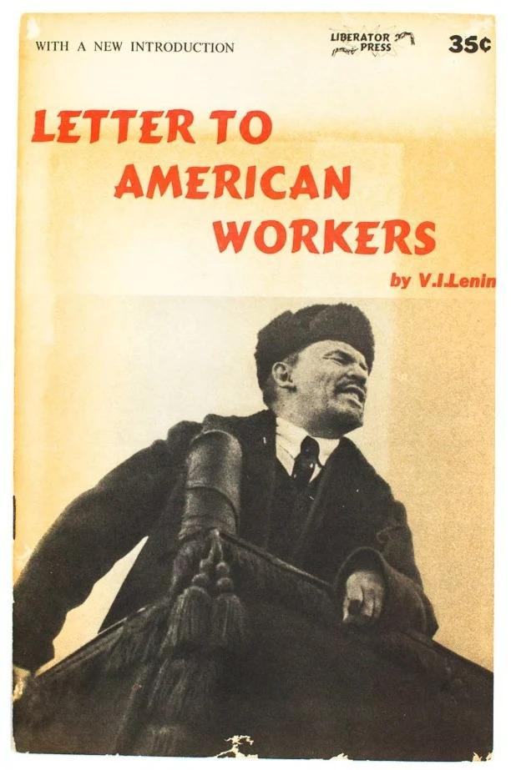
The Democratic Tasks of the Revolutionary Proletariat
Lenin was clearly continuing the ideological work of Marx and Engels regarding electoral politics when he analyzed the 1912 U.S. presidential elections. His assessment of the Democratic and Republican Parties was startlingly modern.
“The world significance of the U.S. elections lies not so much in the great increase in the number of Socialist votes as in the far-reaching crisis of the bourgeois parties, in the amazing force with which their decay has been revealed. Lastly, the significance of the elections lies in the unusually clear and striking revelation of bourgeois reformism as a means of combating socialism. In all bourgeois countries, the parties which stand for capitalism, i.e., the bourgeois parties, came into being a long time ago, and the greater the extent of political liberty, the more solid they are. Freedom in the U.S.A. is most complete. And for a whole half-century—since the Civil War over slavery in 1860–65—two bourgeois parties have been distinguished there by remarkable solidity and strength. The party of the former slave-owners is the so-called Democratic Party. The capitalist party, which favoured the emancipation of the Negroes, has developed into the Republican Party. Since the emancipation of the Negroes, the distinction between the two parties has been diminishing.”

Slide 8
“We Shall Save Capitalism by Remorms”
“This so-called bipartisan system prevailing in America and Britain has been one of the most powerful means of preventing the rise of an independent working-class, i.e., genuinely socialist, party. And now the bipartisan system has suffered a fiasco in America, the country boasting the most advanced capitalism! What caused this fiasco? The strength of the working-class movement, the growth of socialism. The old bourgeois parties (the “Democratic” and the “Republican” parties) have been facing towards the past, the period of the emancipation of the Negroes. The new bourgeois party, the National Progressive Party, is facing towards the future. Its programme turns entirely on the question whether capitalism is to be or not to be, on the issues, to be specific, of protection for the workers and of “trusts”, as the capitalist associations are called in the U.S.A. The old parties are products of an epoch whose task was to develop capitalism as speedily as possible. The struggle between the parties was over the question how best to expedite and facilitate this development. The new party is a product of the present epoch, which raises the issue of the very existence of capitalism. In the U.S.A., the freest and most advanced country, this issue is coming to the fore more clearly and broadly than anywhere else. The entire programme and entire agitation of Roosevelt and the Progressives turn on how to save capitalism by means of bourgeois reforms. The bourgeois reformism which in old Europe manifests itself in the chatter of liberal professors has all at once come forward in the free American republic as a party four million strong. This is American style. We shall save capitalism by reforms, says that party. We shall grant the most progressive factory legislation.”

Slide 9

So Long as Modern Slave Owners Prevail
“We shall establish state control over all the trusts (in the U.S.A. that means over all industries!). We shall establish state control over them to eliminate poverty and enable everybody to earn a “decent” wage. We shall establish “social and industrial justice”. We revere all reforms—the only “reform” we don’t want is expropriation of the capitalists! The national wealth of the U.S.A. is now reckoned to be 120 billion (thousand million) dollars, i.e., about 240 billion rubles. Approximately one-third of it, or about 80 billion rubles, belongs to two trusts, those of Rockefeller and Morgan, or is subordinated to these trusts! Not more than 40,000 families making up these two trusts are the masters of 80 million wage slaves. Obviously, so long as these modern slave-owners are there, all “reforms” will be nothing but a deception. Roosevelt has been deliberately hired by the astute multimillionaires to preach this deception. The “state control” they promise will become—if the capitalists keep their capital—a means of combating and crushing strikes. But the American proletarian has already awakened and has taken up his post. He greets Roosevelt’s success with cheerful irony, as if to say: You lured four million people with your promises of reform, dear impostor Roosevelt. Very well! Tomorrow those four million will see that your promises were a fraud, and don’t forget that they are following you only because they feel that it is impossible to go on living in the old way.”
Campaign pin featuring a bull moose, the Progressive Party's mascot

Slide 10
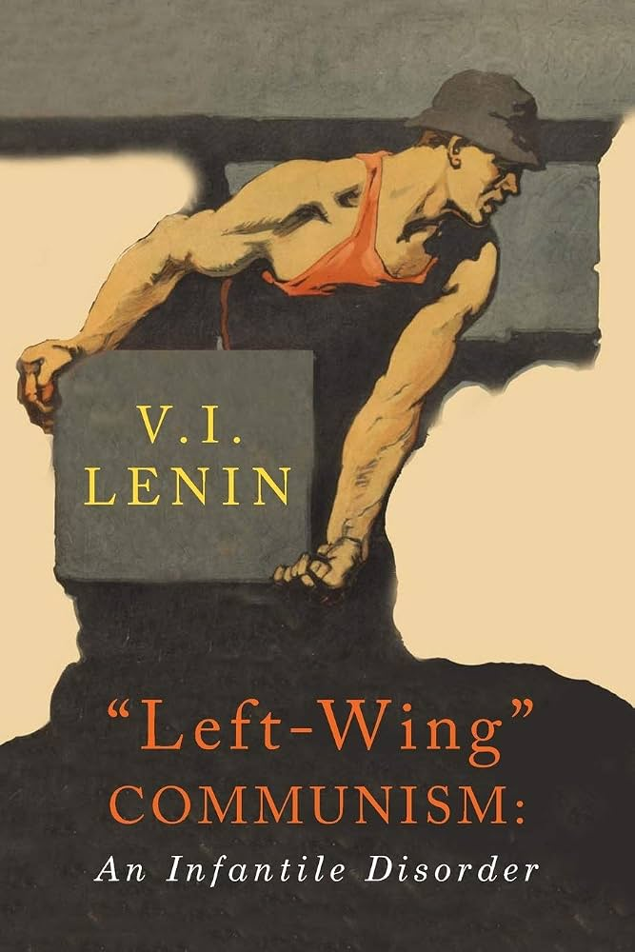
Obsolete or Still Necessary
In light of this severe criticism of Capitalist political parties and the system they control, should Communists simply boycott elections along with the corrupt political system? The answer, as Lenin states in “Left-Wing” Communism: an Infantile Disorder, is a resounding no. As Lenin explains.
“...the “Left” Communists have a great deal to say in praise of us Bolsheviks. One sometimes feels like telling them to praise us less and to try to get a better knowledge of the Bolsheviks’ tactics. We took part in the elections to the Constituent Assembly, the Russian bourgeois parliament in September–November 1917. Were our tactics correct or not? If not, then this should be clearly stated and proved, for it is necessary in evolving the correct tactics for international communism. If they were correct, then certain conclusions must be drawn. Of course, there can be no question of placing conditions in Russia on a par with conditions in Western Europe. But as regards the particular question of the meaning of the concept that “parliamentarianism has become politically obsolete”, due account should be taken of our experience, for unless concrete experience is taken into account such concepts very easily turn into empty phrases.”

Slide 11
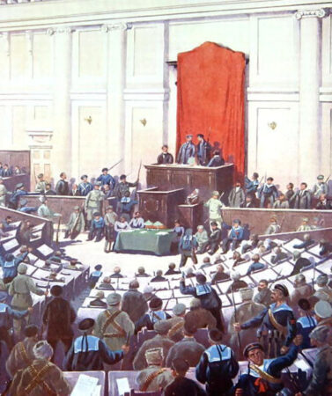
Exceedingly Valuable Political Results
“In September–November 1917, did we, the Russian Bolsheviks, not have more right than any Western Communists to consider that parliamentarianism was politically obsolete in Russia? Of course we did, for the point is not whether bourgeois parliaments have existed for a long time or a short time, but how far the masses of the working people are prepared (ideologically, politically and practically) to accept the Soviet system and to dissolve the bourgeois-democratic parliament (or allow it to be dissolved). It is an absolutely incontestable and fully established historical fact that, in September–November 1917, the urban working class and the soldiers and peasants of Russia were, because of a number of special conditions, exceptionally well prepared to accept the Soviet system and to disband the most democratic of bourgeois parliaments. Nevertheless, the Bolsheviks did not boycott the Constituent Assembly, but took part in the elections both before and after the proletariat conquered political power. That these elections yielded exceedingly valuable (and to the proletariat, highly useful) political results has, I make bold to hope, been proved by me in the above-mentioned article, which analyses in detail the returns of the elections to the Constituent Assembly in Russia.”
Bolshevik artist Boris Zvykorin’s depiction of Red Guards in the Constituent Assembly

Slide 12
Participation in Counter-Revolutionary Parliaments
“The conclusion which follows from this is absolutely incontrovertible: it has been proved that, far from causing harm to the revolutionary proletariat, participation in a bourgeois-democratic parliament, even a few weeks before the victory of a Soviet republic and even after such a victory, actually helps that proletariat to prove to the backward masses why such parliaments deserve to be done away with; it facilitates their successful dissolution, and helps to make bourgeois parliamentarianism “politically obsolete”. To ignore this experience, while at the same time claiming affiliation to the Communist International, which must work out its tactics internationally (not as narrow or exclusively national tactics, but as international tactics), means committing a gross error and actually abandoning internationalism in deed, while recognising it in word. We Bolsheviks participated in the most counterrevolutionary parliaments, and experience has shown that this participation was not only useful but indispensable to the party of the revolutionary proletariat, after the first bourgeois revolution in Russia (1905), so as to pave the way for the second bourgeois revolution (February 1917), and then for the socialist revolution (October 1917). If a parliament becomes an organ and a “centre” (in reality it never has been and never can be a “centre”...) of counter-revolution, while the workers are building up the instruments of their power in the form of the Soviets, then it follows that the workers must prepare—ideologically, politically and technically—for the struggle of the Soviets against parliament, for the dispersal of parliament by the Soviets. But it does not at all follow that this dispersal is hindered, or is not facilitated, by the presence of a Soviet opposition within the counter-revolutionary parliament.”

Slide 13
Discussion & New Members Introductions

Slide 14
New Member Introductions
What is your name, pronouns and state (or country/territory)?
Where do you work? Is it unionized?
How did you find out about the People’s School?
What do you think about tonight's class?

Slide 15
Deviationist Mistakes About Electoralism

Slide 16
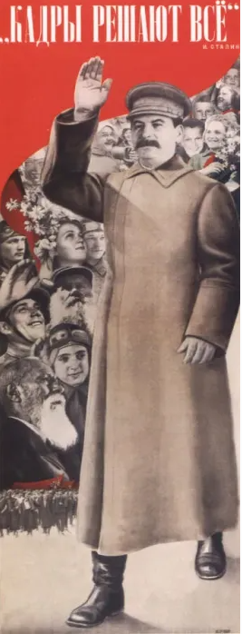
“The Tactics of Any Given Moment”-J.V. Stalin
It is one that no politician can entertain. The fight against the Rights and "ultra-Lefts" must be regarded not from the standpoint of equity, but from the standpoint of the demands of the political situation, of the political requirements of the Party at any given moment. Either the German Communist Party breaks the resistance of the "ultra-Lefts," winning over the majority of the working class; or it does not, making the present crisis chronic and disastrous for the Party. Hence, fighting against the "ultra-Lefts" in the German Communist Party is the latter's immediate task.
In France we have a different situation, there has been no profound revolutionary crisis so far. The struggle has proceeded within the bounds of legality, and the methods of struggle have been almost exclusively of a legal character. It is natural under these circumstances that we should find in the French Party a group (the Rights) - which is unable or unwilling to adapt itself to the new conditions of the struggle, and which continues from inertia to insist on the old methods of struggle as the only correct ones. This hinders the Bolshevisation of the French Communist Party. Hence the Right danger in the French Communist Party is the immediate danger.
This shows that the question of the fight against the Rights and "ultra-Lefts" must be put not abstractly, but concretely, depending on the political situation.

Slide 17
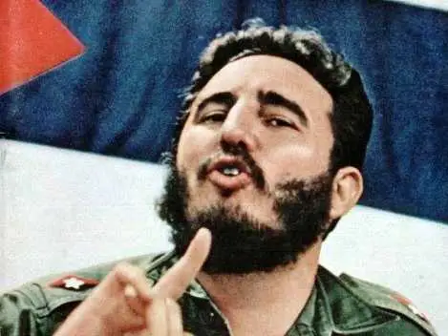
Ultra-leftists; unaligned with Labor-J.V. Stalin
One who is prepared to tolerate a struggle only provided that none of the leaders is in any way compromised, virtually denies the possibility of waging any kind of ideological struggle within the Party. Ought we to disclose mistakes committed by party leaders, so as to educate the party masses on the basis of the mistakes of the leaders? I think that we ought to do so.
We are faced not with the abstract question of combating Rights and "ultra-Lefts" in general, but with the concrete question of the immediate tasks of the German Party, which is to overcome the "ultra-Left" danger, just as the immediate task of the French Communist Party is to overcome the Right danger.
How are we to explain the generally known fact that the Communist Parties of Britain, France and Czechoslovakia have already obtained important footholds in the trade-union movements of their countries, have found their way to the broad masses of the working class, and are beginning to win the confidence of a considerable section of them, whereas in Germany the position in this respect is still weak? It is to be explained above all by the fact that the "ultra-Lefts" are still strong in the German Communist Party, and that they still look sceptically on the trade unions, on the slogan of a united front, on the slogan of winning over the trade unions. Everyone knows that until recently the "ultra-Lefts" upheld the slogan "Get out of the trade unions." Everyone knows that survivals of this anti-proletarian slogan have not yet been completely eradicated among the "ultra-Lefts."
Compañero workers and peasants, this is the socialist and democratic revolution of the working people, with the working people, and for the working people. And for this revolution of the working people, by the working people, and for the working people we are prepared to give our lives. -Fidel Castro

Slide 18
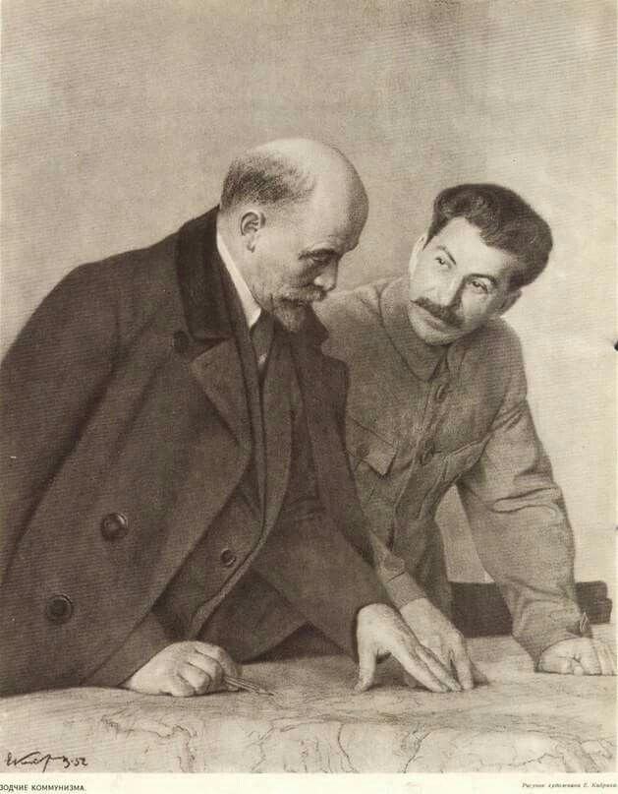
Exposing the Ultra-lefts mistakes at every opportunity. J.V. Stalin on Lenin’s Analysis
But how are those workers to be raised to the level of political understanding of a Leninist party? To be rescued from the misconceptions they are now labouring under owing to the errors and prejudices of their "ultra-Left" leaders? There is only one method of achieving this, by politically repudiating the "ultra-Left" leaders, the method of exposing the "ultra-Left" errors which are misleading honest revolutionary workers and hindering them.
Can we tolerate putrid diplomacy, the slurring over of errors, in questions of the ideological struggle in the Party and the political education of the masses? No, we cannot. We should be deceiving the workers if we did. What is the solution? That is to expose the errors of the "ultra-Left" leaders, and in this way help honest revolutionary workers to take the correct road.
It is said that a blow at the "ultra-Lefts" may lead to the accusation that the German Communist Party has swung to the Right. That is nonsense, at the All-Russian Party Conference in 1908, when Lenin fought the Russian "ultra-Lefts" and utterly routed them, there were people who accused Lenin of Rightism.

Slide 19
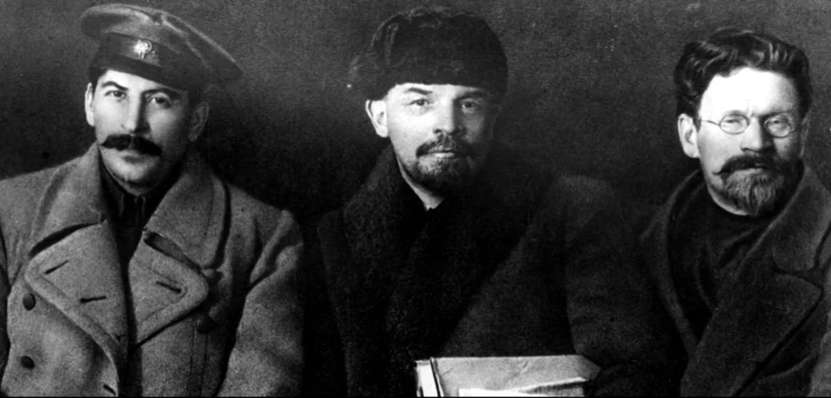
Exposing the Ultra-lefts mistakes at every opportunity. J.V. Stalin on Lenin’s Analysis
All the world now knows that Lenin's position at that time was correct, his standpoint was the only revolutionary one, and the Russian "ultra-Lefts," who were making a show of "revolutionary" phrases, were in reality opportunists.
It should not be forgotten that Rights and "ultra-Lefts" are actually twins, that consequently both take an opportunist stand, the difference between them being that whereas the Rights do not always conceal their opportunism, the Lefts invariably camouflage their opportunism with "revolutionary" phrases.
We cannot allow our policy to be determined by what scandal mongers and philistines may say about us. We must go our way firmly and confidently, paying no heed to the tales idle minds may invent about us.
Stalin, Lenin and Kalinin at the Congress of the Russian Communist Party, March 1919.

Slide 20
Lenin’s “Left-Wing” Communism: an Infantile Disorder
Should We Participate in Bourgeois Parliaments?
DIALECTICAL MATERIALISM
The era of bourgeois parliamentarianism is over, and the era of the proletarian dictatorship has begun. That is incontestable.
But world history is counted in decades. Ten or twenty years earlier or later makes no difference when measured with the yardstick of world history; from the standpoint of world history it is a trifle that cannot be considered even approximately. For that very reason, it is a glaring theoretical error to apply the yardstick of world history to practical politics.
Is parliamentarianism “politically obsolete”? That is quite a different matter. If that were true, the position of the “Lefts” would be a strong one. But it has to be proved by a most searching analysis, and the “Lefts” do not even know how to approach the matter.
It is obvious that the “Lefts” in Germany have mistaken their desire, their politico-ideological attitude, for objective reality. That is a most dangerous mistake for revolutionaries to make. Here again we find that the “Lefts” do not know how to reason or how to act as the party of a class, of the masses.
You must not sink to the level of the masses, to the level of the backward strata of the class. You must tell them the bitter truth.
You are in duty bound to call their bourgeois-democratic and parliamentary prejudices what they are—prejudices.
But at the same time you must soberly follow the actual state of the class-consciousness and preparedness of the entire class (not only of its communist vanguard), and of all the working people (not only of their advanced elements).

Slide 21
Revolutionary Temper
Without a revolutionary mood among the masses or conditions facilitating the growth of this mood, revolutionary tactics will never develop into action. In Russia, however, lengthy, painful and sanguinary experience has taught us the truth that revolutionary tactics cannot be built on a revolutionary mood alone.
Tactics must be based on a sober and strictly objective appraisal of all the class forces in a particular state (and of the states that surround it, and of all states the world over) as well as of the experience of revolutionary movements.
It is very easy to show one’s “revolutionary” temper merely by hurling abuse at parliamentary opportunism, or by repudiating participation in parliaments. However, its ease cannot turn this into a solution of a very difficult problem.
You want to create a new society, yet you fear the difficulties involved in forming a good parliamentary group made up of convinced, devoted and heroic Communists, in a reactionary parliament! Is that not childish?
Why should a rapidly growing revolutionary mass party, in the midst of the post-war disillusionment and embitterment of the masses, be unable to forge a communist group in the worst of parliaments? It is because, in Western Europe, the backward masses of the workers and—to an even greater degree—the small peasants are much more imbued with bourgeois-democratic and parliamentary prejudices than they were in Russia? Because of that, it is only from within such institutions as bourgeois parliaments that Communists must wage a long and persistent struggle, undaunted by any difficulties, to expose, dispel and overcome these prejudices.

Slide 22
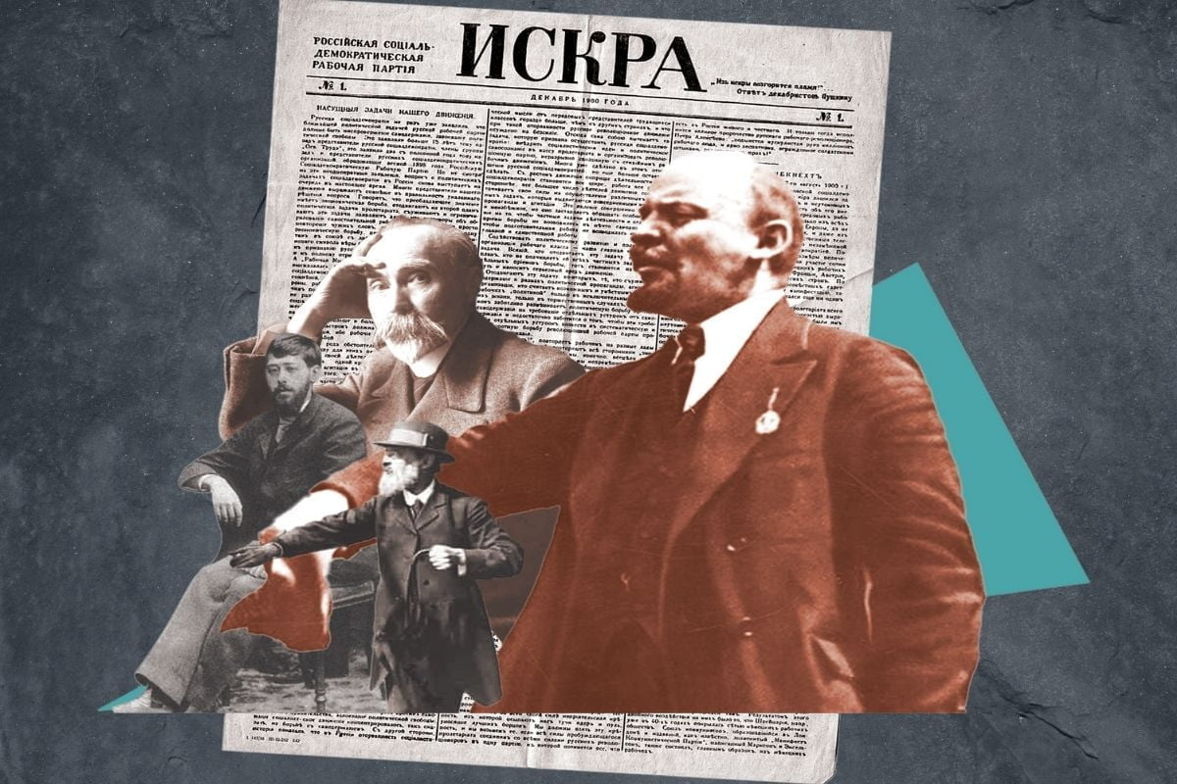
Relentlessly Train the Elected Through Criticism to be Worthy of the Working Class
The most keen, ruthless and uncompromising criticism should be directed not against parliamentarianism or parliamentary activities, but against those leaders who are unable—and still more against those who are unwilling—to utilise parliamentary elections and the parliamentary rostrum in a revolutionary and communist manner.
Only such criticism combined with the dismissal of incapable leaders and their replacement by capable ones will constitute useful and fruitful revolutionary work that will simultaneously train the “leaders” to be worthy of all working people, and train the masses to properly understand the political situation and the complicated and intricate tasks that spring from it.

Slide 23
Discussion

Slide 24
How can Communists use Elections and Legislations?

Slide 25
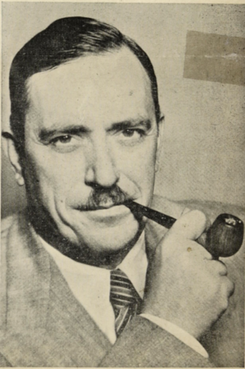
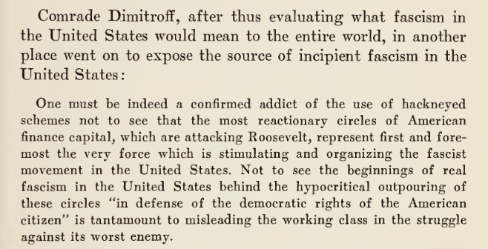
The Defeat of Reaction in the November [1936]
Elections - Earl Browder
Report delivered December 4, 1936 to the Plenum of the Central Committee of the Communist Party of th e U.S

Slide 26
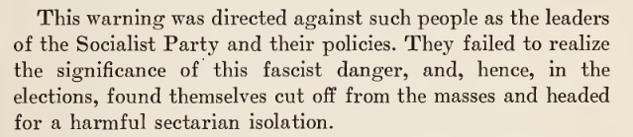

The Defeat of Reaction in the November [1936]
Elections - Earl Browder
Report delivered December 4, 1936 to the Plenum of the Central Committee of the Communist Party of th e U.S

Slide 27
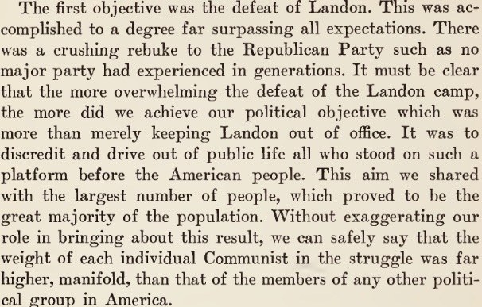
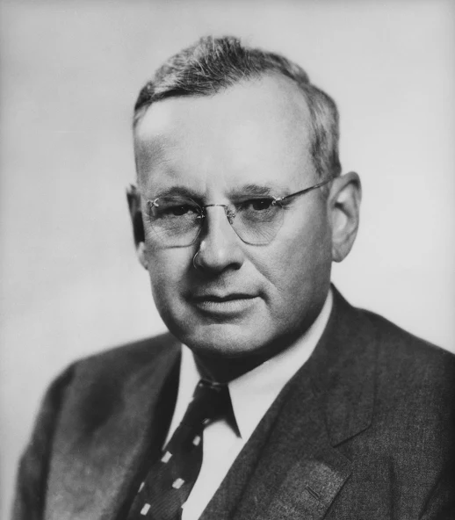
The Defeat of Reaction in the November [1936]
Elections - Earl Browder
Alfred Mossman Landon was an American oilman and politician, he was the Republican party's nominee in the 1936 presidential election, and was defeated in a landslide by incumbent president Franklin D. Roosevelt.

Slide 28
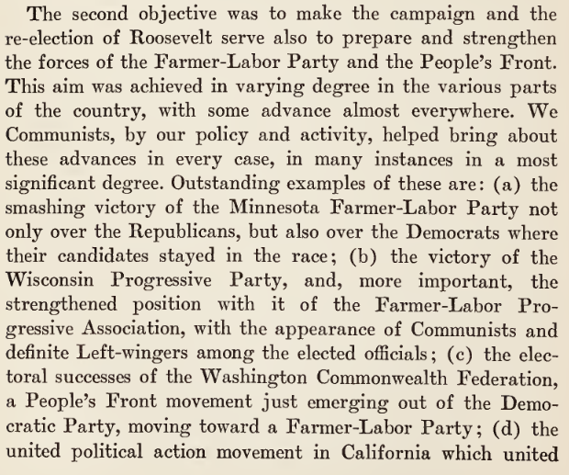

The Defeat of Reaction in the November [1936]
Elections - Earl Browder

Slide 29
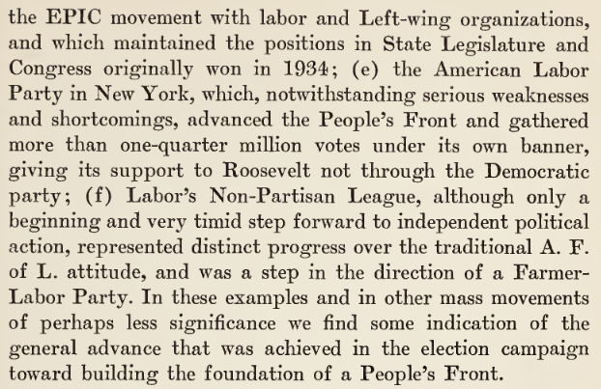

The Defeat of Reaction in the November [1936]
Elections - Earl Browder
The American Labor Party (ALP) was a political party in the United States established in 1936 that was active almost exclusively in the state of New York.

Slide 30

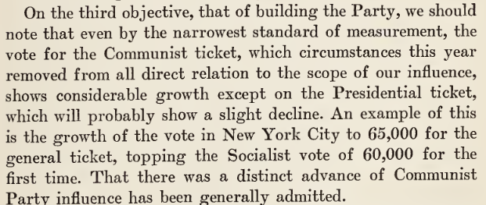
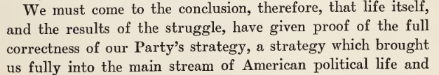
The Defeat of Reaction in the November [1936] Elections - Earl Browder
Read more from The People’s Front from New Outlook Publishers

Slide 31
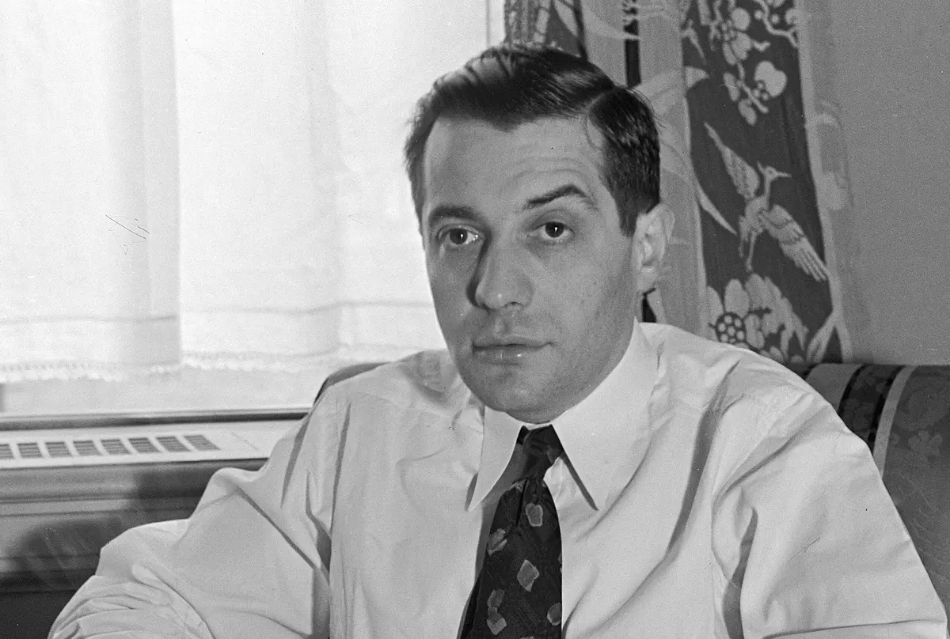
Vito Marcantonio - The Peoples Politician
Vito Marcantonio was a progressive Italian-American who served his East Harlem district in the US House of Representatives. Vito Marcantonio was friendly to Communists and was a member of party-led organizations like the Garibaldi American Fraternal Society and wrote for New Masses. Marcantonio also ran on the Communist-led American Labor Party ticket.
While in office, Marcantonio pushed affordability policies, he fought against racism and the provided a voice for Puerto Ricans, he fought for civil rights, and fought against the repression of McCarthyism.

Slide 32
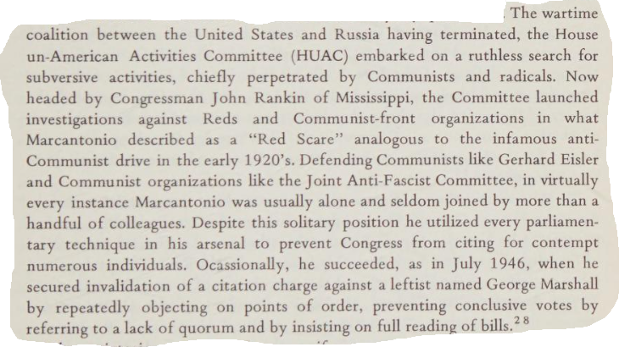
Marcantonio: A Friend in High Places
Passages on next few slides from “Vito Marcantonio, the Peoples Politician” by Salvatore J. LaGumina

Slide 33
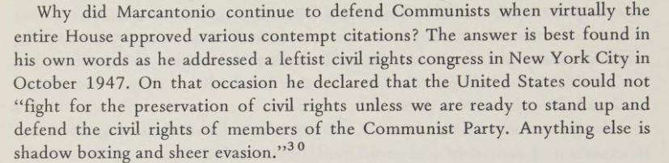
Preservation of Democracy Means Fighting to Protect Communists

Slide 34
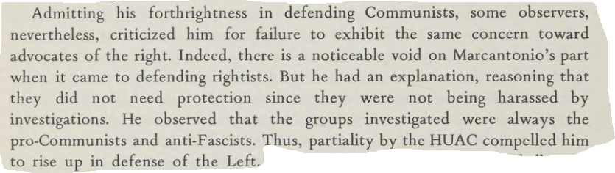
Preservation of Democracy Means Fighting to Protect Communists
For more on Vito Marcantonio, please look here: https://peoplesschool.us/wp-content/uploads/2026/08/PSMLS-Vito-Marcantonio-.pptx

Slide 35
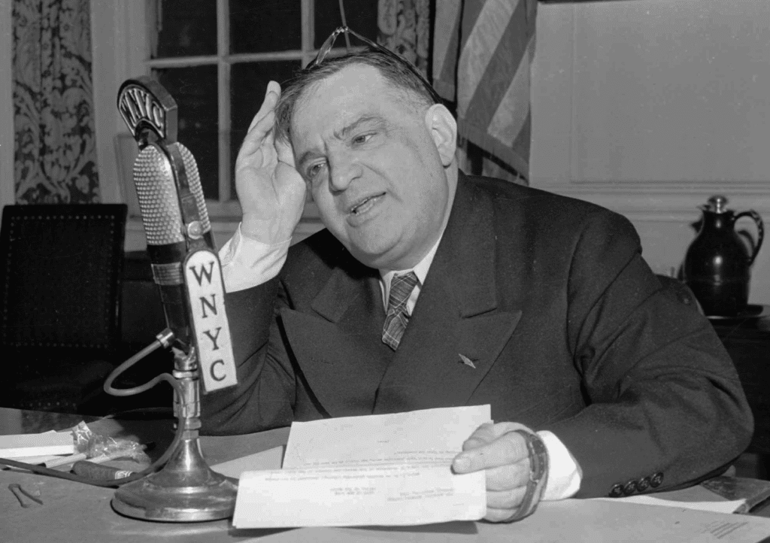
Fiorello H. LaGuardia
In 1933 Fiorello LaGuardia was elected Mayor of New York. He served 3 terms as mayor and then left office in 1945. He represented anti-fascist, anti-Mussolini Italians
In his autobiography, Making of an Insurgent, LaGuardia details his political career.
He also mentored Vito Marcantonio. LaGuardia spoke in schools. At one of these speeches, Marcantonio had an opening speech which impressed LaGuardia, who took him under his wing.

Slide 36
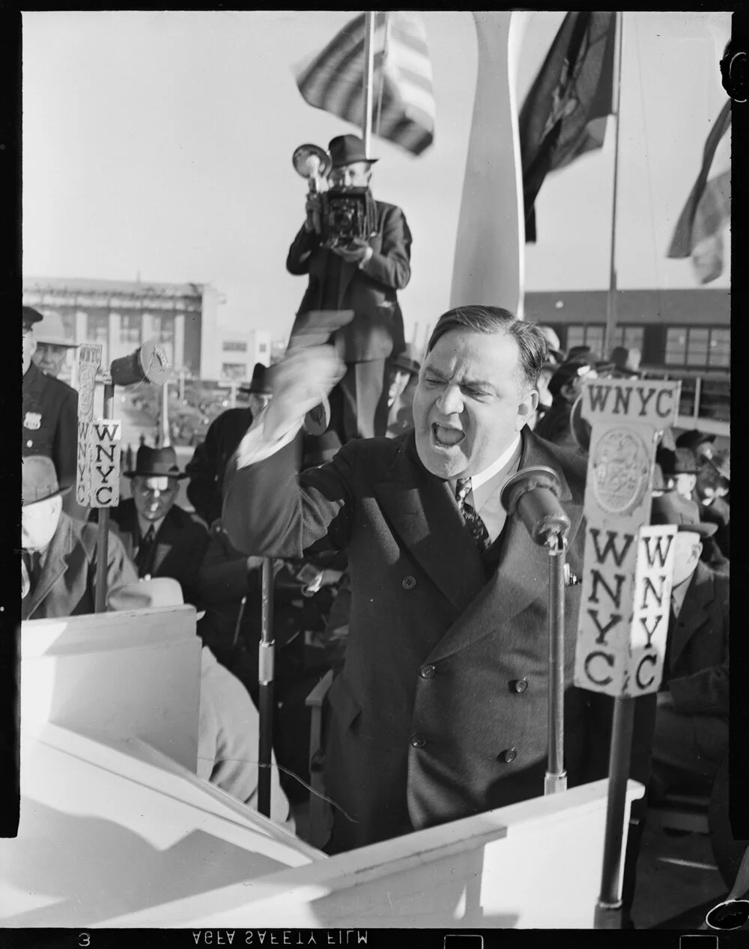
Fiorello H. LaGuardia
During his time, LaGuardia took on many infrastructure and welfare programs.
He oversaw the construction of many key bridges connecting the city including the Triborough Bridge and the Queens-Midtown Tunnel. He built LaGuardia Airport and expanded JFK (then Idlewild Airport).
He leveraged New Deal funds to embark on major public works projects, such as the construction of bridges, roads, and public buildings, which created thousands of jobs for the city’s unemployed.
Provided housing and education for the poor and expanded social services. Also expanded and modernized public hospitals and health clinics.

Slide 37
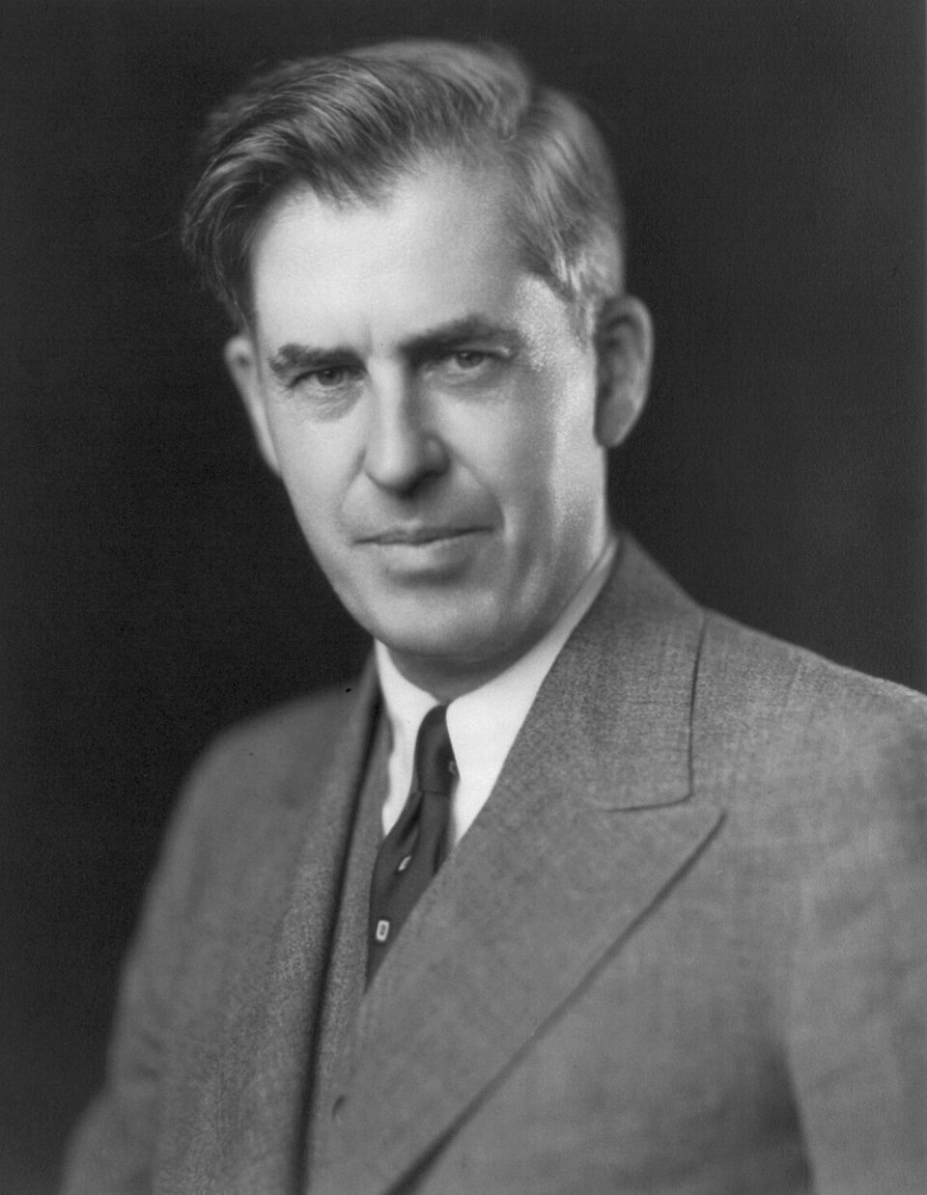
Henry Wallace
Wallace served as Secretary of Agriculture under Roosevelt from 1933 to 1940. He strongly supported the New Deal and presided over a major shift in federal agricultural policy, implementing measures designed to curtail agricultural surpluses and to ameliorate rural poverty.
Roosevelt overcame strong opposition from conservative leaders in the Democratic Party and had Wallace nominated for vice president at the 1940 Democratic National Convention.

Slide 38
Henry Wallace
Though many Democrats were disappointed by Wallace's nomination, it was generally well received by newspapers. Arthur Krock of The New York Times wrote that Wallace was "able, thoughtful, honorable—the best of the New Deal type."
The Roosevelt campaign settled on a strategy of keeping Roosevelt largely out of the fray of the election, leaving most of the campaigning to Wallace and other surrogates. Wallace was dispatched to the Midwest, giving speeches in states like Iowa, Illinois, and Missouri.
He made foreign affairs the main focus of his campaigning, telling one audience that "the replacement of Roosevelt ... would cause Hitler to rejoice." Both campaigns predicted a close election, but Roosevelt won 449 of the 531 electoral votes and the popular vote by nearly ten points.

Slide 39
Henry Wallace
Speculation began as to whether Roosevelt would drop Wallace from the ticket in the 1944 election. Polling published in March 1944 showed that Wallace was clearly the most popular choice for vice president among Democrats, many journalists predicted that he would win renomination. As Roosevelt was in declining health, party leaders expected that the party's vice-presidential nominee would eventually succeed Roosevelt, and Wallace's many enemies within the Democratic Party organized to ensure his removal.
Much of the opposition to Wallace stemmed from his open denunciation of racial segregation in the South, but others were concerned by Wallace's unorthodox religious views and pro-Soviet statements. On January 20, 1945, Wallace swore in Truman as his vice-presidential successor.

Slide 40
Henry Wallace
Roosevelt died in April 1945 and Truman succeeded him as president. Wallace continued to serve as Secretary of Commerce until September 1946, when he was fired by Truman for delivering a speech urging conciliatory policies toward the Soviet Union.
Wallace and his supporters then established the nationwide Progressive Party and launched a third-party campaign for president. The Progressive platform called for conciliatory policies toward the USSR, desegregation of public schools, racial and gender equality, a national health-insurance program, and other left-wing policies.
Accusations of communist influence followed, and Wallace's association with controversial Theosophist figure Nicholas Roerich undermined his campaign; he received 2.4% of the popular vote.

Slide 41
Henry Wallace
Roosevelt died in April 1945 and Truman succeeded him as president. Wallace continued to serve as Secretary of Commerce until September 1946, when he was fired by Truman for delivering a speech urging conciliatory policies toward the Soviet Union.
Wallace and his supporters then established the nationwide Progressive Party and launched a third-party campaign for president. The Progressive platform called for conciliatory policies toward the USSR, desegregation of public schools, racial and gender equality, a national health-insurance program, and other left-wing policies.
Accusations of communist influence followed, and Wallace's association with controversial Theosophist figure Nicholas Roerich undermined his campaign; he received 2.4% of the popular vote.

Slide 42
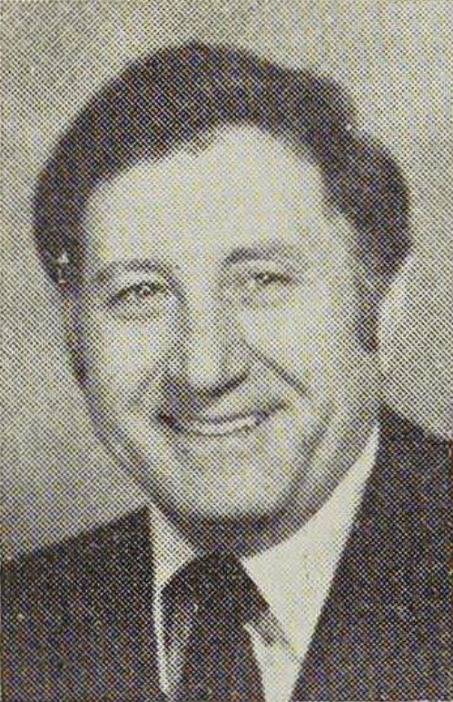
Frank Barbaro
Frank J. Barbaro was an American politician and judge. A son of immigrants, after high school he served in the navy before college (NYU, Brooklyn Law School). Prior to running for office he was a longshoreman.
He served as a Democratic Party member of the New York State Assembly from the 47th district (Bensonhurst, Brooklyn) from 1973 to 1996. He served as a judge on the New York Supreme Court from 1997 to 2003. He was also an unsuccessful nominee for mayor of New York City in 1981, running on the Unity ballot line against incumbent mayor Ed Koch.

Slide 43
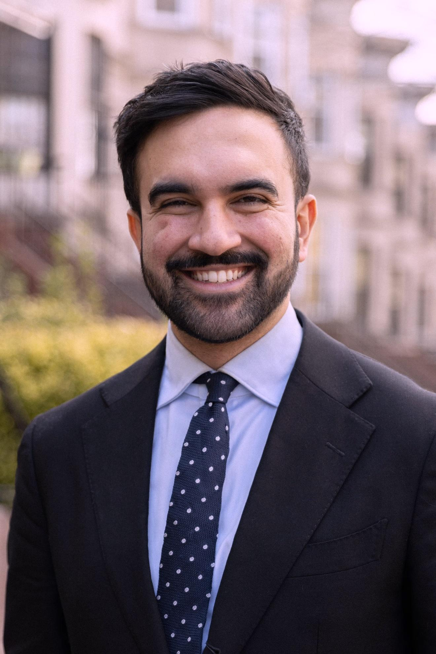
Legacy & Impact
Despite their repression during the Red Scare era, the public support of these progressive politicians led to many positive changes in society, demonstrating how socialism and/or progressive policies benefit them.
And example of this legacy is in New York City, where the progressive legislation of Fiorello LaGuardia, Vito Marcantonio and Benjamin Davis Jr. left its mark. The historically progressive regions of Brooklyn, Manhattan, Queens and the Bronx shifted the 2025 mayoral election in favor of democratic socialist Zohran Mamdani.

Slide 44
Discussion & Wrap Up

Slide 45
Announcements
PCUSA Cell Chairs need to call members of their cells to remind them about attendance.
PCUSA Cell members are reminded attendance at the Continuing Education class of Jones-Foster every first Wednesday of the month is required.
The next issue of New Masses (2026) has begun production. If you have art you want us to feature, email it to info@partyofcommunistsusa.net.

Slide 46
Volunteers Needed!
We are in need of volunteers for the staff of the People’s School! Here’s a few roles we need filled:
People to help manage posting on our social media and podcast platforms
Video Editors, Audio Editors, Graphic Designers, Artists, Narrators
Web Controls, Moderators
Email info@peoplesschool.us if you’re interested and try to attend our next staff meeting if possible.

Slide 47

View From Left Field
https://viewfromleftfield.libsyn.com
The Old PSMLS Youtube is now the Youtube of View From Left Field, a podcast of analysis and discussion of current events from a progressive perspective.
Like the Youtube videos and subscribe with 5 star ratings on your podcast platforms.

Slide 48


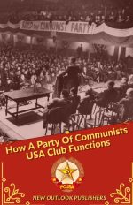
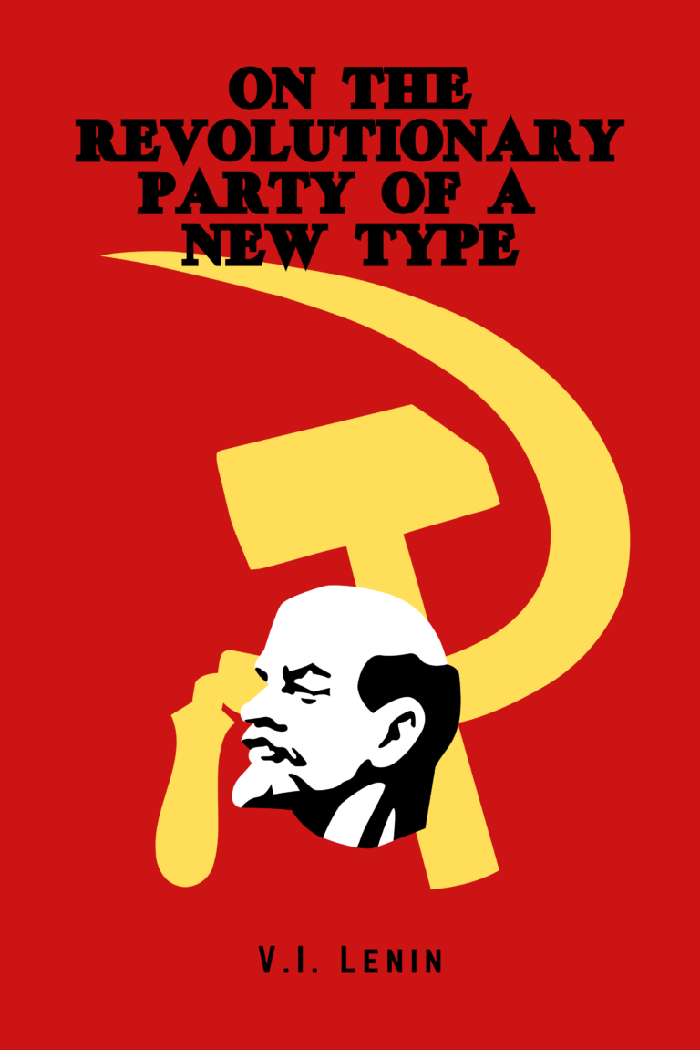

New Outlook Publishers
newoutlookpublishers.store
Relevant and Latest Releases

Slide 49



Harry Bridges School of Labor
luel.us/laborschool/
The Harry Bridges School of Labor is a monthly class covering a variety of topics aimed at building class consciousness among union members. For class schedule and other information, please visit the website at luel.us/laborschool.

Slide 50

Happy Days Are Here Again | FDR Campaign Song (1932)

