Slide 1

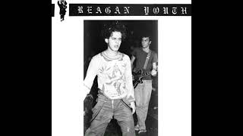
Jesus Was a Communist - Reagan Youth

Slide 2
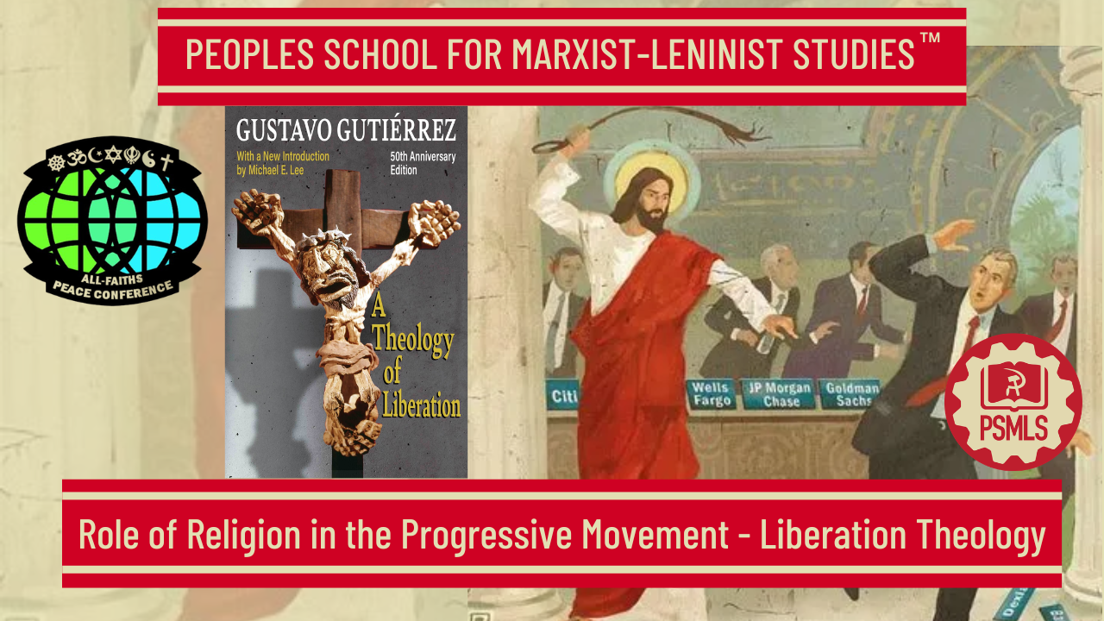
PSMLS 8/10/26

Slide 3
What we’ll be learning today:
Section 1: What is Liberation Theology
Section 2:Notable Figures & Organizations
Section 3: Role of Liberation Theology in the World Today

Slide 4
The Origins of Liberation Theology

Slide 5
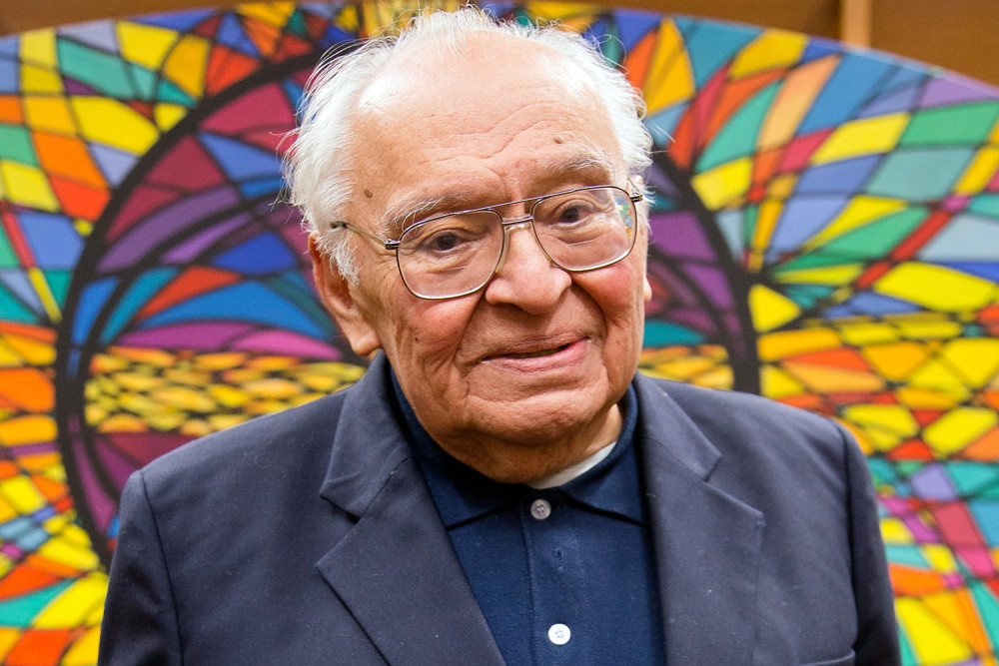
The Foundational Work of the Theology of Liberation
Published in 1971 by Peruvian priest Gustavo Gutiérrez, A Theology of Liberation is based on a Marxist historical analysis of class struggle and economic dependency to argue that Christian faith requires active, political participation in freeing the poor and oppressed from structural injustice. The theological project launched in this book was, as Fr. Gutiérrez wrote, “based on the gospel and the experiences of men and women committed to the process of liberation in the oppressed land of Latin America.” It was “born of the experience of shared efforts to abolish the current unjust situation and to build a different society, freer and more human.” Yet its influence was quickly felt around the world, inspiring numerous offshoots, as well as provoking critical reactions, both inside and outside the Church. A Theology of Liberation has won wide acclaim as one of the most influential works of Christian theology of the last century. Yet Gutiérrez himself concluded the book by noting that any theology of liberation “is not worth one act of genuine solidarity with exploited social classes. They are not worth one act of faith, love, and hope committed … in active participation to liberate humankind from everything that dehumanizes it and prevents it from living according to the will of God.”
Theologian Gustavo Gutiérrez, 1928–2024 (AP Photo / Domenico Stinelli)

Slide 6
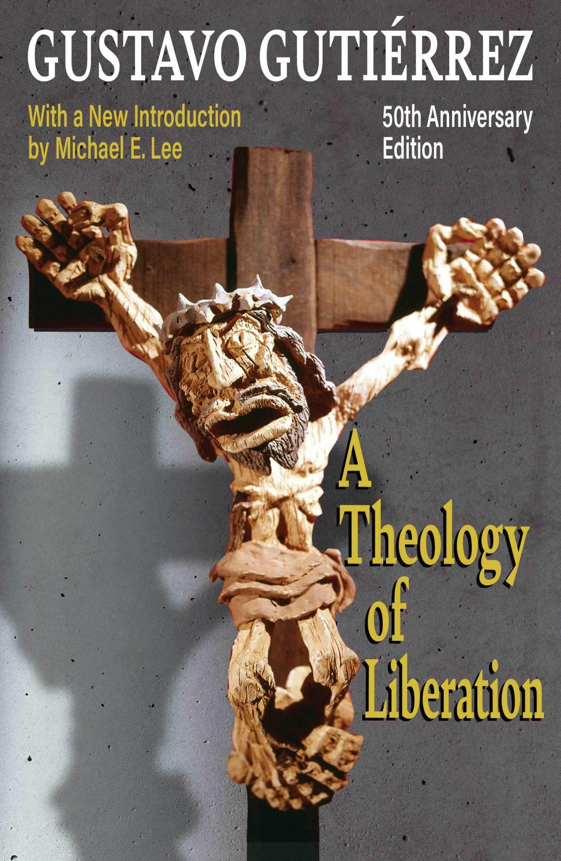
A Reflection on Material Circumstances and Actions Which Must Be Taken
A Theology of Liberation consists of four parts, which include thirteen chapters and cover more than three hundred pages. Part 1 begins with a chapter discussing the purpose of theology. According to Gutiérrez, the classic task of theology was to seek after wisdom and pursue rational knowledge. Throughout history, however, some have seen the task of theology as a meditation on proper human action. Gutiérrez sees his theological method as a reflection on circumstances and actions that should be taken (in pursuit of material change and not just superstitious goals.) Chapter 2 considers liberation as a theological concept. Gutiérrez argues that liberation is a necessary condition for the proper development of individuals and society and that liberation is not merely concerned with otherworldly issues or the afterlife. The second part, called “Posing the Problem,” contains three brief chapters about the social tasks confronting Christianity. Gutiérrez argues that Christians in Latin America are looking for support from the Catholic Church for the social problems faced by people in countries which are oppressed by imperial powers such as those in the so-called “global south”. Gutiérrez argues that the problems of the poor must be considered both on the pastoral level and on the level of theological reflection. On the pastoral level, lay movements must be given particular attention so that the people are supported in their struggle for social justice.

Slide 7
The Liberation of Latin Americans from Economic Servitude
The third part, titled “The Option Before the Latin American Church,” examines the development of theological ideas in Latin America regarding social life. Gutiérrez asserts that for a very long time theologians in Latin America had no real awareness or concern for the economic problems faced by the masses. In the 1950’s, however, theologians began addressing the social plight of Latin Americans. He includes a brief discussion of the theory of dependence as an explanation for the poverty in the Americas. This economic theory argues that Latin American nations never developed vibrant domestic economies because trading partners purchased raw materials at very low prices from Latin American nations and then sold finished goods to these countries at higher prices. Reformist movements were not enough to counter the economic colonialism practiced by northern nations. Finally, Gutiérrez offers a chapter outlining the tasks before the Latin American Church. Laypersons and priests alike must participate in social reform movements. Priests who engage in social reform efforts must not be seen as subversives but as true supporters of the people. Moreover, bishops must be supportive of these social movements. Gutiérrez applauds the efforts of Latin American bishops, particularly those at Medellín Conference in 1968, which called for the liberation of Latin Americans from economic servitude. It is important to note that Gutiérrez rejected the label of communist, an accusation often leveled at progressive priests by red-baiting reactionaries. Instead, he sought to distance his views from Communism, referring to his theory as “socialism informed by Christianity.”

Slide 8
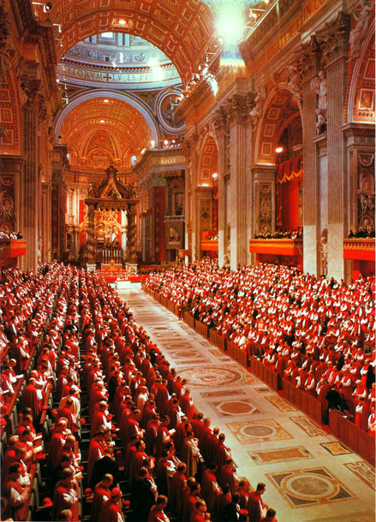
Love Thy Neighbor
Part 4, “Perspectives,” includes five chapters. The first considers the relation between liberation and salvation. Here Gutiérrez agrees with the central concern for salvation in the Christian tradition but asserts that we must reconsider the meaning of salvation: “Salvation is not something otherworldly,” but rather “salvation is something that embraces human reality, transforms it, and leads it to its fullness in Christ.” He calls this a qualitative approach to salvation and asserts that the necessary political liberation will be a “self-creation of man.” He rejects the customary focus on otherworldly liberation and asserts that the promises of God are directed toward earthly realities. In support of his position, he cites passages from documents approved at the Second Vatican Council (1962-1965) which refer to the temporal progress of God’s kingdom. Christ is presented as a liberator who calls for a radical reordering of human life. The next chapter argues from biblical texts that God’s affect on human history can be seen through the acts of people “called by Him.” God’s followers, then, are to work for justice. Gutiérrez lists passages from both the Old and New Testaments in support of his call to work for justice. Finally, Christ is presented not as a teacher of otherworldly realities but as one who called his followers to love their neighbors in a radical way.
Vatican II in session, circa 1962-1965

Slide 9
Socialism as Compatible with a Christian Vision for Society
The first theme expressed in this work is the new mode that theology must undertake to address the social conditions of the poor. Theology is no longer about knowing; rather, it is about action, or praxis as Gutiérrez calls it. Scriptural passages from both the Old and New Testaments and other theological documents of the Catholic Church are interpreted in light of this viewpoint. Thus, passages on the poor in Scripture are given new attention. Christ is presented as a radical social reformer and liberator of the poor. Passages suggesting otherworldly realties are interpreted in the light of worldly conditions. Another theme is the new meanings of “liberation” and “salvation.” These terms become interchangeable, because the work of bringing liberation to the poor will also bring salvation to the poor, salvation from the material poverty forced upon those in less developed countries. Liberation and salvation will occur in this world. Gutiérrez further argues that it is appropriate to have eschatological hope for this to occur. Another theme developed by Gutiérrez is the theological justification for Christians, including laypersons and priests, to become social revolutionaries who seek to overturn existing social and economic arrangements. Gutiérrez recognizes the Marxist tone of this language but rejects the notion that his social vision is aligned with so-called “Marxist atheism” and so-called Marxist “materialism.” Regardless, he calls for all to overturn the unjust social structures in place in the world. In the same vein, Gutiérrez makes a scathing critique of capitalism and argues that socialism is the social order which is most compatible with Christianity. Gutiérrez asserts that forced dependency and capitalistic exploitation explain poverty. He embraces socialism as compatible with a Christian vision for society.

Slide 10
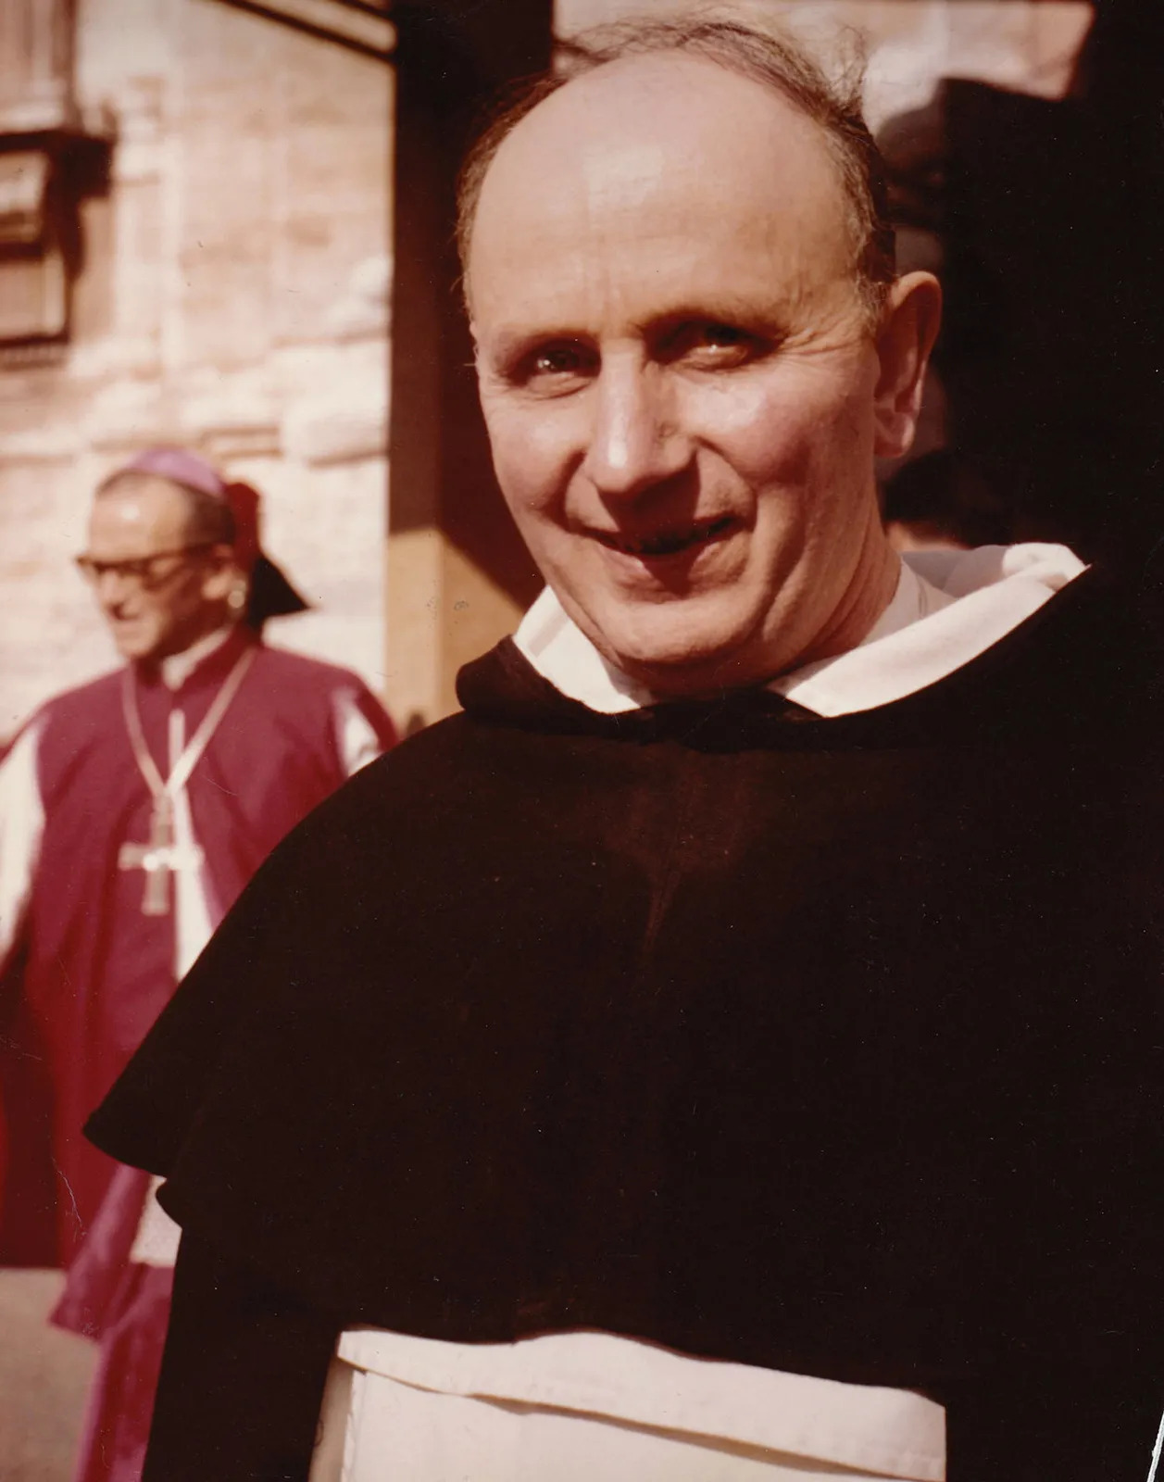
Selected Excerpts from A Theology of Liberation
The Christian community professes a “faith which works through charity.” It is—at least it ought to be—real charity, action, and commitment to the service of others. Theology is reflection, a critical attitude. Theology follows', it is the second step. What Hegel used to say about philosophy can likewise be applied to theology: it rises only at sundown. The pastoral activity of the Church does not flow as a conclusion from theological premises. Theology does not produce pastoral activity; rather it reflects upon it. Theology must be able to find in pastoral activity the presence of the Spirit inspiring the action of the Christian community. A privileged locus theologicus for understanding the faith will be the life, preaching, and historical commitment of the Church. To reflect upon the presence and action of the Christian in the world means, moreover, to go beyond the visible boundaries of the Church. This is of prime importance. It implies openness to the world, gathering the questions it poses, being attentive to its historical transformations. In the words of Congar, “If the Church wishes to deal with the real questions of the modern world and to attempt to respond to them” it must open as it were a new chapter of theologico-pastoral epistemology. Instead of using only revelation and tradition as starting points, as classical theology has generally done, it must start with facts and questions derived from the world and from history.” It is precisely this opening to the totality of human history that allows theology to fulfill its critical function vis-a-vis ecclesial praxis without narrowness.
Yves Marie-Joseph Congar (13 April 1904 – 22 June 1995) a French Dominican friar, priest, and theologian perhaps best known for his influence at the Second Vatican Council

Slide 11
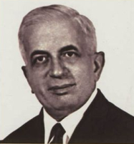
A Novel Understanding of Prophecy
As critical reflection on society and the Church, theology is an understanding which both grows and, in a certain sense, changes. If the commitment of the Christian community in fact takes different forms throughout history, the understanding which accompanies the vicissitudes of this commitment will be constantly renewed and will take untrodden paths. A theology which has as its points of reference only “truths” which have been established once and for all—and not the Truth which is also the Way—can be only static and, in the long run, sterile. In this sense the often-quoted and misinterpreted words of Bouillard take on new validity: “A theology which is not up-to-date is a false Theology.” Finally, theology thus understood, that is to say as linked to praxis, fulfills a prophetic function insofar as it interprets historical events with the intention of revealing and proclaiming their profound meaning. According to Cullmann, this is the meaning of the prophetic role: “The prophet does not limit himself as does the fortune-teller to isolated revelations, but his prophecy becomes preaching, proclamation. He explains to the people the true meaning of all events; he informs them of the plan and will of God at the particular moment.”
Henri Bouillard (1908-1981) was a French Catholic theologian and was a leading figure within the movement known as la nouvelle théologie or ressourcement

Slide 12
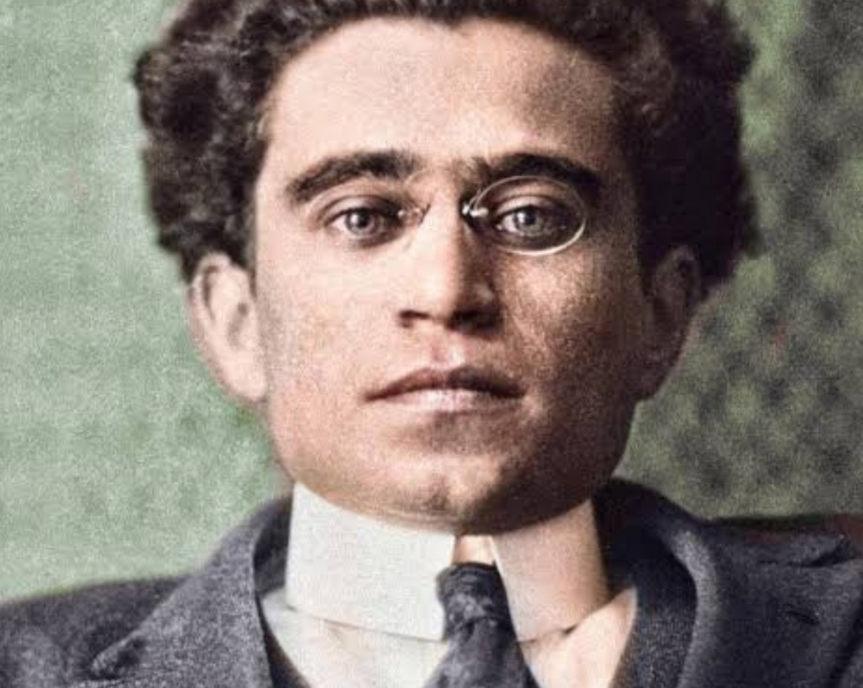
Where Nations, Social Classes, and Peoples Struggle to Free Themselves
But if theology is based on this observation of historical events and contributes to the discovery of their meaning, it is with the purpose of making Christians’ commitment within them more radical and clear. Only with the exercise of the prophetic function understood in this way, will the theologian be—to borrow an expression from Antonio Gramsci—a new kind of “organic intellectual.” Theologians will be personally and vitally engaged in historical realities with specific times and places. They will be engaged where nations, social classes, and peoples struggle to free themselves from domination and oppression by other nations, classes, and peoples. In the last analysis, the true interpretation of the meaning revealed by theology is achieved only in historical praxis. “The hermeneutics of the Kingdom of God,” observed Schillebeeckx, “consists especially in making the world a better place. Only in this way will I be able to discover what the Kingdom of God means.” We have here a political hermeneutics of the Gospel.
Antonio Gramsci - Italian Marxist philosopher, journalist and politician

Slide 13
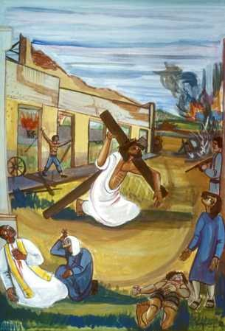
The Critical Function of Theology
The critical function of theology necessarily leads to redefinition of these other two tasks. Henceforth, wisdom and rational knowledge will more explicitly have ecclesial praxis as their point of departure and their context. It is in reference to this praxis that an understanding of spiritual growth based on Scripture should be developed, and it is through this same praxis that faith encounters the problems posed by human reason. Given the theme of the present work, we will be especially aware of this critical function of theology with the ramifications suggested above. This approach will lead us to pay special attention to the life of the Church and to commitments which Christians, compelled by the Spirit and in communion with others, undertake in history. We will give special consideration to participation in the process of liberation, an outstanding phenomenon of our times, which takes on special meaning in the so-called Third World countries. This kind of theology, arising from concern with a particular set of issues, will perhaps give us the solid and permanent albeit modest foundation for the theology in a Latin American perspective which is both desired and needed. This Latin American focus would not be due to a frivolous desire for originality, but rather to a fundamental sense of historical efficacy and also—why hide it?—to the desire to contribute to the life and reflection of the universal Christian community.
By Adolfo Pérez Esquivel of Argentina
(Nobel Peace Prize Laureate, 1980)

Slide 14
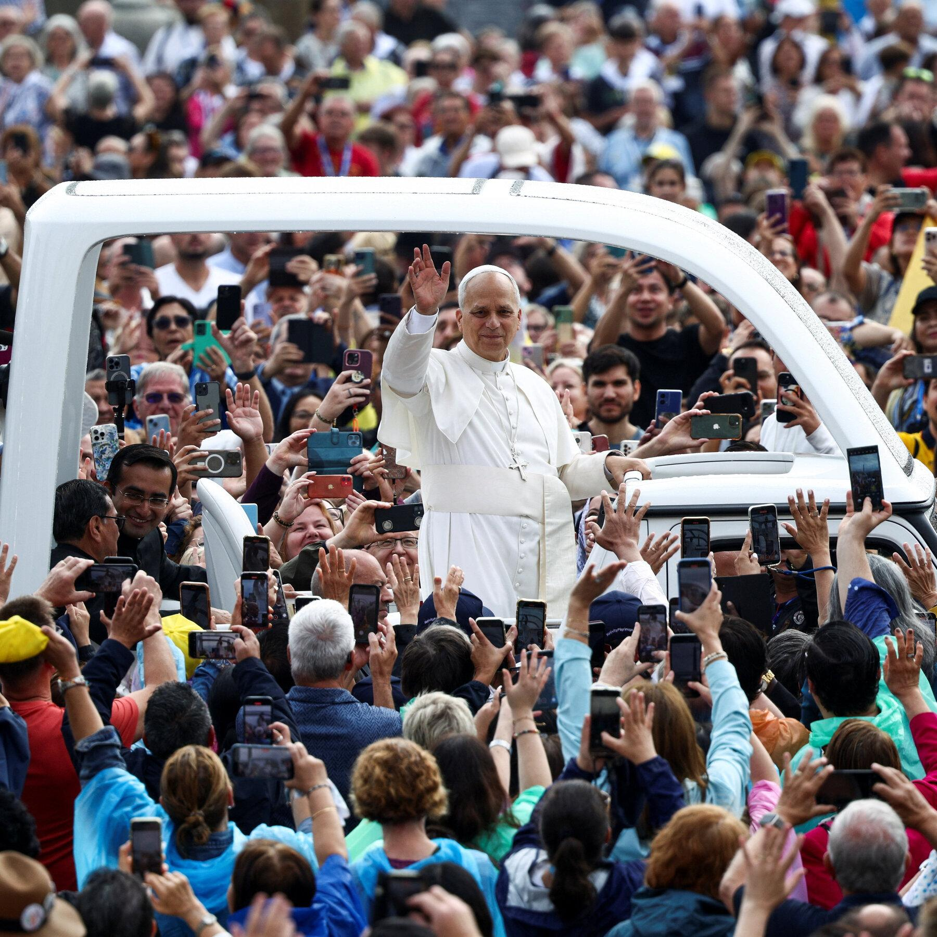
Reflect on the Basis of the Historical Praxis of Liberation
In our approach, to reflect critically on the praxis of liberation is to “limp after” reality. The present in the praxis of liberation, in its deepest dimension, is pregnant with the future; hope must be an inherent part of our present commitment in history. Theology does not initiate this future which exists in the present. It does not create the vital attitude of hope out of nothing. Its role is more modest. It interprets and explains these as the true underpinnings of history. To reflect upon a forward-directed action is not to concentrate on the past. It does not mean being the caboose of the present. Rather it is to penetrate the present reality, the movement of history, that which is driving history toward the future. To reflect on the basis of the historical praxis of liberation is to reflect in the light of the future which is believed in and hoped for. It is to reflect with a view to action which transforms the present. But it does not mean doing this from an armchair; rather it means sinking roots where the pulse of history is beating at this moment and illuminating history with the Word of the Lord of history, who irreversibly committed himself to the present moment of humankind to carry it to its fulfillment.
Pope Leo XIV greets the faithful while riding through St. Peter's Square before celebrating his inauguration Mass at the Vatican May 18, 2025. (CNS photo/Lola Gomez)

Slide 15
Discussion & New Members Introductions

Slide 16
New Member Introductions
What is your name, pronouns and state (or country/territory)?
Where do you work? Is it unionized?
How did you find out about the People’s School?
What do you think about tonight's class?

Slide 17
Notable Figures & Organizations

Slide 18
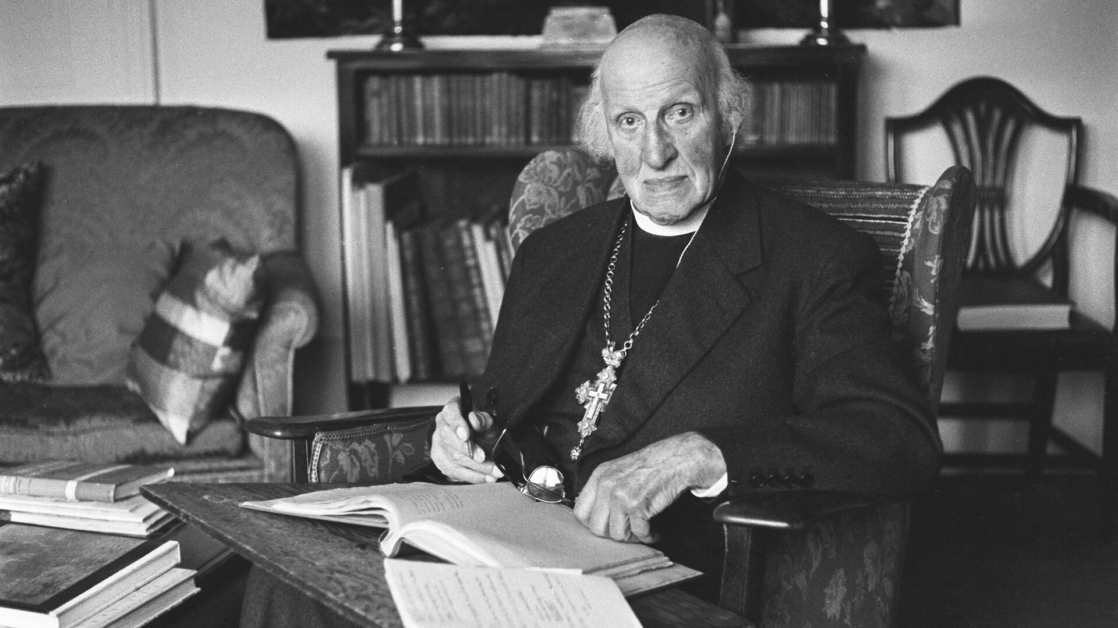
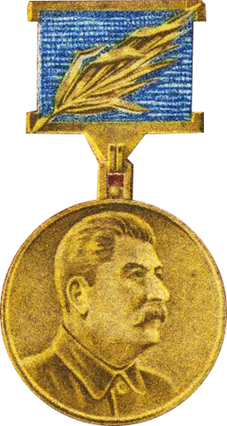
Hewlett Johnson
Hewlett Johnson (25 January 1874 – 22 October 1966) was an English Anglican priest of the Church of England and a Christian communist and Marxist-Leninist activist and author.
As abbot of the Canterbury Cathedral, Hewlett Johnson openly proclaimed that a “true Christian cannot be an enemy of communism”
In the intellectual struggle against Fascism Hewlett had been drawn into the circle of the Left Book Club, many of whose members saw the solution as a move towards Marxism He met Stalin and was awarded the "Order of the Red Banner of Labour" by the praesidium of the Supreme Soviet.
In April 1951 news came that Hewlett had been awarded the Stalin Peace Prize, only the 2nd recipient of the Honor which the Eastern bloc thought of as their version of the Nobel Prize.
Stalin Peace Prize

Slide 19
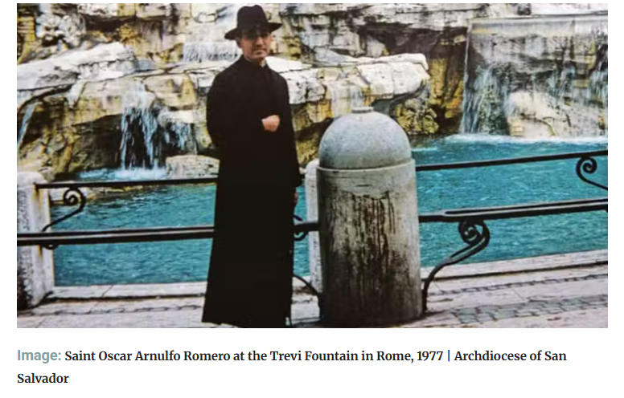
Saint Oscar Romero
Óscar Arnulfo Romero y Galdámez (15 August 1917 – 24 March 1980) was a prelate of the Catholic Church in El Salvador and finally as the fourth Archbishop of San Salvador.
Romero preached that Sin became not only personal, but structural: anything that did not advance God’s reign on earth. He said “You are the image of the divine victim, ‘pierced for our offenses.’”
“One begins to experience faith and conversion when one has the heart of the poor, when one knows that financial capital, political influence, and power are worthless, and that without God we are nothing”.
Romero began to ask some hard questions about the Church’s role in the world. He wondered what his role should be as governmental atrocities continued. He began to question his previous apolitical leanings.

Slide 20
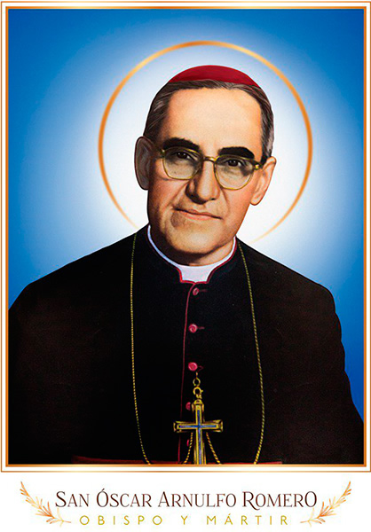
Saint Oscar Romero
Early in his time as archbishop, he boycotted the inauguration of President General Carlos Humberto Romero Mena because of widespread electoral fraud and the 1977 Plaza Libertad Massacre, where security forces killed dozens to hundreds of peaceful political demonstrators.
He also formed an archdiocesan office staffed with lawyers and researchers who were tasked with investigating human rights abuses in El Salvador.
Romero was politically assassinated while celebrating Mass on March 24, 1980, at the Chapel of the Hospital de la Divina Providencia in San Salvador.
His courageous journey and witness invite prayerful wrestling with God, an open-mindedness toward the Spirit’s guidance, and a pursuit of justice that centers the poor and marginalized.
In the words of Romero: “That is when one begins to experience faith and conversion: when one has the heart of the poor, when one knows that financial capital, political influence, and power are worthless, and that without God we are nothing.
Pope Francis canonized Romero on 14 October 2018

Slide 21
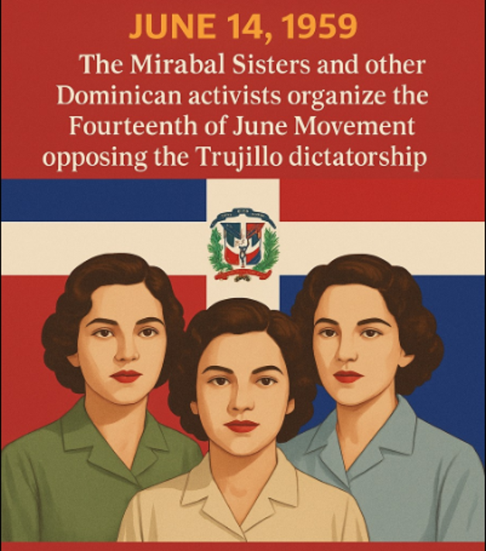
Mirabal Sisters
“Until the nail is hit, it doesn’t believe in the hammer.” -Minerva Mirabal
Minerva and her husband became resistance leaders, and Patria, María Teresa and their husbands soon joined them. In early 1960, they helped form the 14th of June Movement, named for the date of a failed insurrection against Trujillo led by a group of exiled Dominicans with the support of the Cuban government the previous year.
Shortly after the movement was officially organized, Trujillo began mass arrests of resistance figures, including the sisters and their husbands, though he later freed female prisoners as a supposed gesture of his leniency.
Against this backdrop, the Mirabal sisters traveled on November 25, 1960, to visit their husbands in prison in Puerto Plata. On the way back, Trujillo’s henchmen stopped their car along a mountain road and killed their driver, Rufino de la Cruz, before kidnapping the sisters at gunpoint, beating and strangling them. The assassins then put the four bodies back in the car and pushed it over a cliff to make it look like an accident.
The Butterflies, as the Mirabals were known, instantly became martyrs to the revolutionary cause, helping solidify resistance to Trujillo both at home and abroad.
On May 30, 1961, seven assassins (including former members of the armed forces) ambushed the dictator’s car along a coastal highway and killed him. Though Trujillo’s death did not immediately bring democracy to the Dominican Republic—his successor, Joaquin Balaguer, continued the authoritarian tradition until the late 1970s—the country did not return to the level of brutal repression experienced during his reign.

Slide 22
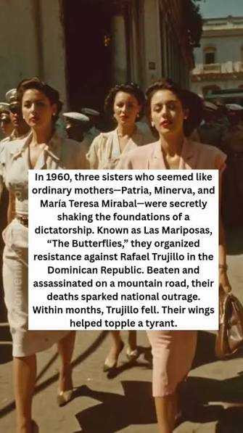
Mirabal Sisters
The Mirabal sisters were four in number (Minerva, Maria Teresa, Patria and Adela) and grew up in the town of Ojo de Agua, in Salcedo province, in a wealthy middle-class Dominican family that, like many others, lost everything when the dictator took over the country.
They were in their early twenties when three of them began to wage a great battle in the name of political freedom and civil rights.
They were the protagonists of a story that took shape in the Dominican Republic after World War II, at the time of Rafael Trujillo’s brutal dictatorship, a bloody and corrupt regime that lasted over thirty years and was also a tragic hyperbole of machismo.
Known as “El Jefe” (“the Boss”) or “el Chivo” (“the Goat”), Trujillo was the commander in chief of the army before he seized power in 1930. The prosperity, modernization and stability his regime brought to the country came at a high price: Trujillo took over the country’s economy, including production of such goods as salt, meat, tobacco and rice, and channeled the profits to his own family and supporters.
Trujillo’s fearsome secret police rooted out dissenters, using tactics of intimidation, imprisonment, torture, kidnapping and rape of women, and murder.
His regime would ultimately be responsible for tens of thousands of deaths, including the massacre of an estimated 20,000 Haitians living near the border between Haiti and the Dominican Republic in 1937.

Slide 23

Abbe Jean Boulier
“Every act of war which tends indiscriminately to the destruction of entire cities or vast regions with their inhabitants is a crime against God and against man himself and it must be condemned firmly and without hesitation.”- Jean Boulier
Boulier was professor of Christian Legal Principles at the Catholic University of Paris.
For social Christianity in the post-Second World War era—as taught by Boulier—the main international peace issue that faced believers was the U.S.-led Cold War, waged in order to undo advances made by the working class as a result of capitalism’s Second World War debacle. More specifically, the priest-professor took a stand, based on Christian authority, against anti-communism.
He also stood firmly against U.S. nuclear policy, as it violated the Christian principles of war and peace. Finally, he took a stand on the side of social Christianity.
Regarding social Christianity, he maintained that Christians can be good citizens of the socialist order, but could not accept the bourgeois state and its fundamental law, the one to which all others finally give in: make money, get rich. In his scholarly writings and his autobiography, Boulier found Marxism compatible with Thomism, ecumenism, mysticism, liturgy, and church hierarchy.
Boulier’s activism began in 1912, when he joined the Jesuits. For twenty years he was with the “Company,” and then became a priest of the Parisian clergy and an advocate for Jews resisting the Vichy and Nazi governments in the Second World War.

Slide 24
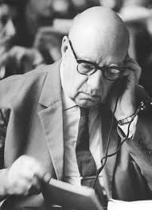
Abbe Jean Boulier
Fr. Boulier maintained that the loss of the peoples’ participation in the mysteries and the vocabulary of awe, fear and unworthiness that was attached to them was a denial of what the Eucharist was all about. From his view the Eucharist was about the redemption of the working class – its empowerment and liberation, not its enslavement.
More recently, Pope Francis stated the same idea, “It is the communists who think like Christians.” Fr. Boulier took the long view and quoted François Mauriac, “If the world lasts twenty thousand years, we are still the first Christians.” In the face of all the contrary evidence, the world for Fr. Boulier was the arena where God’s loving will was brought forward.
Boulier’s activism extended into Eastern Europe, where Christians in significant numbers sided with the communists in the post-Second World War period. In Boulier’s view, the interests that supported fascism during the Second World War sought to unify Europe in order to destroy the communists. Ultimately, these forces achieved their objectives. They unified Europe and, in time, destroyed the USSR.
Today, governments use NATO to make the world a police station in order to enslave the working class. Believers, like Pope Francis, resist and offer hope. As Boulier put it, this is a multimillenial war, and present-day Christians are still the first generation.

Slide 25
Discussion

Slide 26
Role of Liberation Theology in the World Today

Slide 27
Liberation Theology’s Continued Influence
While its prominence has waned since its height in the 1970s and 1980s, liberation theology continues to influence contemporary theological and social movements.
Liberation theology’s critique of neoliberal policies and emphasis on solidarity among oppressed groups remain relevant.
Pope Francis, the first Latin American pope, drew from liberationist ideas, particularly in his advocacy for economic justice and environmental stewardship, as seen in his encyclical Laudato Si’. This development signaled a renewed engagement with the movement’s principles within the institutional Church.

Slide 28
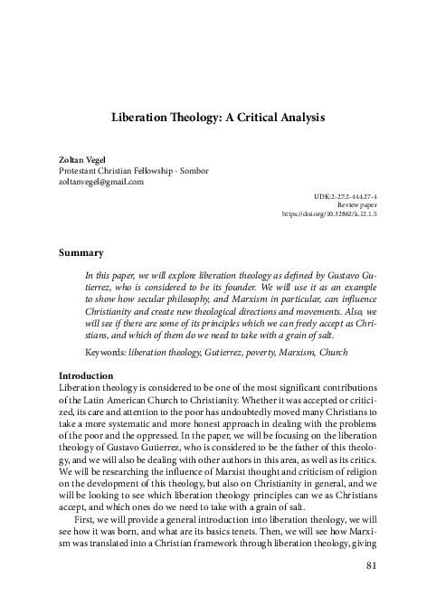
Liberation Theology’s Continued Influence
Liberation theology's legacy also includes its impact on academic discourse, where it has fostered interdisciplinary approaches to theology, sociology, and political science.
Scholars have analyzed its role in creating counter-hegemonic narratives, particularly within the Global South. This scholarship highlights the movement’s enduring relevance in addressing systemic inequality and advocating for transformative social change.

Slide 29
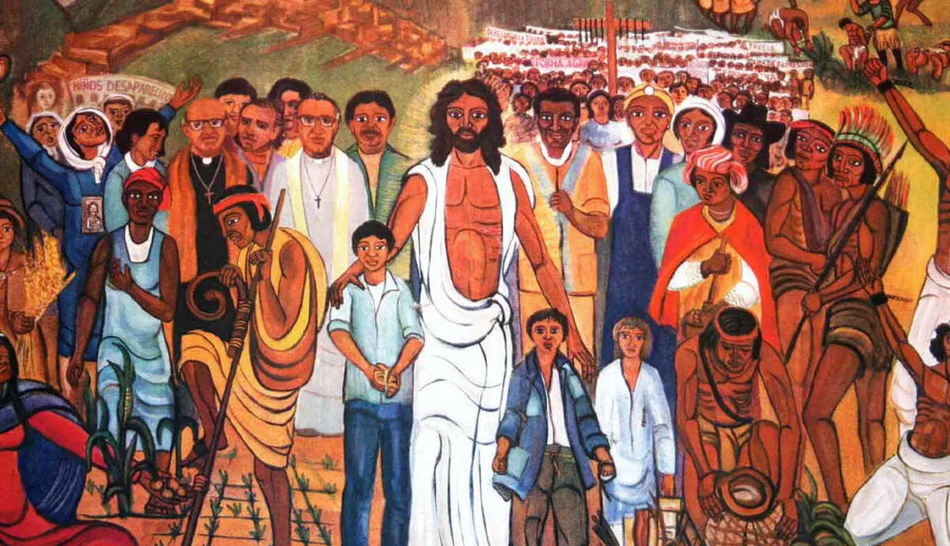
Liberation Theology’s Continued Influence
As a movement that bridges faith and activism, liberation theology continues to serve as a powerful call to action for those seeking to reconcile spirituality with the fight for a more equitable world.
Today, liberation theology’s legacy endures in contemporary critiques of global capitalism and as a source of inspiration for ongoing struggles for justice.

Slide 30

All-Faiths Peace Conference
The All-Faiths Peace Conference is concerned with the inequality found in the areas of housing, healthcare, and the conditions of working people. The All-Faiths Peace Conference unites all religions against war, racism, imperialism and fascism.
CONTACT US
All-Faiths Peace Conference
720 Seneca Street, Suite 106, Seattle, WA 98101
Email :info@allfaithspc.org Web: https://allfaithspc.org/

Slide 31
Discussion & Wrap Up

Slide 32
Announcements
PCUSA Cell Chairs need to call members of their cells to remind them about attendance.
The next issue of New Masses (2026) has begun production. If you have art you want us to feature, email it to info@partyofcommunistsusa.net.

Slide 33
Volunteers Needed!
We are in need of volunteers for the staff of the People’s School! Here’s a few roles we need filled:
People to help manage posting on our social media and podcast platforms
Video Editors, Audio Editors, Graphic Designers, Artists, Narrators
Web Controls, Moderators
Email info@peoplesschool.us if you’re interested and try to attend our next staff meeting if possible.

Slide 34

View From Left Field
https://viewfromleftfield.libsyn.com
The Old PSMLS Youtube is now the Youtube of View From Left Field, a podcast of analysis and discussion of current events from a progressive perspective.
Like the Youtube videos and subscribe with 5 star ratings on your podcast platforms.

Slide 35

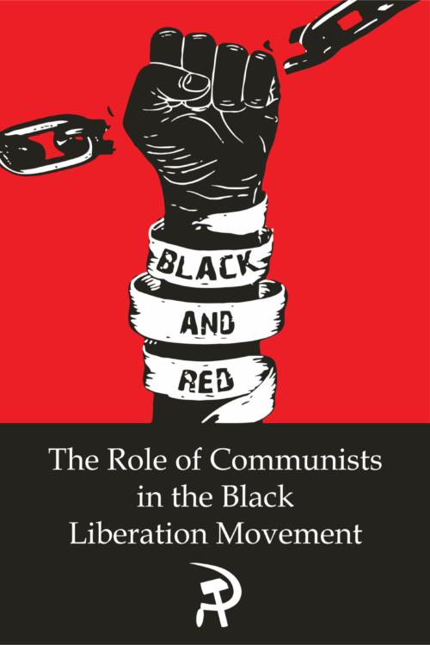
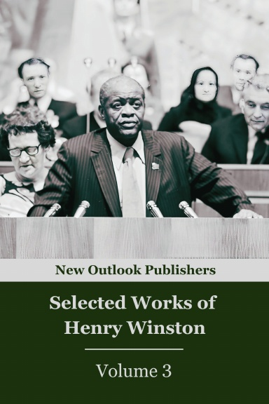
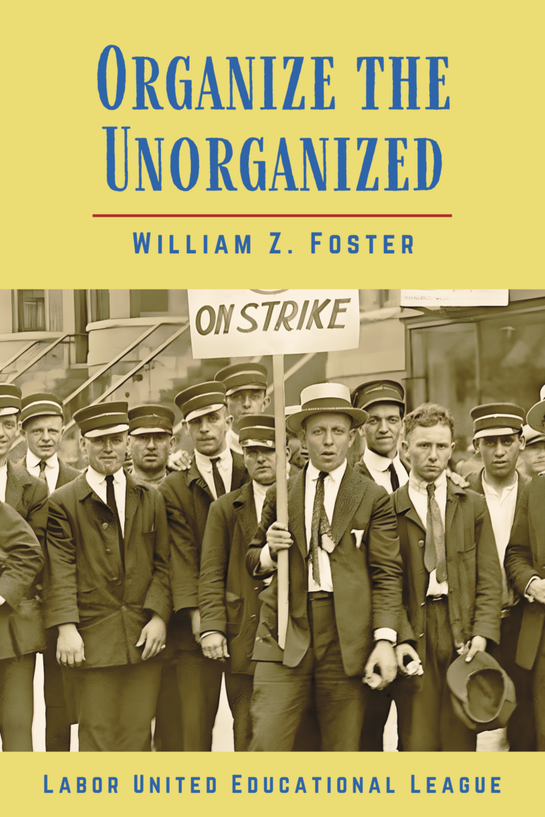

New Outlook Publishers
newoutlookpublishers.store
Relevant and Latest Releases

Slide 36


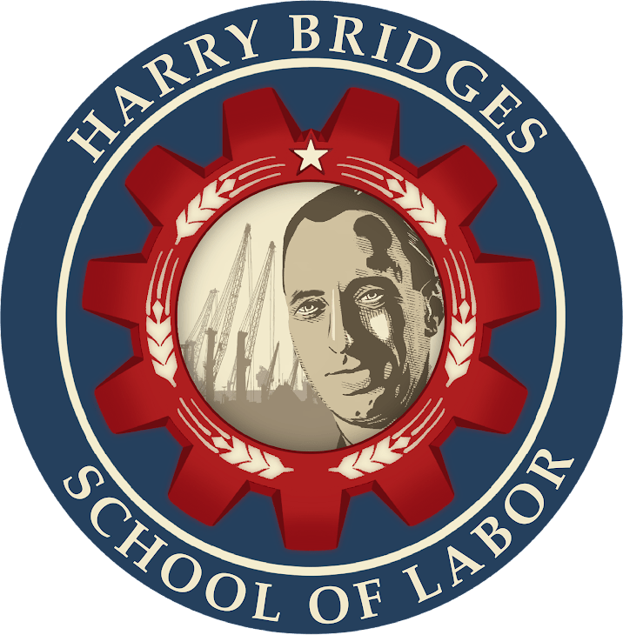
Harry Bridges School of Labor
luel.us/laborschool/
The Harry Bridges School of Labor is a monthly class covering a variety of topics aimed at building class consciousness among union members. For class schedule and other information, please visit the website at luel.us/laborschool.

Slide 37
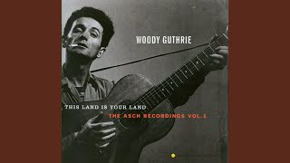
Jesus Christ - Woody Guthrie

