Slide 1

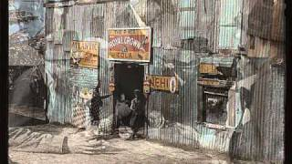
I Don’t Want Your Millions Mister - The Almanac Singers

Slide 2
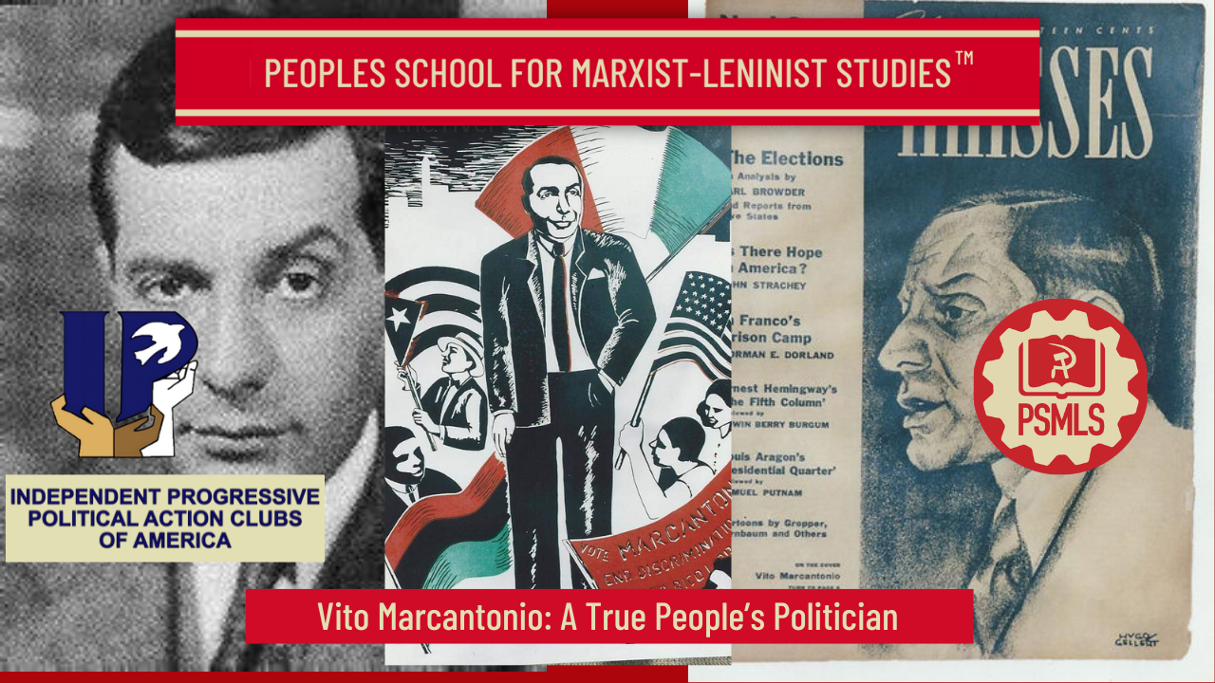
PSMLS 12/10/24

Slide 3
What we’ll be learning today:
An Introduction to IPPACA, the Anti-Monopoly Coalition and the American Labor Party.
Early Life of Vito Marcantonio
His Political Career.
Korean War and Later life.

Slide 4
Introduction to IPPACA, Anti-Monopoly Coalition, and the American Labor Party

Slide 5
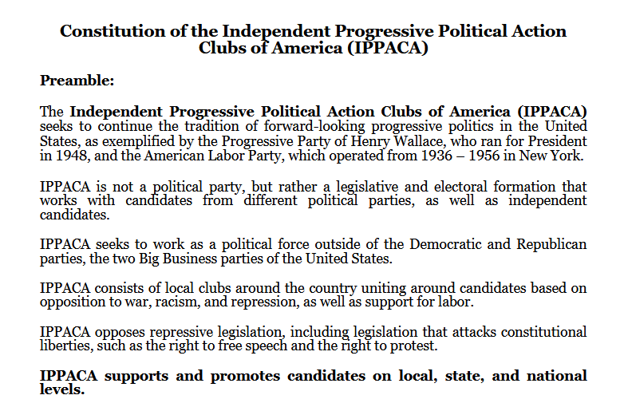

Independent Progressive Political Action Clubs of America

Slide 6
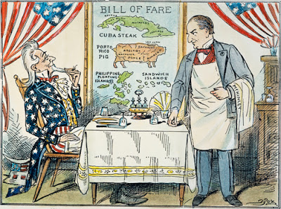
Labor-Led Anti-Monopoly Coalition
In today’s world, political and economic life is governed by corporate monopolies.
Monopolies, in their insatiable drive for further profits, drag the working masses into crisis.
Fearing the growing discontent of the masses, the monopolies tighten their grip on politics and begin to degrade democracy, labor rights, civil liberties, and push the world into wars of plunder and conquest.

Slide 7
Labor-Led Anti-Monopoly Coalition
In order to end the monopoly stranglehold, we must build an anti-monopoly coalition which centers organized labor as its leadership and comprises of all democratic-loving peoples.
The anti-monopoly coalition will strike at monopolies through every front such as demanding cuts to the military budget in order to fund nationalized healthcare, expanded education, public housing, public railroads, etc
The anti-monopoly coalition will also join in the demands for not only preserving civil liberties and democracy, but also towards expanding them.
Regarding the subject of labor, we call for passing the Protecting the Right to Organize Act, repealing of the Taft-Hartley Act, ending “Right to Work”, etc.
The anti-monopoly coalition will struggle against gender, sex, racial, national, religious, and ethnic discrimination as tools of monopolies to divide up the working masses
Importantly, the anti-monopoly coalition will not narrow its tactics and will work both within and without electoral and legislative frameworks

Slide 8

American Labor Party
Born out of the struggles of the 20s and 30s to build independent political action for labor and farmers, states throughout the US formed Farmer and Labor Parties.
In 1936, New York labor unions, liberals social democrats, and communists came together to form their own called the American Labor Party
For the 20 years of its existence, the American Labor Party provided the working masses, the most oppressed, and the pro-democratic Americans an electoral and legislative weapon against the monopolies, their anti-democratic trend, and their war drive
Logo of the American Labor Party

Slide 9
Vito Marcantonio - Early Life and Early Career

Slide 10
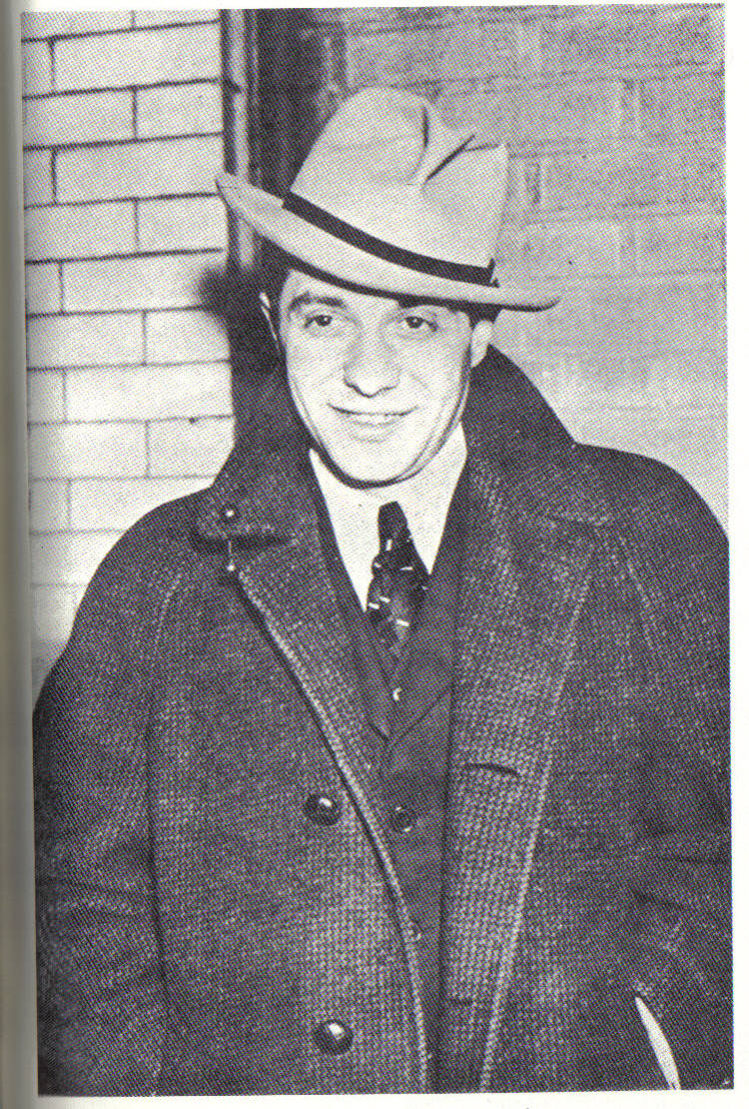
Early Life and Career
Electorally one of the most successful radicals in U.S. political history, Vito Marcantonio was born the son of Italian immigrants in 1902 in the same East Harlem neighborhood of Manhattan that he represented in the U.S. House of Representatives for seven terms.
He made his political debut in 1924 when he managed Fiorello LaGuardia's campaign for reelection to Congress from East Harlem.

Slide 11
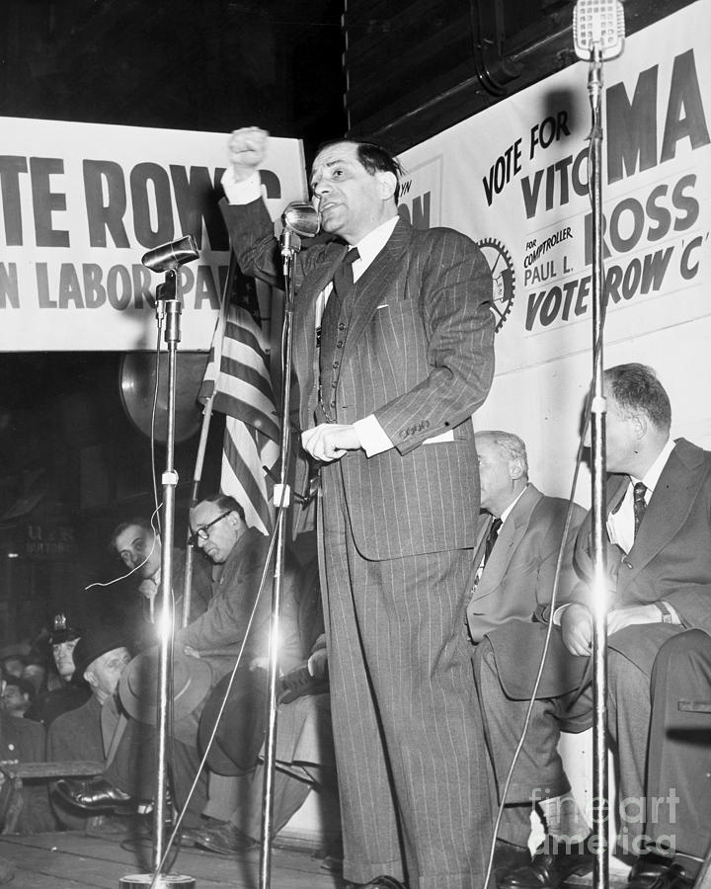
Early Life and Career
In 1930 he was appointed assistant U.S. Attorney, and in 1934, when LaGuardia became mayor of New York, Marcantonio ran as a Republican for LaGuardia's old seat in Congress, defeating the Democratic incumbent.
Two years later he was defeated in the Democratic landslide, but returned in 1938, running on both the Republican and American Labor Party tickets.

Slide 12
Discussion

Slide 13
The November 1938 Election and Career of Marcantonio

Slide 14
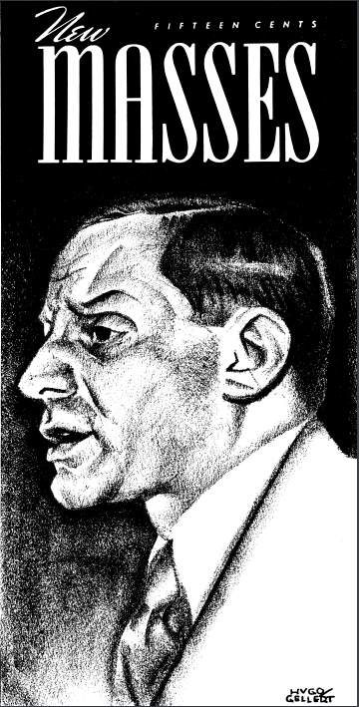
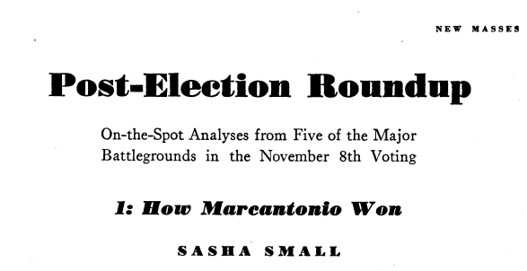
November 1938 Election

Slide 15
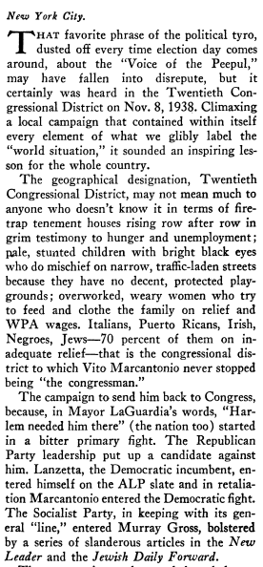
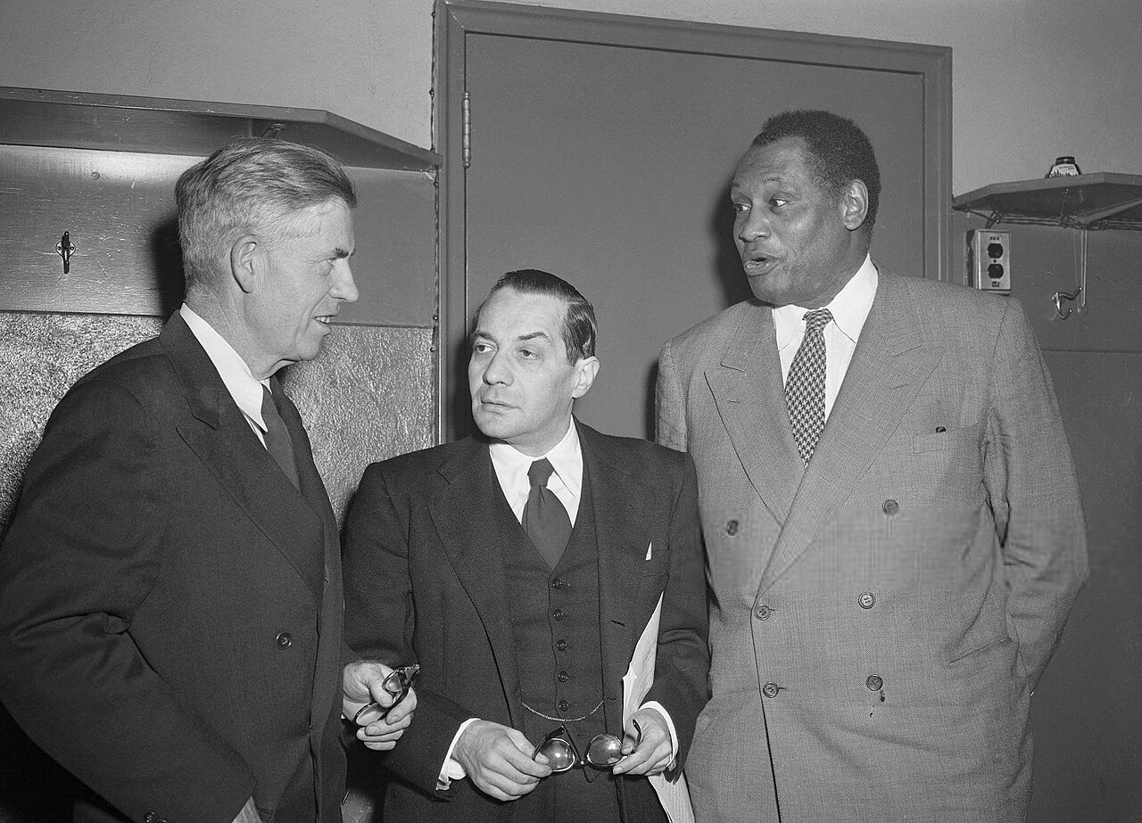
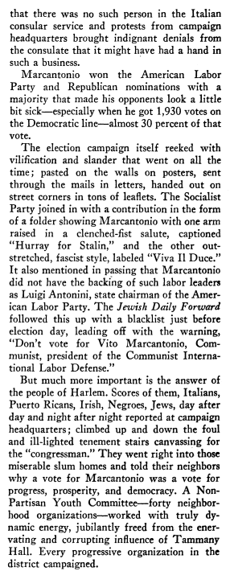
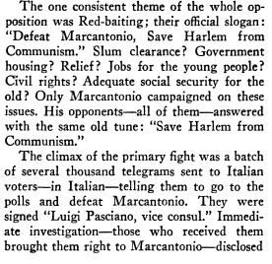
Marcantonio (Center) with Henry Wallace (Left) and Paul Robeson (Right)

Slide 16
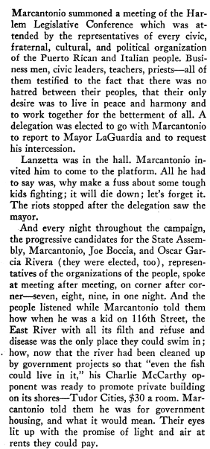
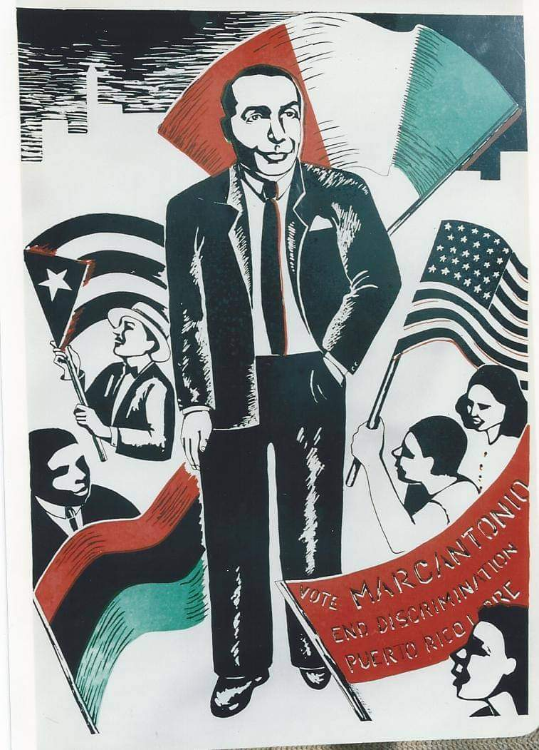
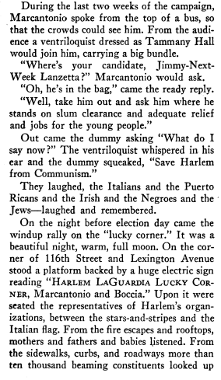

Slide 17
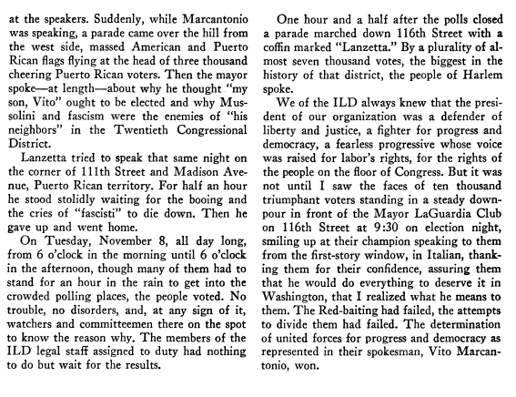
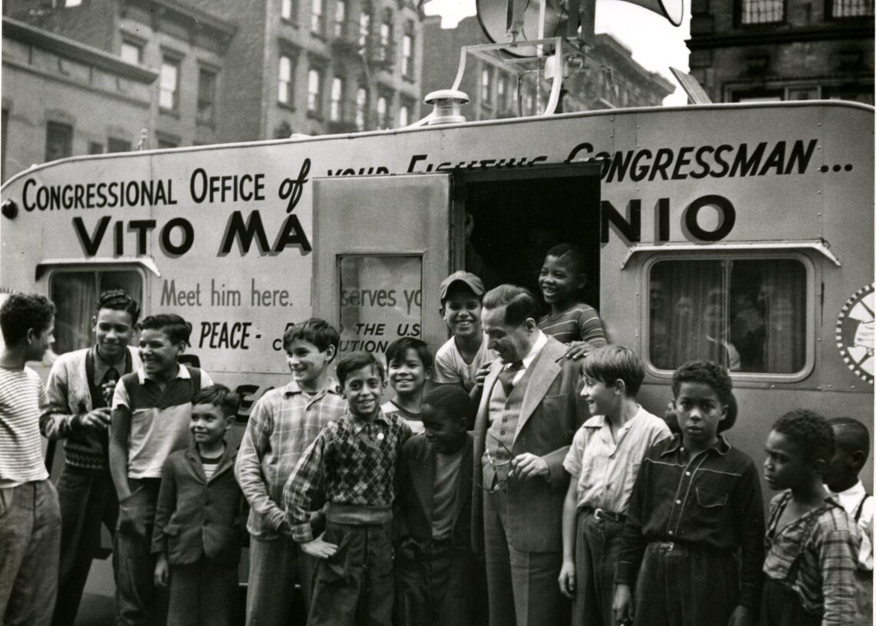
Marcantonio with local children in Harlem in front of campaign trailer

Slide 18
Vito Marcantonio Against Taft-Hartley Act in Congress
“What is your justification for this legislation?” A labor union, he explained, is a worker’s “only defense against exploitation,”
“You are making him “free”—and impotent to defend himself against any attempt by industry to subject him to the same working conditions that existed in the United States 75 years ago. You are giving him the freedom to become enslaved to a system that has been repudiated in the past not only by Democrats but also by outstanding progressive-minded Republicans….Under the guise of fighting communism you are, with this legislation, advancing fascism on American labor.”

Slide 19
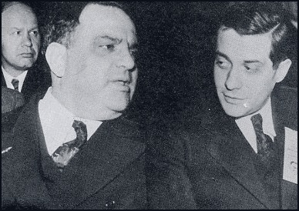
Marcantonio (Right) next to NYC Mayor Fiorello LaGuardia (another progressive politician)

Slide 20
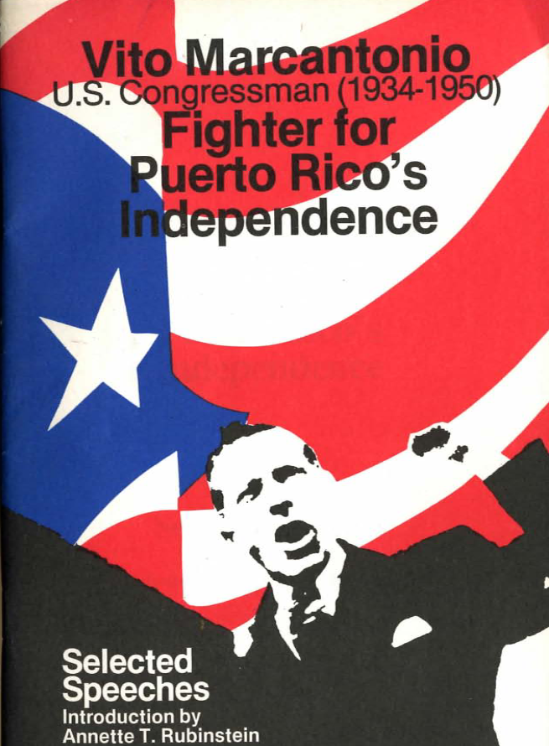
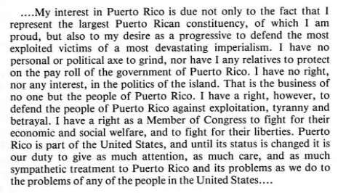
Vito Marcantonio’s Politics
Speech on Puerto Rico given in 1939:

Slide 21
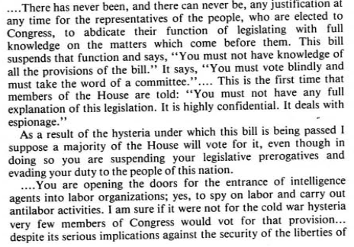
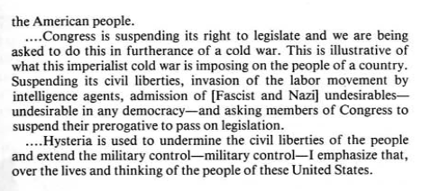
Vito Marcantonio speaks against founding of the CIA - March 7, 1949 to the House.

Slide 22
Discussion

Slide 23
Marcantonio, the Korean War, and Later Life

Slide 24
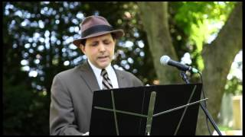
Vito Marcantonio - Opposition to
Korean War Speech

Slide 25
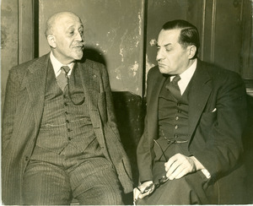
Vito Marcantonio Later Years
In 1950 he successfully defended W.E.B. DuBois against the U.S. government's charge that DuBois had failed to register as the agent of a foreign power.
He also acted as one of the attorneys for the U.S. Communist Party in hearings before the Subversive Activities Control Board.
In 1954 he announced his return to politics as an independent candidate for his old seat, but died before he could begin his campaign.

Slide 26
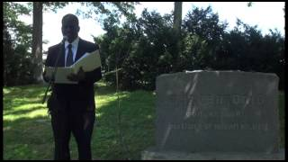
Paul Robinson’s Eulogy of Vito Marcantonio

Slide 27
Discussion & New Members Introductions

Slide 28
New Member Introductions
What is your name, pronouns and state (or country/territory)?
Where do you work? Is it unionized?
How did you find out about the People’s School?
What do you think about tonight's class?

Slide 29
Discussion & Wrap Up

Slide 30
Announcements
PSUSA Cell Chairs need to call members of their cells to remind them about attendance.
The PSMLS will be off on the week of December 23-27th for the Holidays.

Slide 31
Volunteers Needed!
We are in need of volunteers for the staff of the People’s School! Here’s a few roles we need filled:
People to help manage posting on our social media and podcast platforms
Video Editors, Audio Editors, Graphic Designers, Artists, Narrators
Facilitators, Web Controls, Moderators
Email info@peoplesschool.us if you’re interested and try to attend our next staff meeting if possible.

Slide 32

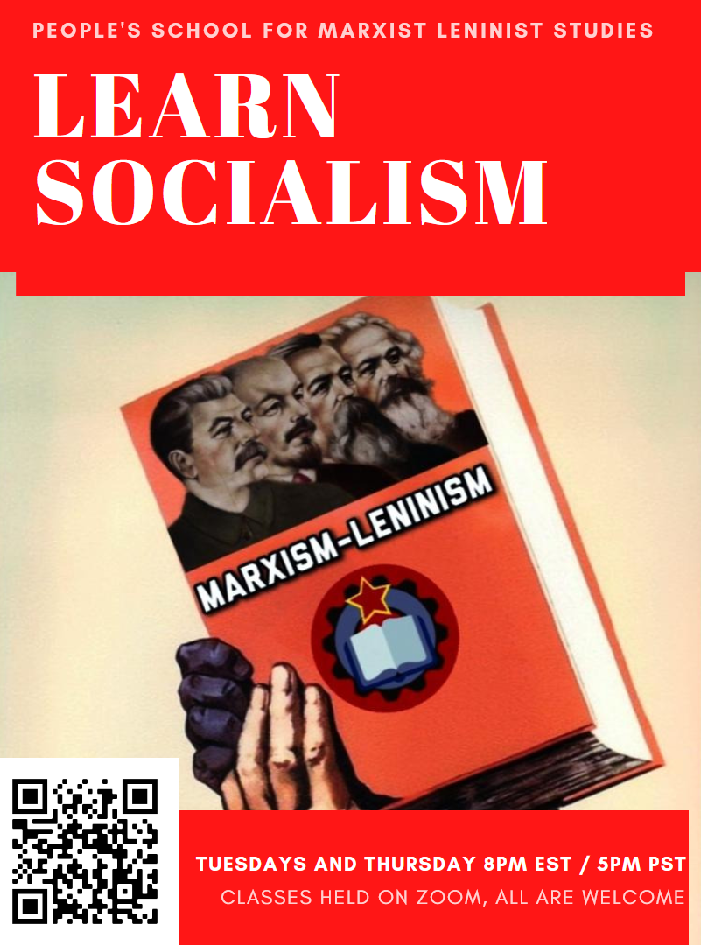





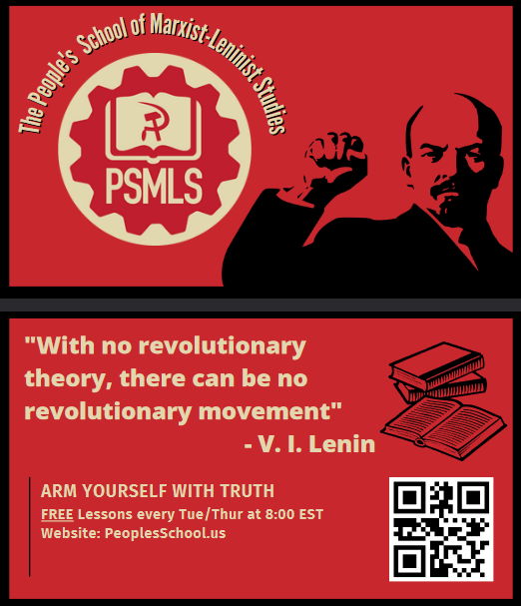

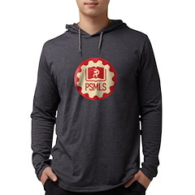
PSMLS Propaganda
peoplesschool.us/media & peoplesschool.us/store
Materials to help promote the school!

Slide 33

View From Left Field
https://viewfromleftfield.libsyn.com
The Old PSMLS Youtube is now the Youtube of View From Left Field, a podcast of analysis and discussion of current events from a progressive perspective.
Like the Youtube videos and subscribe with 5 star ratings on your podcast platforms.

Slide 34

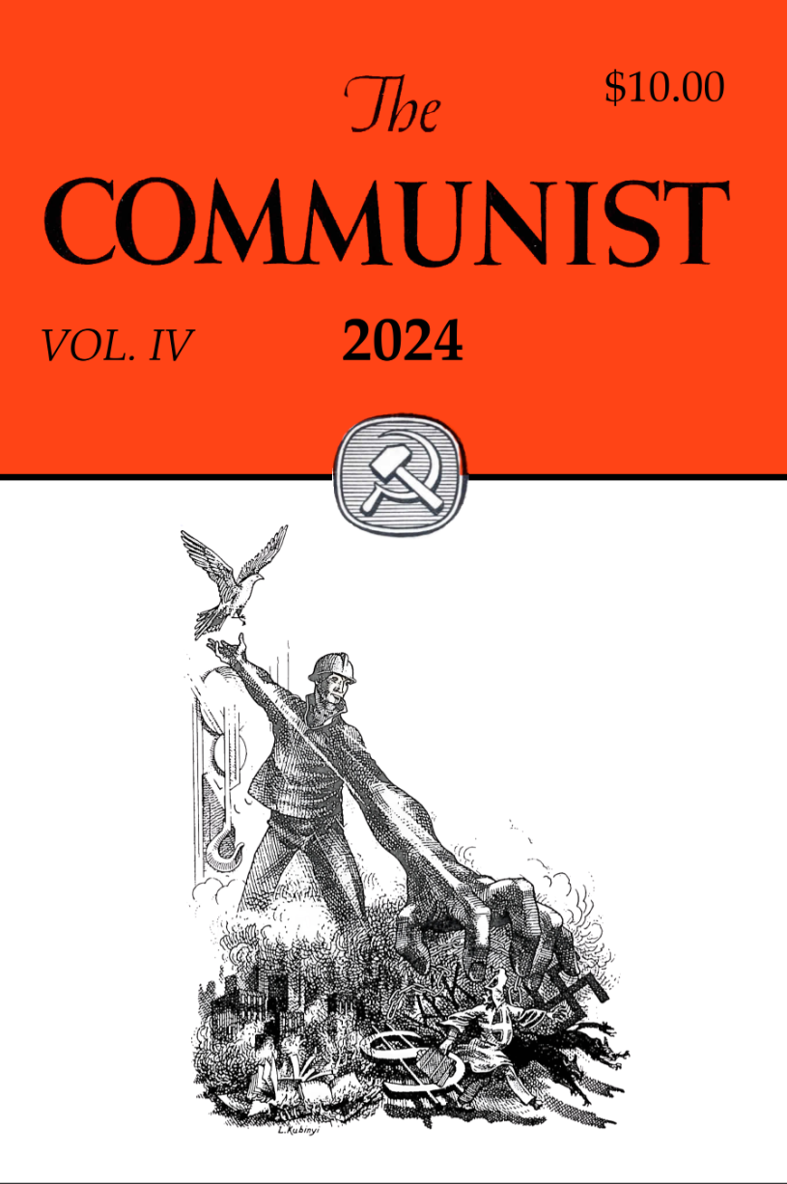
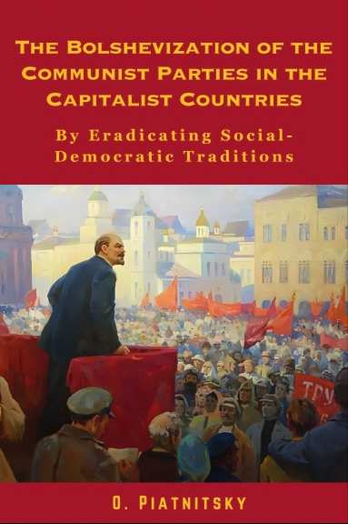


New Outlook Publishers
newoutlookpublishers.store
Latest Releases

Slide 35


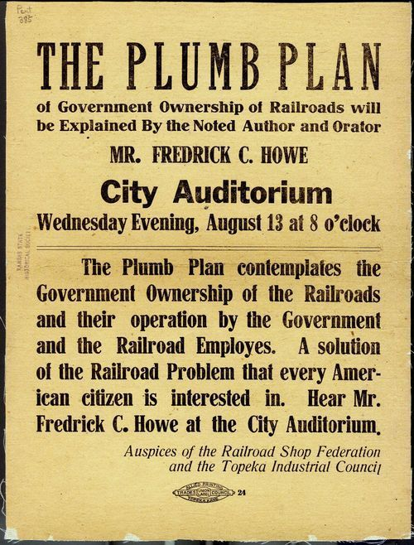
Harry Bridges School of Labor
luel.us/laborschool/
The Harry Bridges School of Labor is a monthly class held 2x per month. Classes cover a variety of topics aimed at building class conscious among union members.
January’s class is “The Plumb Plan” as a sequel to the class on Public Rail Now. Class will be January 8, 2025 at 9pm EST/6pm PST and Saturday January 11, 2025 at 7pm EST/4pm PST.

Slide 36
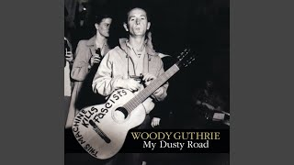
Gonna Roll the Union On - Woody Guthrie

