Slide 1


Which Side are You On? By Pete Seeger

Slide 2
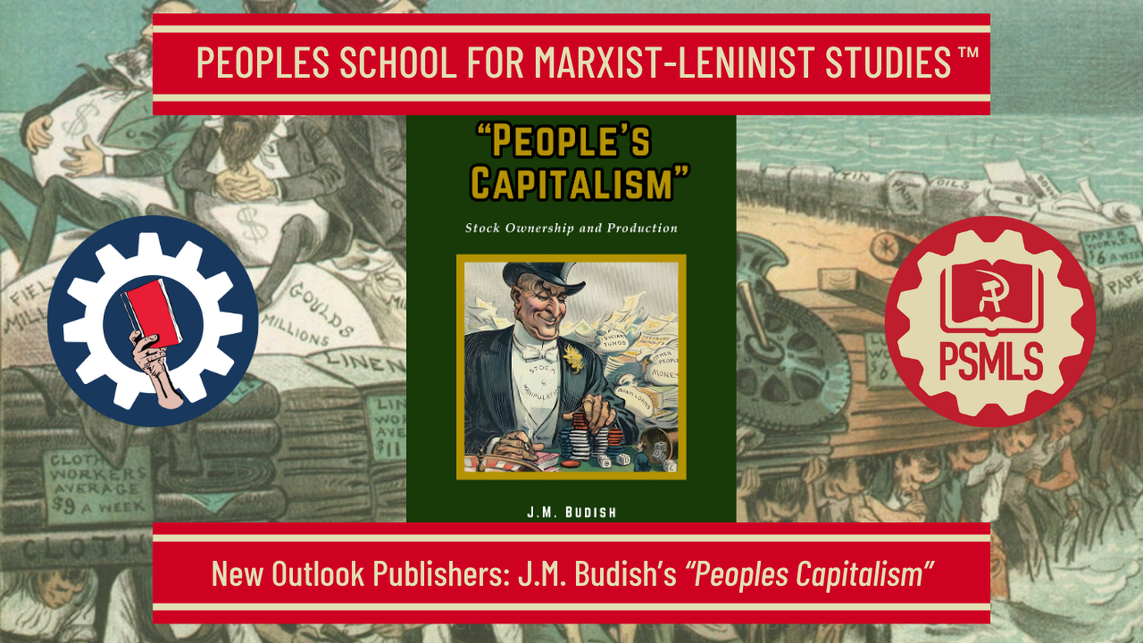
PSMLS 9/22/26

Slide 3
What we’ll be learning today:
Background and Review of People’s Capitalism
Chapters I & II
Chapters III & IV

Slide 4
Background and Review of People’s Capitalism

Slide 5
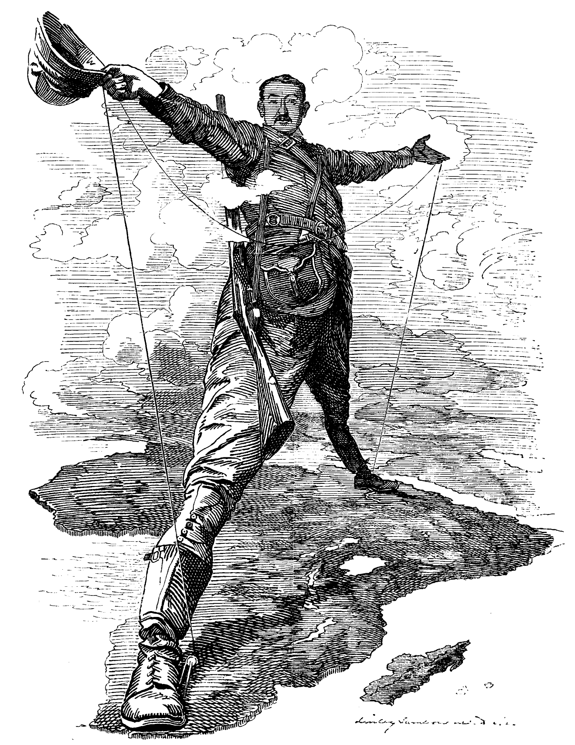
Imperialism and the Split in Socialism
Imperialism is a specific historical stage of capitalism. Its specific character is threefold: imperialism is monopoly capitalism; parasitic, or decaying capitalism; moribund capitalism.
Imperialism, as the highest stage of capitalism in America and Europe, and later in Asia, took final shape in the period 1898–1914.

Slide 6
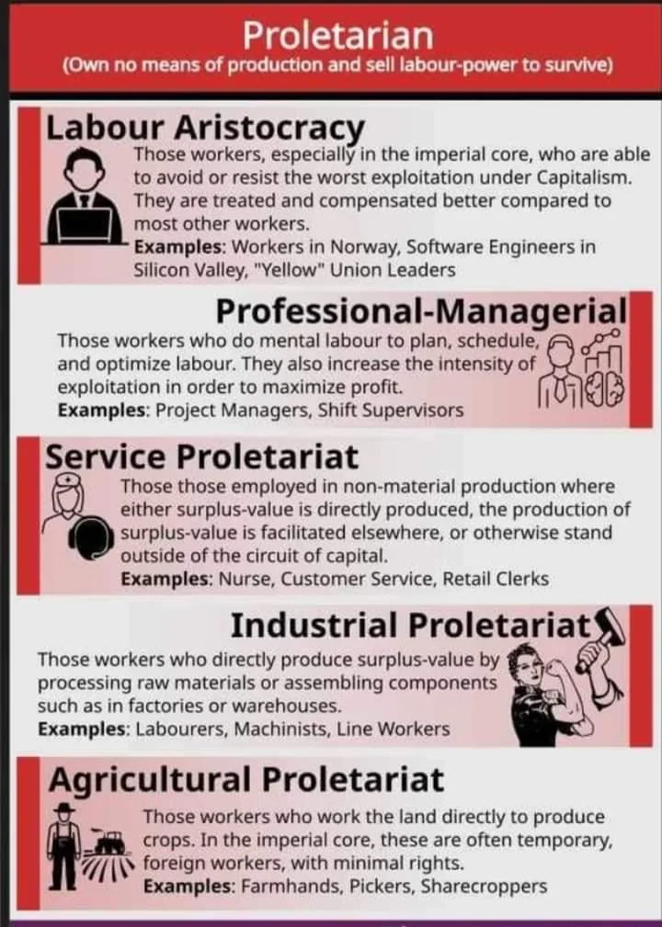
Imperialism and the Split in Socialism
What is labor aristocracy?
Two sets of circumstances, in Hobson's opinion, weakened the power of the old empires: (1) "economic parasitism", and (2) formation of armies from dependent peoples. "There is first the habit of economic parasitism, by which the ruling state has used its provinces, colonies, and dependencies in order to enrich its ruling class and to bribe its lower classes into acquiescence."

Slide 7
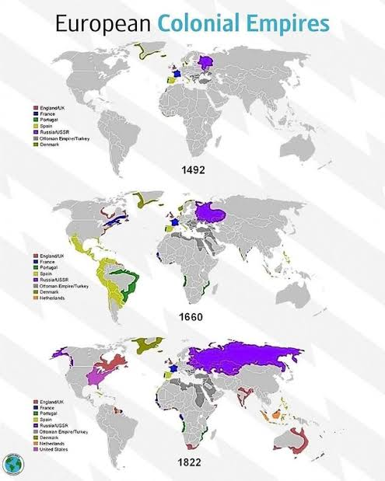
Imperialism and the Split in Socialism
We have foreshadowed the possibility of even a larger alliance of Western states, a European federation of Great Powers which, so far from forwarding the cause of world civilisation, might introduce the gigantic peril of a Western parasitism, a group of advanced industrial nations, whose upper classes drew vast tribute from Asia and Africa, with which they supported great tame masses of retainers, no longer engaged in the staple industries of agriculture and manufacture, but kept in the performance of personal or minor industrial services under the control of a new financial aristocracy.

Slide 8
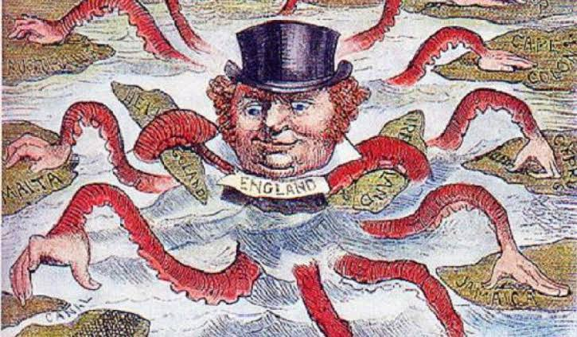
Imperialism and the Split in Socialism
Both in articles and in the resolutions of our Party, we have repeatedly pointed to this most profound connection, the economic connection, between the imperialist bourgeoisie and the opportunism which has triumphed (for long?) in the labour movement. And from this, incidentally, we concluded that a split with the social-chauvinists was inevitable.

Slide 9
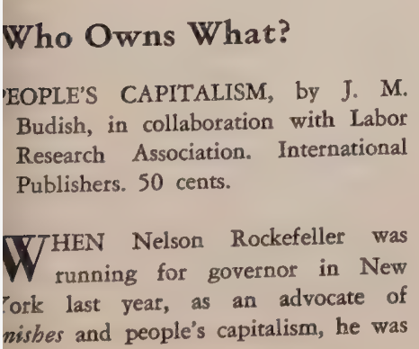
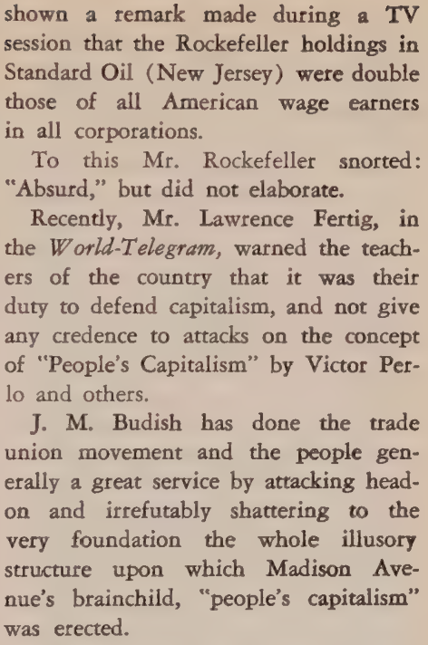
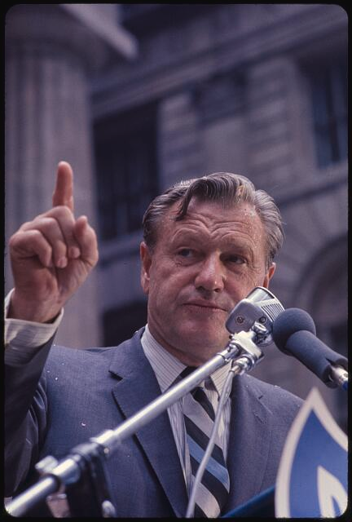
Victor Perlo’s Review of “People’s Capitalism”

Slide 10
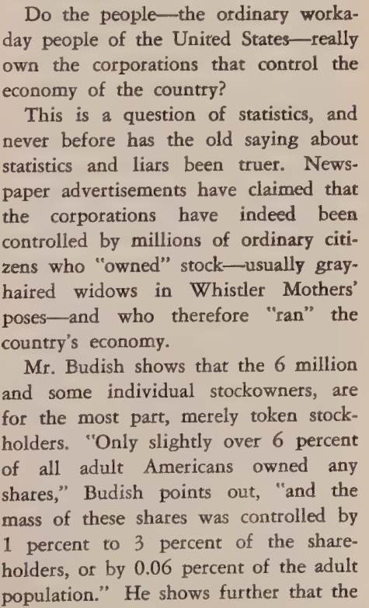
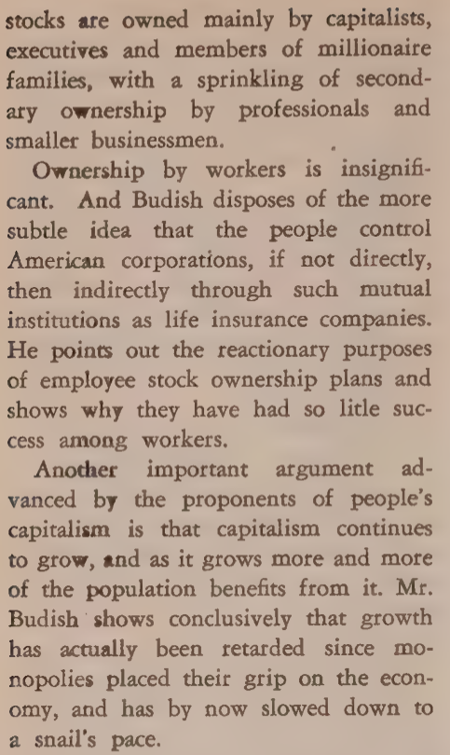

Slide 11
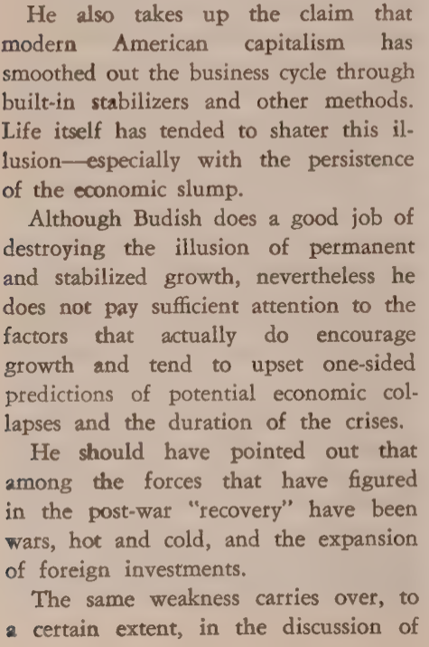
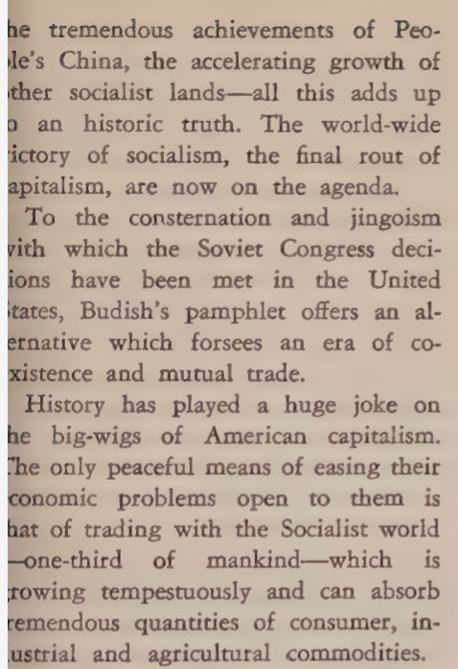

Slide 12
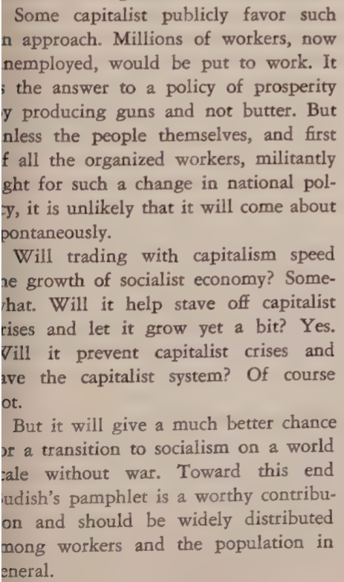
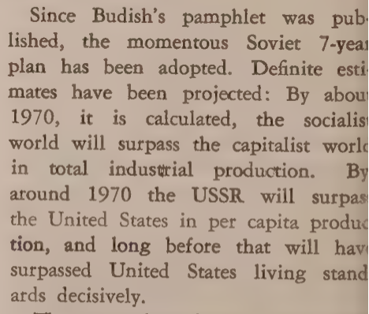

Slide 13
Discussion & New Members Introductions

Slide 14
New Member Introductions
What is your name, pronouns and state (or country/territory)?
Where do you work? Is it unionized?
How did you find out about the People’s School?
What do you think about tonight's class?

Slide 15
Chapters I & II

Slide 16
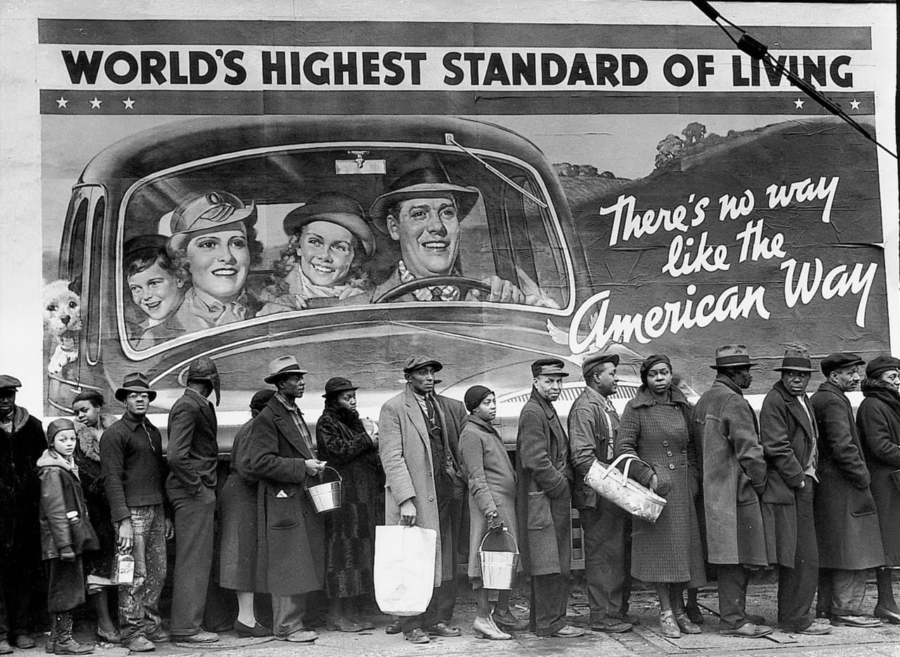
The Myth of “People’s Capitalism”
There has been much said about the American economic system as‚ “People’s Capitalism.” Two world wars, several lesser economic crises and recessions, and the Great Depression —all in one generation— so discredited the capitalist economy that its spokesmen no longer considered it possible to “sell it under its own label.”
In a pamphlet titled American Capitalism written by a Professor, Massimo Salvadori, and praised effusively by then President Eisenhower, it was admitted: “There are in fact few people in Europe or Asia who will stand for capitalism of the American variety... To the educated European or Asian, capitalism— represents mainly crises, instability, unemployment, war and imperialism.”
But the professor proceeds to assure us that, while these concepts may be true of old-style European capitalism, they are not characteristic of U.S. capitalism today, which should be designated by some special and clearly distinguishing name. Designing an effective “selling” label for capitalism, however, has not been a simple matter. The “creations” of the resourceful advertising writers of the 30’s and 40’s— “The American System,” “The American Way of Life,” “The Free Enterprise System,” “The Individual Enterprise System”—did not satisfy the client corporations.

Slide 17
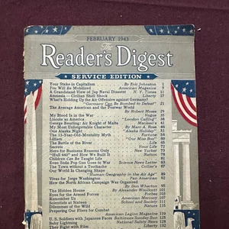
“We Fear” That Capitalism is “Unpopular”
Eric A. Johnston, then president of the Chamber of Commerce of the United States, expressed this dissatisfaction (in February 1943) in an article in Reader’s Digest:
“We fear that word capitalism is unpopular. So we take refuge in a nebulous phrase and talk about the “Free Enterprise System.” And we even run to cover in the folds of the flag and talk about the ‘American Way of Life.’ Such language dangerously obscures the main issue. You cannot take a whiff of ‘free enterprise’ or a stretch of a ‘way of life’ and start a factory with it. To start a factory ... you have to have capital. People will never understand this point unless we say capitalism.”

Slide 18

Admitting the State of the Workers Under Capitalism
A pamphlet, People’s Capitalism, published by the U.S. Information Agency (a federal propaganda organization operating in foreign countries) for distribution abroad, admits with disarming modesty that:
“Capitalism in the United States went through a period when the general welfare was often neglected, when great fortunes were amassed while the workers were overworked and underpaid.” But, we are told, “This belongs in the historical past. Today's picture is a different one.”
One may ask, however, when and how this rapacious capitalism changed into the alleged benevolent capitalism of today? What structural changes have taken place, presumably transforming the old system, that was admittedly neglectful of the general welfare, into the alleged new “People’s Capitalism?”

Slide 19
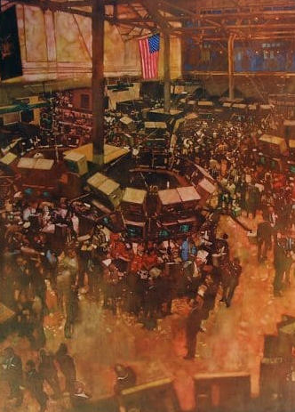
Stock Ownership as Distribution of Production
At the visitors’ gallery that overlooks the trading floor of the New York Stock Exchange, where millions of shares are bought and sold each day, there was a great sign reading NEW YORK STOCK EXCHANGE—CORNERSTONE OF A PEOPLE’S CAPITALISM.
Under that sign there are a number of rotating cardboard panels with the following legends:
“Two Significant Developments Sparked Our Democratic Capitalism—Division of Corporate Ownership Into Shares and Stock Exchanges Where These Shares Can Be Traded.‛”
“Our National Corporations Are Owned by Millions of People.‛”
“Share Owners Are Increasing at the Rate of 500,000 a Year.”
So here are the structural changes involved in the so-called‚ democratic people’s capitalism: One, the division of the capital of industrial and other corporate enterprises into shares; Two, the functioning of stock exchanges where these stocks can be bought and sold. However, if we are to truly assess the distribution of the means of production in the U.S. we must consider how widespread the ownership of stocks actually is.
New York Stock Exchange
by Bernie Fuchs in 1992

Slide 20
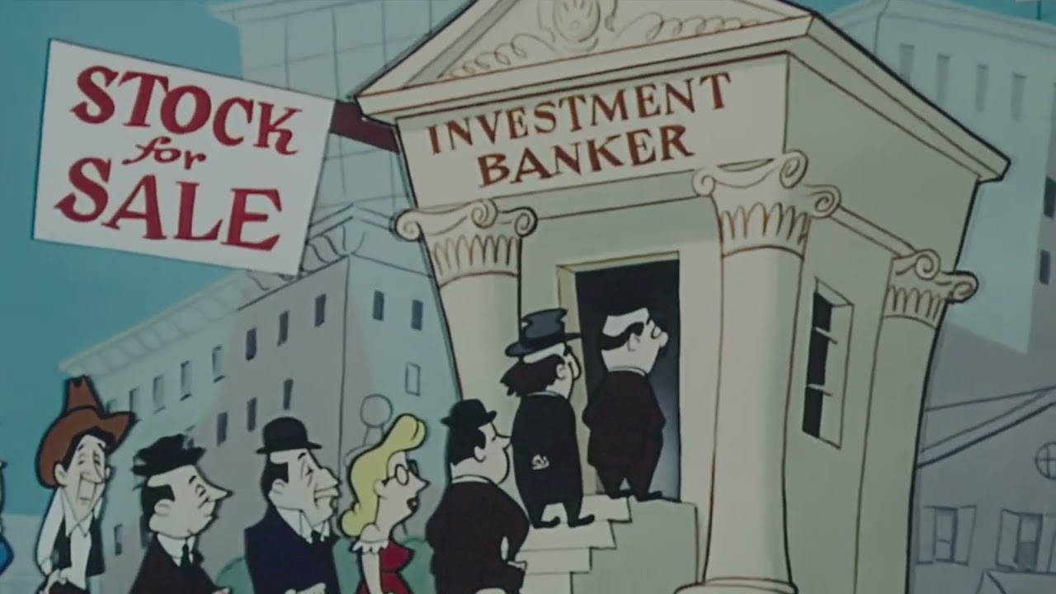
Stock Options Give the Workers No Leverage
In 1952, Brookings found the total number of shareholders in all companies whose shares are quoted on the various stock exchanges was 6,490,000. In other words, only slightly over 6% of all adult Americans owned any shares, and the mass of these shares was controlled by 1% to 3% of the shareholders, or by 0.06% to 0.18% of the adult population. Thus, the effective shareholding control of the U.S. economy is concentrated in the hands of a tiny monopolistic class ranging, for the various branches, from two persons in every thousand to one person in every two thousand adults. The other millions of shareholders own an average of approximately four shares per stockholder. This, of course, gives them no voice whatever in the control of the economy.
This Image is Clipped from a 1952 film by John Sutherland Productions describing the Operation of the New York Stock Exchange

Slide 21

A Cultivated Illusion
The insignificance of stock ownership by wage earners is spelled out by Victor Perlo in an article in American Economic Review with estimates that the Rockefeller, the Du Pont and the Mellon family groups, each separately in 1956, “owned many times as much stock as all the wage earners in the United States. Indeed, the market value of Rockefeller holdings in a single corporation, Standard Oil of New Jersey, was twice the market value of all the holdings of all American wage earners.”
Professor C. Wright Mills of Columbia University, could not escape the conclusion that “The idea of a really wide distribution of economic ownership is a cultivated illusion: at the very most, 0.2 or 0.3 percent of the adult population own the bulk, the pay-off shares of the corporation world.”
Victor Perlo - an American Marxist economist, government functionary, and a longtime member of the governing National Committee of the Communist Party USA

Slide 22

Employee Stock Ownership Schemes
The promoters of “People’s Capitalism” myths lay special stress on employee stock purchase plans that have recently been sprouting again. And it is the biggest corporations which have taken the lead in these schemes. The biggest monopoly in the field of electrical equipment (at the time), General Electric Co., ran a full-page ad in the Wall Street Journal, May 13, 1957 headlined “People’s Capitalism.” It says that in addition to the many “customers, suppliers, dealers, or neighbors in our plant communities,” who are the “Company’s owners,” there are also some 129,000 of the men and women who work at General Electric, who are “owners” or becoming “owners”. And GE asks you to draw the conclusion that in America‚ “nearly every citizen is a capitalist.” Such a starry-eyed view is wishful thinking. In fact, some executives are even alarmed lest their workers take this propaganda too seriously. As one of them cautioned, “They (the workers) might start really thinking it’s their company.” Actually, hard-headed Big Business has designed these “shareownership” plans as a sort of minor fringe benefit to stave off substantial demands (like that for Supplementary Unemployment Benefits, etc.) and to influence them in a desired direction.

Slide 23

Other Enticements are Necessary
The latest drive by Big Business to induce employees to buy corporate stock requires a still stronger appeal than was used in earlier campaigns. As Business Week noted:
“It isn’t enough, any more, simply to establish a mechanism for the workers to buy stock without paying brokerage fees— and then preach the glories of owning ‘a piece of American prosperity.’ Other enticements are necessary to capture the employee’s imagination.”
What new blandishments do the present programs offer the workers? There is an endless variety of details. But all of them hold out some kind of promise to turn employees into “owners” and to protect them against losses even in a declining market. All programs impose on the employees a compulsory saving plan through regular deductions from the payroll mostly from 1% to 5% (depending on earnings and length of service) for a specified period, mostly three to five years, with the employee acquiring title to the stock at the end of that period

Slide 24

False Progress Measured in Centuries
The official statement of Standard Oil Co. (NJ) carried by the New York press, May 28, 1957, said that 1956 was the very best year for its Plan in terms of number of shares subscribed for by its employees. During that year they increased their holdings by 600,000 shares. This included shares acquired by the supervisory staff and members of management. Even so, and on the untenable assumption that once acquired the workers and other employees would never be forced by emergencies to sell their shares, especially during periods of recurring unemployment, it would still take 170 years for employees to buy up a majority of the outstanding shares of this corporation! And if we made allowance for the portion of the shares that were acquired by members of the management and supervisory staff, the period needed for Standard Oil employees to acquire a majority of the stock would have to be extended to several centuries! This is equally true of all the other Plans, except that in most cases it would take a still longer period for the workers to buy up a majority of the stock of their respective giant enterprises.

Slide 25
A Psychological Weapon Against the Masses
To an increasing extent the billionaire corporations are now designing their stock ownership programs not only as a means of sapping union solidarity but also as tools in their campaigns for better “public relations.” A 1956 study by the National Industrial Conference Board, a major private U.S. business research organization, found that the prime objective of any effective public relations program is to create a “good name” or “acceptance” for the company and its products, with a view to increasing its profits. And sometimes the objective is broadened to include better “acceptance” of the entire “free enterprise” system. A study by Rudolph Sobernheim and William Brown in the Columbia Law Review reported that “employers have become more conscious of the need to gain acceptance among their employees of business enterprise as an institution.” Developments since World War II have shown that the Soviet Union and other socialist countries can and do significantly increase production without benefit of the profit incentive of private enterprise (see final section of this pamphlet). This fact tends to shake the people’s faith in the immutability and superiority of capitalism. It is not surprising, therefore, that the motives of the corporations in pushing their new stock plans frankly include, as the Columbia Law Review writers put it, the “desire to strengthen the workers’ attachment to the present economic system.”

Slide 26
Discussion

Slide 27
Chapters III & IV

Slide 28
Chapter III. Economic Growth Under Capitalism
On November 16 and 17, 1956, a panel for the discussion of ‚People’s Capitalism‛ was held in New Haven, Conn., under the sponsorship of Yale University and the Advertising Council. The purpose, as announced in the American Round Table report called People’s Capitalism, which gave a digest of the discussion, was to help make clear ‚the new, unique and vital economic system which has evolved in America.‛ It attempted also to reach conclusions on ‚the manner in which the American form of capitalism differs from older (and less enlightened) forms.‛ In the course of this discussion the college professors and others who participated did not follow the line of argument which we have analyzed in the first part of this pamphlet. In fact, they went so far as to admit that ‚widespread ownership of capital, though significant, is not an essential feature‛ of People’s Capitalism.

Slide 29
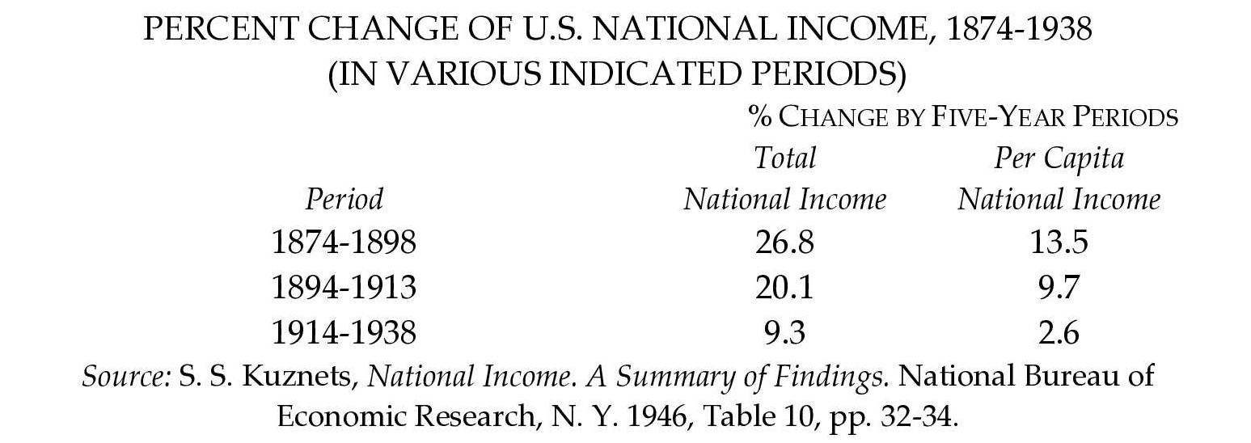
Trend of Growth, Past and Present
A careful statistical study by the National Bureau of Economic Research of the rate of growth of total and per capita national income since the early 1870’s, and up to the eve of World War II (1938), reached telling conclusions, summarized in the following table:

Slide 30
Atomized but interdependent production
This retarded growth of the U.S. economy has not just happened. It has not been due to any special adversities. It has come about as an inescapable result of the inherent characteristics of capitalism in the course of its progressive concentration and monopolization Capitalist production is interdependent, and in the course of the expansion, concentration and centralization of the economy this interdependence increases. In the present stage of capitalism many thousands of workers will be employed to produce the output of a single great enterprise. The average number of men and women employed, for instance, by the U.S. Steel Corp, in 1957, was 271,037. But each individual business, however big, in its turn depends on the production and demand of many other private businesses. For example, a big can and container-producing enterprise may employ thousands of workers in a number of plants.

Slide 31
Disproportions and Imbalances
Under these conditions disproportionate development of output between individual industries and branches of the economy is inescapable, particularly between industries producing machinery, equipment and other capital goods and industries turning out durable and non-durable goods for the consumer! Capitalist businessmen, in the words of the National Association of Manufacturers, ‚look, therefore, to marketing experience to ascertain what goods shall be produced, and when and how much.‛
The relative overproduction and instability of capitalism are aggravated by another inherent deficiency—the fact that the pursuit of profit and not any socially useful end is the only motive involved. And the drive for the maximum possible profits results in the piling up of greater and greater aggregate profits by the capitalist owners of industry. The rise in corporate profits in the U.S. illustrates this trend.

Slide 32
Accumulation of Inventories
As a result of this situation an increasingly larger part of the output accumulates as unsold inventories. Before World War II, total business inventories amounted to $20.1 billion; in 1943, they reached $31.3 billion; in the first post-war peace year, 1947, they increased to $50.6 billion, and then kept on rising except in 1949 and 1954, the years of business slumps. By August, 1957, they exceeded $91 billion.
Upholders of the capitalist system have claimed that since the Great Depression ‚a revolutionary change‛ has taken place in the American economy. It is contended that a remodeled ‚People’s Capitalism‛ has been supplied with so-called built-in stabilizers, such as unemployment benefits, Social Security, price supports for farmers, as well as plans for deficit spending. Government monetary and fiscal (credit control and taxation) policies plus various welfare programs have allegedly insured the U.S. economy against violent business fluctuations and have practically eliminated the danger of another serious economic crisis or depression.

Slide 33
Monopoly and the Profit Motive
In the early stages of U.S. capitalism, profit was a significant factor of economic growth. So long as free enterprise and ruthless competition were still effective realities, the profit motive did provide an incentive for innovation and technological improvement, making possible cost reduction and increased profit, but requiring mass production on an ever larger scale. The drive for more and more profits, under unrestrained competitive conditions, therefore, was an accelerator contributing to a rising rate of multiplication or to economic growth.
But that very process led to the elimination of the technologically poorer-equipped and weaker enterprises, to the growing accumulation of profits and capital, and increasing concentration of production in a smaller number of the largest and strongest enterprises. Under these new conditions the profit motive leads to operation at less than capacity, thus slackening the rate of economic growth. To illustrate, let us take an example supplied by the National Association of Manufacturers, whom nobody will suspect of an anti-profit bias.

Slide 34
Squeezing out Free Enterprise
Under present conditions, when each major industry is controlled by a few companies, operating within it, ‚free enterprise has ceased to be an important competitive factor except in a small and declining segment of the economy.
It is now two decades since Franklin D. Roosevelt, in a message to Congress in 1938, warned the American people that, ‚Private enterprise is ceasing to be free enterprise and is becoming a cluster of private collectivisms; masking itself as a system of free enterprise after the American model it is in fact becoming a concealed cartel system after the European model.‛ (A cartel is a combination of big private enterprisers, the largest business corporations, to eliminate competition by a formal agreement for control of output, markets and prices.)

Slide 35
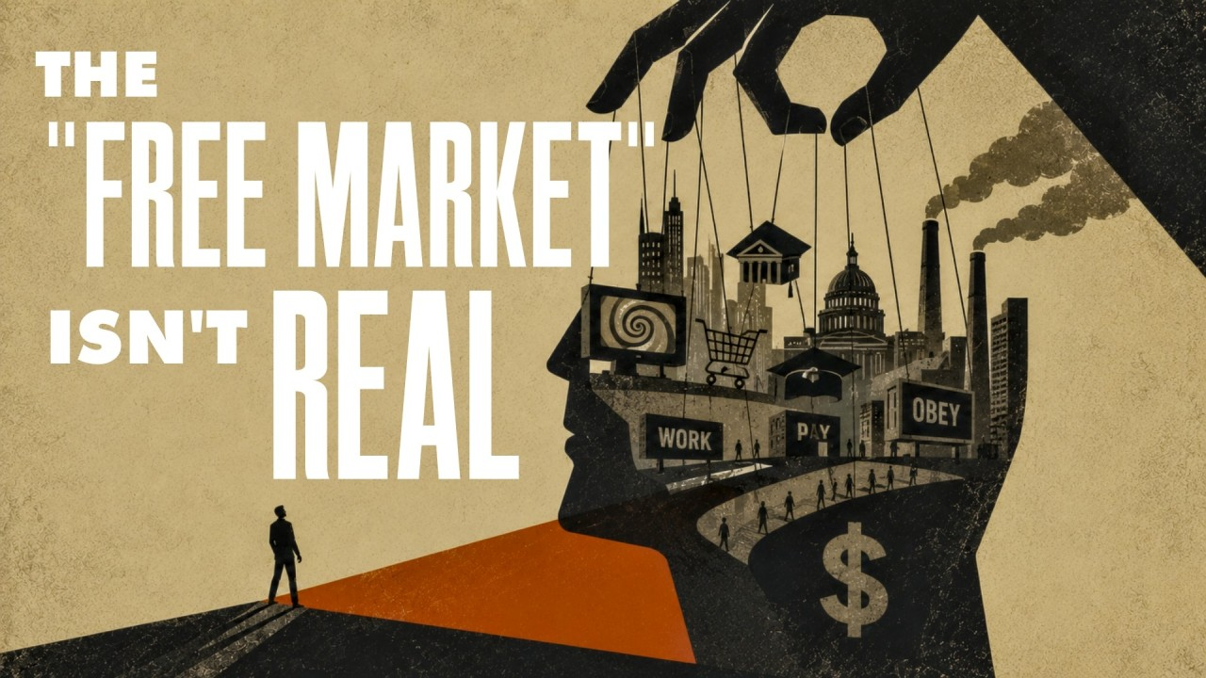
Contradiction 1: “Free” Enterprise isn’t Free
Capitalist production is interdependent, and in the course of the expansion, concentration and centralization of the economy this interdependence increases.
In the present stage of capitalism many thousands of workers will be employed to produce the output of a single great enterprise.
In making such decisions the owner is motivated exclusively by the incentive to make the maximum possible profit.

Slide 36
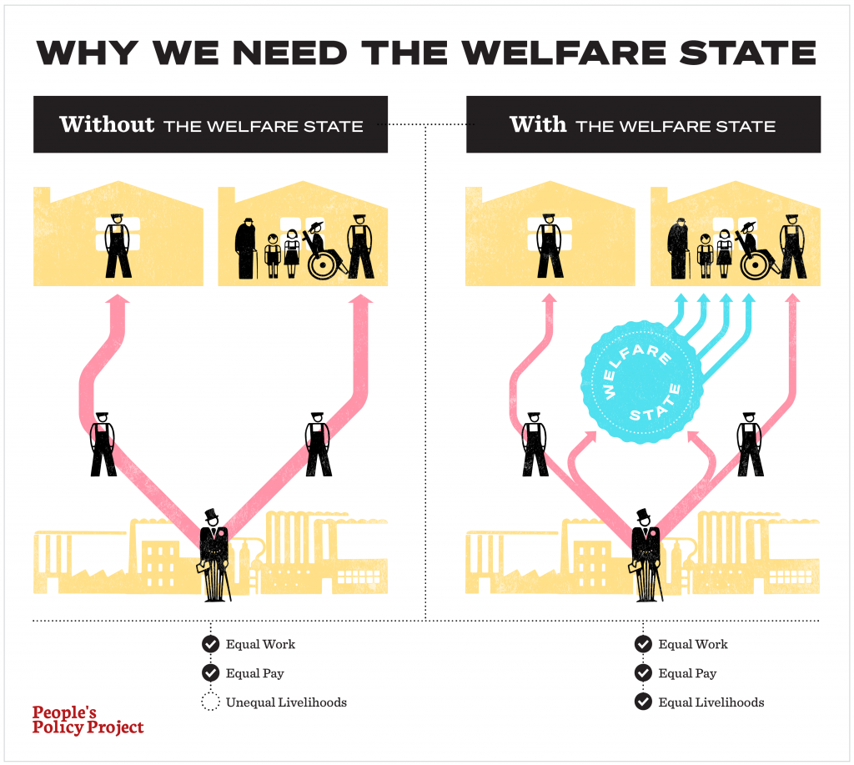
Contradiction 2: Reforms Never Change the Conditions
Welfare-state programs, including compulsory state unemployment insurance, were in effect in Great Britain and Germany long before they were introduced in the United States. As early as 1911 in Great Britain and 1927 in Germany, fully 75% of all wage-earners in each of these two countries were covered by unemployment insurance laws.
Much more important is the simple fact that the Employment Act of 1946, plus the so-called built-in stabilizers, did not change the inherent nature of U.S. capitalism.
So long as these fundamental characteristics remain unchanged, instability of the economy with recurrent business contractions and expansions, boom and bust, are the inescapable pay-off.
The economy must first regain the losses it suffered during the recession before it can make any further progress.

Slide 37
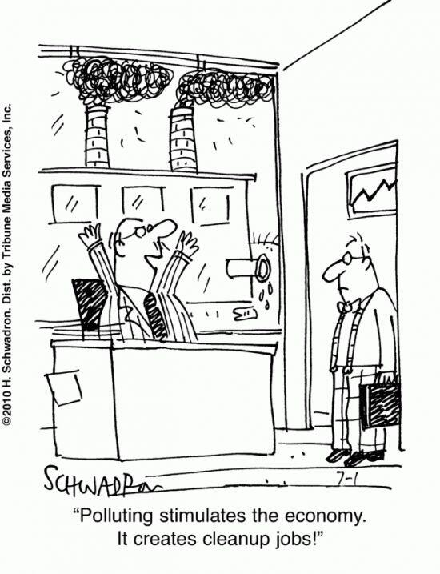
Contradiction 3: Competition Isn’t Profitable Enough
The spokesmen of capitalism, even while making every effort to sell it under the label of ‘People’s Capitalism,” tell us that profit is “the one thing our economy must have to live and grow”.
In the early stages of U.S. capitalism, profit was a significant factor of economic growth. So long as free enterprise and ruthless competition were still effective realities, the profit motive did provide an incentive for innovation and technological improvement, making possible cost reduction and increased profit, but requiring mass production on an ever larger scale.
But that very process led to the elimination of the technologically poorer-equipped and weaker enterprises, to the growing accumulation of profits and capital, and increasing concentration of production in a smaller number of the largest and strongest enterprises.
Under these new conditions the profit motive leads to operation at less than capacity, thus slackening the rate of economic growth.

Slide 38
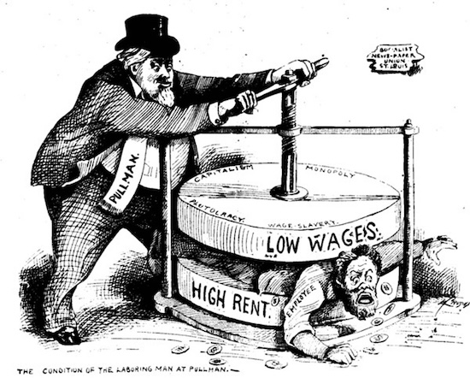
Monopolization of U.S. Economy
In 1955 out of a total of 365,000 industrial firms 41 the 500 largest corporations (less than one-seventh of 1 %) owned almost three-fifths (59%) of the total resources of all U.S. industries produced

Slide 39
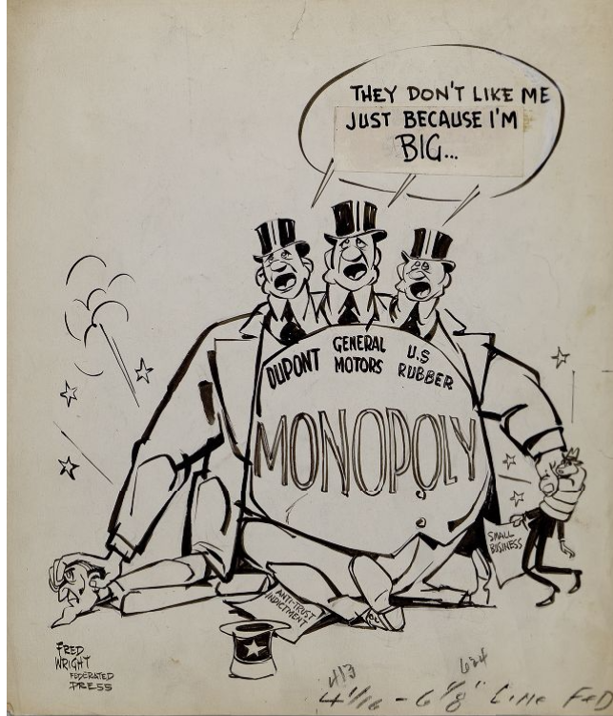
Contradiction 4: Anti-trust Laws Meaningless to Monopoly
Control by the giant corporations is not limited to such portions of the industries as they own outright. Very frequently they direct the activities and business policies and fix the prices of numerous so-called independent enterprises.
It may be objected that the U.S. anti-trust laws are supposed to ban cartel agreements to allocate markets, limit production, fix prices and the like.
Aside from the fact that these anti-trust laws were never effectively enforced to curb the powerful corporations, these business giants are in an excellent position to exercise their monopolistic control without entering into any formal cartel agreements.

Slide 40
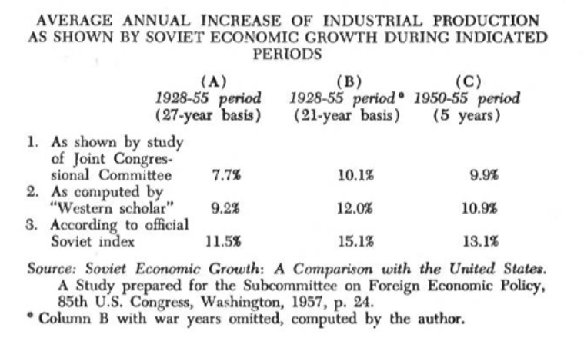
“…by its own bootstraps”
Predominantly a peasant country, it had to create and train a large working class, and from the development of its own resources and skills accumulate the capital for rapid expansion.
The average rates of growth of industrial output in the U.S. during the periods chosen by the Congressional committee’s study were as follows, according to their own official statistics.
During 1956 and 1957, and the first half of 1958 (preliminary), Soviet industrial output continued to increase at the rate of 11% per year, according to official Soviet statistics.

Slide 41
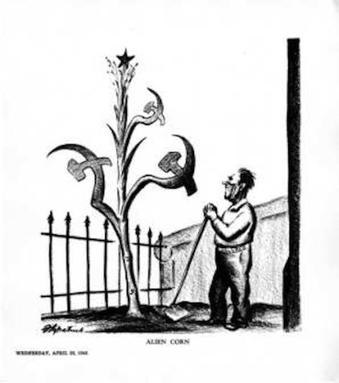
“Soviet Economic Growth: A Comparison with the United States”
The Congressional Joint Economic Committee was prepared by a staff of expert economists with the advice of specialists of the Departments of Agriculture, Commerce, Defense, Labor and State, and the Library of Congress.
But this study was apparently so greatly concerned lest it might unintentionally exalt the Soviet system that it went to great lengths to deflate all available statistics picturing Soviet economic growth.

Slide 42

Contrasts in Two Systems: Collective Planning
By contrast, the Soviet economic system has ended the private ownership of the means of production and the pursuit of private profit, thus making possible the mobilization of the resources and energies of the nation for socially useful ends (in the order of their relative urgency) with over-all collective planning.
The Socialist system thus enabled the Soviet people in but slightly more than two decades of peacetime progress (eliminating the years of civil war after the revolution and two world wars) to transform a backward, stagnant, nearly illiterate country into a dynamic advanced one with universal secondary education, and an extensive system of higher education, which has the highest standards in the fields of science, technology and culture, and with an economy that is now admittedly challenging that of the United States.

Slide 43

Social System and Human Institutions
The crux of the situation is the social system of human institutions, and these cannot be isolated and applied only to one field of activity.
The ability to make correct decisions about what is important to achieve and then to motivate and organize the effort to achieve it, once it is based on socialism, cannot but be universally applied to all important endeavors.

Slide 44
Discussion & Wrap Up

Slide 45
Announcements
PCUSA Cell Chairs need to call members of their cells to remind them about attendance.
The next issue of New Masses (2026) has begun production. If you have art you want us to feature, email it to info@partyofcommunistsusa.net.

Slide 46
Volunteers Needed!
We are in need of volunteers for the staff of the People’s School! Here’s a few roles we need filled:
People to help manage posting on our social media and podcast platforms
Video Editors, Audio Editors, Graphic Designers, Artists, Narrators
Web Controls, Moderators
Email info@peoplesschool.us if you’re interested and try to attend our next staff meeting if possible.

Slide 47

View From Left Field
https://viewfromleftfield.libsyn.com
The Old PSMLS Youtube is now the Youtube of View From Left Field, a podcast of analysis and discussion of current events from a progressive perspective.
Like the Youtube videos and subscribe with 5 star ratings on your podcast platforms.

Slide 48

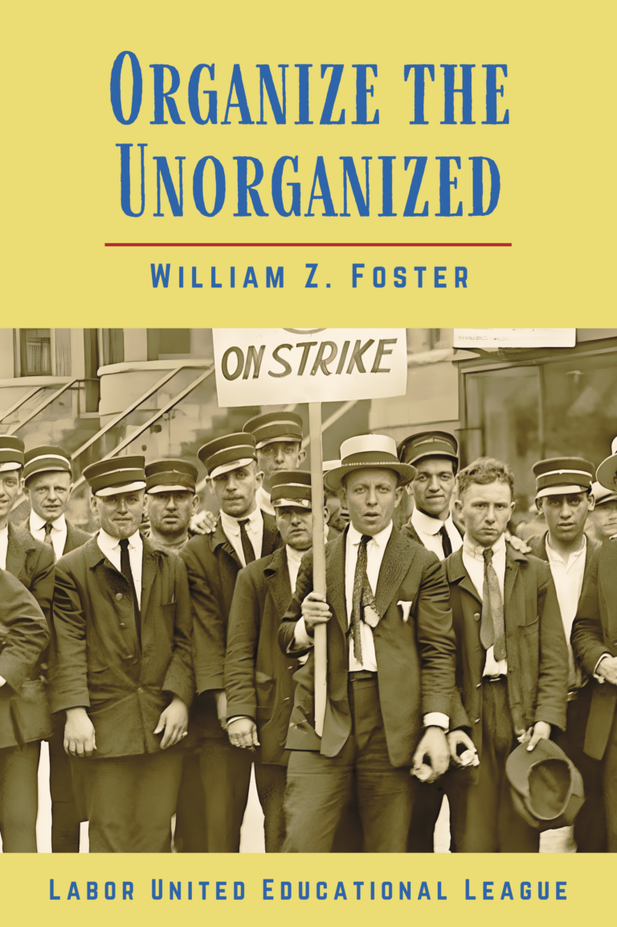

New Outlook Publishers
newoutlookpublishers.store
Relevant and Latest Releases

Slide 49



Harry Bridges School of Labor
luel.us/laborschool/
The Harry Bridges School of Labor is a monthly class covering a variety of topics aimed at building class consciousness among union members. For class schedule and other information, please visit the website at luel.us/laborschool.

Slide 50

Jewish
Peoples Schule
The Jewish Peoples Schule educates in fraternity along secular, progressive lines to our Jewish and non-Jewish friends to share and relate the historical struggles of the Jewish peoples to other peoples’ struggles against oppression.
Join us for Sukkot and “Which Way Israel?: Progressivism or Zionism” - September 26th, 2026 4:30 PM to 6:00 PM EASTERN.
Sign up by sending an email to info@ujpfo.org with subject “Sukkot”

Slide 51

Solidarity Forever - Pete Seeger

