Slide 1


The Internationale

Slide 2

PSMLS 9/29/26

Slide 3
What we’ll be learning today:
The Dialectical Method
The Materialist Theory
Proletarian Socialism

Slide 4
The Dialectical Method

Slide 5
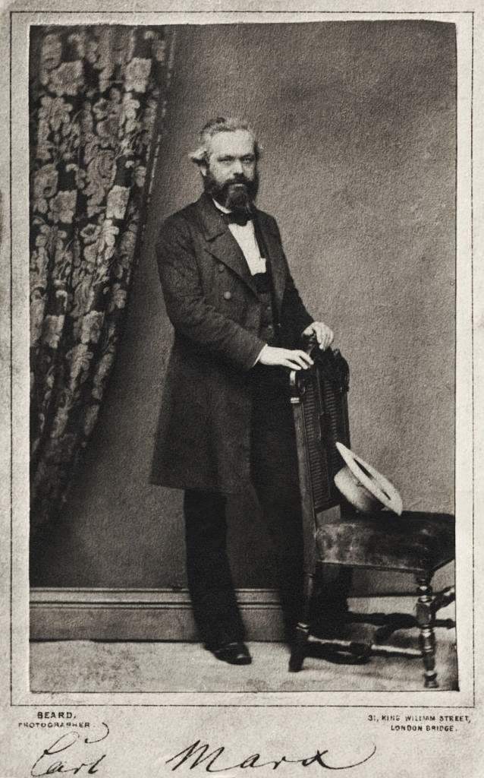
What is the Dialectical Method?
“Everything in the world is in motion. ... Life changes, productive forces grow, old relations collapse.” - Karl Marx
Marxism is not only the theory of socialism, it is an integral world outlook, a philosophical system, from which Marx’s proletarian socialism logically follows. This philosophical system is called dialectical materialism.
Hence, to expound Marxism means to expound also dialectical materialism. Why is this system called dialectical materialism?
Because its method is dialectical, and its theory is materialistic.
What is the dialectical method?
It is said that social life is in continual motion and development. And that is true: life must not be regarded as something immutable and static; it never remains at one level, it is in eternal motion, in an eternal process of destruction and creation. Therefore, life always contains the new and the old, the growing and the dying, the revolutionary and the counterrevolutionary.

Slide 6
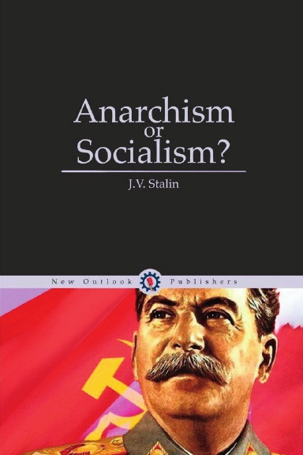
“All That Which Really Exists”
The dialectical method tells us that we must regard life as it actually is. We have seen that life is in continual motion; consequently, we must regard life in its motion and ask: Where is life going? We have seen that life presents a picture of constant destruction and creation; consequently, we must examine life in its process of destruction and creation and ask: What is being destroyed and what is being created in life? That which in life is born and grows day by day is invincible, its progress cannot be checked. That is to say, if, for example, in life the proletariat as a class is born and grows day by day, no matter how weak and small in numbers it may be today, in the long run it must triumph. Why? Because it is growing, gaining strength and marching forward. On the other hand, that which in life is growing old and advancing to its grave must inevitably suffer defeat, even if today it represents a titanic force. That is to say, if, for example, the bourgeoisie is gradually losing ground and is slipping farther and farther back every day, then, no matter how strong and numerous it may be today, it must, in the long run, suffer defeat. Why? Because as a class it is decaying, growing feeble, growing old, and becoming a burden to life. Hence arose the well-known dialectical proposition: all that which really exists, i.e., all that which grows day by day is rational, and all that which decays day by day is irrational and, consequently, cannot avoid defeat.

Slide 7
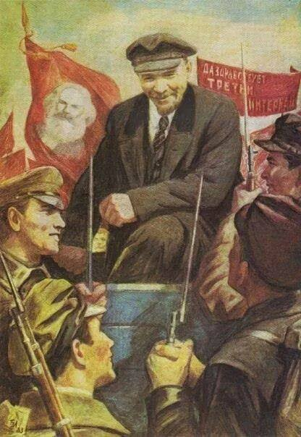
The Evolutionary and The Revolutionary Forms
As you see, the point is not which class today constitutes the majority, or which class is poorer, but which class is gaining strength and which is decaying. And as the proletariat is the only class, which is steadily growing and gaining strength, which is pushing social life forward and rallying all the revolutionary elements around itself, our duty is to regard it as the main force in the present day movement, join its ranks and make its progressive strivings our strivings. But there is movement and movement. There was movement in social life during the “December days,” when the proletariat, straightening its back, stormed arms depots and launched an attack upon reaction. But the movement of preceding years, when the proletariat, under the conditions of “peaceful” development, limited itself to individual strikes and the formation of small trade unions, must also be called social movement. And so, the dialectical method says that movement has two forms: the evolutionary and the revolutionary form. Movement is evolutionary when the progressive elements spontaneously continue their daily activities and introduce minor, quantitative changes into the old order. Movement is revolutionary when the same elements combine, become imbued with a single idea and sweep down upon the enemy camp with the object of uprooting the old order and of introducing qualitative changes in life, of establishing a new order.

Slide 8
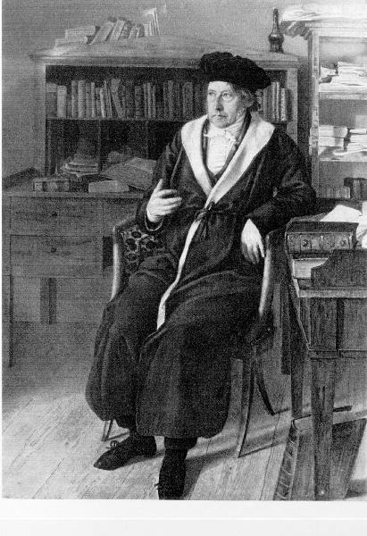
A Refutation of The Dialectical Method
How do the Anarchists look upon the dialectical method? Everybody knows that Hegel was the father of the dialectical method. Marx purged and improved this method. The Anarchists are aware of this, of course. They know that Hegel was a conservative, and so, taking advantage of this, they vehemently revile Hegel as a supporter of “restoration,” they try with the utmost zeal to “prove” that “Hegel is a philosopher of restoration . . . that he eulogizes bureaucratic constitutionalism in its absolute form, that the general idea of his philosophy of history is subordinate to and serves the philosophical trend of the period of restoration,” and so on and so forth. True, nobody contests what they say on this point; on the contrary, everybody agrees that Hegel was not a revolutionary. Marx and Engels themselves proved before anybody else did, in their Critique of Critical Criticism, that Hegel’s views on history fundamentally contradict the idea of the sovereignty of the people. But in spite of this, the Anarchists go on trying to “prove,” and deem it necessary to go on day in and day out trying to “prove,” that Hegel was a supporter of “restoration.” Why do they do this? Probably, in order by all this to discredit Hegel and make their readers feel that the “reactionary” Hegel’s method also cannot be other than “repugnant” and unscientific. The Anarchists think that they can refute the dialectical method in this way.
Julius Ludwig Sebbers painted Hegel’s “Schlafrockbild” in his office at home in Berlin in 1928

Slide 9
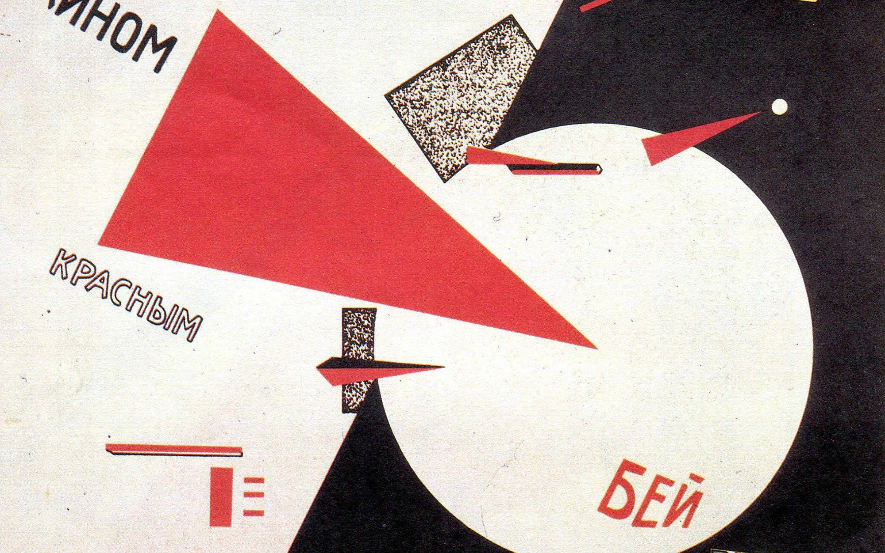
“Blame Others For Your Own Sins”
We affirm that in this way they can prove nothing but their own ignorance. Pascal and Leibnitz were not revolutionaries, but the mathematical method they discovered is recognised today as a scientific method. Mayer and Helmholtz were not revolutionaries, but their discoveries in the field of physics became the basis of science. Why, then, should the fact not be admitted that, in spite of his conservatism, Hegel succeeded in working out a scientific method which is called the dialectical method? In the opinion of the Anarchists, “dialectics is metaphysics,” and as they “want to free science from metaphysics, philosophy from theology,” they repudiate the dialectical method. Oh, those Anarchists! As the saying goes: “Blame others for your own sins.” Dialectics matured in the struggle against metaphysics and gained fame in this struggle; but according to the Anarchists, dialectics is metaphysics! Dialectics tells us that nothing in the world is eternal, everything in the world is transient and mutable; nature changes, society changes, habits and customs change, conceptions of justice change, truth itself changes—that is why dialectics regards everything critically; that is why it denies the existence of a once-and-for-all established truth. Consequently, it also repudiates abstract “dogmatic statements, which, once discovered, had merely to be learned by heart”.
Beat the Whites with the Red Wedge (1919) by El Lissitzky. Courtesy the Russian State Library

Slide 10
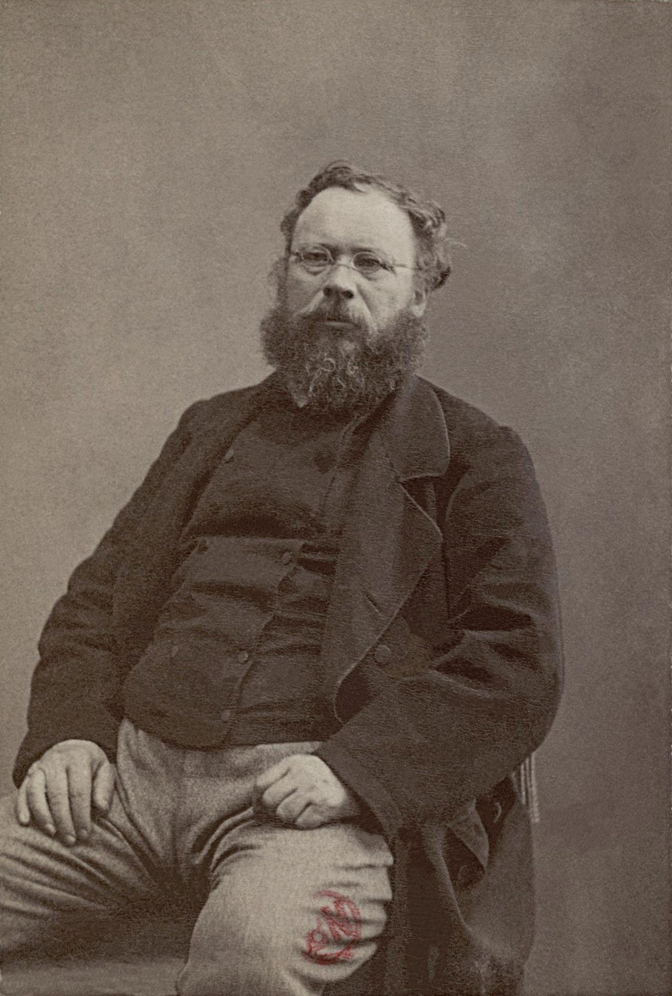
A Bunch of Metaphysical Nonsense
Metaphysics, however, tells us something altogether different. From its standpoint the world is something eternal and immutable, it has been once and for all determined by someone or something—that is why the metaphysicians always have “eternal justice” or “immutable truth” on their lips. Proudhon, the “father” of the Anarchists, said that there existed in the world an immutable justice determined once and for all, which must be made the basis of future society. That is why Proudhon has been called a metaphysician. Marx fought Proudhon with the aid of the dialectical method and proved that since everything in the world changes, “justice” must also change, and that, consequently, “immutable justice” is metaphysical nonsense. Metaphysics recognises various nebulous dogmas, such as, for example, the “unknowable,” the “thing-in-itself,” and, in the long run, passes into empty theology. In contrast to Proudhon and Spencer, Engels combated these dogmas with the aid of the dialectical method; but the Anarchists—the disciples of Proudhon and Spencer—tell us that Proudhon and Spencer were scientists, whereas Marx and Engels were metaphysicians! At all events, it is beyond doubt that the Anarchists confuse Hegel’s metaphysical system with his dialectical method.
Pierre-Joseph Proudhon (1809 - 1865)

Slide 11

A Scientific and Revolutionary Method
Needless to say, Hegel’s philosophical system, which rests on the immutable idea, is from beginning to end metaphysical. But it is also clear that Hegel’s dialectical method, which repudiates all immutable ideas, is from beginning to end scientific and revolutionary. That is why Karl Marx, who subjected Hegel’s metaphysical system to devastating criticism, at the same time praised his dialectical method, which, as Marx said, “lets nothing impose upon it, and is in its essence critical and revolutionary”. That is why Engels sees a big difference between Hegel’s method and his system. “Whoever placed the chief emphasis on the Hegelian system could be fairly conservative in both spheres; whoever regarded the dialectical method as the main thing could belong to the most extreme opposition, both in politics and religion”. The Anarchists say that the dialectical method is “subtle word-weaving,” “the method of sophistry,” “logical somersaults,” “with the aid of which both truth and falsehood are proved with equal facility”. At first sight it would seem that the accusation advanced by the Anarchists has some foundation. Listen, for example, to what Engels says about the follower of the metaphysical method: “...For him a thing either exists, or it does not exist; a thing cannot at the same time be itself and something else. Positive and negative absolutely exclude one another ...”.
Joseph Stalin, 1902

Slide 12

The Substance of the Matter
How is that?—the Anarchists cry heatedly. Is it possible for a thing to be good and bad at the same time?! That is “sophistry,” “juggling with words,” it shows that “you want to prove truth and falsehood with equal facility”! ... Let us, however, go into the substance of the matter. Today we are demanding a democratic republic. Can we say that a democratic republic is good in all respects, or bad in all respects? No we cannot! Why? Because a democratic republic is good only in one respect: when it destroys the feudal system; but it is bad in another respect: when it strengthens the bourgeois system. Hence we say: in so far as the democratic republic destroys the feudal system it is good—and we fight for it; but in so far as it strengthens the bourgeois system it is bad— and we fight against it. So the same democratic republic can be “good” and “bad” at the same time—it is “yes” and “no.” The same thing may be said about the eight-hour day, which is good and bad at the same time: “good” in so far as it strengthens the proletariat, and “bad” in so far as it strengthens the wage system.
"The length of the working day. Yesterday. Today. Tomorrow. The USSR will have the shortest working day in the world and the shortest working week", Soviet poster, 1960

Slide 13
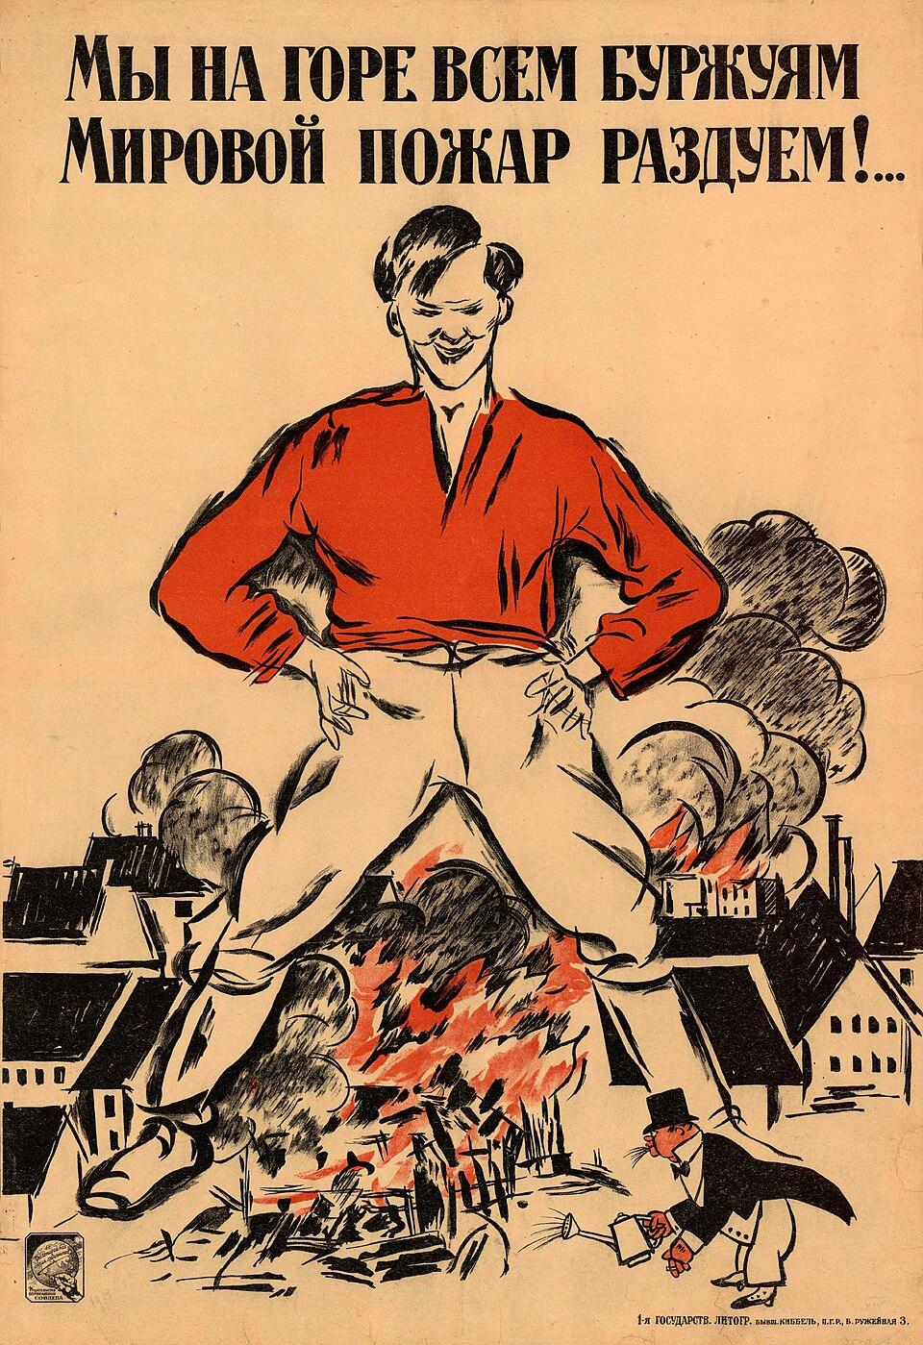
An Epoch of Social Revolution
Let us turn to the facts. Marx says:
“At a certain stage of development, the material productive forces of society come into conflict with the existing relations of production, or—this merely expresses the same thing in legal terms—with the property relations… Then begins an epoch of social revolution.” But “no social order is ever destroyed before all the productive forces for which it is sufficient have developed ...”
If this thesis of Marx is applied to modern social life, we shall find that between the present day productive forces, which are social in character, and the form of appropriation of the product, which is private in character, there is a fundamental conflict which must culminate in the socialist revolution.

Slide 14
Discussion & New Members Introductions

Slide 15
New Member Introductions
What is your name, pronouns and state (or country/territory)?
Where do you work? Is it unionized?
How did you find out about the People’s School?
What do you think about tonight's class?

Slide 16
The Materialist Theory

Slide 17
Theoretical history
Early history-There have been two great schools of philosophy going all the way back to the hellenistic world that of the materialist and idealist schools finding primitive expressions in things like vulgar materialism and idealism metaphysics,virtue ethics etc...
The continuation of the developments of philosophy eventually produced a cartesian model for understanding the world that was still compatible with the idealist worldview but the real revolution would come with feuerbach and haggle the latter for developing the dialectical method the former his contribution to materialism was the development of speculative as opposed to mechanical materialism his critique of religion provided a basis for eventually developing a materialist examination of history

Slide 18
Theoretical history
Marx expanded the system that was being developed by young hegelians like the aforementioned feuerbach who principally claimed on the religious question he was instrumental in developing a anthropological approach that focused on the substance of man as a material actor in the phenomena of religion particularly with his projection theory transforming it from a divine force to a sociological consequence
Engles found the system devised by feuerbach to be to metaphysical believing that reality is something only to be observed not something changed through what marx would call “practical human sensuous activity” things like the nature of mankind are static abstract essences immutable and common to all people

Slide 19
What is the materialist theory?
We already know what the dialectical method is. What is the materialist theory? Everything in the world changes, everything in life develops, but how do these changes take place and in what form does this development proceed? We know, for example, that the earth was once an incandescent, fiery mass; then it gradually cooled, plants and animals appeared, the development of the animal kingdom was followed by the appearance of a certain species of ape, and all this was followed by the appearance of man.
This, broadly speaking, is the way nature developed. We also know that social life did not remain static either.
There was a time when men lived on a primitive-communist basis; at that time, they gained their livelihood by primitive hunting; they roamed through the forests and procured their food in that way.
There came a time when primitive communism was superseded by the matriarchate—at that time men satisfied their needs mainly by means of primitive agriculture. Later the matriarchate was superseded by the patriarchate, under which men gained their livelihood mainly by cattle breeding.

Slide 20
What is the materialist theory?
The patriarchate was later superseded by the slave-owning system—at that time men gained their livelihood by means of relatively more developed agriculture. The slave-owning system was followed by feudalism, and then, after all this, came the bourgeois system.
That, broadly speaking, is the way social life developed. Yes, all this is well known. ... But how did this development take place; did consciousness call forth the development of “nature” and of “society,” or, on the contrary, did the development of “nature” and “society” call forth the development of consciousness? This is how the materialist theory presents the question.
Some people say that “nature” and “social life” were preceded by the universal idea, which subsequently served as the basis of their development, so that the development of the phenomena of “nature” and of “social life” is, so to speak, the external form, merely the expression of the development of the universal idea. Such, for example, was the doctrine of the idealists, who in the course of time split up into several trends.
Others say that from the very beginning there have existed in the world two mutually negating forces—idea and matter, consciousness and being, and that correspondingly, phenomena also fall into two categories—the ideal and the material, which negate each other, and contend against each other, so that the development of nature and society is a constant struggle between ideal and material phenomena.

Slide 21
What is the materialist theory?
Such, for example, was the doctrine of the dualists, who in the course of time, like the idealists, split up into several trends. The materialist theory utterly repudiates both dualism and idealism. Of course, both ideal and material phenomena exist in the world, but this does not mean that they negate each other.
On the contrary, the ideal and the material sides are two different forms of one and the same nature or society, the one cannot be conceived without the other, they exist together, develop together, and, consequently, we have no grounds whatever for thinking that they negate each other. Thus, so-called dualism proves to be unsound. A single and indivisible nature expressed in two different forms—material and ideal; a single and indivisible social life expressed in two different forms—material and ideal—that is how we should regard the development of nature and of social life.
Such is the monism of the materialist theory. At the same time, the materialist theory also repudiates idealism.
It is wrong to think that in its development the ideal side, and consciousness in general, precedes the development of the material side. So-called external “non-living” nature existed before there were any living beings. The first living matter possessed no consciousness, it possessed only irritability and the first rudiments of sensation.
Later, animals gradually developed the power of sensation, which slowly passed into consciousness, in conformity with the development of the structure of their organisms and nervous systems. If the ape had always walked on all fours, if it had never stood upright, its descendant—man—would not have been able freely to use his lungs and vocal chords and, therefore, would not have been able to speak; and that would have fundamentally retarded the development of his consciousness.

Slide 22
What is the materialist theory?
History shows that if at different times men were imbued with different ideas and desires, the reason for this is that at different times men fought nature in different ways to satisfy their needs and, accordingly, their economic relations assumed different forms. There was a time when men fought nature collectively, on the basis of primitive communism; at that time their property was communist property and, therefore, at that time they drew scarcely any distinction between “mine” and “thine,” their consciousness was communistic.
There came a time when the distinction between “mine” and “thine” penetrated the process of production; at that time property, too, assumed a private, individualist character and, therefore, the consciousness of men became imbued with the sense of private property.
Then came the time, the present time, when production is again assuming a social character and, consequently, property, too, will soon assume a social character—and this is precisely why the consciousness of men is gradually becoming imbued with socialism. Hence arose the well known materialist proposition: in the process of development content precedes form, form lags behind content.

Slide 23
What is the materialist theory?
And as, in Marx’s opinion, economic development is the “material foundation” of social life, its content, while legal political and religious-philosophical development is the “ideological form” of this content, its “superstructure,” Marx draws the conclusion that: “With the change of the economic foundation the entire immense superstructure is more or less rapidly transformed.”
Content is impossible without form, but the point is that since a given form lags behind its content, it never fully corresponds to this content; and so, the new content is “obliged” to clothe itself for a time in the old form, and this causes a conflict between them.
At the present time, for example, the form of appropriation of the product, which is private in character, does not correspond to the social content of production, and this is the basis of the present-day social “conflict.”
On the other hand, the idea that consciousness is a form of being does not mean that by its nature consciousness, too, is matter. That was the opinion held only by the vulgar materialists…

Slide 24
What is the materialist theory?
According to Marx’s materialism, consciousness and being, idea and matter, are two different forms of the same phenomenon, which, broadly speaking, is called nature, or society. Consequently, they do not negate each other nor are they one and the same phenomenon.
The only point is that, in the development of nature and society, consciousness, i.e., what takes place in our heads, is preceded by a corresponding material change, i.e., what takes place outside of us; any given material change is, sooner or later, inevitably followed by a corresponding ideal change.
Very well, we shall be told, perhaps this is true as applied to the history of nature and society. But how do different conceptions and ideas arise in our heads at the present time? Do so-called external conditions really exist, or is it only our conceptions of these external conditions that exist? And if external conditions exist, to what degree are they perceptible and cognizable?
On this point the materialist theory says that our conceptions, our “self,” exist only in so far as external
conditions exist that give rise to impressions in our “self.”
Whoever unthinkingly says that nothing exists but our conceptions, is compelled to deny the existence of all external
conditions and, consequently, must deny the existence of all other people and admit the existence only of his own “self,” which is absurd, and utterly contradicts the principles of science.

Slide 25
What is the materialist theory?
Obviously, external conditions do actually exist; these conditions existed before us, and will exist after us; and the more often and the more strongly they affect our consciousness, the more easily perceptible and cognizable do they become. As regards the question as to how different conceptions and ideas arise in our heads at the present time, we must observe that here we have a repetition in brief of what takes place in the history of nature and society.
In this case, too, the object outside of us preceded our conception of it; in this case, too, our conception, the form, lags behind the object—behind its content.
When I look at a tree and see it—that only shows that this tree existed even before the conception of a tree arose in my head, that it was this tree that aroused the corresponding conception in my head. ... Such, in brief, is the content of Marx’s materialist theory.
The importance of the materialist theory for the practical activities of mankind can be readily understood. If the economic conditions change first and the consciousness of men undergoes a corresponding change later, it is clear that we must seek the grounds for a given ideal not in the minds of men, not in their imaginations, but in the development of their economic conditions. Only that ideal is good and acceptable which is based on a study of economic conditions.
All those ideals which ignore economic conditions and are not based upon their development are useless and unacceptable. Such is the first practical conclusion to be drawn from the materialist theory.

Slide 26
The Shoemaker
Here is a simple illustration. Let us take a shoemaker who owned a tiny workshop, but who, unable to withstand the competition of the big manufacturers, closed his workshop and took a job, say, at Adelkhanov’s shoe factory in Tiflis. He went to work at Adelkhanov’s factory not with the view to becoming a permanent wage-worker, but with the object of saving up some money, of accumulating a little capital to enable him to reopen his workshop. As you see, the position of this shoemaker is already proletarian, but his consciousness is still non-proletarian, it is thoroughly petty-bourgeois.
In other words, this shoemaker has already lost his petty bourgeois position, it has gone, but his petty-bourgeois consciousness has not yet gone, it has lagged behind his actual position. Clearly, here too, in social life, first the external conditions change, first the conditions of men change and then their consciousness changes accordingly. But let us return to our shoemaker. As we already know, he intends to save up some money and then reopen his workshop. This proletarianised shoemaker goes on working, but finds that it is a very difficult matter to save money, A because what he earns barely suffices to maintain an existence.
Moreover, he realises that the opening of a private workshop is after all not so alluring: the rent he will have to pay for the premises, the caprices of customers, shortage of money, the competition of the big manufacturers and similar worries— such are the many troubles that torment the private workshop owner. On the other hand, the proletarian is relatively freer from such cares; he is not troubled by customers, or by having to pay rent for premises.

Slide 27
The Shoemaker
He goes to the factory every morning, “calmly” goes home in the evening, and as calmly pockets his “pay” on Saturdays. Here, for the first time, the wings of our shoemaker’s petty-bourgeois dreams are clipped; here for the first time proletarian strivings awaken in his soul. Time passes and our shoemaker sees that he has not enough money to satisfy his most essential needs, that what he needs very badly is a rise in wages. At the same time, he hears his fellow-workers talking about unions and strikes. Here our shoemaker realises that in order to improve his conditions he must fight the masters and not open a workshop of his own. He joins the union, enters the strike movement, and soon becomes imbued with socialist ideas. ...
Thus, in the long run, the change in the shoemaker’s material conditions was followed by a change in his consciousness: first his material conditions changed, and then, after a time, his consciousness changed accordingly. The same must be said about classes and about society as a whole. In social life, too, first the external conditions change, first the material conditions change, and then the idea s of men, their habits, customs and their world outlook change accordingly.
That is why Marx says: “It is not the consciousness of men that determines their existence, but their social being that determines their consciousness.” If we can call the material side, the external conditions, being, and other phenomena of the same kind, the content, then we can call the ideal side, consciousness and other phenomena of the same kind, the form.

Slide 28
What is the anarchist view of the materialist theory of Marx and Engels?
What is the anarchist view of the materialist theory of Marx and Engels? While the dialectical method originated with Hegel, the materialist theory is a further development of the materialism of Feuerbach. The Anarchists know this very well, and they try to take advantage of the defects of Hegel and Feuerbach to discredit the dialectical materialism of Marx and Engels.
We have already shown with reference to Hegel and the dialectical method that these tricks of the Anarchists prove nothing but their own ignorance. The same must be said with reference to their attacks on Feuerbach and the materialist theory.
True, nobody has any doubts about Feuerbach’s pantheism, his deification of man, and other errors of his of the same kind. On the contrary, Marx and Engels were the first to reveal Feuerbach’s errors. Nevertheless, the Anarchists deem it necessary once again to “expose” the already exposed errors. Why?
Probably because, in reviling Feuerbach, they want indirectly to discredit the materialist theory of Marx and Engels. Of course, if we examine the subject impartially we shall certainly find that in addition to erroneous ideas, Feuerbach gave utterance to correct ideas, as has been the case with many scholars in history. Nevertheless, the Anarchists go on “exposing.” ... We say again that by tricks of this kind they prove nothing but their own ignorance.
Fin.

Slide 29
Discussion

Slide 30
Proletarian Socialism

Slide 31
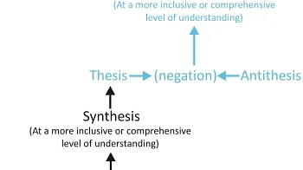
Applying Theory to Revolution
What practical conclusions can we draw from Marx’s theoretical method and theory?
How is the dialectical method connection to proletarian socialism?
The dialectical method affirms that the proletarian class is the only class which continuously grows and marches forward, therefore we serve and place our hopes on this class.

Slide 32
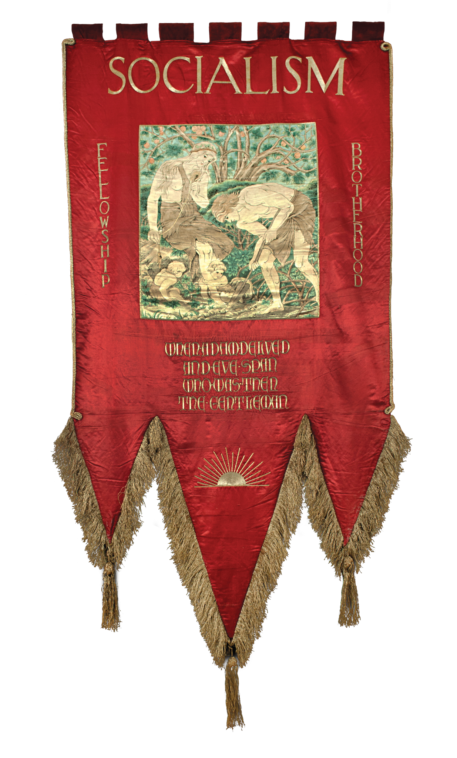
Applying Theory to Revolution
How should we serve the proletariat?
Any ideal should fully serve the economic development of the country, and the capitalist system shows that production is now assuming a social character.
This developing social character is a negation of existing capitalist property.
Therefore, our task is to abolish capitalist property and establish socialist property.
Capitalist development also shows us that production is expansive, thus fight for a broad socialist life as the principal goal— this is how we should serve the proletariat.

Slide 33

What is Proletarian Socialism?
Capitalists buy the labour power of the proletarians, they hire the proletarians, and this is why the capitalists appropriate the fruits of the labour of the proletarians, this is why the capitalists exploit the proletarians and not vice versa.
Capitalists hire proletarians to keep the factories and mills going—if they did not do that their instruments and means of production would yield no profit. That is why the proletarians sell their labour power to the capitalists—if they did not, they would die of starvation.

Slide 34
What is Proletarian Socialism?
Capitalist production cannot be united and organised: it is all split up among the private enterprises of individual capitalists.
Secondly, the immediate purpose of this scattered production is not to satisfy the needs of the people, but to produce goods to increase the profits of the capitalists.
Crises, unemployment, suspension and anarchy of production are the direct results of present-day unorganised capitalist production.
If this social system still remains standing, if it firmly withstands the attacks of the proletariat, it is because it is protected by the capitalist state, by the capitalist government.

Slide 35
Future Society will be Socialist Society
There will be no classes; neither capitalists nor proletarians and, no exploitation. There will be only workers engaged in collective labour.
With the abolition of exploitation commodity production, buying and selling will also be abolished, there will be no room for buyers and sellers of labour power— there will be only free workers.
The abolition of wage-labour will be accompanied by the complete abolition of the private ownership of the instruments and means of production.
There will be only workers who collectively own all the land and minerals, all the forests, factories, mills, railways, etc.

Slide 36
Future Society will be Socialist Society
The main purpose of production in the future will be to satisfy the needs of society and not to produce goods to increase the profits of the capitalists.
Future production will be socialistically organised, highly developed, which will take into account the needs of society and will produce as much as society needs.
There will be no room whether for scattered production, competition, crises, or unemployment.
Where there are no classes, where there are neither rich nor poor, there is no need for a state, there is no need either for political power, which oppresses the poor and protects the rich. Consequently, in socialist society there will be no need for the existence of political power.

Slide 37
Future Society will be Socialist Society
For the purpose of administering public affairs there will have to be in socialist society, in addition to local offices which will collect information, a central statistical bureau, which will collect information about the needs of the whole of society, and then distribute the various kinds of work among the working people accordingly.
It will also be necessary to hold conferences, and particularly congresses, the decisions of which will certainly be binding upon the comrades in the minority until the next congress is held.
Future society demands from each of its members as much labour as he can perform, it, in its turn, must provide each member with all the products he needs. From each according to his ability, to each according to his needs!

Slide 38
Future Society will be Socialist Society
In the first stage of socialism, when conditions are shifting into the new way of life, when the productive forces also will not yet have been sufficiently developed and there will still be “dirty” and “clean” work to do, the “to each according to his needs,” will be greatly hindered and society will be obliged temporarily to take some other path, a middle path.
But it is also clear that when future society runs into its groove, when the survivals of capitalism will have been eradicated, the only principle that will conform to socialist society will be the one pointed out above.

Slide 39
Can Production Keep up with Every Need?
Socialist society presupposes an adequate development of productive forces and socialist consciousness among men, their socialist enlightenment.
As capitalist property will not exist in future society, productive forces will increase tenfold.
The millions of unemployed will also be put to work, which greatly develops the productive forces.
Proletarian socialism is based not on sentiment, not on abstract “justice,” not on love for the proletariat, but on the scientific grounds referred to above.
That is why proletarian socialism is also called “scientific socialism.”

Slide 40
The Minimum & Maximum Programme
That does not mean that since capitalism is decaying the socialist system can be established any time we like. Only Anarchists and other petty-bourgeois ideologists think that.
The majority in society may already be proletarianised, but socialism may still not be achievable. The achievement of socialism calls for class consciousness, the unity of the proletariat and its ability to manage its own affairs. In order that all this may be acquired, political freedom is needed. But political freedom is not equally ensured everywhere.
Political freedom is best ensured in a democratic republic, in so far as it can be ensured under capitalism at all. Therefore, all advocates of proletarian socialism necessarily strive for the establishment of a democratic republic as the best “bridge” to socialism.

Slide 41
The Minimum & Maximum Programme
The maximum programme is the goal of which is socialism, and the minimum programme the object of which is to lay the road to socialism through a democratic republic.
Whether it’s a strike, boycott, meetings, demonstrations, political activity, all of these are forms of class struggle, all are important for developing the proletarian movement.
All these forms of struggle are merely preparatory means, that not one of them, taken separately, constitutes the decisive means by which the proletariat can smash capitalism.The general strike can only create some of the conditions that are necessary for the smashing of capitalism. Parliamentarism can only prepare some of the conditions that are necessary for overthrowing capitalism.

Slide 42
The Political Domination of the Proletariat Over the Bourgeoisie
The socialist revolution must not be conceived as a sudden and short blow, it is a prolonged struggle waged by the proletarian masses, who inflict defeat upon the bourgeoisie and capture its positions. And as the victory of the proletariat will at the same time mean domination over the vanquished bourgeoisie, as, in a collision of classes, the defeat of one class signifies the domination of the other, the first stage of the socialist revolution will be the political domination of the proletariat over the bourgeoisie.
The socialist dictatorship of the proletariat, capture of power by the proletariat—this is what the socialist revolution must start with. This means that until the bourgeoisie is completely vanquished, until its wealth has been confiscated, the proletariat must without fail possess a military force, it must without fail have its “proletarian guard,” with the aid of which it will repel the counter-revolutionary attacks of the dying bourgeoisie, exactly as the Paris proletariat did during the Commune.

Slide 43

Proletarian Political Supremacy
The socialist dictatorship of the proletariat is needed to enable the proletariat to expropriate the bourgeoisie, to enable it to confiscate the land, forests, factories and mills, machines, railways, etc., from the entire bourgeoisie. This, then, is the principal and decisive means by which the proletariat will overthrow the present capitalist system.
That is why Karl Marx said as far back as 1847:
  “... The first step in the revolution by the working-class is to raise the proletariat to the position of ruling class ... The proletariat will use its political supremacy to wrest, by degrees, all capital from the bourgeoisie, to centralize all instruments of production in the hands ... of the proletariat organised as the ruling class ...”
Soviet poster celebrating depicting the one-year proletarian dictatorship by Alexander Petrovich Apsit

Slide 44
Smash the Capitalist System
All other views on tactics emerge from the general principle of the dictatorship of the proletariat. Strikes, boycott, demonstrations, and parliamentarism are important only in so far as they help to organise the proletariat and to strengthen and enlarge its organisations for accomplishing the socialist revolution. Thus, to bring about socialism, the socialist revolution is needed, and the socialist revolution must begin with the dictatorship of the proletariat, i.e., the proletariat must capture political power as a means with which to expropriate the bourgeoisie.
But to achieve all this the proletariat must be organised, the proletarian ranks must be closely-knit and united, strong proletarian organisations must be formed, and these must steadily grow. The most widespread, mass organisations are trade unions and workers’ co-operatives, but trade unions and co-operatives alone cannot satisfy the organisational needs of the militant proletariat. in addition, an organisation is needed that will rally around itself the class-conscious elements of the workers of all trades, that will transform the proletariat into a conscious class and make it its chief aim to smash the capitalist system, to prepare for the socialist revolution.

Slide 45
Discussion & Wrap Up

Slide 46
Announcements
PCUSA Cell Chairs need to call members of their cells to remind them about attendance.
Reminder for PCUSA Cadre to attend the Jones-Foster continuing educ
The next issue of New Masses (2026) has begun production. If you have art you want us to feature, email it to info@partyofcommunistsusa.net.

Slide 47
Volunteers Needed!
We are in need of volunteers for the staff of the People’s School! Here’s a few roles we need filled:
People to help manage posting on our social media and podcast platforms
Video Editors, Audio Editors, Graphic Designers, Artists, Narrators
Web Controls, Moderators
Email info@peoplesschool.us if you’re interested and try to attend our next staff meeting if possible.

Slide 48

View From Left Field
https://viewfromleftfield.libsyn.com
The Old PSMLS Youtube is now the Youtube of View From Left Field, a podcast of analysis and discussion of current events from a progressive perspective.
Like the Youtube videos and subscribe with 5 star ratings on your podcast platforms.

Slide 49




New Outlook Publishers
newoutlookpublishers.store
Relevant and Latest Releases

Slide 50



Harry Bridges School of Labor
luel.us/laborschool/
The Harry Bridges School of Labor is a monthly class covering a variety of topics aimed at building class consciousness among union members. For class schedule and other information, please visit the website at luel.us/laborschool.

Slide 51


