Slide 1

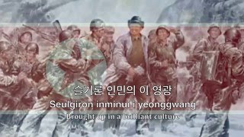
Aegukka - National Anthem of North Korea

Slide 2
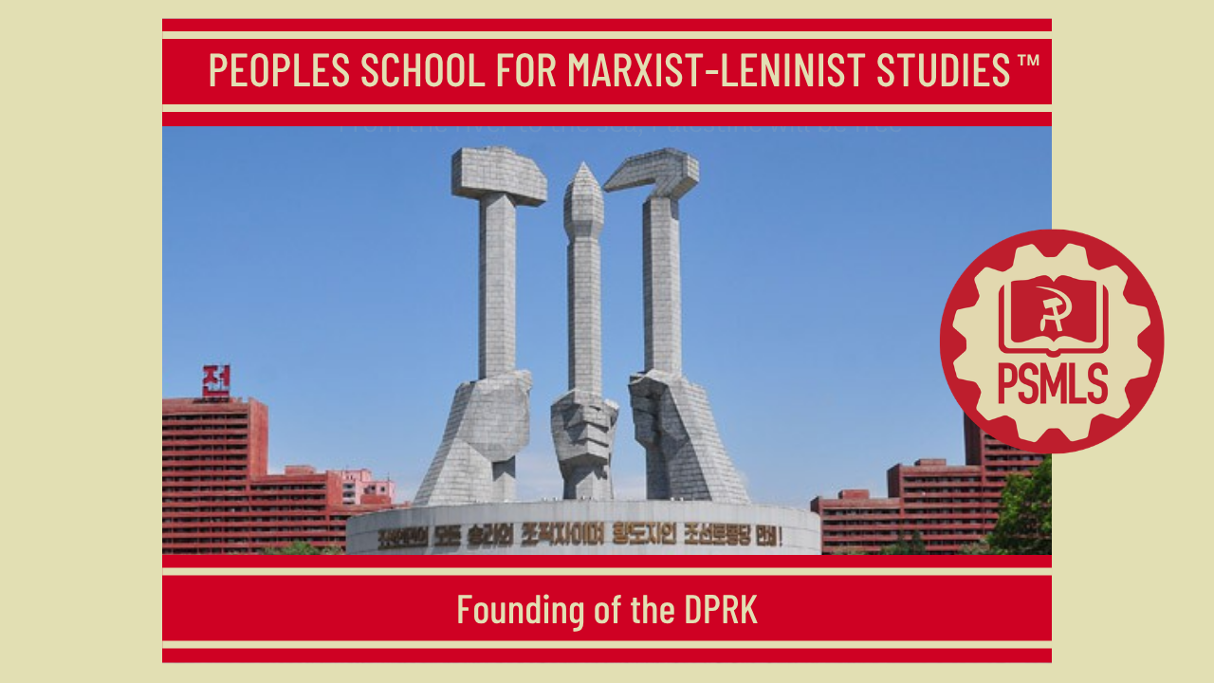
PSMLS 9/8/26

Slide 3
What we’ll be learning today:
Liberating Korea: Above the 38th Parallel
Occupying Korea: Below the 38th Parallel
Rebuilding after the Korean War

Slide 4
Liberating Korea: Above the 38th Parallel

Slide 5
Liberation
When the Japanese capitulated on August 15, 1945, Soviet troops were already on Korean soil. The bright new day for which Korean patriots had worked, organised and fought for 40 years was about to dawn. Overnight the first great symbol of freedom appeared. Throughout Korea in every town and village, Koreans discarded their drab, ungainly Japanese-imposed dress and appeared in their graceful, snow-white summer garments in a spontaneous salute to liberation. The commander of the Soviet forces, Guard Colonel-General Chistiakov, captured the imagination of all when he issued the first proclamation of the Soviet Army in Korea. It read like a poem, an answer to the hopes that beat so strongly in Korean hearts for so long.
TO THE KOREAN PEOPLE!
“The Soviet Army and Allied forces have driven the Japanese plunderers from Korea. Korea has become a country of freedom. However, this is only the first step in a new era of Korean history. An abundant fruitful orchard is the result of man’s effort and foresight. Therefore the happiness of the Korean people will only be achieved by the heroic efforts that you Korean people will exert. Remember those bitter days that you have suffered under Japanese rule. The very stones testify to your sufferings. You are all aware of the fact that the Japanese could afford to live in lofty, spacious pavilions, well-clad, well-fed, despising Koreans and humiliating Korean customs and culture. Such a past of slavery will never be repeated. Like a nightmare, this humiliating past has now disappeared forever.”

Slide 6
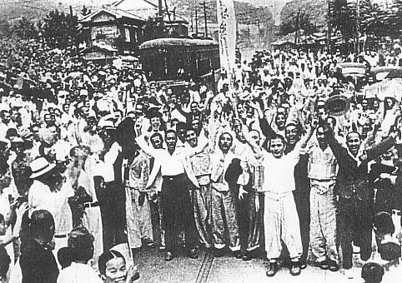
TO THE KOREAN PEOPLE! Cont.
“Korean people! Remember you have your future happiness in your own hands. You have attained liberty and independence. Now everything is up to you. The Soviet Army has paved the way and created the conditions for you Korean people, for the free and creative ventures you are bound to embark on. Koreans must make themselves the creators of their own happiness. The owners of mills and factories, the merchants and manufacturers will restore the factories, mills and enterprises which the Japanese have wrecked. They will create new enterprises for production. The headquarters of the Soviet Army is fully prepared to safeguard in every possible way the property of all manufacturing facilities and ensure their normal Functioning.”
“Workers of Korea! Display your heroism and creative effort through your industry which is one of the most splendid characteristics of your race. Those who exert the most appropriate efforts in furthering the economic and cultural development of Korea by means of their own efforts will become the patriots and honoured citizens of Korea. Long live the Korean People!”
Korea celebrates Independence Day on Aug. 15, known as "Gwangbokjeol," which literally translates into "bringing back the light" in Korean

Slide 7
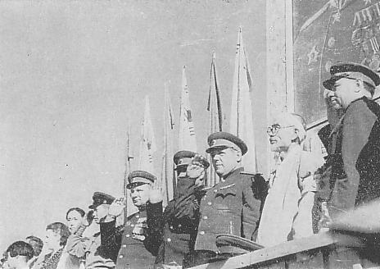
Soviet Forces Reach Korea
Under a war-time agreement between the Great Powers, the Soviet Army was to enter Korea to accept the surrender of the Japanese troops north of the 38th parallel; American forces were to accept the surrender south of the parallel. There was fairly heavy fighting in a few places when Soviet troops broke through into Korea. There was a severe battle at Chongjin, in which Soviet fleet units and planes took part, and there was vigorous resistance at other scattered points along the Soviet and Manchurian borders with Korea. How liberation came can best be described by recounting one of hundreds of eye-witness accounts from Koreans north of the parallel. Some accounts were more dramatic, some more prosaic but what happened in the little village of Tonglim, eight miles north of the city of Sunchon and about 40 miles north of Pyongyang, seems typical of what happened in villages throughout North Korea. The Japanese in Tonglim knew by the early morning of the 15th that Soviet forces were in Korea and that Japan had capitulated, but the villagers first heard of it around 3 p.m. There was a skeleton youth organisation in the village and an underground representative of the Youth Association. As it was the only organisation of any sort, it took the lead in the events which followed.
Welcome Celebration for the Red Army in Pyongyang on 14 October 1945

Slide 8
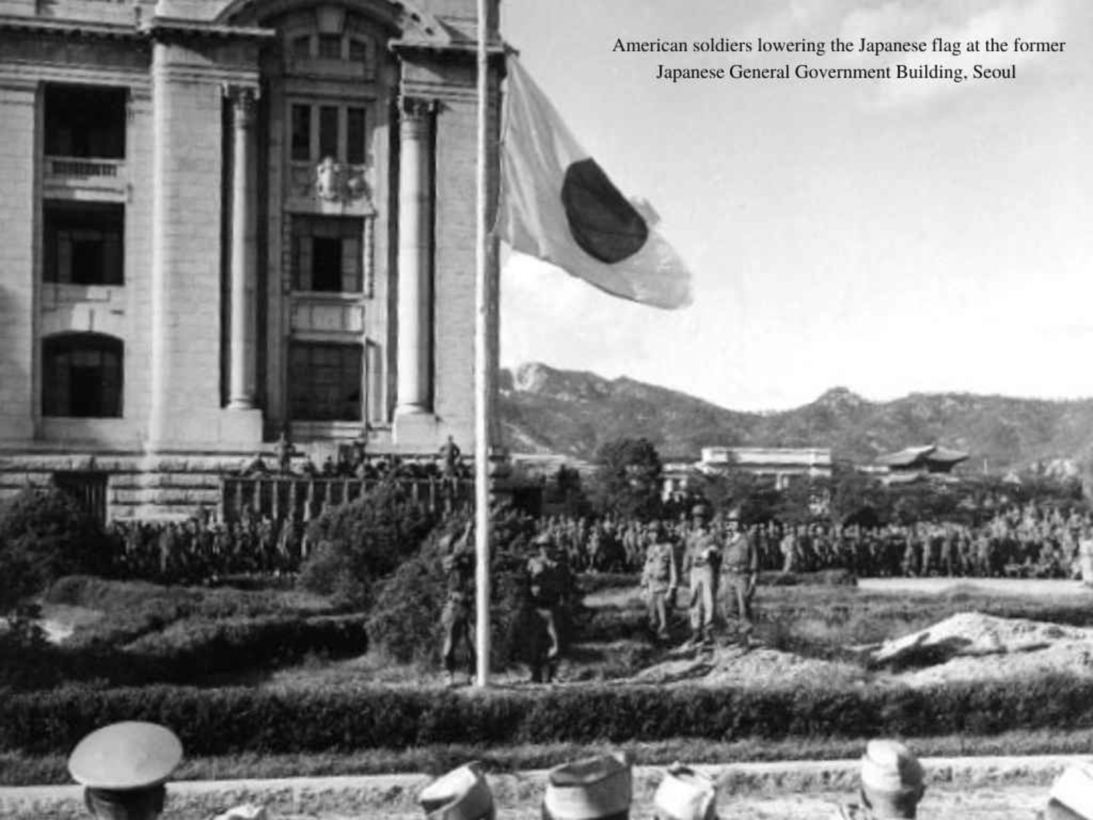
Symbols of Japanese Oppression are Overtaken
Soviet troops were still fighting along the Yalu and at Chongjin. The Japanese had a full division of troops and air units at Pyongyang. At the meeting’s close, however, the entire population of the village marched to the Japanese police station and after a short struggle in which the police chief fired on the crowd the Japanese were disarmed and locked up. The police station was taken over and a Korean guard was placed in charge. From there the crowd went to the village administration headquarters and dealt with the Japanese and puppets whom the Japanese had installed there. Korean flags were hoisted over the police station and other former Japanese offices. The local symbols of Japanese oppression were in the hands of the people by midnight. By next morning, plans had been approved for taking over the administration, registering all Japanese property and preventing sabotage and establishing contact with other villages and the district centre. For the next few days Tonglim was a bustling bee-hive of committees and patriotic young people working almost 24 hours a day.
American Soldiers Lowering the Japanese Flag at the Former Japanese General Government Building, Seoul

Slide 9
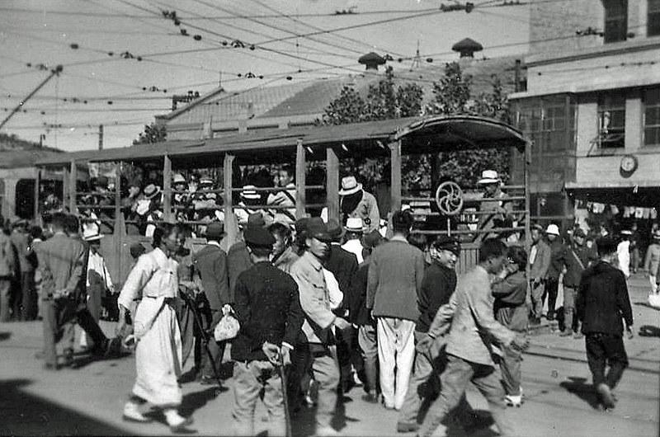
The Self-Administration Committee
Within three days the following tasks had been carried out. The village school was open again with lessons conducted in Korean, from Korean text-books. This was of course not organised from Tonglim alone, but by working with other village committees. There were no Korean text-books as they had been banned and destroyed by the Japanese, but teachers, writers, historians and workers got together to produce within three days mimeographed sheets which could serve as text-books until policies and publishing houses could be organised. A village Self-Administration Committee had been set up as the local administrative organ. The rural bank was open for business again. The post office was also functioning and a bus service was organised between Tonglim and the nearest town; the train service between Tonglim and Sunchon was also restored. The Tonglim Self-Administration Committee had established contact with other villages in the district and elected a district Self-Administration Committee. Every scrap of Japanese property in the district from factories down to pencils and note-paper and stocks of seed, were carefully registered in the Committee’s register. Guards were posted in factories and buildings as a precaution against sabotage.
Seoul, Korea: October 1945 - Streetcars were running crowded as almost no Koreans were driving private cars. Some of the streets were quite rough

Slide 10
A Smooth Take-Over of Power
When the committee members of Tonglim had time to draw breath at the end of the first three days, they and their fellow citizens could survey with pride what had been done. Their faith in themselves was justified. There were those amongst them who doubted whether Koreans were capable of organising and administering. For 40 years they had been educated to believe that Koreans were an inferior people who had to be ruled by a “superior” race. The general population within those first few days of liberation could now see that Koreans could organise and run their lives without outside interference. The encouraging words of General Chistiakov, which had reached them by this time, took on added meaning. This revived faith in their future was enormously strengthened too, by the knowledge that they would have powerful support from the Soviet Union, that such support was already on the horizon and would soon be felt throughout the land. The fact that such a smooth take-over of power could be accomplished within a few days and that the day-to-day administration of the country was running smoothly in Korean hands, was a heavy blow for the national traitors and top collaborators whose excuse for treachery had always been that Koreans were an inferior, ignorant people incapable of running their own affairs. Village and district committees were quickly set up by mutual agreement between the various political and social organisations which quickly sprang into being, the Peasants’ Associations, the Youth, and Women’s Leagues, the Communist Party and others. The Self-Administration Committees had the complete support of the people – or they were quickly changed until they did. The only people banned from taking part in the Committees or in taking over responsible administrative tasks under the Committees’ control were the out-and-out collaborationists. In general it was the young people that played the leading role, but their selfless energy inspired the whole population.

Slide 11
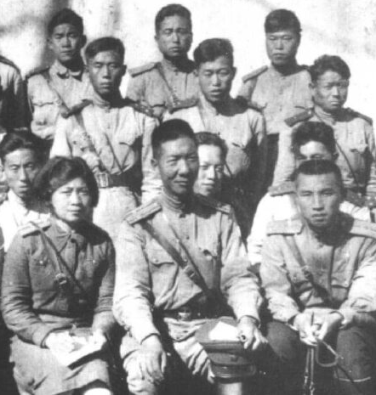
The Soviet Soldiers and the Korean People
The majority of the population knew very little about Communism. In the first days after liberation, the pro-Japanese collaborators spread slanderous stories about what would happen when the Communists – in the shape of the Soviet Army – spread over the country. But doubts and fears dissolved like snow on a hot stove when Soviet troops actually appeared. The only type of army the people knew was the Japanese Army – an inhuman, cold and brutal machine that ground Korean dignity and individuality into the ground. Officers were aloof and unapproachable; the troops were themselves treated like animals and passed on the inhuman treatment they received to the Korean people. When Japanese troops entered a town or village, the people withdrew behind closed doors. “When the huge columns of Soviet troops moved through Tonglim,” one old white-bearded resident stated, “we thought, ‘this is not an army. These are real people.’ Well, it’s true, at first we were a little afraid. They looked so different to any people we had seen….But those soldiers from the first moment talked and laughed with the people. Within an hour or two, they were playing with the children and were using some Korean words they had learned on their way down from the north. And the children were trying to stumble over Russian words. When we saw them, we remembered the Soviet general’s speech. We knew it was right what he said about a rich new life ahead of us. We knew Communism must be all right and that we had powerful new friends.”
A Young Kim Il Sung (Front Right) was a Major in the Soviet Red Army, serving in the far eastern brigade where he would be part of the local Korean Anti-Imperial resistance movements, launching daring attacks and movements against colonial forces

Slide 12
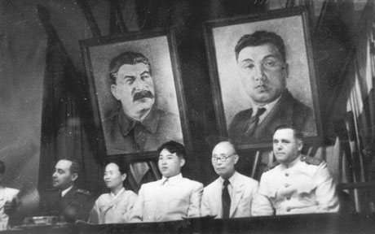
The Advent of Korean Politics
Within a few days of liberation, two main political groupings clearly emerged. The first was centred around the Communist Party, the second around the nationalist conservative groups under the leadership of the Christian Nationalist, Cho Man-sik. (Later these groups fused into the Democratic Party of North Korea with Cho Man-sik as leader.) The workers, the peasants, the entire youth and most of the intellectuals rallied around the Communist Party; the landlords, manufacturers, merchants and a small part of the intellectuals supported the national conservative groups at this stage. The Communist Party, organisationally, was at a great disadvantage as most of its leaders had been killed and those who had survived had not yet returned from exile or had just been released from long-years in jail. Kim Il-sung had not yet returned to Korea in those early days after liberation. Within ten days of the arrival of the first Soviet troops, leaders of the various political groups in South Pyongyang province met together in Pyongyang and by consultation among themselves set up a coalition, Temporary People’s Political Committee of 30 members, 16 of whom were from groups supporting the Communists and 14 from those supporting the Nationalists.
Founding Joint Plenum of the New People's Party and the North Korea Bureau of the Communist Party of Korea on 28 August 1946

Slide 13
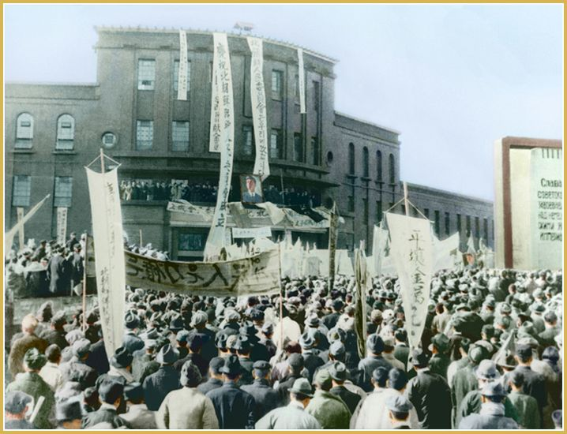
The People’s Committees
At the end of September, 100,000 of Pyongyang’s citizens turned out to welcome Kim Il-Sung returning from his 15-year-long heroic struggle as leader of the armed resistance to the Japanese. His name had long since become legendary throughout Korea and all political groups turned out to pay him homage. Cho Man-Sik made a powerful speech in which he hailed Kim Il-Sung as the great national hero of Korean armed resistance. Towards the end of October, the People’s Committees from all provinces met together in Pyongyang to establish a central organ to coordinate their activities. They set up a Temporary People’s Political Committee of North Korea and elected Kim Il-sung chairman of what was the chief administrative organ of North Korea. Within a few months of the arrival of American troops, MacArthur who was determined not to allow the Koreans any say in their own affairs but to deal with them as an enemy people to be ruled, had reported to his government that the unification of Korea was beyond his powers, and accordingly the problem was handed over in December, 1945, to the Moscow meeting of the foreign ministers of America, Britain and the U.S.S.R. Actually, of course, the problem of unification was one for the Korean people to solve. Had they been left alone by the Americans there was no problem. The Korean people had no desire for their country to be politically divided because of a military arrangement to facilitate the disarming of the Japanese.
Kim Il Sung delivers a speech at the Pyongyang mass rally held to celebrate the establishment of the Provisional People’s Committee of North Korea (February 1946)

Slide 14
Discussion & New Members Introductions

Slide 15
New Member Introductions
What is your name, pronouns and state (or country/territory)?
Where do you work? Is it unionized?
How did you find out about the People’s School?
What do you think about tonight's class?

Slide 16
Occupying Korea: Below the 38th Parallel

Slide 17
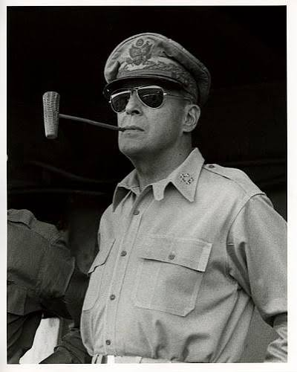
General Douglas MacArthur’s Proclamation No.1
Proclamation No. 1 by General of the Army Douglas MacArthur
Yokohama, September 7, 1945
To the People of Korea:
As Commander-in-chief, United States Army Forces, Pacific, I do hereby proclaim as follows:
By the terms of the Instrument of Surrender,56 signed by command and in behalf of the Emperor of Japan and the Japanese Government and by command and in behalf of the Japanese Imperial General Headquarters, the victorious military forces of my command will today occupy the territory of Korea south of 38 degrees north latitude.
General Douglas MacArthur

Slide 18
General Douglas MacArthur’s Proclamation No.1 Cont.
Having in mind the long enslavement of the people of Korea and the determination that in due course Korea shall become free and independent, the Korean people are assured that the purpose of the occupation is to enforce the Instrument of Surrender and to protect them in their personal and religious rights. In giving effect to these purposes, your active aid and compliance are required.
By virtue of the authority vested in me as Commander-in-Chief, United States Army Forces, Pacific, I hereby establish military control over Korea south of 38 degrees north latitude and the inhabitants thereof, and announce the following conditions of the occupation:
Article I
All powers of Government over the territory of Korea south of 38 degrees north latitude and the people thereof will be for the present exercised under my authority.

Slide 19
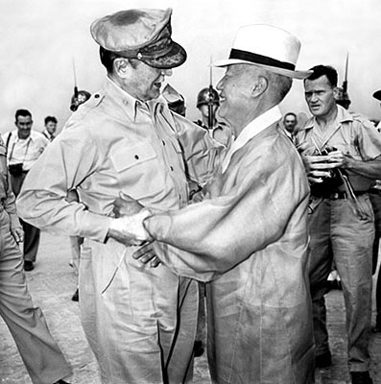
General Douglas MacArthur’s Proclamation No.1 Cont.
Article II
Until further orders, all governmental, public and honorary functionaries and employees, as well as all officials and employees, paid or voluntary, of all public utilities and services, including public welfare and public health, and all other persons engaged in essential services, shall continue to perform their usual functions and duties, and shall preserve and safeguard all records and property.
Article III
All persons will obey promptly all my orders and orders issued under my authority. Acts of resistance to the occupying forces or any acts which may disturb public peace and safety will be punished severely.
General MacArthur embraces Syngman Rhee

Slide 20
General Douglas MacArthur’s Proclamation No.1 Cont.
Article IV
Your property rights will be respected. You will pursue your normal occupations, except as I shall otherwise order.
Article V
For all purposes during the military control, English will be the official language. In event of any ambiguity or diversity of interpretation or definition between any English and Korean or Japanese text, the English text shall prevail.
Article VI
Further proclamations, ordinances, regulations, notices, directives and enactments will be issued by me or under my authority, and will specify what is required of you. Given under my hand at Yokohama this seventh day of September 1945
Douglas MacArthur
Commander-in-Chief, United States
Army Forces, Pacific

Slide 21
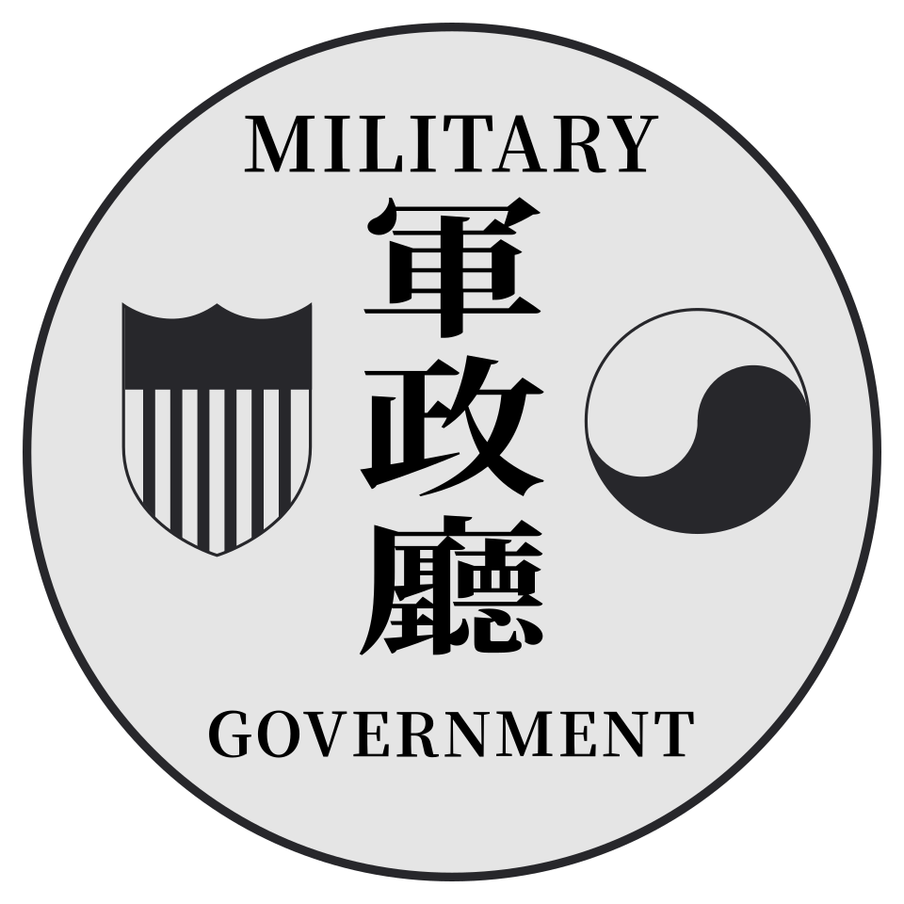
US Army Military Government in Korea (USAMGIK) takes power away from Peoples Committees forcibly
Chief of the Public Opinion Section of the Department of Information of the USAMGIK and Historian Richard D. Robinson admits:
“It was safe to say that for the most part the local People's Committees in these early days were of the genuine grassroots democratic variety and represented a spontaneous urge of the people to govern themselves. [...] They resented orders from the Military Government to turn the administration of local government over to American Army officers and their appointed Korean counterparts, many of whom were considered to be Japanese collaborators. It seemed like a reversion to what had gone before. Bloodshed ensued in many communities as local People's Committees defied the Military Government and refused to abandon government offices. Koreans and Americans met in pitched battles, and not a few Koreans met violent death in the struggle.”
Emblem of the USAMGK

Slide 22
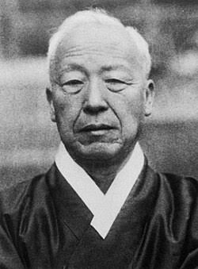
Short Biography of a fascist dictator
Born into the privileged landowning yangban class (aristocracy)
Primary education in American Methodist missionary school
Lived in the US for nearly 20 years earning his PhD at Princeton
Ruled until 1960 until US saw him as too unpopular and deposed him
Brutally suppressed and massacred hundreds of thousands of Koreans in his reign
Syngman Rhee

Slide 23
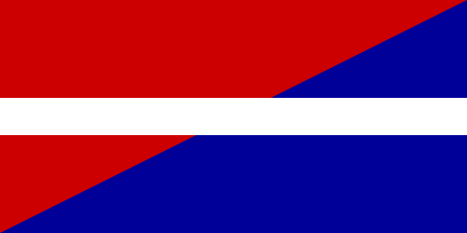
Ilminism in Brief
“I advocate Ilminism. Through this, I aim to clarify the national principle of a newly emerging nation. We are originally a single ethnic group with a long history, always one and never two. This single ethnic group of ours must be one and must remain one. However, the poison of class distinctions tore the nation apart, and the harm of wealth disparities divided it. As regional notions emerged, the nation lost its unity, and due to gender distinctions, it strayed from that unity.” - Syngman Rhee on Ilminism
“If unity is not yet achieved, it must be created; if obstacles hinder unity, they [Communists] must be removed” - Syngman Rhee
Ilminism is a fascist ideology of class collaboration that is forced onto the working class.
Flag of the Ilminist Liberal Party

Slide 24
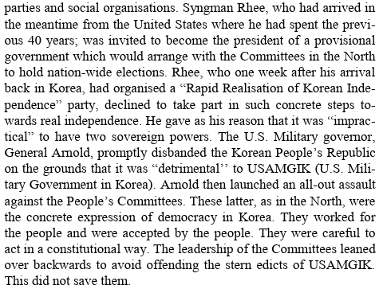
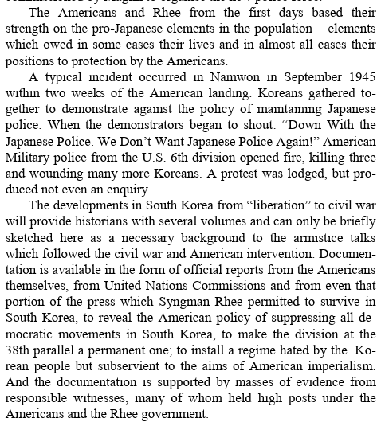
Rhee’s Role in the South - Excerpts from This Monstrous War

Slide 25
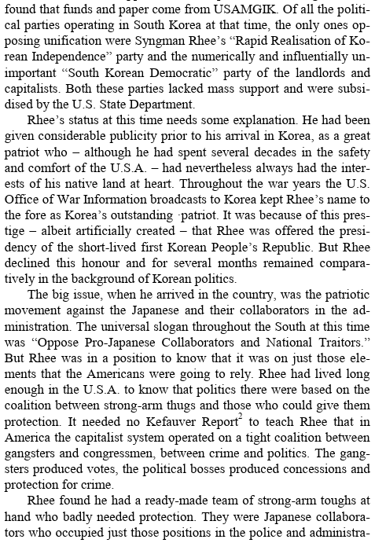
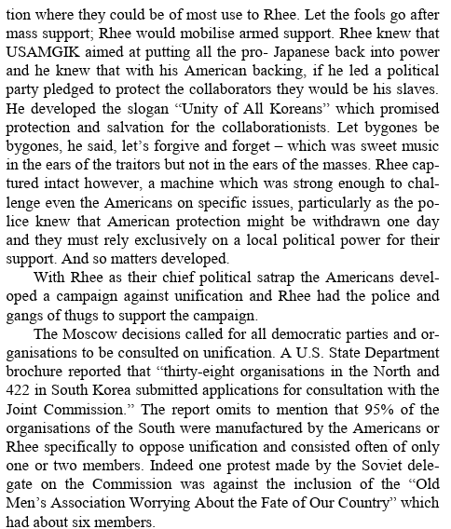

Slide 26
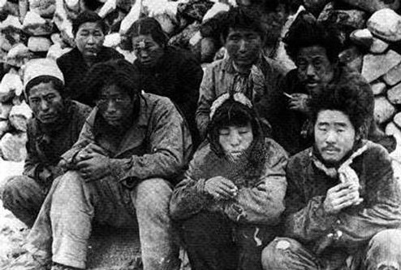
Syngman Rhee’s First Year in Office
Rhee was handpicked by the US Army Military Government in Korea (USAMGIK) to become first president of South Korea
In November 1948, the Rhee government declared Martial Law against protesters in Jeju Island
The government led by Rhee brutally suppressed the uprising leading to tens of thousands of protesters being murdered by the government forces and far right paramilitaries
The government further killed thousands more in Yeosu-Suncheon after rebellions against the government’s repressions in Jeju
Jeju residents awaiting execution

Slide 27
Discussion

Slide 28
Rebuilding after the Korean War

Slide 29
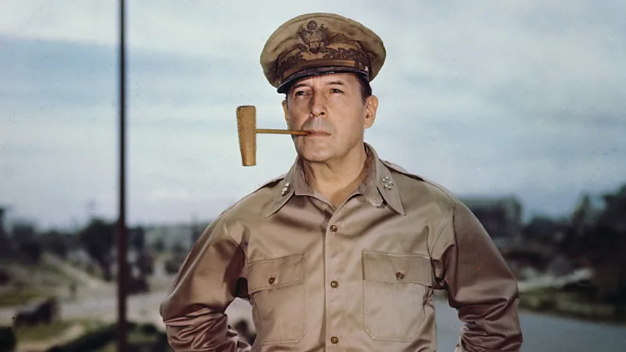
“Back to the Stone Age”
MacArthur argued that the US should threaten the use of nuclear weapons and bomb China itself unless the Communist forces in Korea laid down their arms.
This insistence of the viability of using atomic weapons deeply alarmed other UN countries caught up in the Korean conflict, including the UK Prime Minister, Clement Attlee, who flew to Washington, DC to object to the idea.
But MacArthur was adamant that his plan would work, believing the Russians would be intimidated and not do anything about the US striking China.

Slide 30
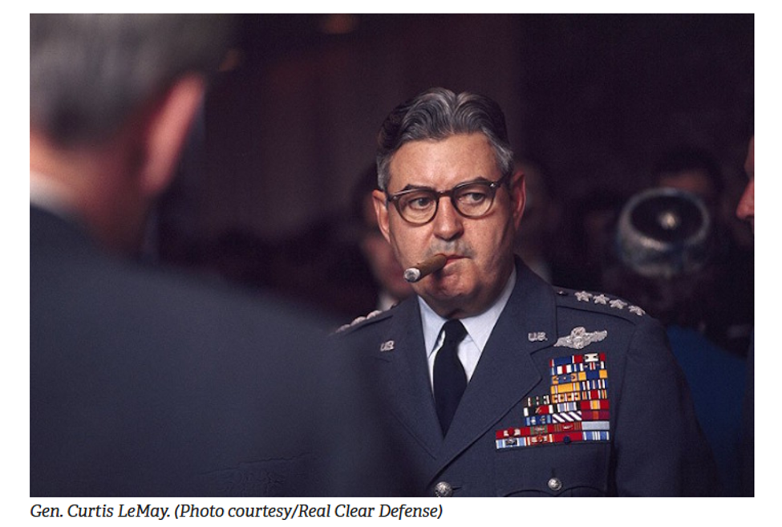
“Back to the Stone Age” (cont.)
On 9 December 1950, MacArthur formally requested the authority to have the discretion to use atomic weapons. Truman refused.
MacArthur was joined by General Curtis LeMay, head of the US Strategic Air Command during the Korean War, was also in favor of using nuclear weapons pre-emptively.
LeMay, who believed that a nuclear war was inevitable, would later try to persuade President John F Kennedy that he should be allowed to bomb nuclear missile sites during the Cuban Missile Crisis.
Two weeks later, MacArthur submitted a list of targets for strikes, including ones within China, and listed the number of atomic bombs he would require. He continued to push for the Pentagon to grant him a field commander's discretion to employ nuclear weapons as necessary.
"We're going to bomb them back into the Stone Age." -Gen. Curtis E. LeMay, Air Force Chief of Staff in 1965

Slide 31
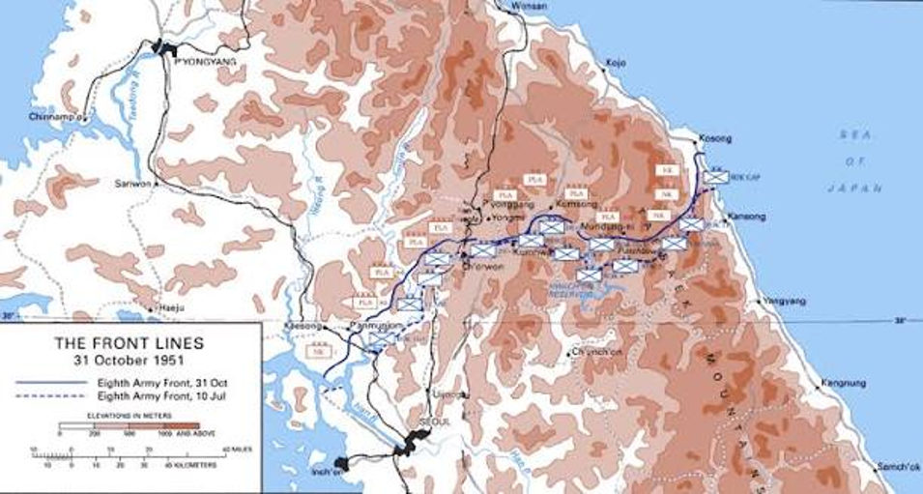
Stalemate at the 38th Parallel
"One of the great ironies of the war is that, at that point in the spring of 1951, where the front line of the two forces is, is not that far from the partition line, the 38th parallel. All of these great losses on both sides, the absolute civilian devastation that had occurred, but they were more or less back to where they started."
The two countries eventually ended the fighting with an uneasy truce in 1953, but they did not sign a peace treaty – meaning that technically they are still at war. The conflict was ruinous to the peninsula.

Slide 32
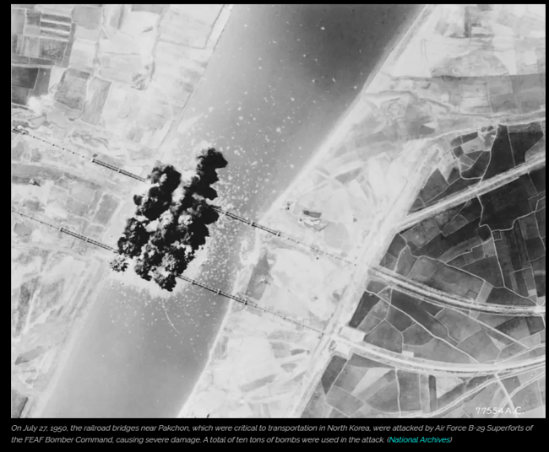
Relentless Destruction
The U.S. Military destroyed nearly all substantial buildings in a massive three-year bombing campaign of the Korean Peninsula
The U.S. dropped approximately 635,000 tons of explosives in the Korean conflict, exceeding the total tonnage dropped in the entire Pacific Theater during World War II.
Over 32,000 tons of napalm were deployed, causing widespread destruction to urban centers and rural areas alike.
Major cities, including the capital of Pyongyang, were largely reduced to rubble, forcing schools, factories, and hospitals to move underground.

Slide 33
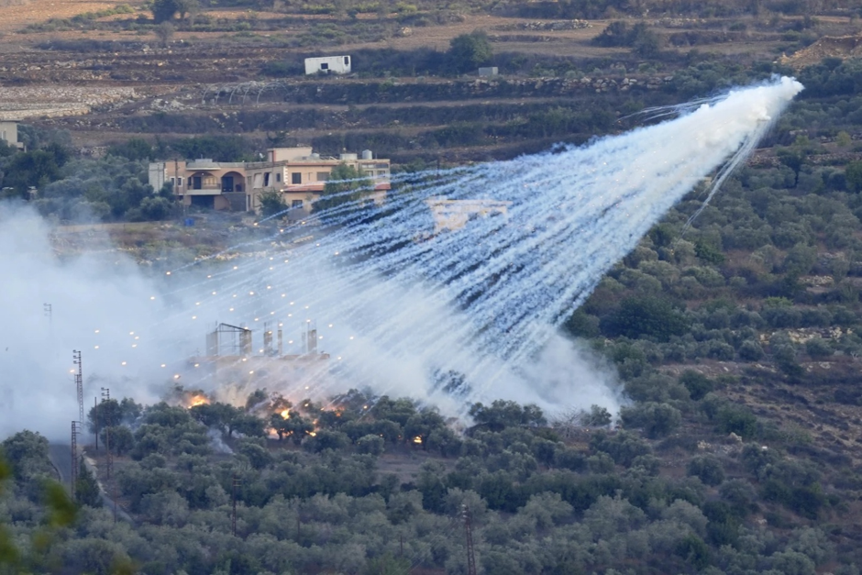
White Phosphorus
White phosphorus ⁠is a highly toxic substance that can ignite on contact with air and is used in ⁠battlefield smoke screens and incendiary weapons.
The physical destruction and loss of life on both sides was almost beyond comprehension, but the North suffered the greater damage, due to American saturation bombing and the scorched-earth policy of the retreating UN forces.
White phosphorus munitions are known to produce significant thermal effects, burning bodies and scorching lands in multiple contexts of military violence (e.g., in Gaza, Lebanon, Syria)

Slide 34
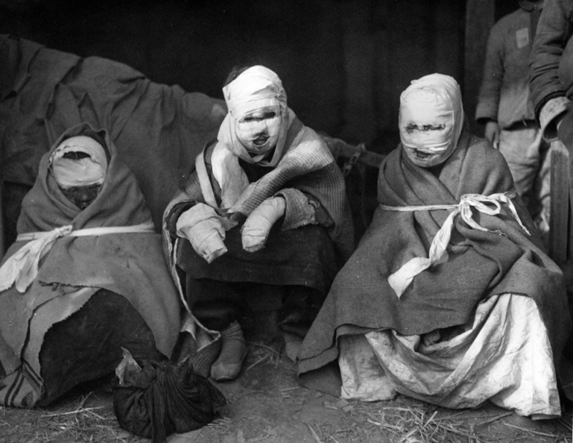
White Phosphorus
White phosphorus munitions are known to produce significant thermal effects, burning bodies and scorching lands in multiple contexts of military violence (e.g., in Gaza, Lebanon, Syria).
White phosphorus munitions also drift into urban areas and farmlands; they deplete ecosystems and damage agricultural products, causing long-term toxifying effects for both human and nonhuman life.
Most recently Israel deploys white phosphorus munitions in southern Lebanon, where farmers and residents report enduring effects on health and the environment.
White phosphorus munitions effect enduring and dispersed forms and volumes of military violence by operating to modulate inhabitability

Slide 35
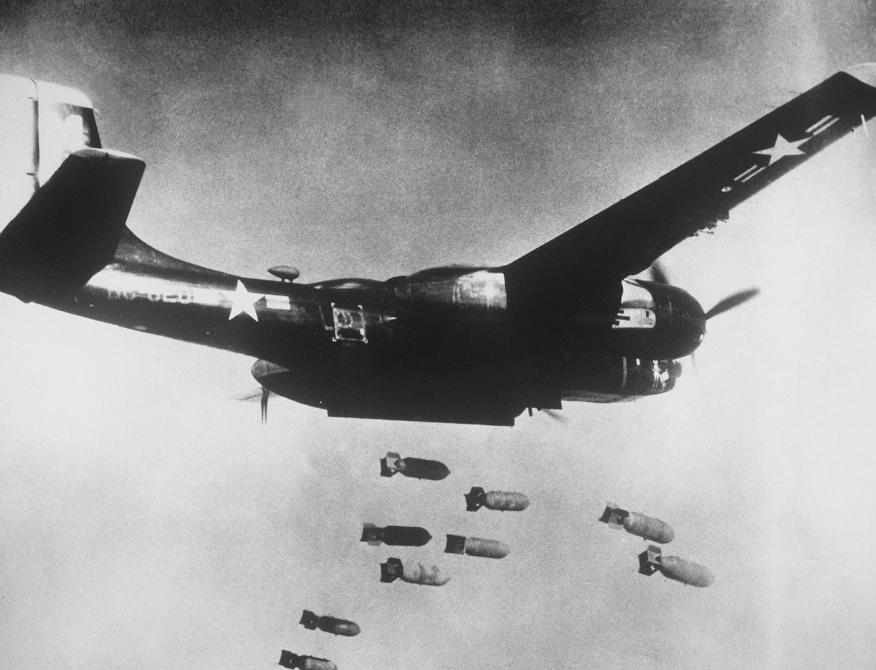
Decimated
The US Air Force estimated that North Korea’s destruction was proportionately greater than that of Japan in the Second World War, where the US had turned 64 major cities to rubble and used the atomic bomb to destroy two others.
The number of Korean dead, injured or missing by war’s end approached three million, ten percent of the overall population. The majority of those killed were in the North, which had half of the population of the South; although the DPRK does not have official figures, possibly twelve to fifteen percent of the population was killed in the war, a figure close to or surpassing the proportion of Soviet citizens killed in World War II.
The act which inflicted the greatest loss of civilian life in the Korean War by far, one which the North Koreans have claimed ever since was America’s greatest war crime, was the aerial bombardment of North Korean population centers.

Slide 36
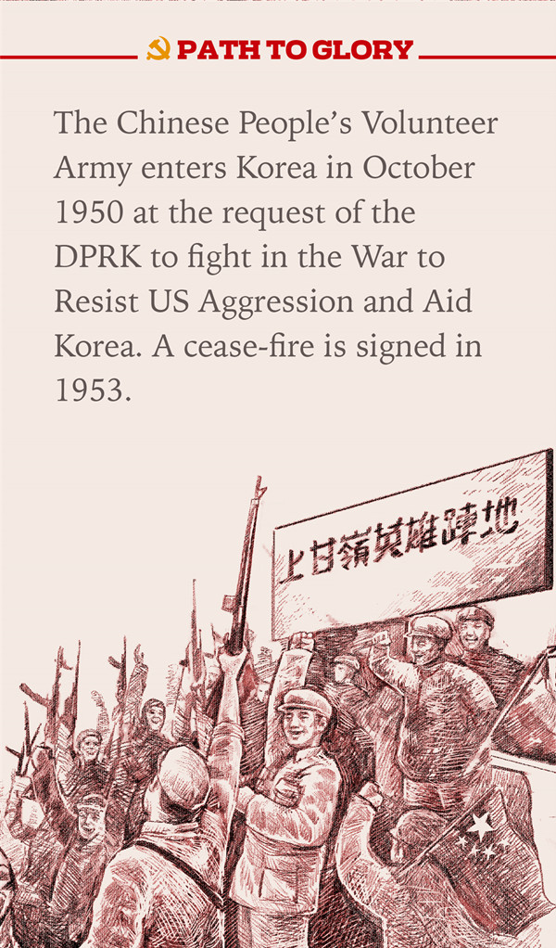
The U.S. Never Sought Peace
Referring to the American defence pact in South Korea, Mr Malenkov said: “It (The United States) is planned to go on maintaining South Korea in the status of a military springboard of the United States, which obviously runs counter to the exigencies of the final peaceful settlement of the Korean question and the strengthening of security in Asia.”
“For many decades the struggle of imperialist groups for domination in China has created a particular tension of international relations in the East, but there has appeared in the world a new Power which, together with all peace-loving forces, is upholding the interests of the strengthening of peace and international security.
China is now a mighty stabilising factor in the East,and will not be isolated. Peace-loving forces will use the Korean truce for new efforts to ease international tension throughout the world.”
The Chinese People's Volunteer Army enters Korea at the request of the DPRK to fight in the War to Resist US Aggression and Aid Korea.

Slide 37
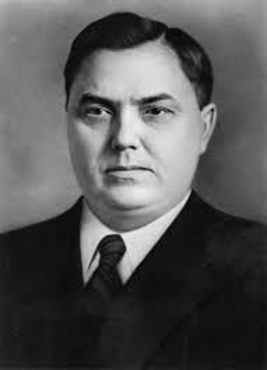
Fraternal Aid to Restructuring
Soviet Prime Minister, Mr. Malenkov denounced American Far East policy and accused it of failing to move towards “a final peaceful settlement” in Korea after the armistice.
Russia had earlier announced an agreement to help North Korea to rebuild her war-damaged country.
Western observers believe these moves indicate a widespread development of Soviet technical aid to Communist countries as a possible counter to the American mutual assistance program.
Mr Malenkov condemned American opposition to Indian and other Far East countries joining the political conference on Korea.
He said the armistice in Korea had shown that “the peace-loving forces can achieve the due settlement of acute international problems if they display this fortitude and persistence,” but it would be “unforgivable to pay no attention to the new schemes of the reactionary forces in the East. The aim of these schemes is perfectly obvious – to wreck the armistice in Korea and aggravate the situation in Asia and the Pacific.”
Soviet Prime Minister, Mr. Malenkov

Slide 38
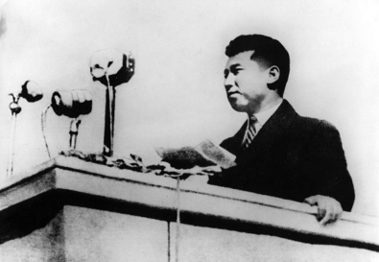
Rebuilding
Considering that the Soviet Union was still rebuilding from the devastation of World War II, that China had only recently concluded its civil war, and that East Germany (the third-largest aid source) was rebuilding from war as well, the scale of aid to North Korea is remarkable.
Contemporary Soviet sources give a breakdown in foreign assistance to the DPRK between 1953 and 1960 as dividing roughly into thirds, no doubt a division of labor suggested by Moscow. Exactly (33.3%) of reconstruction aid came from the USSR, 29.4% from China, and 37.3% from other countries.
The monetary figures do not consider aid in the form of labor, which was particularly important on the Chinese side. Source: USSR Academy of Sciences, 1988), p. 256
North Korea was dependent on fraternal assistance for more than 80% of its industrial reconstruction needs between 1954 and 1956, the period of the Three-Year Plan.

Slide 39
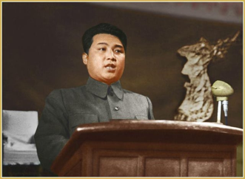
Rebuilding
North Korea could not possibly have rebuilt its economy as quickly as it did without this massive inflow of aid into nearly every sector of production and consumption.
But the DPRK did not remain aid-dependent for long. Partly this was out of necessity, as socialist-bloc aid was intended from the beginning to be phased out as reconstruction was completed.
Yet it is remarkable how quickly North Korea’s aid dependency dropped – North Korea’s declaration of “self-reliance” by the end of the 1950s was not without substance.
In 1954, 33.4% of North Korea’s state revenue came from foreign aid; in 1960, the proportion was down to a paltry 2.6%. By contrast, well over half of South Korea’s government revenue came from foreign assistance in 1956. By the early 1960’s, well before South Korea’s industrial take-off, the North had impressively re-industrialized.

Slide 40
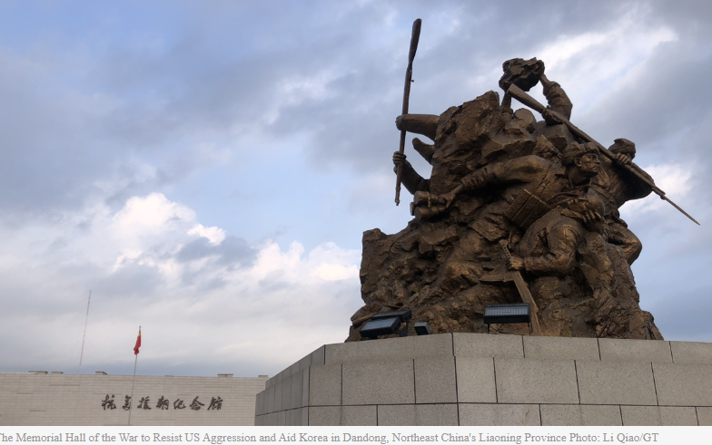
Chinese Volunteers Remain to Rebuild
In labor-short North Korea, the physical assistance of Chinese People’s Volunteers was invaluable for the rehabilitation of the war damaged infrastructure.
Chinese technical experts went to North Korea, and Koreans traveled to China for technical training. But perhaps the most important contribution that China made to North Korea’s reconstruction, in addition to monetary aid and debt cancellation, was the manpower supplied by Chinese People’s Volunteer (CPV) troops who remained in North Korea until 1958.
These troops, who numbered in the thousands, helped repair roads and rail lines damaged by war and rebuild schools, bridges, tunnels and irrigation dams.
The period of post-war reconstruction in North Korea was the first and only time the Soviet Union, China, and the Soviet-aligned countries of Eastern Europe and Mongolia cooperated on a large-scale economic project of this nature. It was the historical high point of “international socialist solidarity,” one that would never be repeated after the USSR and China fell out in the early 1960s.
The Memorial Hall of the War to Resist US Aggression and Aid Korea in Dandong, Northeast China's Liaoning Province Photo: Li Qiao/GT

Slide 41
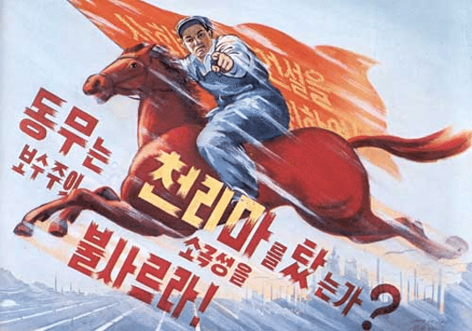
The Chollima Movement (cont.)
The slogan of 'Let us dash forward in the spirit of Chollima' was adopted to help motivate workers, with the result that successes were reported in many areas of economic activity. North Korea experienced an annual industrial growth of 36.6 percent during the five-year plan.
In 1959, the Chollima Work Team Movement was started. This was a system of socialist competition waged among teams of workers, upholding the Communist lifestyle and working under the lofty socialist ideal "One for all and all for one."
"A work team would receive the title of Chollima Work Team by setting a production target high enough to stand out among other work teams in the whole nation and actually attaining the target as assessed competitively under a national evaluation system." If the title was awarded the team and its members would receive honorific items such as Chollima embossed banners, flags and notebooks.

Slide 42
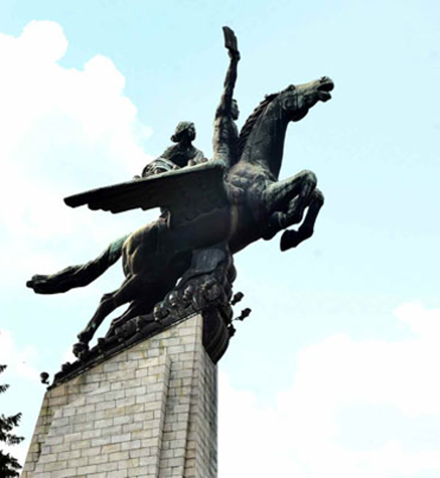
The Chollima Movement
At a meeting of the Workers' Party of Korea held in December 1956, Kim Il Sung called on the nation to be more motivated in economic production. He said, "Let us produce more, practice economy, and over fulfill the five-year plan ahead of schedule!" Within four years the aims of the five-year plan were met.
Kim Il Sung first introduced the term Chollima in December 1956, shortly before the start of the 1957-61 five-year plan.
The successes of the Chollima movement were first seen in 1957 when Kim Il Sung called on workers in a factory near Pyongyang which only had a capacity of 60,000 tons to produce an extra 10,000 tons of steel. The factory, however, was able to produce 120,000 tons, 60,000 tons more than its capacity. This achievement was credited as lighting the torch of the Chollima movement. The term 'Chollima rider' was given to workers who surpassed their targeted goals of production. This title encouraged people to work harder.

Slide 43
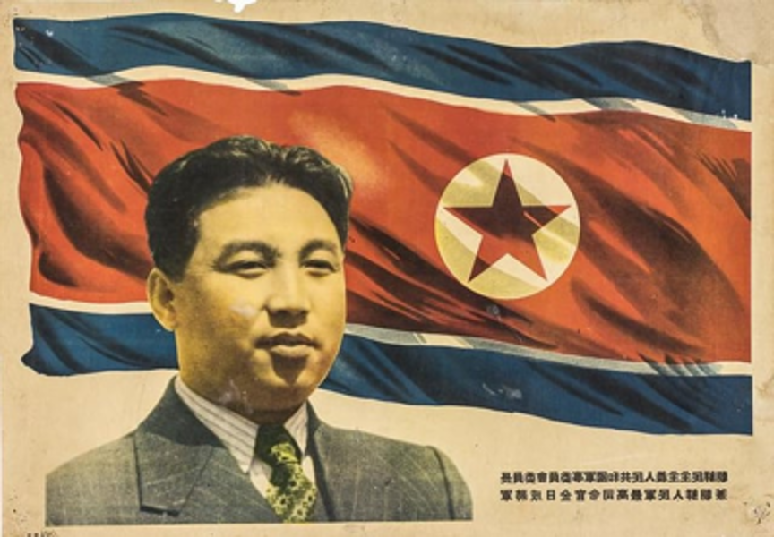
Rebuilding towards Self-reliance
This difference cannot be explained by foreign aid alone, which was far greater in absolute terms in South Korea than in the North. The regime’s ability to mobilize the North Korean population was also indispensable for the success of this project.
In just over five years, North Koreans with East German assistance rebuilt Hamhung as a modern industrial city, and for decades the city would be the main industrial hub of North Korea outside the capital Pyongyang. In 1960 – long before the term would be applied to South Korea – the East German press called North Korea “an economic miracle in the Far East.”
In June 1956, Kim Il Sung visited the GDR and personally thanked the East Germans for their help. But from the beginning of the reconstruction process, the DPRK leadership had seen foreign assistance as a limited process that would gradually give way to North Korean self-reliance.
In December 1955 Kim made his subsequently famous speech about “Juche” or self –reliance, Originally referring to ideological independence, especially with regard to the Soviet Union, over the course of the next two decades Juche would be extended to all aspects of North Korean behavior, from politics to economics to military defense.

Slide 44
Discussion & Wrap Up

Slide 45
Announcements
PCUSA Cell Chairs need to call members of their cells to remind them about attendance.
PCUSA Cell members are reminded attendance at the Continuing Education class of Jones-Foster every first Wednesday of the month is required.
The next issue of New Masses (2026) has begun production. If you have art you want us to feature, email it to info@partyofcommunistsusa.net.

Slide 46
Volunteers Needed!
We are in need of volunteers for the staff of the People’s School! Here’s a few roles we need filled:
People to help manage posting on our social media and podcast platforms
Video Editors, Audio Editors, Graphic Designers, Artists, Narrators
Web Controls, Moderators
Email info@peoplesschool.us if you’re interested and try to attend our next staff meeting if possible.

Slide 47

View From Left Field
https://viewfromleftfield.libsyn.com
The Old PSMLS Youtube is now the Youtube of View From Left Field, a podcast of analysis and discussion of current events from a progressive perspective.
Like the Youtube videos and subscribe with 5 star ratings on your podcast platforms.

Slide 48

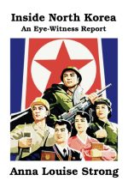
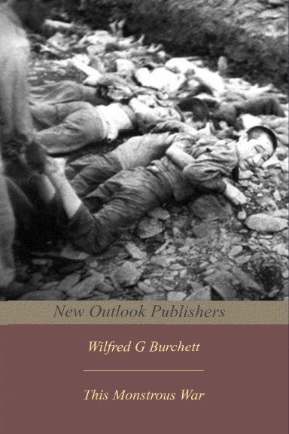
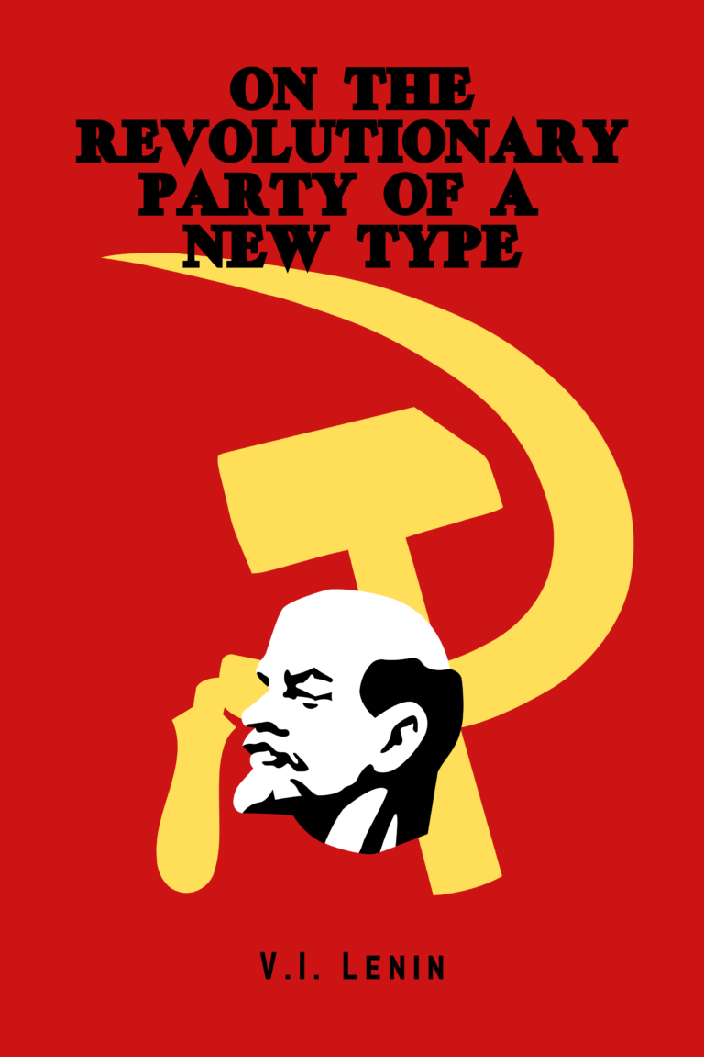

New Outlook Publishers
newoutlookpublishers.store
Relevant and Latest Releases

Slide 49


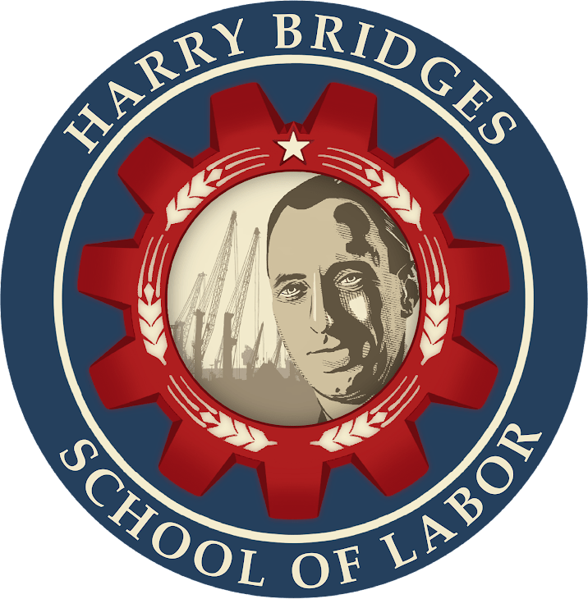
Harry Bridges School of Labor
luel.us/laborschool/
The Harry Bridges School of Labor is a monthly class covering a variety of topics aimed at building class consciousness among union members. For class schedule and other information, please visit the website at luel.us/laborschool.

Slide 50
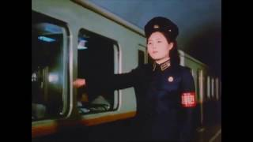
Chollima On The Wing by Pochonbo Electronic Ensemble

