Slide 1


Star Spangled Banner - George Wesley, Jr.

Slide 2
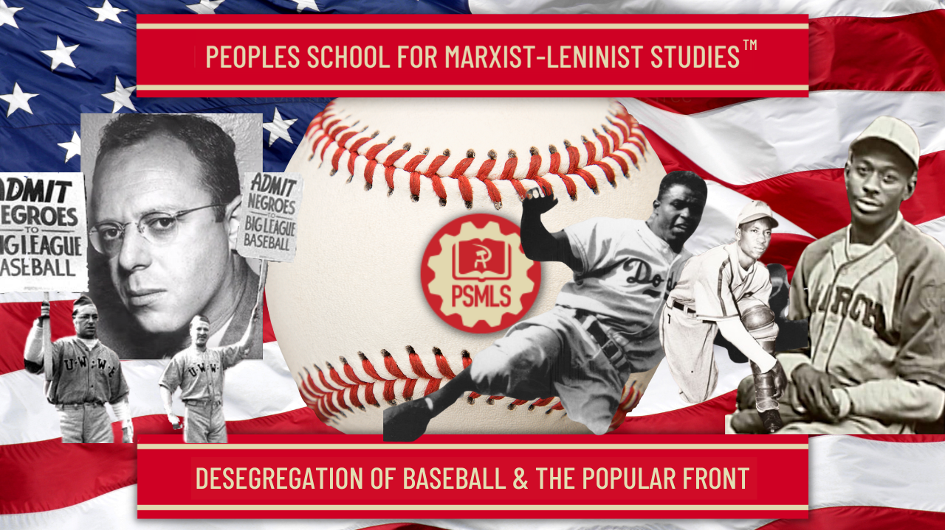
PSMLS 8/31/26

Slide 3
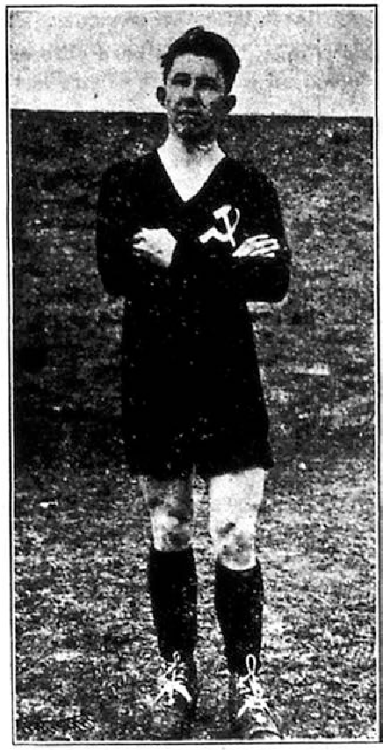
The Party, Sports and the Popular Front
American Communist Journalist Lester Rodney, the Daily Worker, and the Fight to Desegregate Baseball
Sports as a Platform for Democracy
A player for the New York Red Sparks Soccer Club

Slide 4
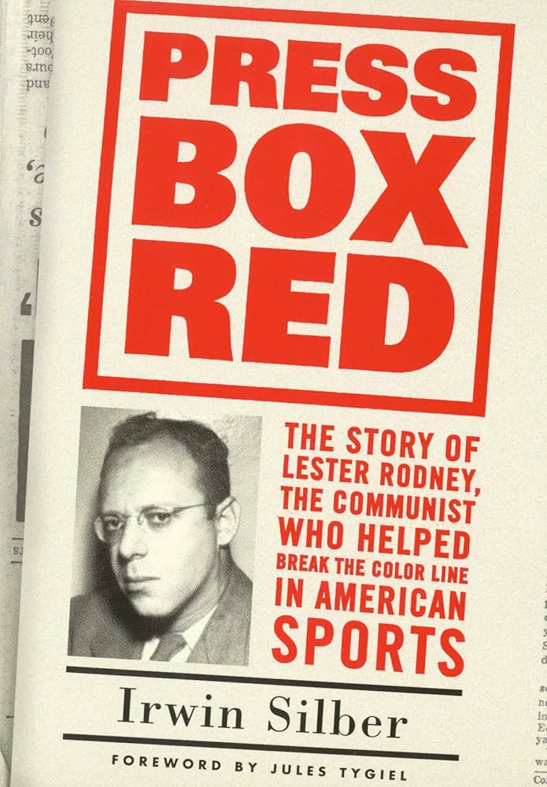
Press Box Red
The Story of Lester Rodney, the Communist who Helped Break the Color Line in American Sports
By Irwin Silber

Slide 5
The Party, Sports & The Popular Front

Slide 6
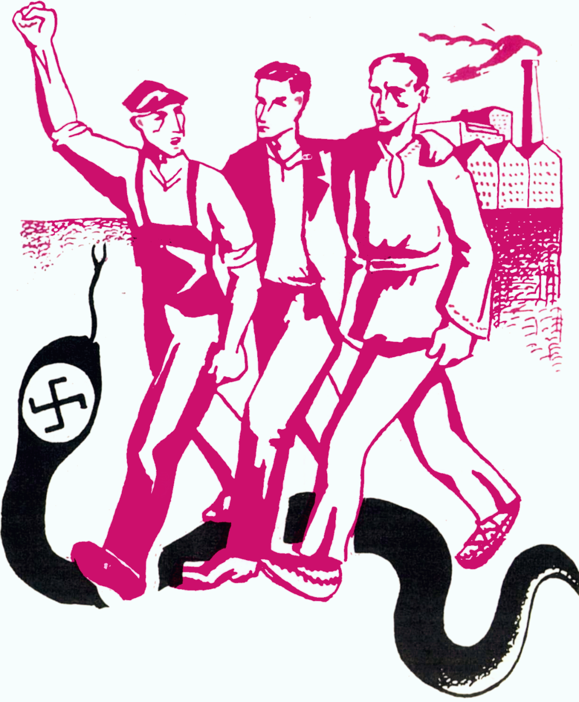
The Popular Front Era
On July 25, 1935, at the historic Seventh World Congress of the Communist Third International (Comintern) held in Moscow, the assembled seventy-six Communist Parties of the world adopted a major shift in political outlook. Spurred by the growth of fascism and the rise of Hitler in Germany, the Comintern dropped its previous focus on the promotion of world revolution in favor of building in every country a broad-based Popular Front against war and fascism.

Slide 7
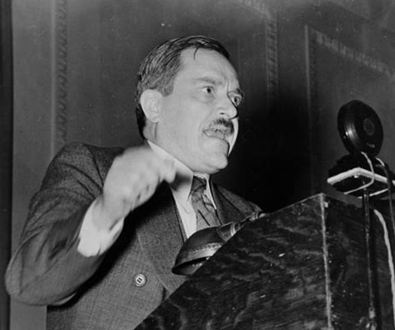
Communism as American as Apple Pie and Baseball
More explicit in the new approach was the view that Communist Parties should no longer divorce themselves from their respective national traditions and culture.
For the U.S. Communist Party in particular, it meant a new and heightened emphasis on what was already a nominal goal—the Party’s Americanization.
“We are the Americans, and Communism is Americanism of the 20th Century.” ~ Earl Browder - What Is Communism- June 1935

Slide 8
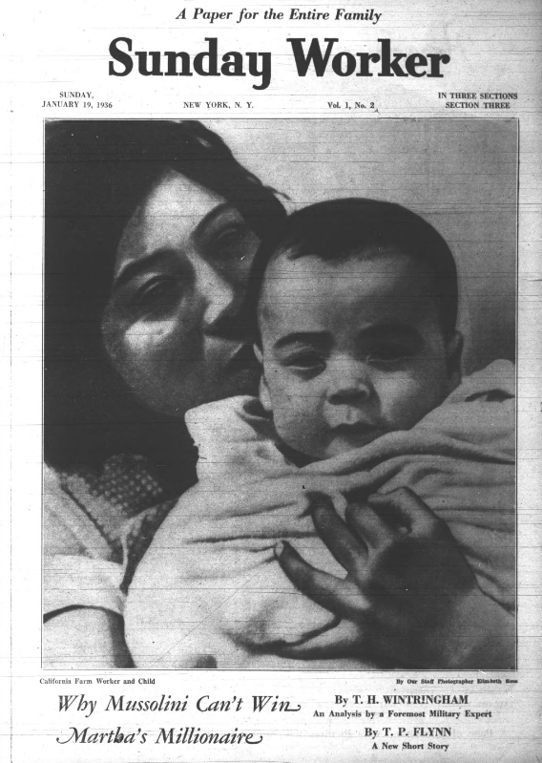
Weekend Edition of the Daily Worker
One spin-off of the turn to Popular Front politics was a decision to begin a weekend edition of the Daily Worker that would be aimed at reaching a broader audience than the daily paper did. The first issue of the new Sunday edition of the Daily Worker, the Sunday Worker appeared January 12, 1936. Opening its new tabloid-size pages, the readers found cartoons, comic strips, catchy headlines, new bylines (along with some old ones). In addition to three full pages of movie, theater, and music reviews, there were feature articles dealing with great moments in American history, a woman’s page featuring household hints, recipes, articles on parenting, and short fiction with a working-class bent.

Slide 9
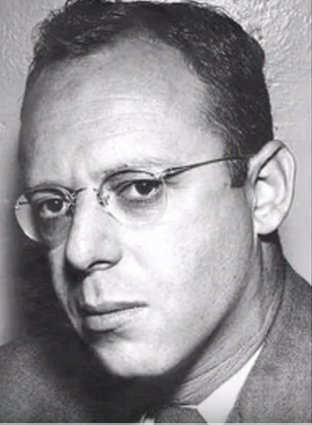
Weekend Edition of the Daily Worker
Many of the individuals who ran the Daily Worker and the Sunday Worker, however, had little understanding or knowledge of American sports. Their earliest once-a-week efforts proved heavy-handed and propaganda-laden. Reading these dispatches prompted Lester Rodney, a freelance writer, to send a letter suggesting a different approach. Rodney had grown up in Brooklyn, an avid athlete and fan. Rodney believed that a sports page, even one in a Communist newspaper, must not only critique the flaws of capitalist athletics but also convey the love of the games that drew fans to them. To Rodney, sport was not an
“opiate for the masses” but an important component of people’s lives and culture. His enthusiasm convinced the editors of the Daily Worker to entrust him with responsibility for a new daily sports section.
Rodney Lester

Slide 10
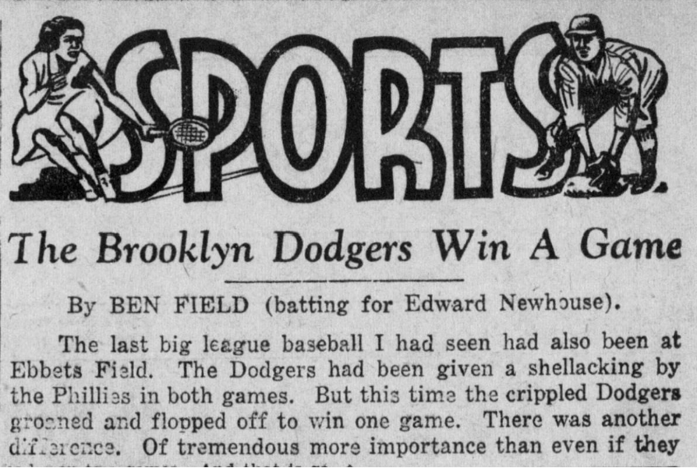
In 1933, staff writer Ben Field ventured out to report on a Dodgers-Giants game at Brooklyn’s Ebbets Field. Noting the typically raucous comments of the fans as they responded to the ebb and flow of the game, Field wrote:
“Are these ‘bad elements’? Many are workers who have so identified themselves with their team that they cannot sleep or eat when the team loses.The leanness of American life under capitalism drives them to this fever.”

Slide 11
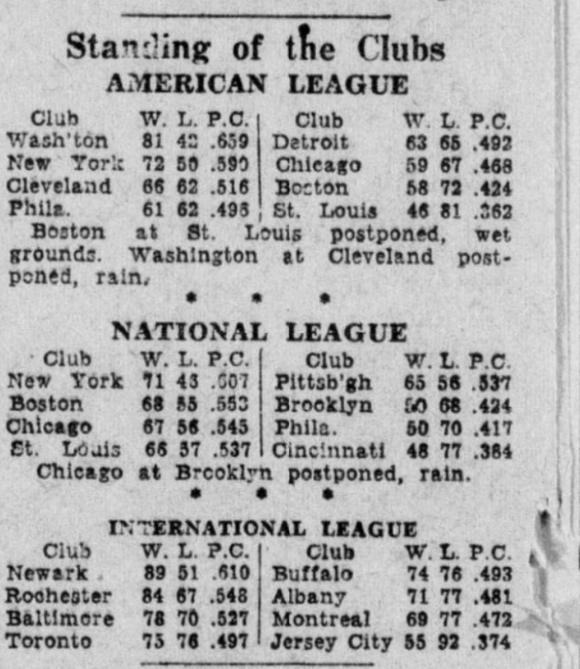
Nevertheless, Field did make a certain kind of history when he wrote: “You spot a few Negro fans. Negro workers make good athletes. But where are the Negroes on the field? The Big Leagues will not admit Negro players. There is something else to chalk up against capitalist-controlled sports.” It was the first time that the Daily Worker highlighted the issue that, a few years later, would become one of the hallmarks of its sports section (Daily Worker, August 29, 1933).
The Daily Worker, like any other paper, would report on the standings in Baseball

Slide 12
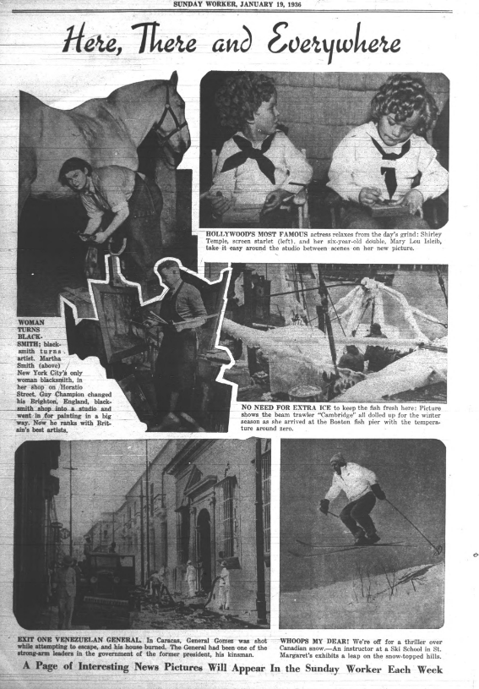
“The People’s Front must be directed towards identifying these enemies.”
Most astonishing of all, perhaps, were the two full pages devoted to
sports. Gone were the ponderous dismissals of professional sports as nothing but an ideological tool of the bosses and the patronizing continents
about the fans who came out to the games.
It was probably one of the first issues of this new weekend edition of the Daily Worker that Lester Rodney, the Communist who helped break the Color Line in American Sports found himself thumbing through on a January winters night on the NYU campus.

Slide 13
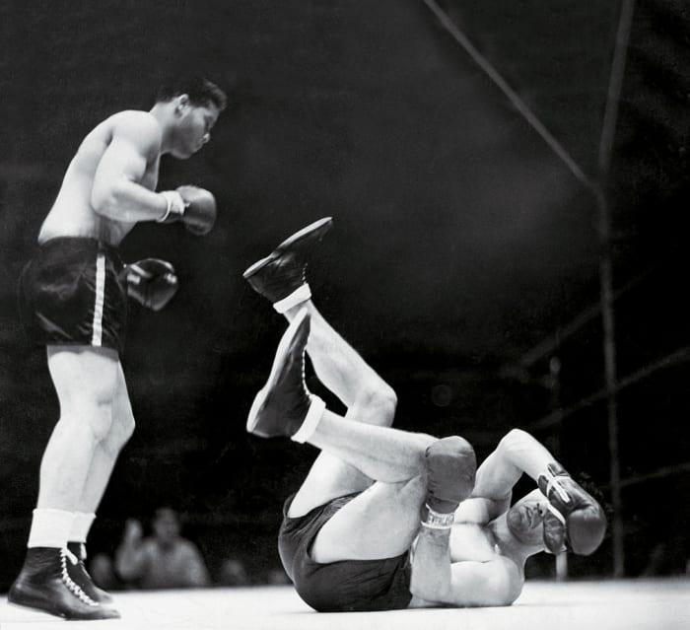
“The People’s Front must be directed towards identifying these enemies.”
Even while racial barriers were eroding in the other sports as a result of the breakthrough of Jesse Owens and his fellow black starts at the 1936 Berlin Olympics and the accomplishments of Joe Louis and Henry Armstrong in the boxing ring, “organized” baseball remained lily-white.
Rodney Lester: Our biggest asset though, was that the tunc was light Black athletes had stolen the show at the 1936 Olympics in Berlin, especially Jesse Owens, who won tour of five gold medals. And Hitler had made such a big deal about his
Aryan athletes was so embarrassed he wouldn’t even shake the hands of the American blacks. This was all over the newspapers, which had these marvelous pictures of black medal winners draped with the American flag.
And Joe Louis was on his way to the heavyweight title. The last time there’d be a black heavyweight champion in more than twenty years So it was a good time to say. ‘Why not in baseball?'
June 22, 1938: Joe Louis won by KO over German Max Schmeling. With Hitler in power and a second world war looming, Louis was cast as the defender of democracy against Schmeling, the hero of Nazi Germany.

Slide 14
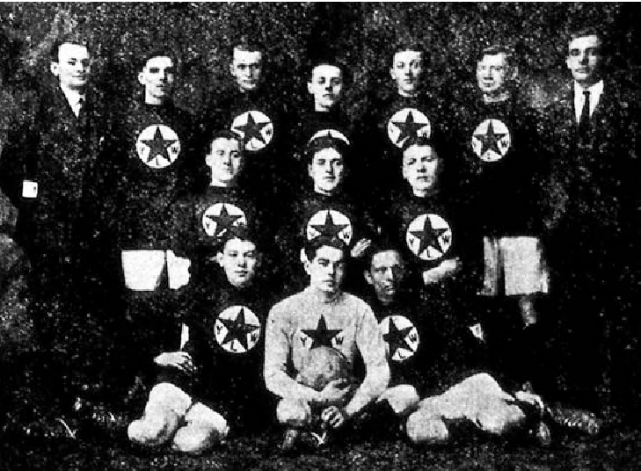
The Party, the Daily Worker and Sports
Until the early 1930s, the Party's membership was made up largely of European immigrants who had brought with them a tradition of workers’ sports associations, organized principally by socialist and Communist parties. In some Central European countries, membership in such organizations numbered in the hundreds of thousands. The main sports these immigrants enjoyed playing and watching were soccer, volleyball, gymnastics, and track and field.
The CPUSA established the Labor Sport Union, a coalition of worker athletic clubs, primarily located in the urban Northeast and Midwest. One of their successful sporting accomplishments was the Workers' Soccer Association (WSA).This communist soccer league played two seasons per year and competed for city, regional, and national championships. (From the Young Worker)

Slide 15
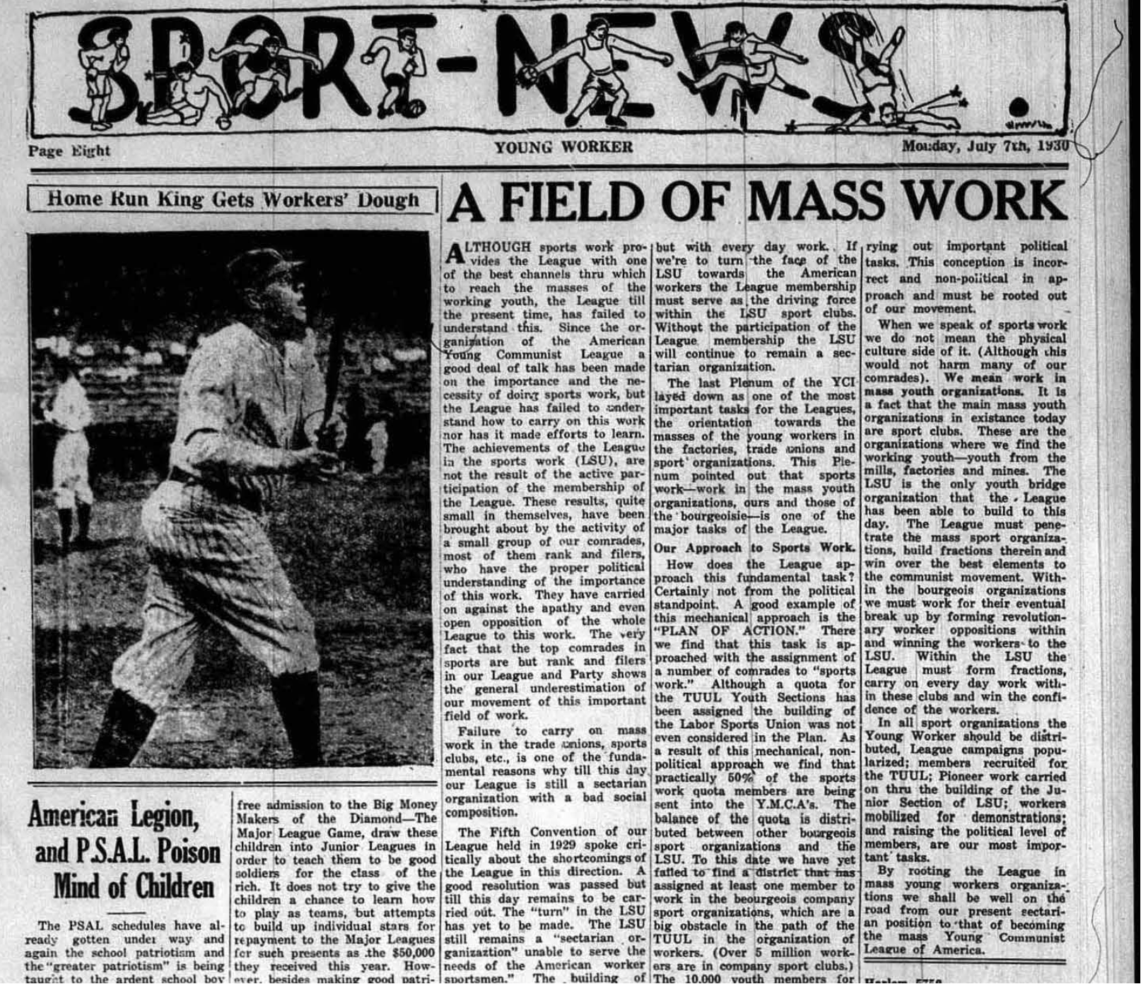
The Party, the Daily Worker and Sports
In 1927, acknowledging their own members’ interest in sport and trying to reach out to others of similar national background, the U.S. Communist Party helped establish the Labor Sports Union (LSU). While the Daily Worker occasionally reported on the LSU’s activities—one can find there the announcement of an “Eastern District Wrestling Meet’’ and a “Workers’ Table Tennis Meet,” along with the standings of the Metropolitan Workers’ Basketball League and the schedule of the Metropolitan Workers’ Soccer League (February 3, 1933)—regular Communist coverage of sports was to be found only in the pages of the Young Communist League’s monthly newspaper, the Young Worker.

Slide 16
Discussion & New Members Introductions

Slide 17
New Member Introductions
What is your name, pronouns and state (or country/territory)?
Where do you work? Is it unionized?
How did you find out about the People’s School?
What do you think about tonight's class?

Slide 18
Lester Rodney & the Fight to Desegregate Baseball

Slide 19
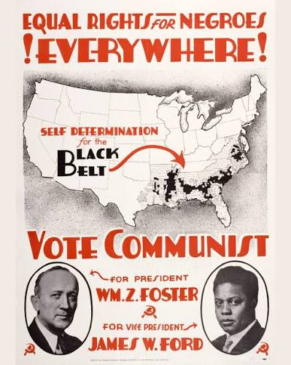
A Communist in the Press Box?
Lester Rodney: By the time I got to NYU in the thirties. I still didn't know much about communism. I was working odd depression-type jobs by day and going to NYU at night.
I wasn't looking for a degree or anything, just picking a few courses that interested me: journalism, sociology, political science. But you couldn't avoid the political discussions that went on everywhere.
I used to argue with the Communists at first. I'd use the same arguments that people later used against me. like "You can't change human nature." Things like that.
1932 Campaign Poster Communist Party USA. James W. Ford was the first Black VP candidate in history.

Slide 20
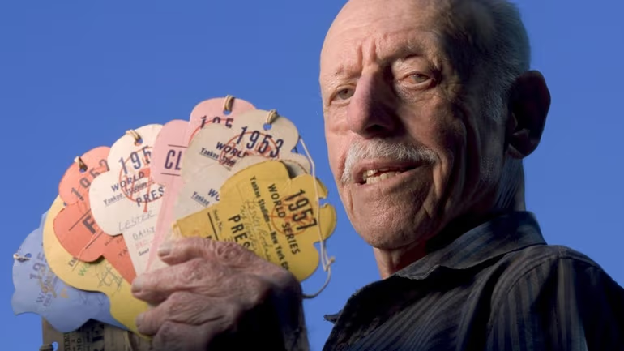
A Communist in the Press Box?
Leonard Rodney on getting a press pass: The first thing I did was write to the secretary of the Baseball Writers’ Association (BBWA) of America. I told him the Daily Worker had started a sports section and I was covering baseball and wanted to be a member.
They wrote back and said, in effect ‘You’d better get a track record.’ It took a year before I was admitted as a working professional for a regular sports section.
They wanted to see that we were really covering sports and not just writing “Communist propaganda.”
Lester Rodney holding the press passes he earned as a working professional Baseball Writers’ Association (BBWA) of America

Slide 21
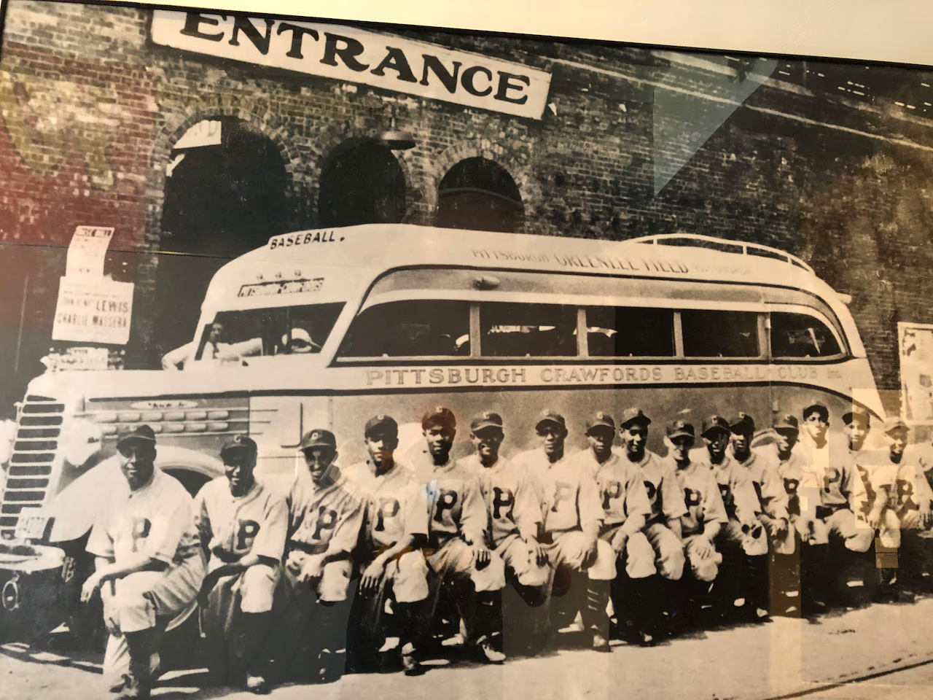
A Communist in the Press Box?
LR: In general, I got along pretty well with the other writers. They got a kick just out of my being around. Newspapermen like the offbeat. I wasn't there as a Communist but as a sportswriter. They knew where I stood politically, but I didn't preach to them.
You know, in all my years as a sportswriter nobody ever raised the question whether a Communist should be allowed in the press box—not even in the McCarthy years during the fifties. Because they knew me. I'm a fellow working sportswriter and knowledgeable.
Pittsburgh Crawfords, 1935 (Negro Leagues Baseball Museum)

Slide 22
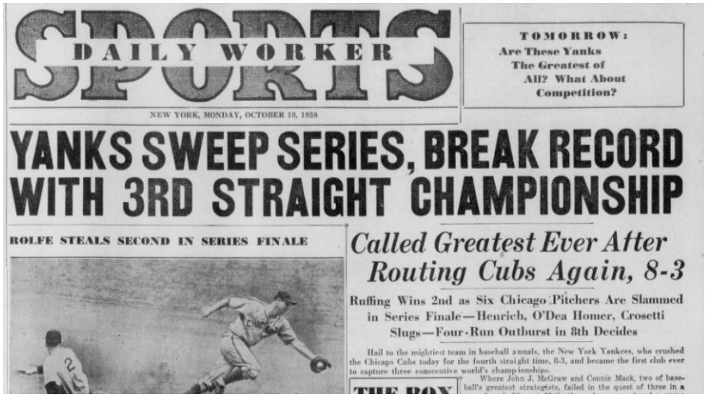
Covering sports in the Daily Worker
LR: We covered the games just the same as the other sports writers but in addition we began to introduce these other questions. But seperate.
We didn’t write stories about how the Dodgers defeated the Giants 3-2 and so and so pitched, and then in the next sentence say, “but where were the Black players?” We just ran sports stories, but separately in the same page we began raising the question of Black players.

Slide 23
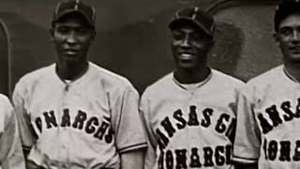
Crime of the Big Leagues (full movie) - Lester Rodney's fight to desegregate baseball

Slide 24
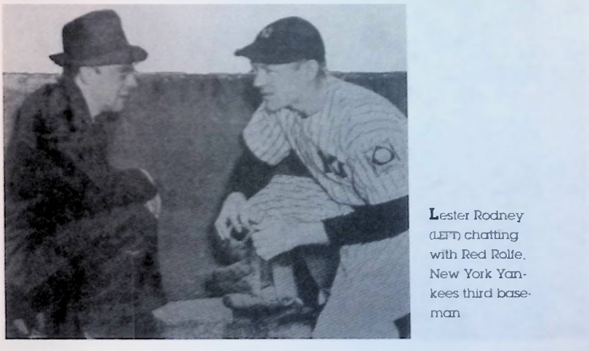
Mike Gold wrote. "We must never cease to be that 'nerve over which oppression's pains are felt, otherwise unrecorded.' We must keep on fighting until jim crow is ruined, finished, destroyed in every dirty root and fibre.”
"I hope this victory will gladden the lonesome days of Lester Rodney and make him remember that his life has been important in the anti-fascist struggle. We owe a big bouquet to Lester Rodney."

Slide 25
Discussion

Slide 26
The Negro Baseball League and Breaking the Color Line in Baseball.

Slide 27
The Negro National League and the First Black Players into the Major Leagues

Slide 28
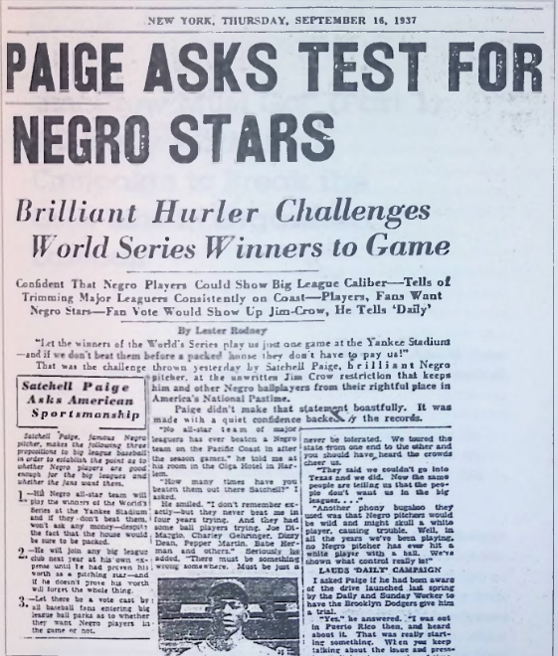
“Jim Crow Must Go!”
The Daily Worker sportswriters also wrote often about the talented stars of the Negro Leagues and urged readers to attend black baseball games to see for themselves what the color line was denying them. The newspaper also informed its readers of the history of the Negro Leagues and how major league managers, such as John McGraw of the New York Giants, had praised the talents of its stars and how McGraw himself had tried to sign a black player, Charlie Grant, in the early 1900s.

Slide 29
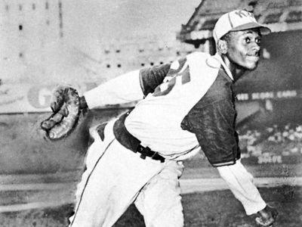
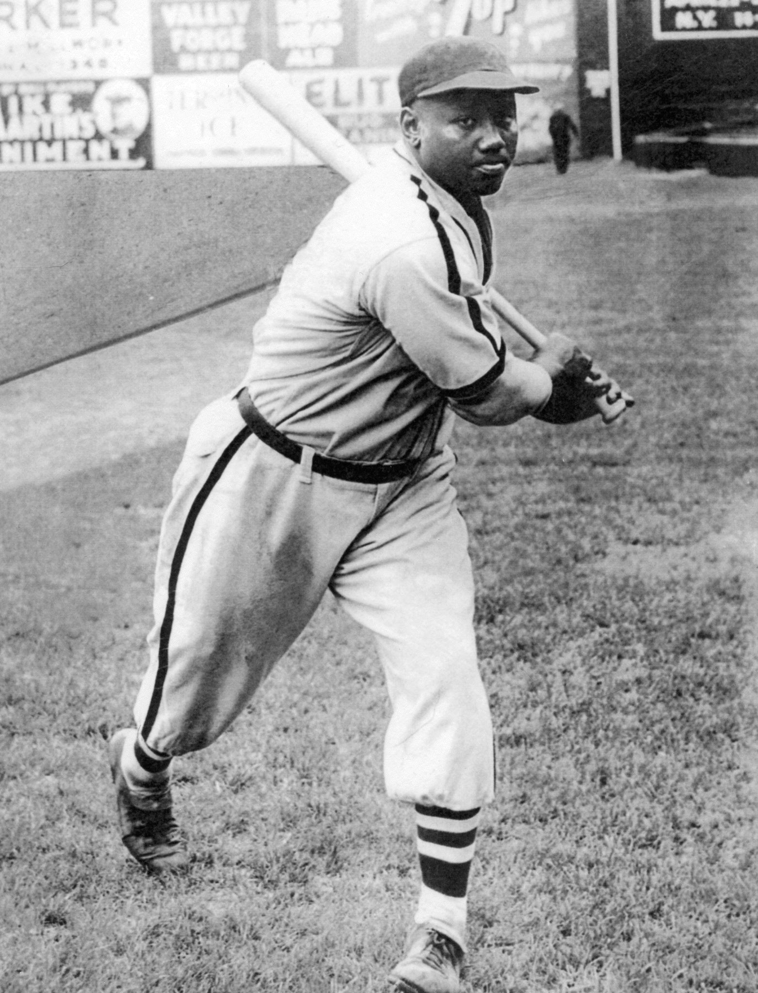
Burleigh Grimes, manager of the Brookyln Dodgers, admitted to Lester Rodney in an interview that he had been impressed with black players during off-season barnstorming games.
"How would you feel about putting a Dodger uniform on Satchel Paige and Josh Gibson?" Rodney asked.
The question made Grimes uncomfortable. "You're wasting your time," he answered.
"That'll never happen as long as there are segregated trains and restaurants." Rodney then said,
"Can I say how good you think these players are?" "No, no," Grimes answered. "He didn't want to stick his head out," Rodney said.
Satchel Paige
Josh Gibson

Slide 30
Campaign to integrate Blacks into Major League
The actual implementation was in the hands of a middle level of Communist Party leadership who were baseball fans and some of the leading people in the YCL, the live ones like Gil Green and Carl Ross, whose political imaginations could grasp the implications of the campaign.
Pete Caccione - he was the Communist city councilman from Brookyln - also got into it in a big way. The top Party leaders would give me an occasional pat on the back, but they had other things on their mind.
LR: Members of the YCL fanned out everywhere with petitions at the Big League ballparks, the Negro League games,busy street corners. They’d go up to people and ask, “Would you sign a petition to give Negro ballplayers a chance to play in the Big Leagues?” And they got pretty good responses.
Although Rodney Coordinated the campaign, the underlying foundation for it was the Communist Party and the various institutions it set up.

Slide 31
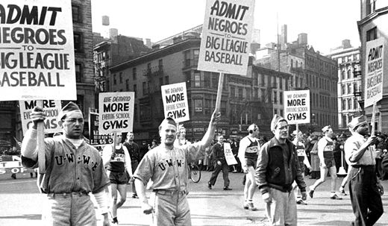
On Trade Unions joining the struggle
In the spring of 1939, the campaign penetrated the halls of the New York state legislature when State Senator Charles Perry from Harlem introduced a resolution originally drafted by the Daily Worker writer Mike Singer.
In 1940, the momentum generated in 1939 kept picking up steam. Now other papers and groups, not just the Daily Worker, were getting into it. A
major step was taken when the New York Trade Union Athletic Association (TUAA) threw its weight into the campaign.
LR: Our people in the trade unions really pushed the campaign. The NMU [National Maritime Union], District 65, a huge union, mostly young workers with left leadership, and the Furriers (Fur union). It came as a big shock to a lot of trade unionist that blacks weren’t allowed in baseball. We had to educate them to the fact that there were black players good enough to play in the Big Leagues. Many of them have never heard of Satchel Paige.
Members of the United Wholesale and Warehouse Workers Union (CIO) marching in the
New York May Day parade, 1940
Many unions consisted of young trade unionists reading the Daily Workers and in the Party. They Also had their own baseball teams.

Slide 32
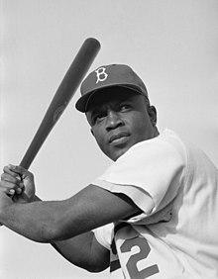
Of the many fine Negro ball players I’ve seen in recent years. Jackie Robinson strikes me as having the best chance to cut the bin k in organized bail. He’s a corking fielder, a darned good hitter and a helluva guy with a bunt. But it isn't until you’ve seen him on the bases that you realize what a tootsie he is. His extraordinary speed will drive pitchers crazy and balk them to death.
[Daily Worker. October 4. 1939)
Also in 1939, the first paper in the country to tout Jackie Robinson, then
a student at Pasadena Junior College in California, as a major league prospect was the Daily Worker.
Jackie Robinson

Slide 33
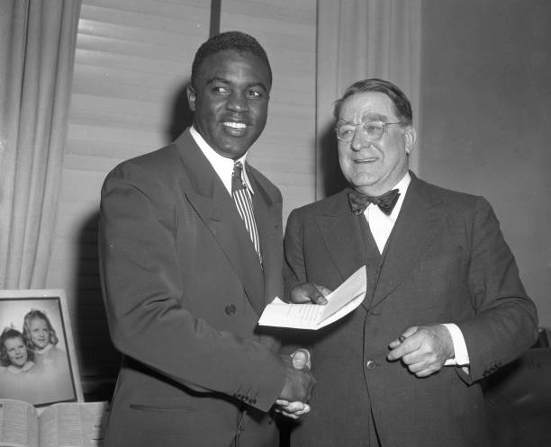
Until Branch Rickey, president and general manager of the Brooklyn Dodgers, signed Jackie Robinson to a Brooklyn Dodgers organization contract in 1945, baseball color line was largely unaddressed by the mainstream sports media, while being vigorously denied by the baseball hierarchy. Even while racial barriers were eroding in the other sports.
Jackie Robinson
Branch Rickey

Slide 34
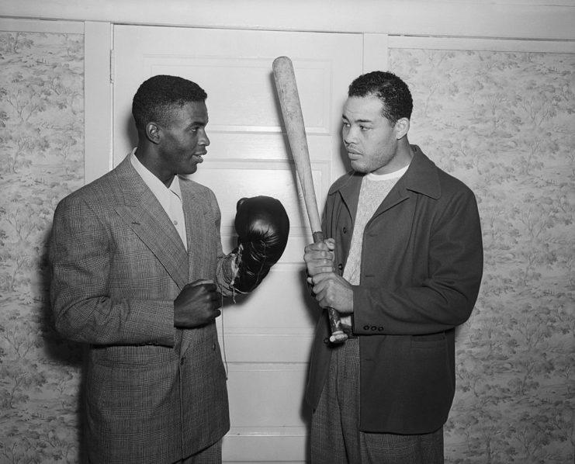
This was a new day for baseball and society -- and the Worker praised itself and the Communist Party for helping to bring it about. Once again, they reminded their readers that they often had been the only daily newspaper to raise the issue. The Worker added that it would not be satisfied until there was no more segregation. "We must crusade and fight for justice even if we are alone,"
Jackie Robinson served in the military from 1942-1944 where he met Joe Louis. This picture is after Robinson was signed into the Major Leagues.

Slide 35
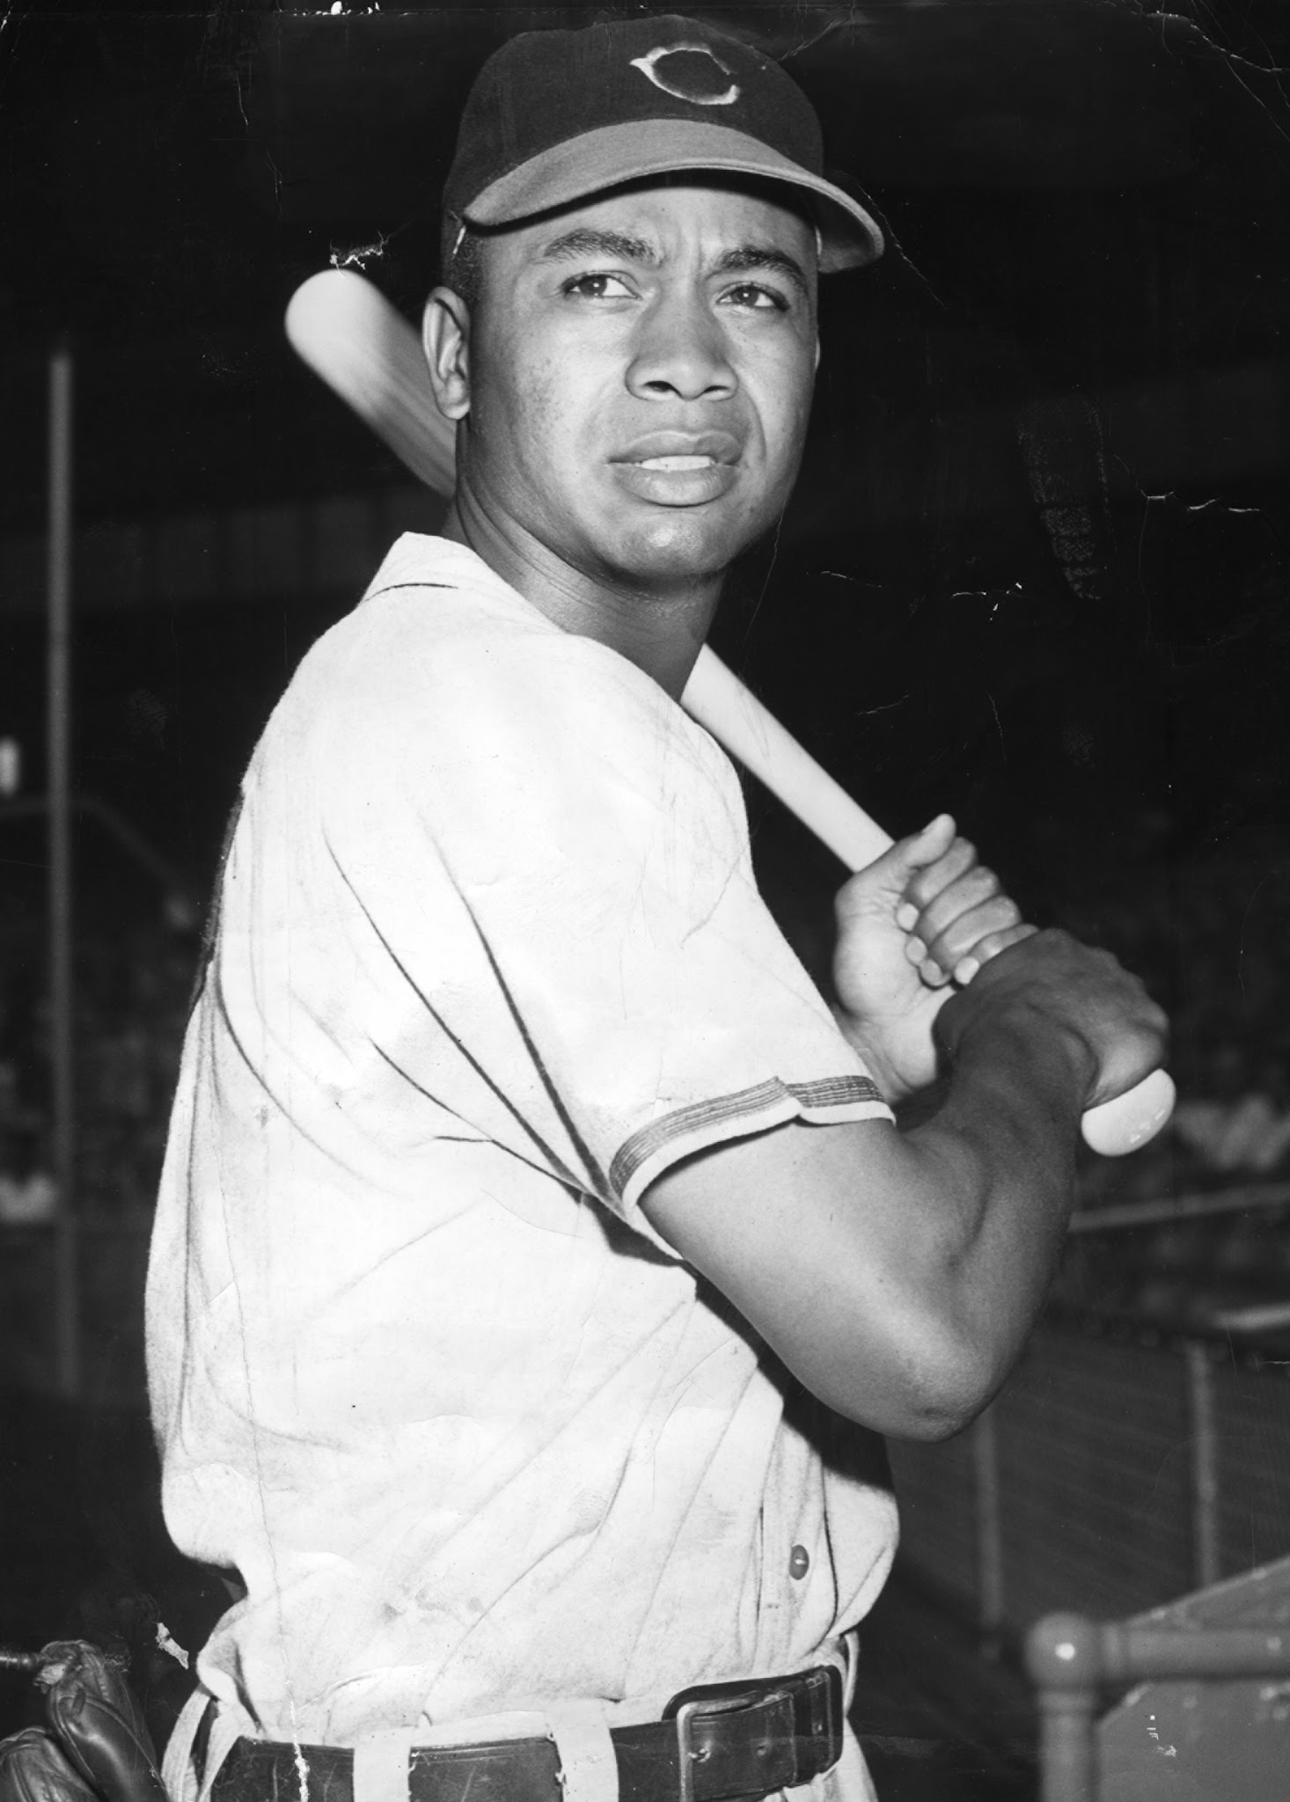
Most owners still hoped to keep Baseball white. Now their strategy was to keep integration confined to the Dodgers while hoping Robinson would flop and keep the “experiment" to an end. We kept mentioning other black players we thought had major-league potential, and Larry Doby was one of them. When Bill Veeck, president of the Cleveland Guardians (then the Indians), brought Doby directly up to Cleveland, he was consciously declaring that desegregation wouldn't be confined to the National League. It was a sensational move.
Larry Dobb

Slide 36
Sports as a Platform for Democracy

Slide 37
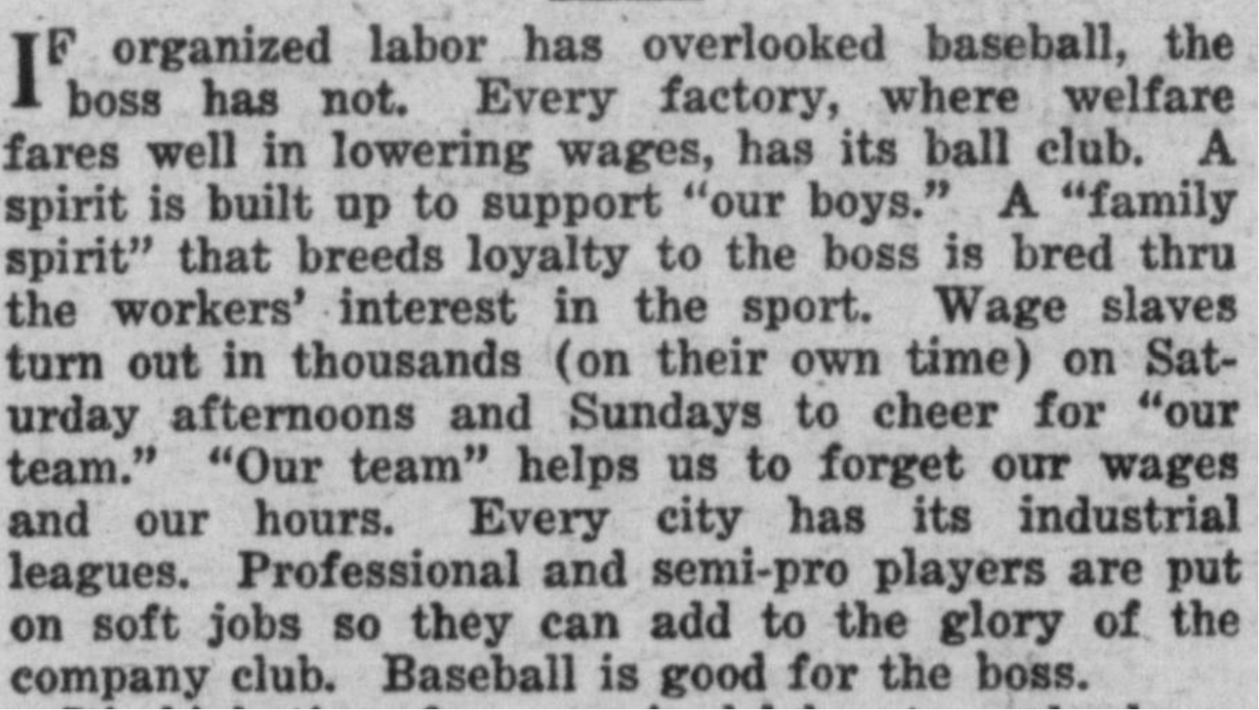
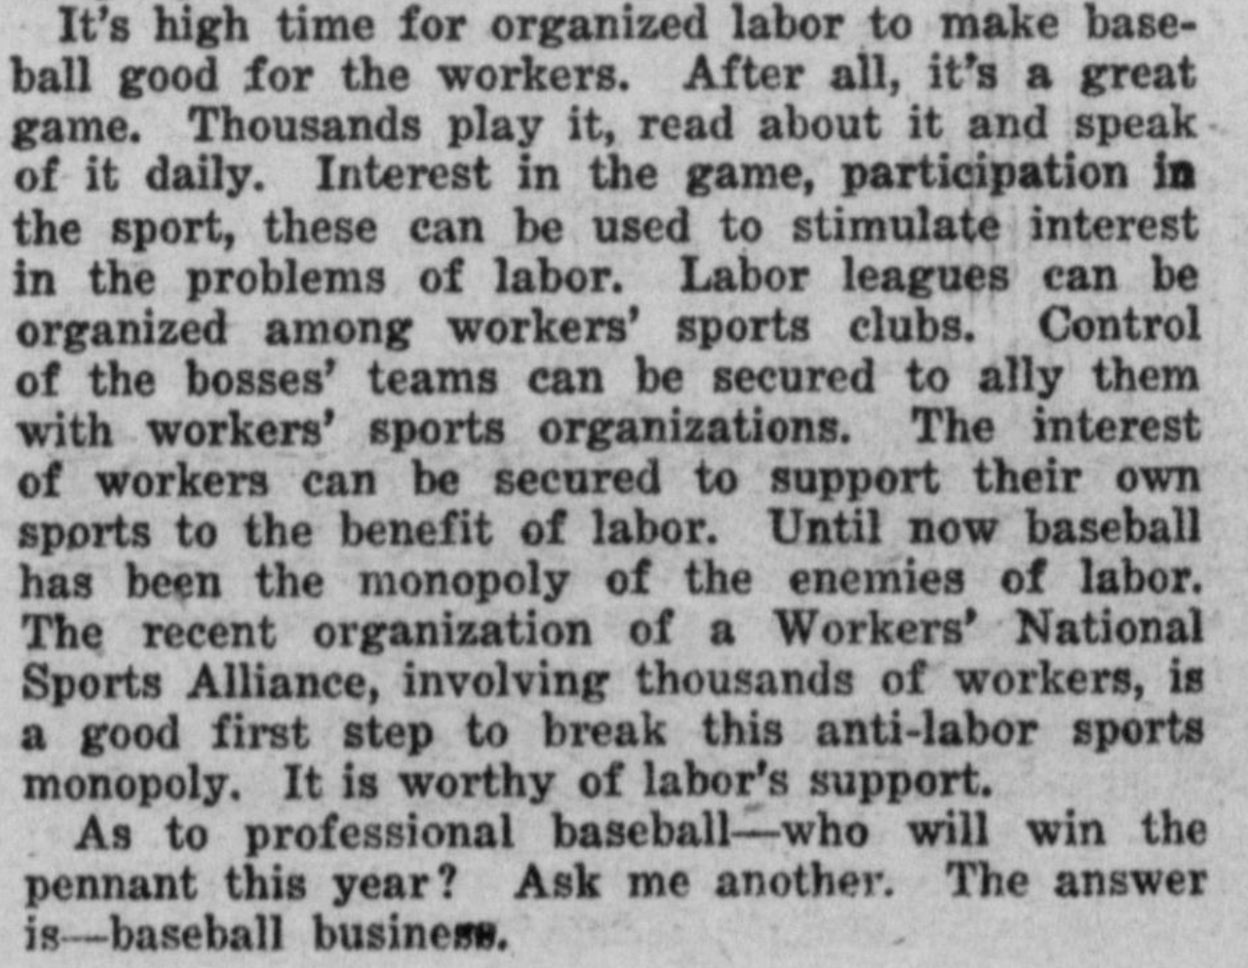
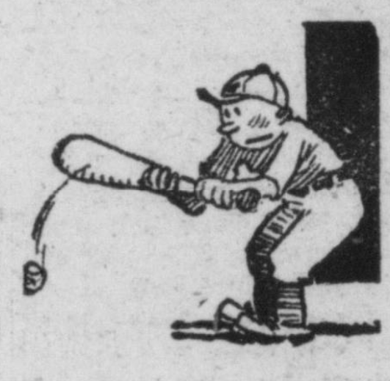
The Baseball Business by Walt Carmon - April 2, 1927

Slide 38
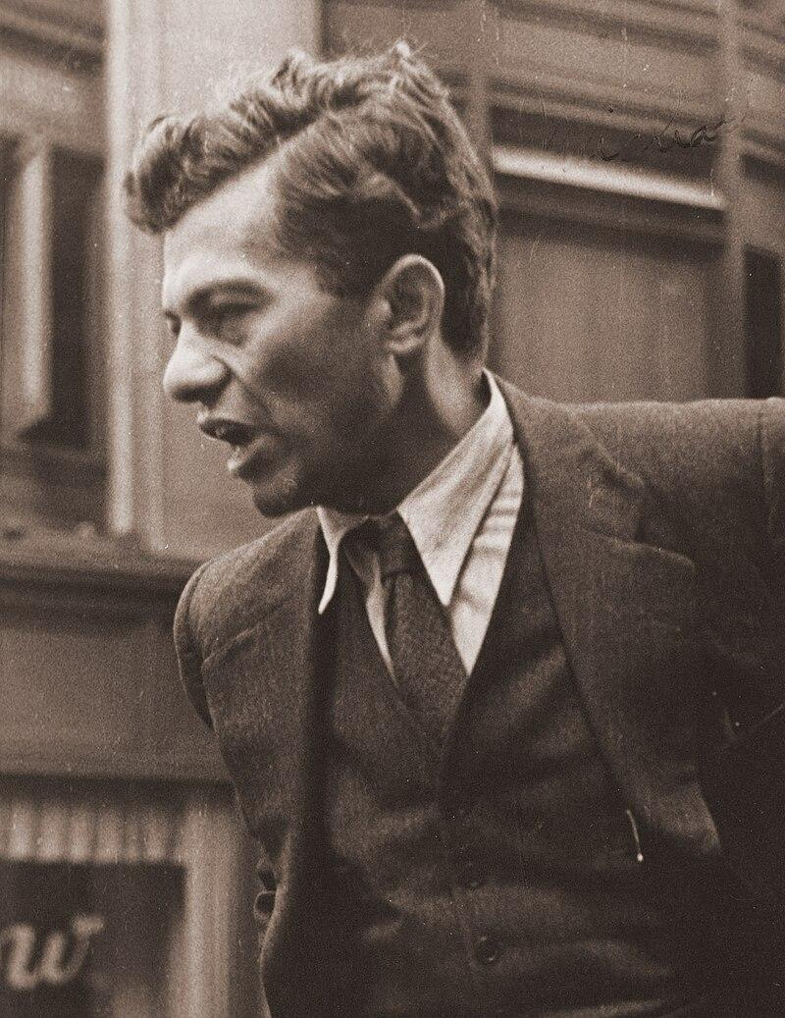
One of the first to realize the significance of this change in the Party's view of sports was the novelist and Daily Worker columnist Mike Gold. Soon after the Comintern Congress, Gold turned his fire on those Daily Worker readers who had registered opposition to the idea of instituting regular sports coverage in the paper:
Mike Gold’s Contributions
You can condemn them for it, if you are built that way, and you can call baseball a form of bourgeois opium for the masses. But that doesn’t get around the fact that... the vast ocean of Americans of whom we are as yet a minority, adore baseball. What are we going to do, insist that they give up this taste? Are we going to maintain our isolation and make Americans stop their baseball before we will condescend to explain Communism to them? When you run the news of a strike alongside the news of a baseball game, you are making American workers feel at home. It gives them the feeling that Communism is nothing strange and foreign. . . . Let’s loosen up. Let’s begin to prove that one can be a human being as well as a Communist. (Daily Worker, August 31, 1935)
(Mike Gold’s novel, Jews without Money, made
him a celebrity not only in Party ranks but also in
broader literary circles.)

Slide 39
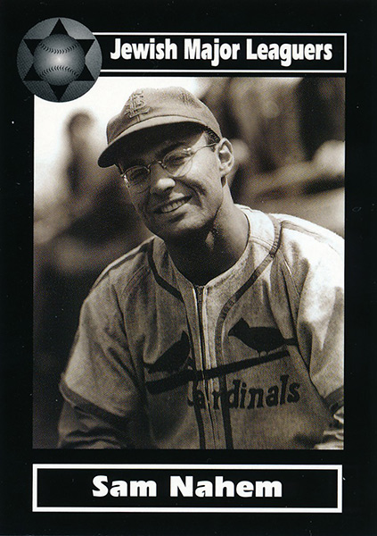
“Subway” Sam Nahem
As the rare Jewish ballplayer, Nahem also faced anti-Semitism, which certainly contributed to his outlook on Blacks playing the game. The Communist Party’s 1935 adoption of Popular Front collaboration with liberals and labor unions against fascism led Nahem to the political left.
Subsequently, the Soviet Union and the United States forged a wartime alliance against Hitler. In addition, the Communist Party supported Black civil rights, and Nahem believed bigotry toward Blacks and Jews was intertwined. Thus, from his coming of age until his view of the Soviet Union’s suppression of the 1956 Hungarian (Counter)Revolution, Nahem identified as a communist. FBI surveillance of Nahem produced a thick file.
The Communist Party’s Daily Worker newspaper waged a strong campaign for the integration of baseball, a matter of importance to Nahem. Indeed, Nahem integrated baseball – or at least a portion of it – before Brooklyn Dodgers President Branch Rickey brought Jackie Robinson to Ebbets Field.
In 1945, U.S. Army Staff Sergeant Sam Nahem found himself the player-manager of the Overseas Invasion Service Expedition All-Stars baseball team in the European Theater of Operations. When not taking his turn on the mound, Nahem played first base and hit well. Bucking the brass, Nahem fought successfully to have two Negro League stars, Leon Day and Willard Brown, on his team.
“Sam wears spectacles and talks less like a ballplayer than any diamond star this reporter knows,” a reporter for the Associated Press wrote in 1940.

Slide 40
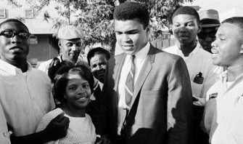
Muhammad Ali
On June 20, 1967, the great Muhammad Ali was convicted in Houston for refusing induction in the U.S. armed forces. Ali saw the war in Vietnam as an exercise in genocide. He also used his platform as boxing champion to connect the war abroad with the war at home,
“Why should they ask me to put on a uniform and go 10,000 miles from home and drop bombs and bullets on Brown people in Vietnam while so-called Negro people in Louisville are treated like dogs?” -Muhammad Ali
The day of Ali’s conviction the U.S. Congress voted 337-29 to extend the draft four more years. They also voted 385-19 to make it a federal crime to desecrate the flag. Their fears of a rising movement against the war were well-founded.
Above: Muhammad Ali leaves the Federal Court Building after being convicted of refusing to be inducted into the military, June 20, 1967. Source: AP
Over the next three years, he would collect more than 20,000 signatures on a petition calling for the restoration of Muhammad Ali’s heavyweight title.
Eventually justice did prevail and the Supreme Court overturned Ali’s conviction in 1971. They did so only after the consensus on the war had changed profoundly.

Slide 41
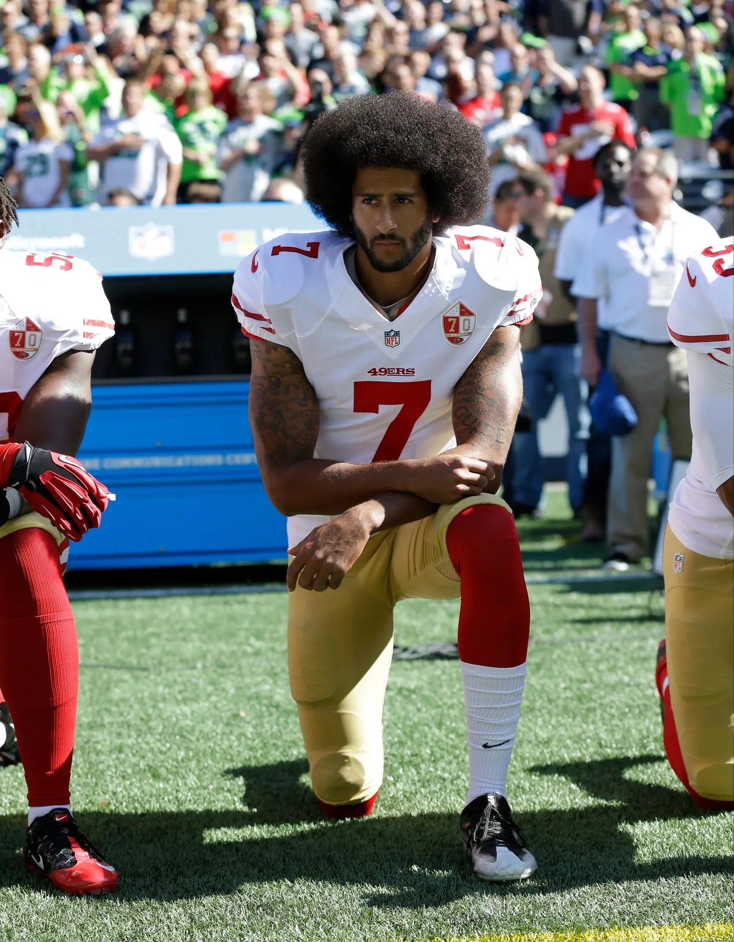
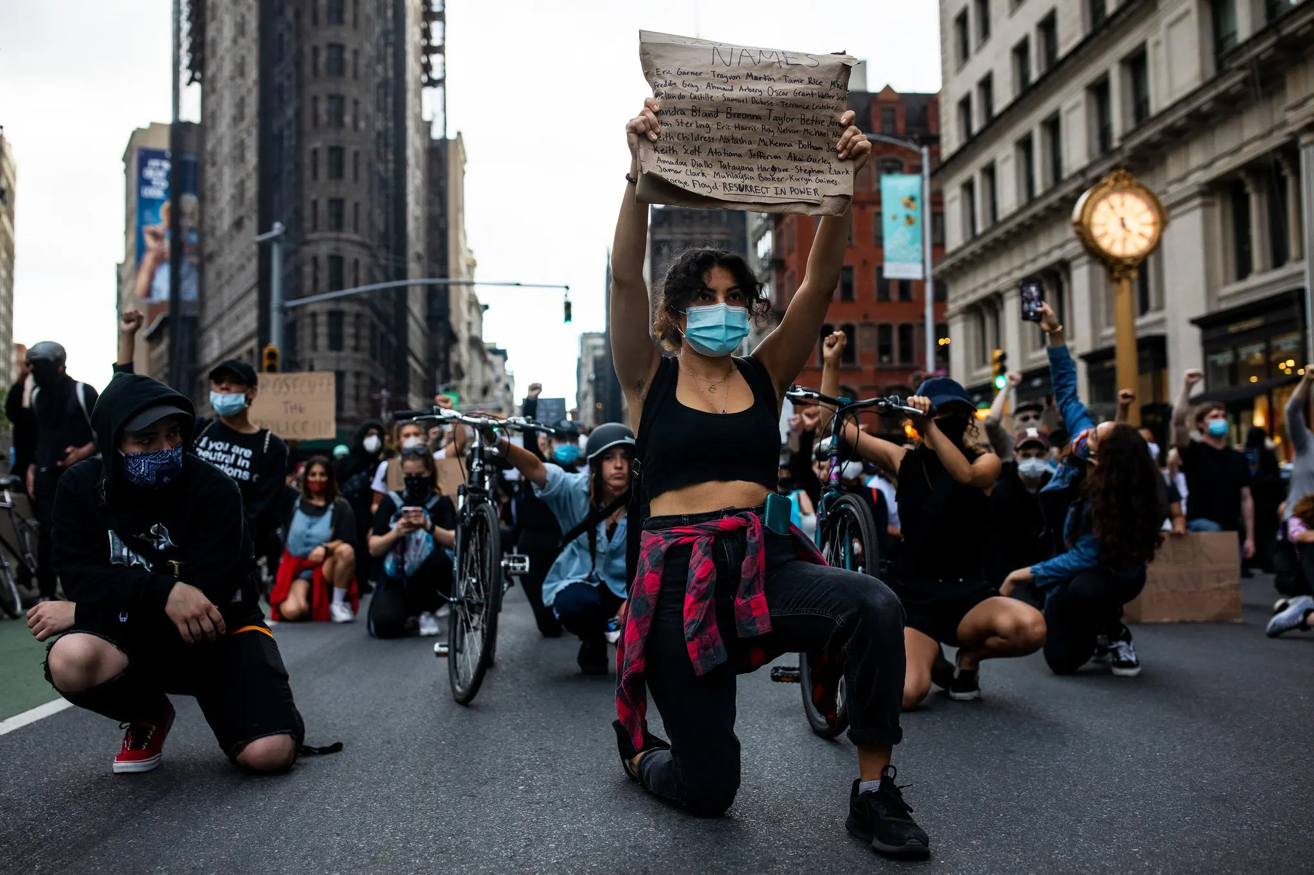
Colin Kaepernick
“Kneeling is both an act of defiance and resistance, but also of reverence, of mourning, but also honoring lives lost,” said Chad Williams, the chairman of the Department of African and Afro-American Studies at Brandeis University. “It is also simple and clear. Its simplicity gave it symbolic power, and as we see now, its power persists.”
Kaepernick’s protest began in August, when he sat on the bench during the National Anthem at each of the 49ers’ first three preseason games. Media took note for the first time on August 26, 2016 at a home game against the Green Bay Packers.
“I am not going to stand up to show pride in a flag for a country that oppresses Black people and people of color,” Kaepernick told NFL Network reporter Steve Wyche after the game.. “To me, this is bigger than football and it would be selfish on my part to look the other way. There are bodies in the street and people getting paid leave and getting away with murder.”
Starting in 2016, despite Kaepernick’s explanation that his kneeling during the national anthem was a call to end racial injustice and police brutality toward people of color, a backlash fomented, spurred largely by President Trump, who tried to recast Kaepernick and the predominantly African-American group of players who followed his lead as unpatriotic. That viewpoint persists.

Slide 42
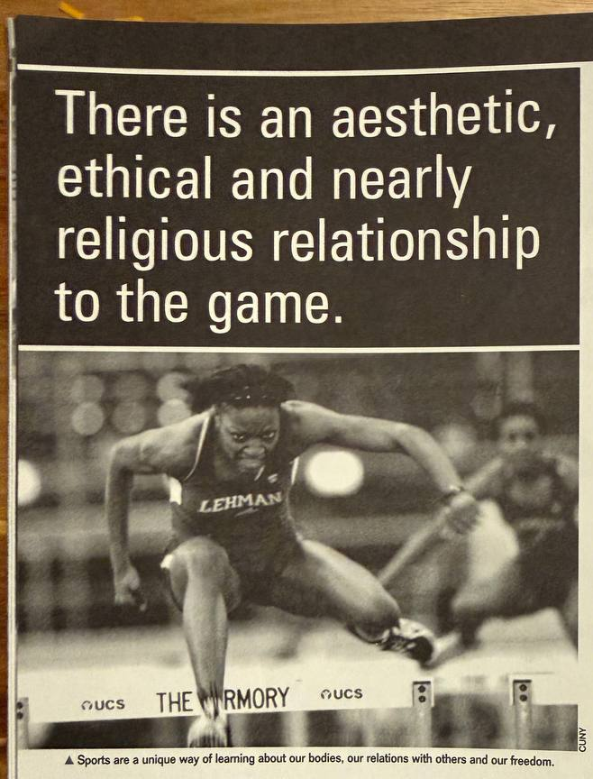
Just Do It? Capitalism and Sports
But how have progressive commentators tended to talk about sports? Unfortunately, they often behave as if sports are too lowly to require serious thought. The attitudes here range from simple dismissal to sophisticated critique, but almost everyone seems united on one basic point: sport, in and of itself, is not valuable as an area of human experience. On the one hand, there is the view that sports are something we enjoy for entertainment, but which we shouldn't bother about when we are asking serious questions about society.
Article written by Ken Knies taken from Political Affairs July 2004.

Slide 43
And even when progressives look at sport as a lens through which to view working-class culture, or as a way of reading the contradictions present in a given society, there is often too little emphasis placed on just what kind of lens sport is. These commentators look at sports to learn about other aspects of the society, not about sport itself.
But there is a lot we can't know if we stay on this level. For instance, when the women's movement struggles for the application of Title IX to collegiate athletics, is it just a matter of equal opportunity and access? Or is there something about sport itself and the experience it gives us of our bodies that makes this issue particularly important for young women living in a sexist society? What is the significance of sporting leagues and events in which people with cognitive and physical disabilities compete?
Title IX or the Equal Protection Clause prohibits sex-based discrimination, including sexual harassment and sexual assault, in education programs that receive federal financial assistance.
The U.S. Supreme Court ruled in mid-2026 that discriminatory, anti-transgender sports bans in West Virginia and Idaho do not violate Title IX.
Justice Jackson wrote in her dissent against the ruling:
“A transgender woman penalized for being perceived as aggressive has experienced discrimination ‘on the basis of sex’ just as much as a cisgender woman has, no matter that the transgender woman’s behavior matches expectations of her sex assigned at birth. Either way, the institution has imposed its gender-based expectations upon her. And either way, the institution may have violated Title IX.”

Slide 44
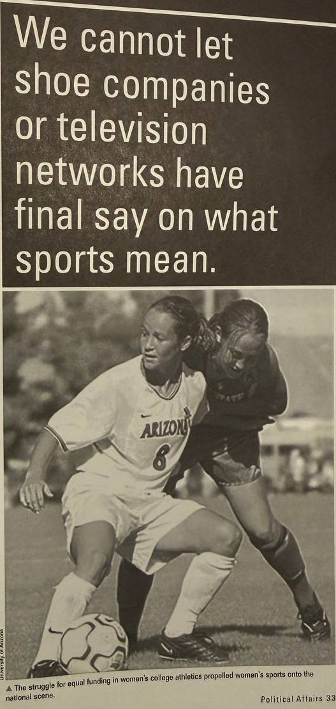
We can talk all we'd like about how sports encourage competition, and how the fanatical identification of onlookers with one side or another leads to a nearly violent desire to crush the opponent. But beyond or behind this, fans and athletes who truly love their sports can always appreciate a "good game." Beyond the question of which side wins or loses, fans and athletes have a sense of whether the game itself is being respected or abused.
We can talk all we'd like about how sports are a way of avoiding our responsibilities, of displacing our emotions and attaching our aspirations to meaningless outcomes.
Only by looking into the essential features of sport itself can we begin so see the reason behind this appeal and its connection to our economic existence.

Slide 45
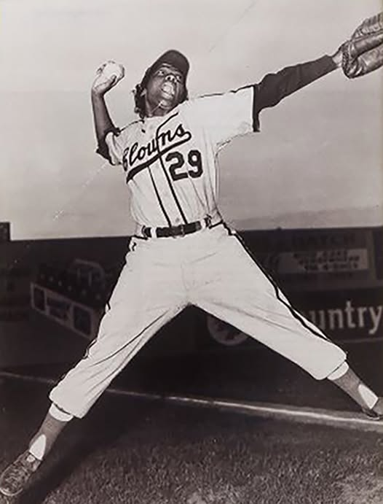
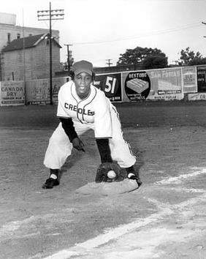
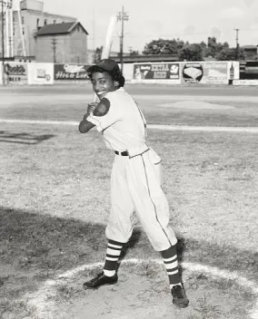
Women Struggles in Sports
But perhaps the most important consequence of this kind of questioning is that it puts us on the road to understanding the extent of the crisis we face concerning gender and sports. It was no one less than Plato who argued that in a healthy society women must be allowed to engage in athletics alongside men. He was well aware that this flew in the face of the social conventions of his time. But he insisted. We should keep his insistence in mind when we hear "common sense" reasons for the inferiority of women's athletics, and when the notion of devoting equal resources to them is dismissed as ridiculous.
Mamie Johnson, Toni Stone, and Connie Morgan were all black women baseball players who played with their male teammates in the Negro Leagues

Slide 46
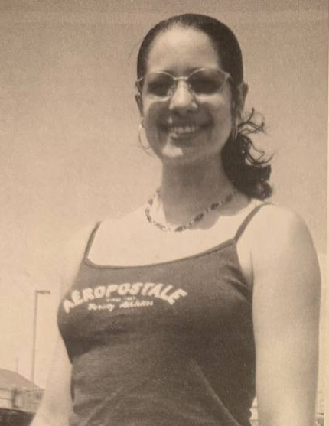
Women Struggles in Sports
If sport is defined as the opportunity to glorify the body as a subject of effort, skill, coordination, strength and agility, then it is obvious that sports are a vehicle of liberation for women, whose bodies are too often considered passive objects incapable of navigating the world without a male guide and protector. And the systematic exclusion and undervaluation of women in sport is part and parcel of this oppression.
The effort to win equal access to sports for women involves opening up an entire dimension of experience, one that re-captures the body-in-action as a source of power and value.
Toni Smith was the starting forward/center and team captain at Manhattanville College. In 2003 she decided to protest US militarism and war. Before each game, instead of saluting the US flag as is customary during the national anthem, she turned away with her head bowed. She felt the flag did not represent her, her family or beliefs.

Slide 47
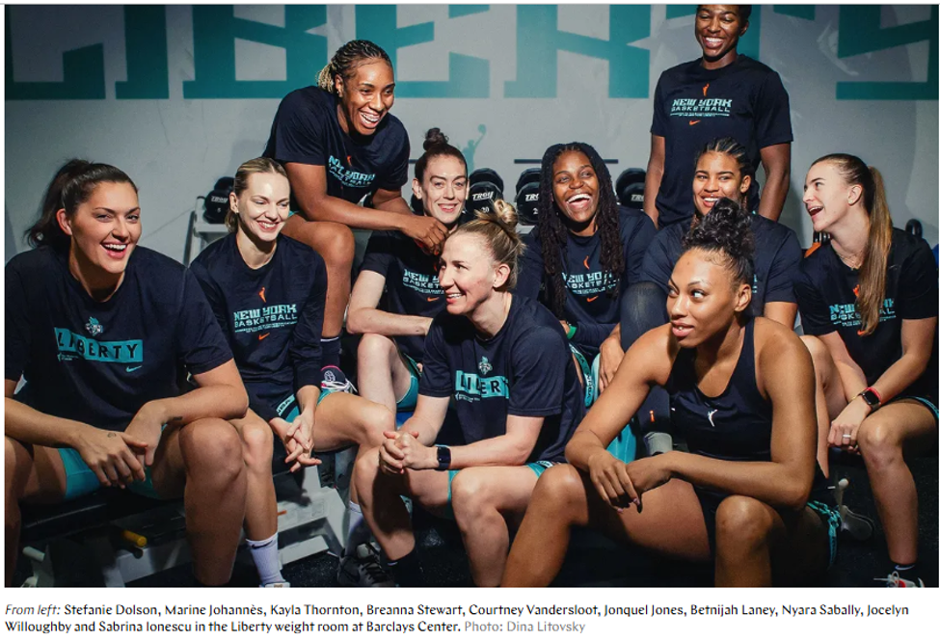
“We all we got, we all we need”
At a time when the White House is selling exclusion, nationalism, and hatred, the Liberty sell a different vision of America: a collective, multicultural, politically conscious country and one that’s unapologetically loud about it.
“We all we got, we all we need” says the liberty team mantra, a unifying call to anyone who has been left out or left behind. One that says you might not want us here — but we’ve got each other.
In 2026, women’s basketball is not just a game on the court, but a grand-scale cultural battle on the political stage.

Slide 48
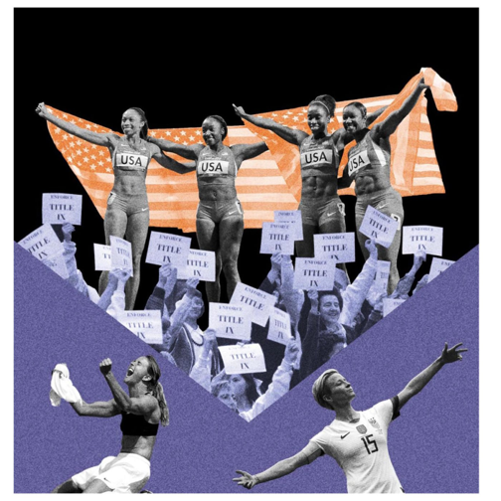
“We all we got, we all we need”
Mainstream American culture and politics have become increasingly fixated on gender.
Bioessentialism claims biology is destiny: that being born with certain biological traits means one is inherently a certain kind of person, with predictable traits, limitations, and proper place in society. This is a key component of the right wing’s view of gender.
As a result of the civil rights gains made in the 1960s, in 1972 Title IX of the Education Amendments was enacted by Congress. This amendment prohibited discrimination against and exclusion of women in federally funded schools, universities, and colleges, including within sports.

Slide 49
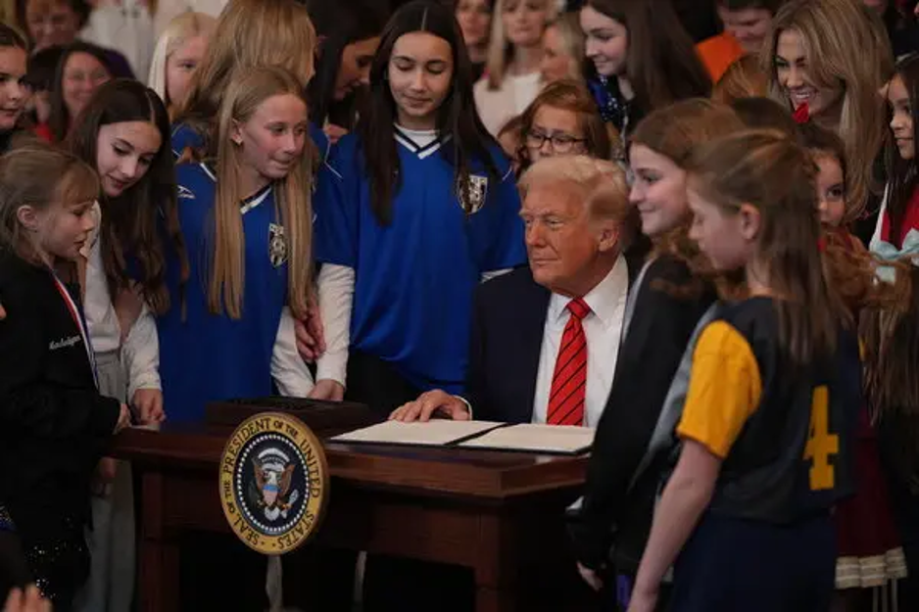
“We all we got, we all we need”
In 2025, President Trump signed an Executive Order titled “Keeping Men Out of Women’s Sports” where the administration argues that the inclusion of transgender women in sports “endangers” and “humiliates” cisgender women.
This is the far-right that protects sex offenders, tries to limit women’s participation in professional fields, and wants to strip women of their bodily autonomy. Yet they want us to believe they are the ones who keep women safe.
The bioessentialist rhetoric that says that women can’t be athletic, also says women aren’t as smart and can be easily controlled. The right believes the women of this country will be too weak to fight back and easily manipulated by fear-mongering.

Slide 50
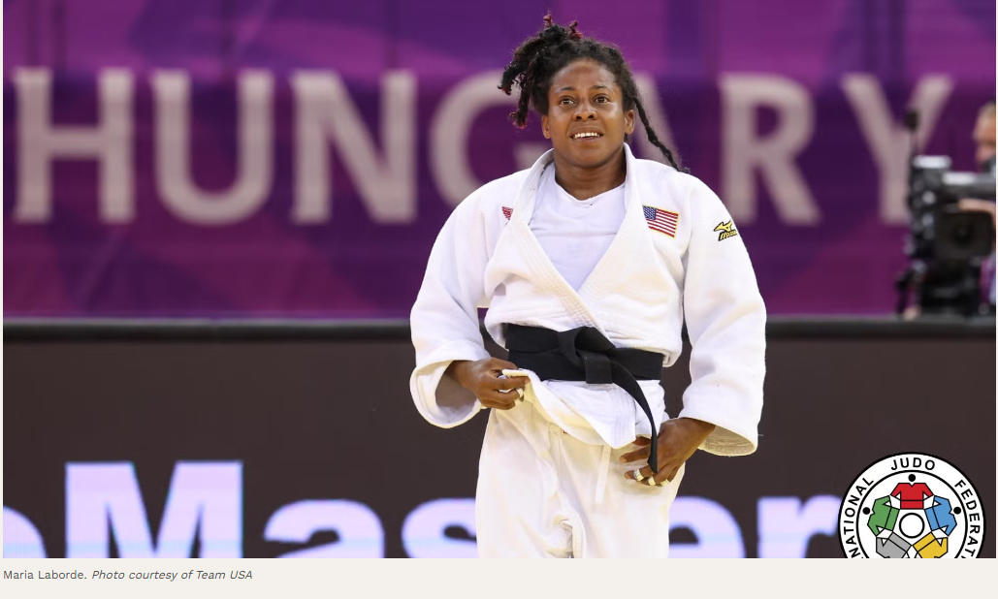
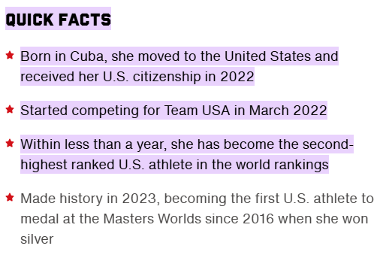
“We all we got, we all we need”
Women’s basketball and sports generally have become a major site of cultural and political debate. As the power of the WNBA grows, the far-right can no longer outright ignore the existence of women’s athletes, but has attempted to take over the stage to further their political goals.
Using xenophobia, transphobia, sexism, and racism as their vehicle, they expect to use people’s fears and take control of a league whose very existence was disputed by these very same conservative leaders decades ago.
Women of the WNBA are rejecting this trickery, proving to everyone that women are not weak, passive, or easily controlled. Strength comes through struggle. And today, “fighting like a girl” is no longer an insult, but a winning strategy.

Slide 51
A Communist in the Press Box?
Lester Rodney: By the time I got to NYU in the thirties. I still didn't know much about communism. I was working odd depression-type jobs by day and going to NYU at night. I wasn't looking for a degree or anything, just picking a few courses that interested me: journalism, sociology, political science. But you couldn't avoid the political discussions that went on everywhere. I used to argue with the Communists at first. I'd use the same arguments that people later used against me. like "You can't change human nature." Things like that.

Slide 52
Discussion & Wrap Up Introductions

Slide 53
Announcements
PCUSA Cell Chairs need to call members of their cells to remind them about attendance.
PCUSA Cell members are reminded attendance at the Continuing Education class of Jones-Foster every first Wednesday of the month is required.
The next issue of New Masses (2026) has begun production. If you have art you want us to feature, email it to info@partyofcommunistsusa.net.

Slide 54
Volunteers Needed!
We are in need of volunteers for the staff of the People’s School! Here’s a few roles we need filled:
People to help manage posting on our social media and podcast platforms
Video Editors, Audio Editors, Graphic Designers, Artists, Narrators
Web Controls, Moderators
Email info@peoplesschool.us if you’re interested and try to attend our next staff meeting if possible.

Slide 55
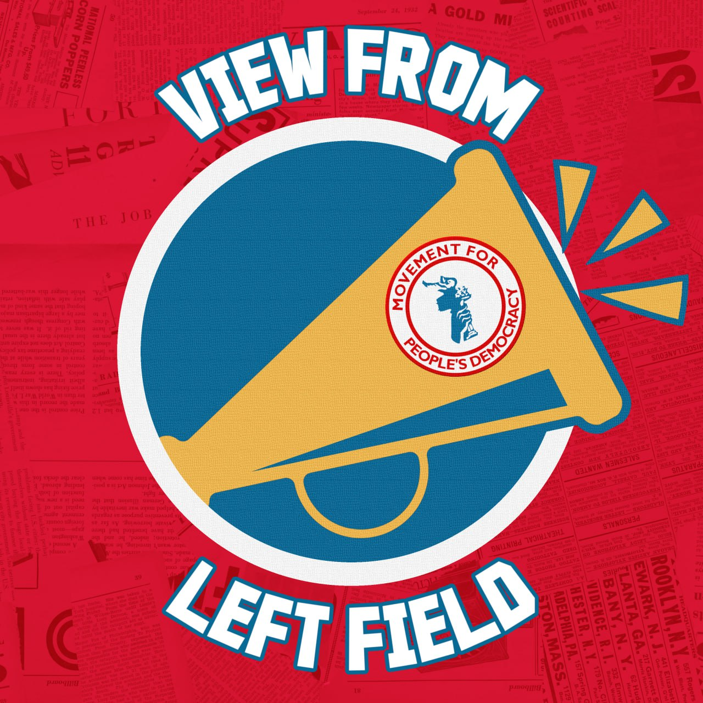
View From Left Field
https://viewfromleftfield.libsyn.com
The Old PSMLS Youtube is now the Youtube of View From Left Field, a podcast of analysis and discussion of current events from a progressive perspective.
Like the Youtube videos and subscribe with 5 star ratings on your podcast platforms.

Slide 56

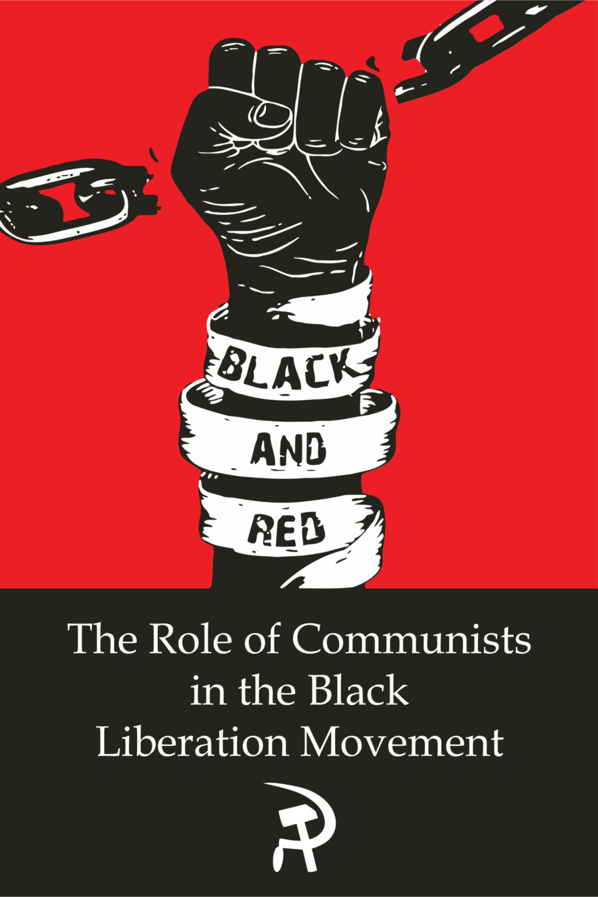



New Outlook Publishers
newoutlookpublishers.store
Relevant and Latest Releases

Slide 57



Harry Bridges School of Labor
luel.us/laborschool/
The Harry Bridges School of Labor is a monthly class covering a variety of topics aimed at building class consciousness among union members. For class schedule and other information, please visit the website at luel.us/laborschool.

Slide 58
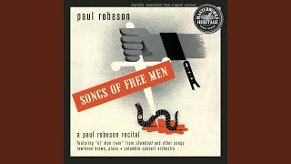
The House I Live In - Paul Robeson

