Slide 1
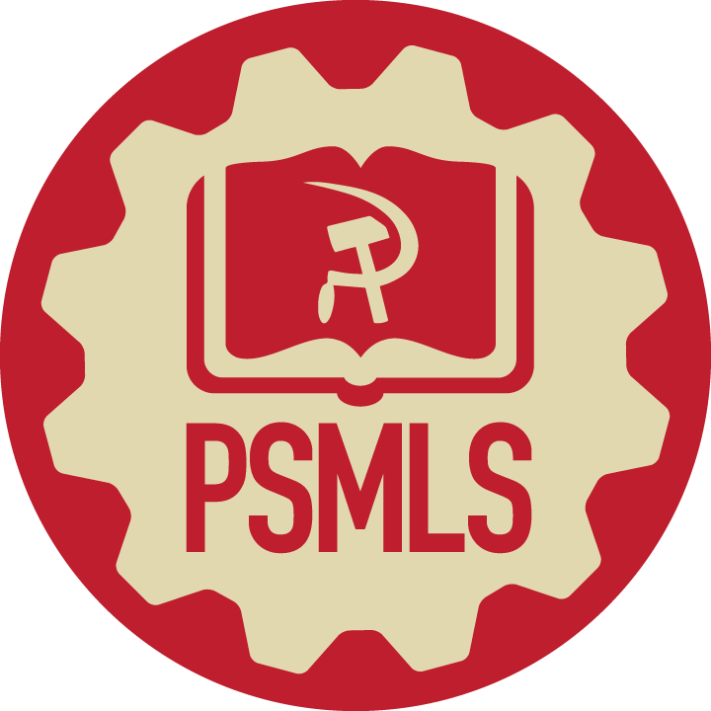
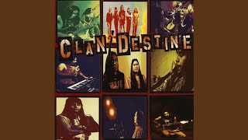
All Nations by Clan/Destine

Slide 2
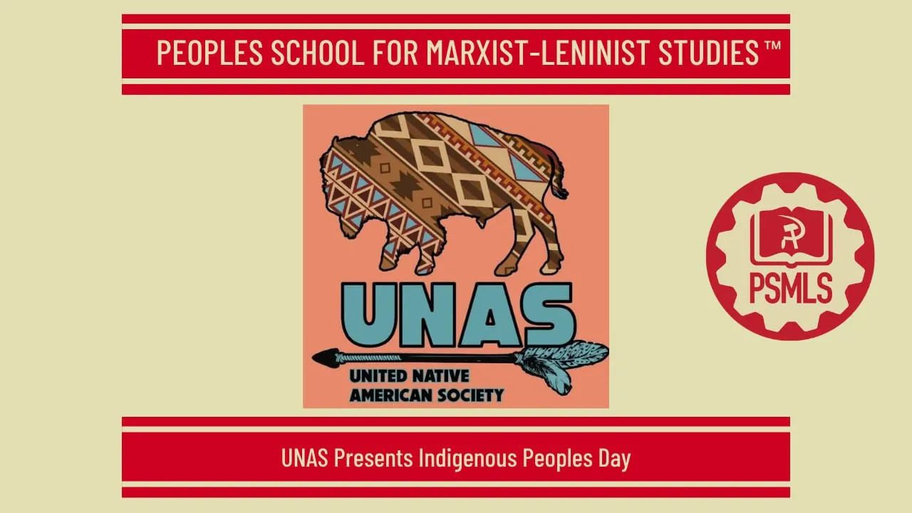
PSMLS 10/13/26

Slide 3
What we’ll be learning today:
What is Indigenous People’s Day
CPUSA Resolution on Native American Liberation
Native American Activism and Organizations

Slide 4
What is Indigenous People’s Day?

Slide 5
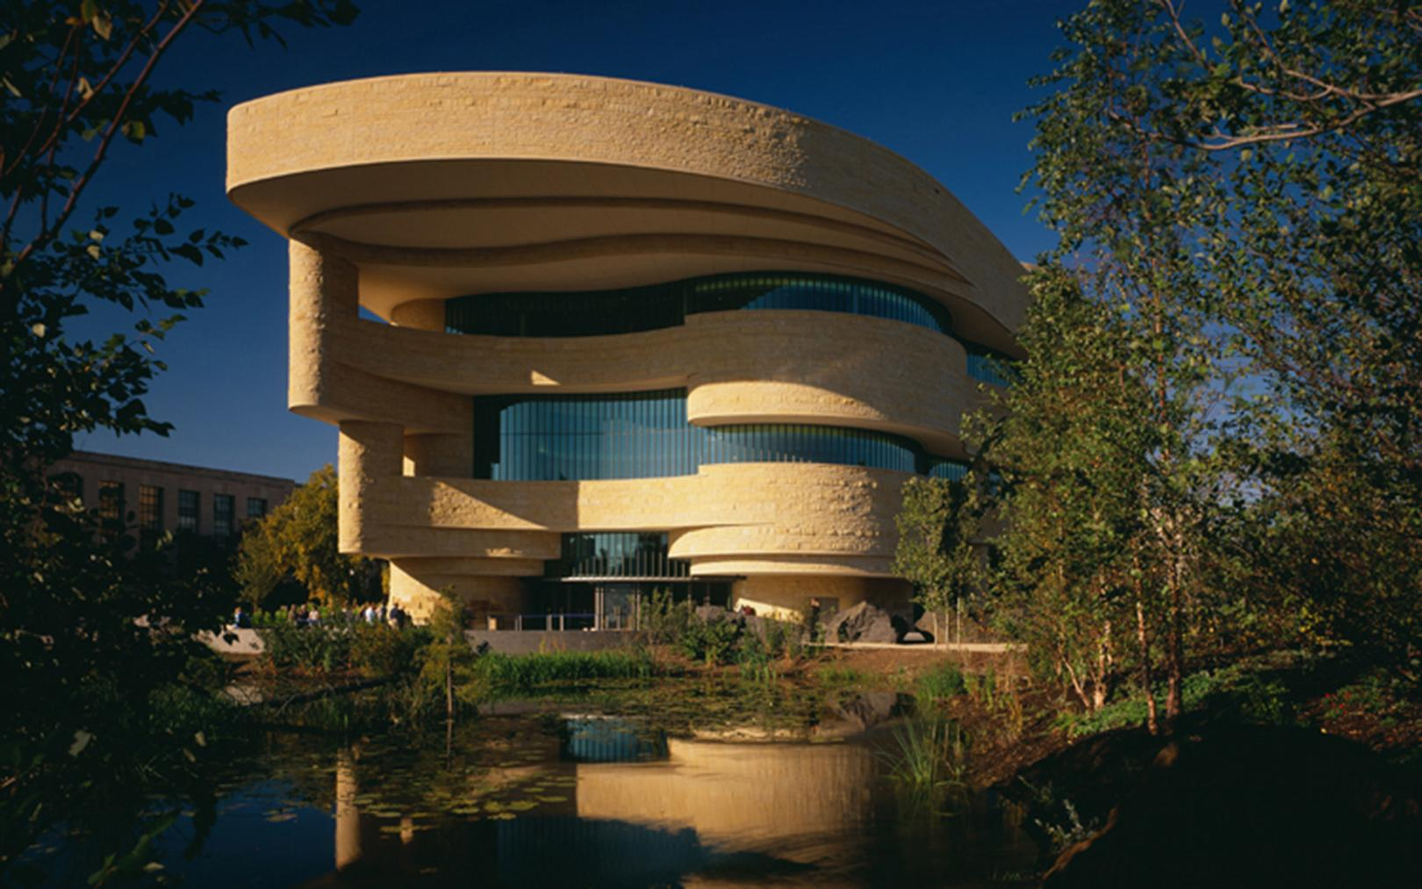
A Day for Indigenous Americans
Biden, in 2021, became the first U.S. president to recognize Indigenous Peoples' Day officially. That year, he proclaimed to observe the second Monday in October as a day to honor Native Americans, their “resilience and strength” and determination to preserve “land, language, spirit, knowledge, and tradition," even as they have faced a “centuries-long campaign of violence, displacement, assimilation, and terror,” he said.
Indigenous Peoples' Day advocates say the recognition helps correct a "whitewashed" American history that has glorified Europeans like Italian explorer Christopher Columbus, who have committed violence against Indigenous communities. Native Americans have long criticized the inaccuracies and harmful narratives of Columbus' legacy that credited him with his "discovery" of the Americas when Indigenous people were there first.
"It is difficult to grapple with the complete accomplishments of individuals and also the costs of what those accomplishments came at," said Mandy Van Heuvelen, the cultural interpreter coordinator at the Smithsonian's National Museum of the American Indian.
The Smithsonian's National Museum of the American Indian

Slide 6
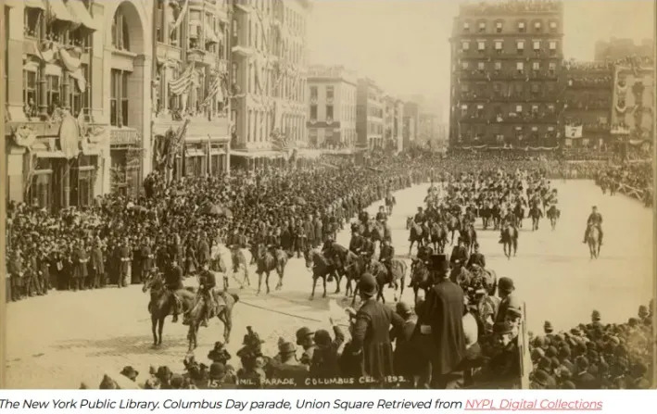
Origins
To understand the history of Indigenous Peoples’ Day, it’s important to understand how Columbus Day came about. Columbus had been celebrated unofficially around the US since the late 1700s. In 1892, President Benjamin Harrison issued a proclamation commemorating the 400th anniversary of his landing. As waves of Italian immigrants arrived in the US in the late 19th and early 20th centuries, they faced prejudice and discrimination. To combat negative perceptions, a group of Italian American elites took up the cause of Columbus Day, arguing that the contributions of Italian immigrants had helped make America the nation it was. In 1934, President Franklin D. Roosevelt designated Columbus Day a national holiday.
The narrative around Columbus Day helped uphold “the new racial order that would emerge in the US in the 20th century, one in which the descendants of diverse ethnic European immigrants became ‘White’ Americans,” historian Malinda Maynor Lowery wrote in a 2019 article for The Conversation.
First Columbus Day Parade, NYC Union Square, 1892

Slide 7
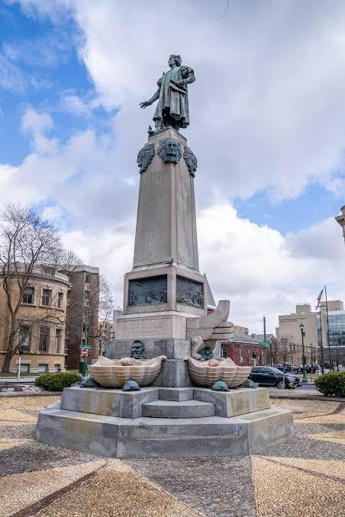
Origins
During WWII, Mussolini’s regime promoted Christopher Columbus as an Italian national hero and a pioneer of Italian imperial and cultural expansion. Propaganda portrayed him as an ancestor to Italy's modern colonial ambitions, drawing parallels between his voyages and Italy's military campaigns in Africa during the 1930s.
During this time, several Columbus statues were directly financed by Mussolini. These include Columbus Circle in Syracuse, NY, Grant Park in Chicago, Bayfront Park in Florida and Ludington Library in Pennsylvania.

Slide 8
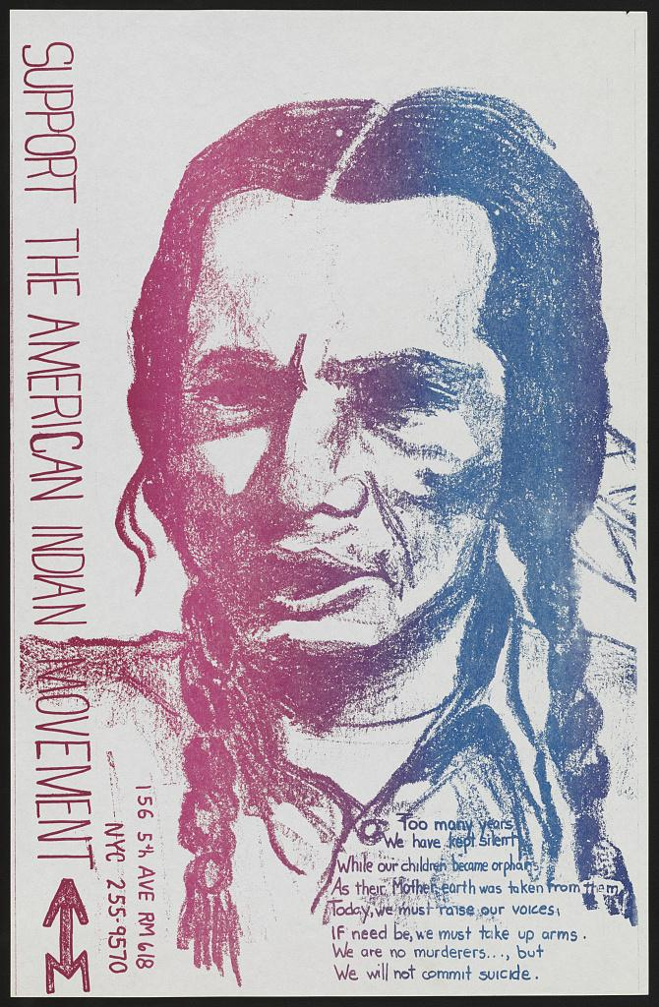
An International Day of Solidarity
Eventually, Native Americans began to challenge the history behind the holiday. Inspired by the Civil Rights Movement, Native American activists in the late 1960s formed the Red Power Movement, built on principles of self-determination and cultural pride. At a 1977 United Nations conference in Geneva, Indigenous delegates from around the world resolved “to observe October 12, the day of so-called ‘discovery’ of America, as an International Day of Solidarity with the Indigenous Peoples of the Americas.”
It would be longer before their calls were adopted. South Dakota became the first to officially celebrate the day (calling it Native American Day) in 1990. The city of Berkeley, California, embraced Indigenous Peoples’ Day in 1992 as a protest to the 500th anniversary of Columbus’ arrival. Now, numerous states and more than 130 cities observe the holiday.

Slide 9
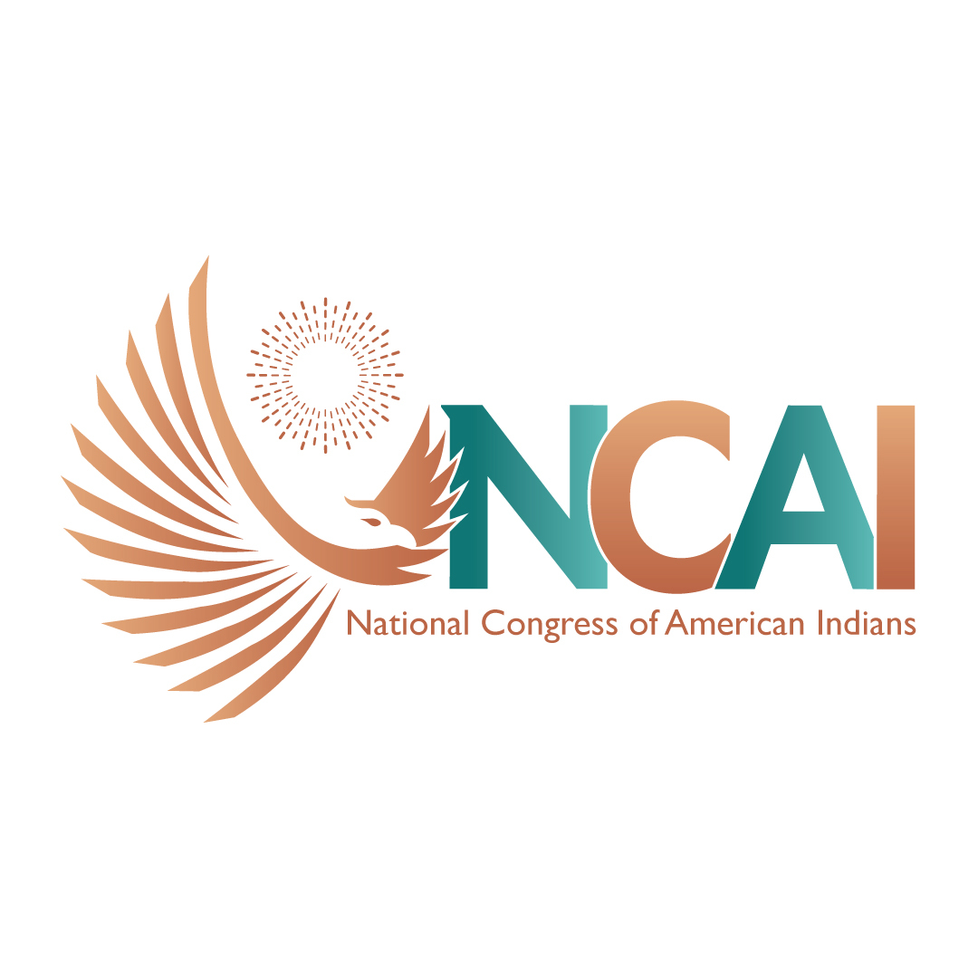
A Time to Reflect
For some, Indigenous Peoples’ Day is an occasion to consider the history of the US and how it has treated Native people.
“It’s a time to reflect on all that we’ve been through as a people: How much we endured, how much we’ve persevered and how much we still have to continue to fight for — for ourselves, for generations before us and for generations that will come after us,” Weeden said.
Indigenous people have often been erased from the country’s historical record — a survey from the National Congress of American Indians found that 87% of state history standards don’t mention Native American history after 1900, while 27 states don’t mention Native Americans in their K-12 curriculum. Yet Native people continue to have a presence here, while the lands and natural resources that were taken from them became foundational to this country.

Slide 10
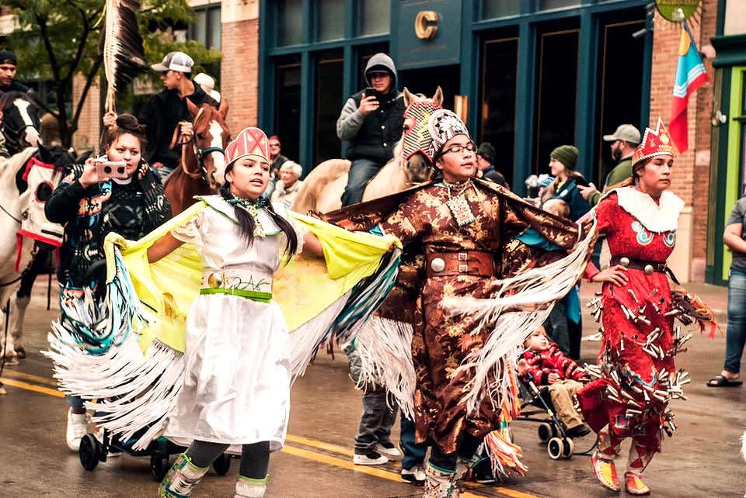
Recognition
What began as an initiative at the UN in 1977 became reality in 1989 in South Dakota, when Indigenous Peoples’ Day was first recognized by the state government as an alternative to the Federally-recognized Columbus Day. In South Dakota the day is called Native American Day. In the late 1980’s, members of the Sioux Nation organized enough people to get the attention of the then-Governor, George S. Mickelson, who became the first to codify the claim that peace between Indian and non-Indian people could benefit by renaming the holiday. While recognition of Indigenous Peoples Day is now commonplace in many states to honor the day, it is largely symbolic amid the ongoing systemic oppression of Native Peoples under Capitalism. Native Americans continue to be subjected to mistreatment by the US government, including unlawful breaking of treaties, stolen land, and broken promises across the country. The current configuration and economic challenges on Indian Reservation lands remain invisible to Americans, no matter their political affiliations.
A Photo of one of Sioux Falls Native American Day Parade in South Dakota

Slide 11
The Dialectic of Indigenous People’s Day
Native communities, while culturally strong in nature, are still recovering from genocide and trauma they endured for two centuries. These include detrimental policies like Indian boarding schools, Christian missions and the brokered deals under the Indian Termination Act. When those deals were “resolved” they often homogenized the character of unique communities and conjoined regional Tribal groups for Federal recognition. The Confederated Klamath Tribes, for example, includes Yahooskin, Klamath and Modoc, that include differing languages and cultures. The physical and legal framework surrounding the self-governance of Tribal Nations in the US continues to evolve and one can observe many encouraging steps that indicate power-building and increased influence on proactive policies. In the Chickasaw Nation for example, more than 14,000 Tribal members are employed in public services. In Yurok Territory, hundreds of thousands of acres of land have been purchased from timber companies to increase their landbase. Notably, the largest dam removal project in US history was led by a coalition of Tribes from the Klamath River watershed, which marked a huge victory for Indigenous peoples everywhere. Indigenous Peoples Day in Southern Oregon has a sour bite, as all of the Tribal communities have been displaced from their homelands and not been allowed to return. Many, including the Shasta, Takelma, and Rogue River Indians were assigned residency to a reservation more than 100 miles away from their native lands and waters. But even amid these insurmountable odds, peoples and cultures persevere and have survived.

Slide 12
Discussion

Slide 13
Discussion & New Members Introductions

Slide 14
New Member Introductions
What is your name, pronouns and state (or country/territory)?
Where do you work? Is it unionized?
How did you find out about the People’s School?
What do you think about tonight's class?

Slide 15
1979 CPUSA Resolution on Native American Liberation

Slide 16
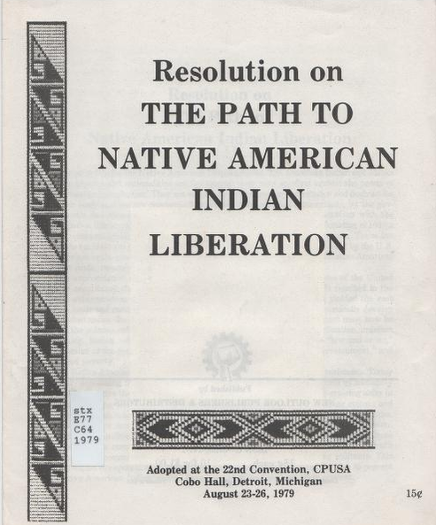
Following Material Comes From:
https://archive.org/details/ResolutionOnThePathToNativeAmericanLiberationAdoptedAtThe22nd/mode/1up

Slide 17
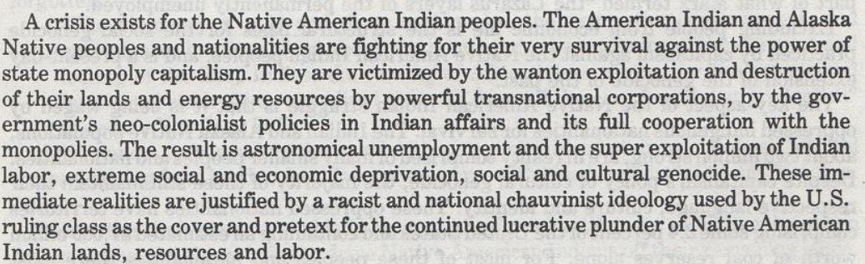
The Path to Native American Indian Liberation

Slide 18
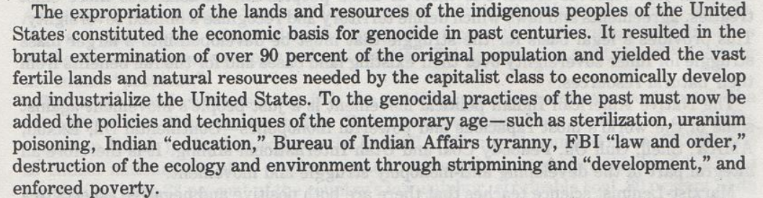
The Path to Native American Indian Liberation

Slide 19
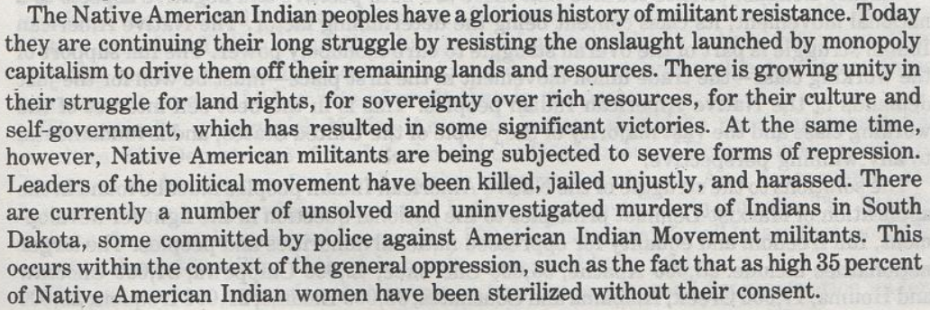
The Path to Native American Indian Liberation

Slide 20
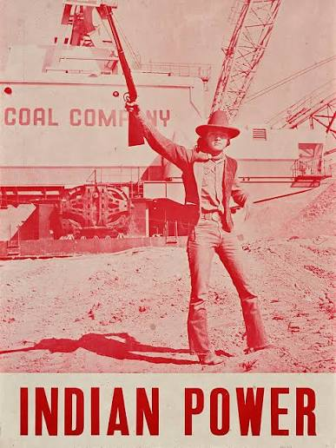
Indian Power
Leroy Keams, a prominent member of the American Indian Movement and Diné at protest against the strip mining of Black Mesa by Peabody Coal Company

Slide 21
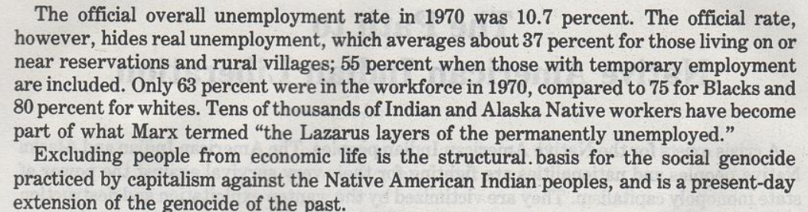
The Path to Native American Indian Liberation Cont.

Slide 22
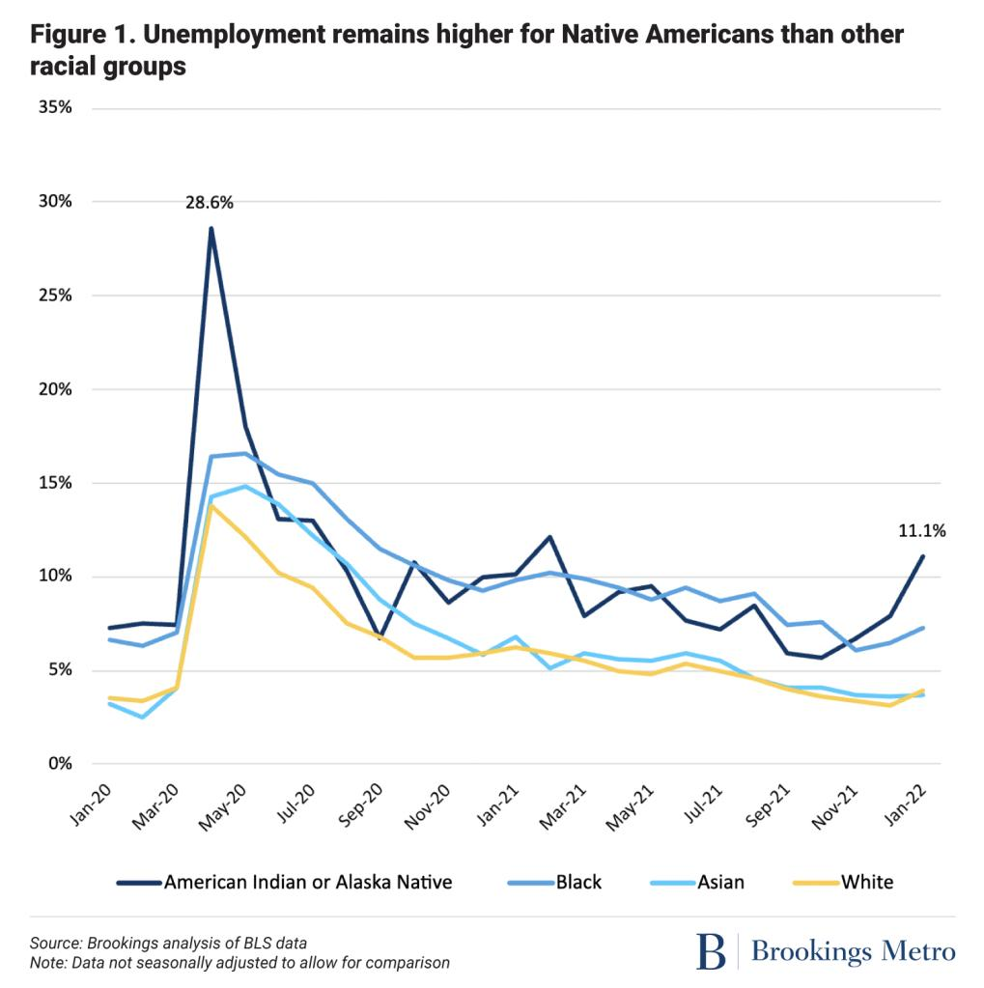
Continued Discrimination

Slide 23
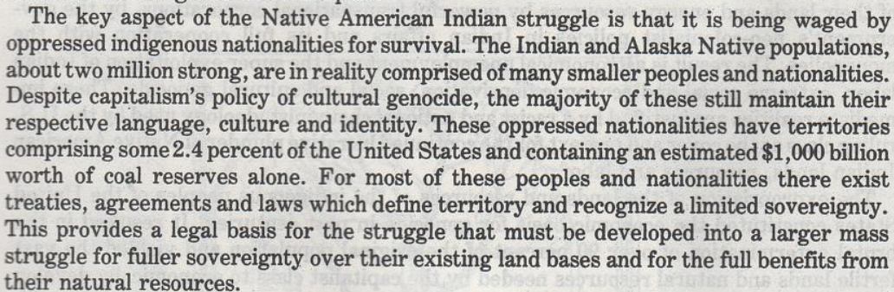
The Path to Native American Indian Liberation Cont.

Slide 24
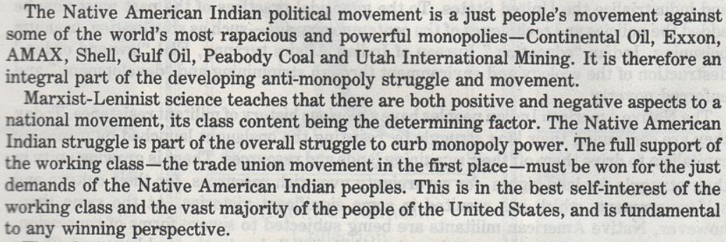
The Path to Native American Indian Liberation Cont.

Slide 25
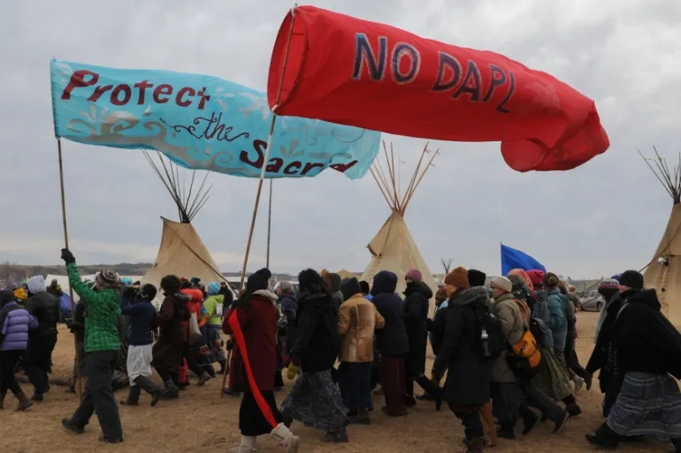
Native Led Anti-Pipeline Protests
Protest against Dakota Access Pipeline

Slide 26
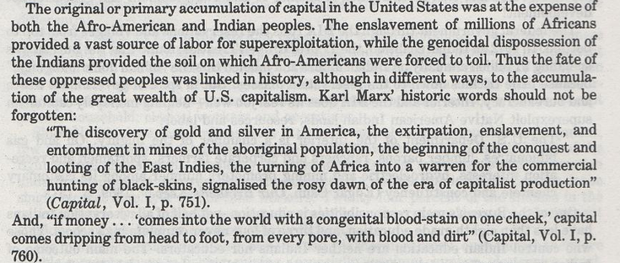
The Path to Native American Indian Liberation Cont.

Slide 27
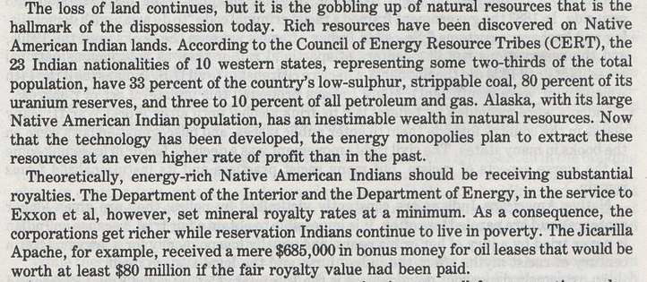
The Path to Native American Indian Liberation Cont.

Slide 28
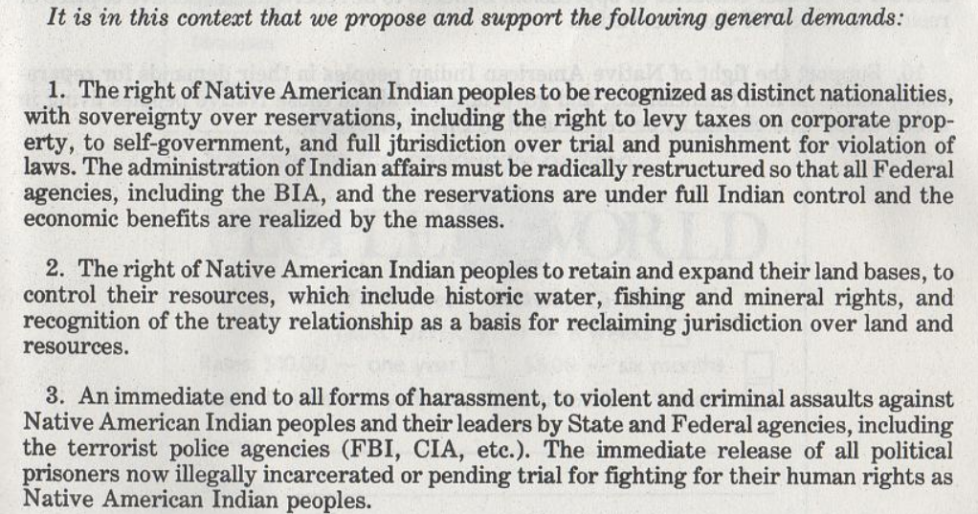
The Path to Native American Indian Liberation Cont.

Slide 29
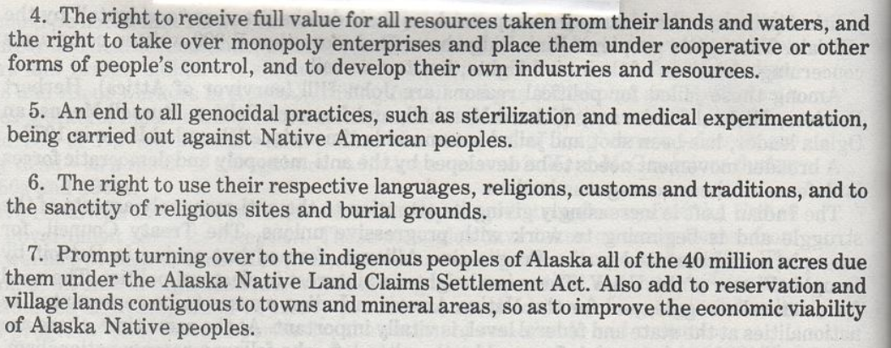
The Path to Native American Indian Liberation Cont.

Slide 30
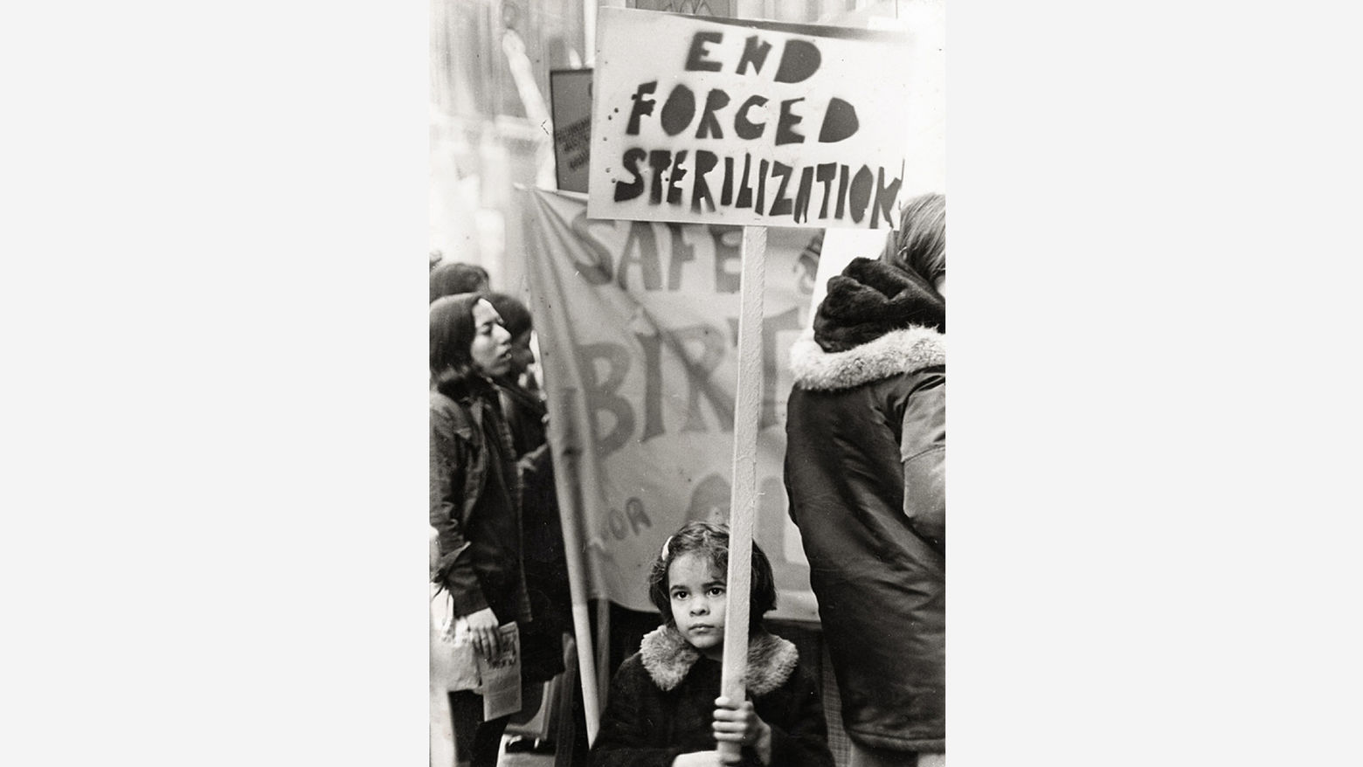
Genocidal Practices

Slide 31
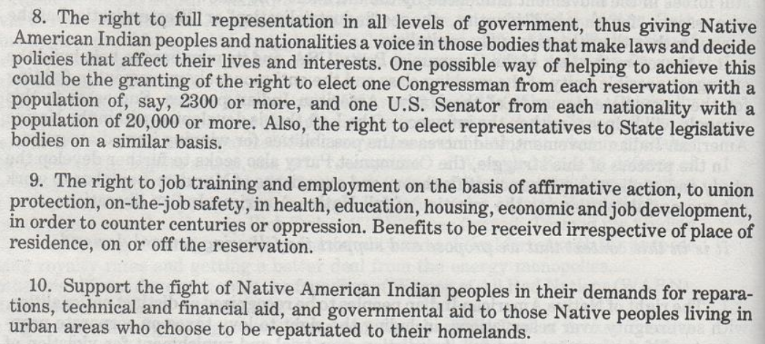
The Path to Native American Indian Liberation Cont.

Slide 32
Discussion

Slide 33
Native American Activism & Organizations

Slide 34
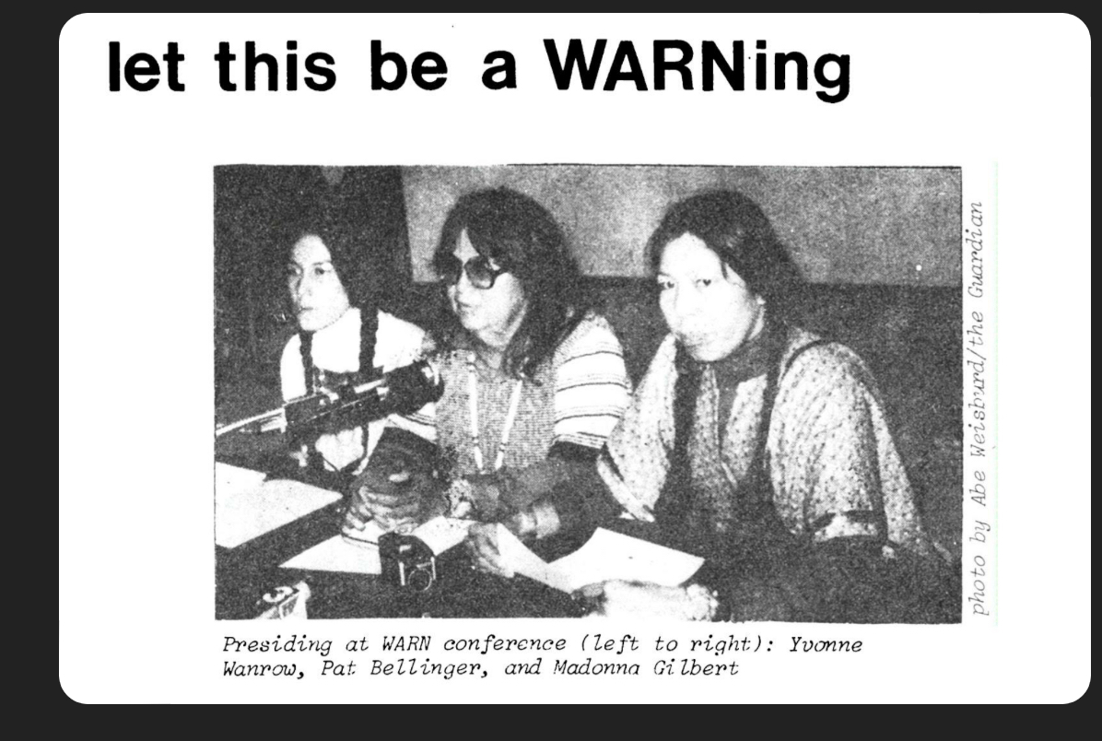
Native American Activism
American Indian Movement (AIM)
  Started in Minnesota
  In the 1960’s
Women of All Red Nations (WARN)
  Founded in 1974
Dakota Access Pipeline Protesters
Tohono O’odham Protesting the Border Wall
Missing and Murdered Indigenous Women
Every Child Matters
Every Native American movement has and will always be for Native Survival.
From the Trail of Tears, forced removal, environmental and cultural destruction, children that survived boarding schools, Indian Child Welfare Act.

Slide 35
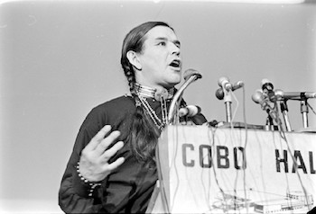
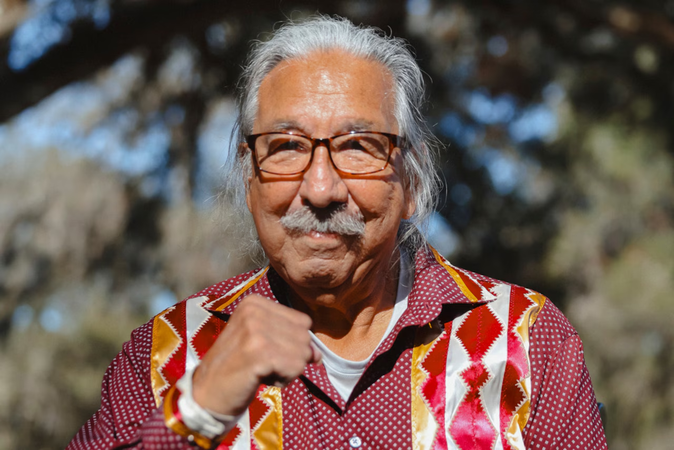
Native American Activists
Clyde Bellecourt (1936-2022): Born and grown on the White Earth Indian Reservation. Head and founding member of A.I.M. in 1968, member of the Ojibwe tribe, Leader, Organizer, and Activist.
Leonard Peltier: Born in N. Dakota, raised on the Turtle Mountain Reservation. One of the Founding members of A.I.M., Leader, Organizer, and Activist. Is currently imprisoned for his political activities.

Slide 36
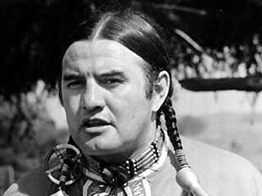
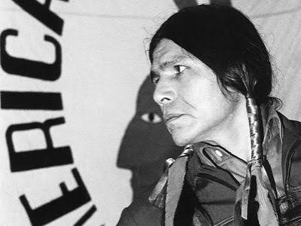
Native American Activists
Vernon Bellecourt (1931-2007): Brother of Clyde Bellecourt. One of the Founding members of AIM. Leader, Organizer, and Activist. In his final days, he attended the First International Congress of Anti-Imperialist Indigenous Peoples of America
Dennis Banks (1937- 2017): was a Native American activist and long time leader of the A.I.M. which he co-founded in 1968 in Minneapolis to represent urban Native Americans . His protests created national attention on the deplorable conditions for Native Americans.

Slide 37
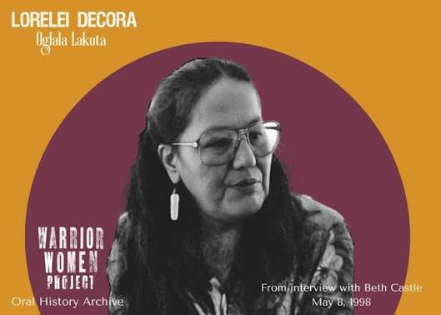
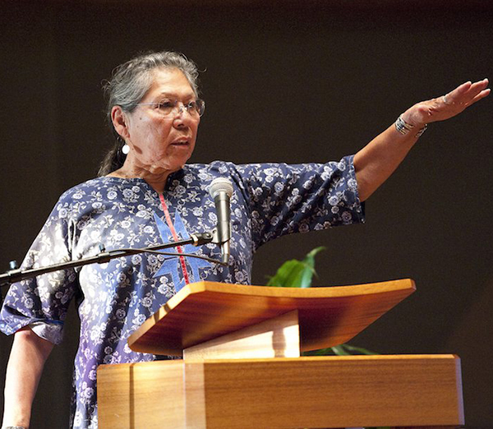
Native American Activists
Lorelei DeCora Means: Born on the Winnebago Reservation in Nebraska. Proponent of the Red Power Movement., Nurse, and Co-Founder of Women of All Red Nations. Youngest members on the board of directors for A.I.M.
Madonna Thunder Hawk: Born on the Yankton Sioux Reservation. Belongs to the Oohenumpa band of the Cheyenne River Sioux Tribe. Early proponent of the Red Power Movement. Joined the American Indian Movement in its early years. Leader, Organizer, and Activist

Slide 38
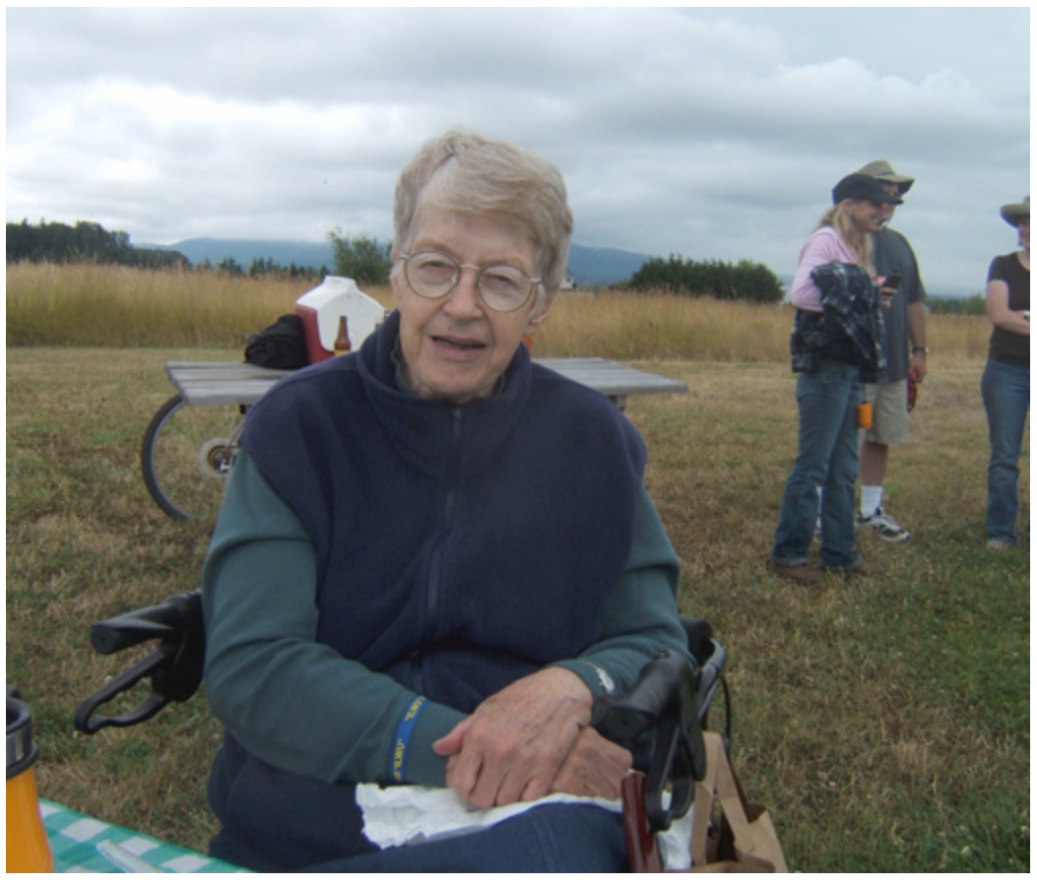
Lonnie Nelson
Daughter of Communist Party leader and founding member of the International Longshore and Warehouse Union (ILWU) Burt Gale Nelson
Her uncle joined Abraham Lincoln Brigade
Participated in the Wounded Knee Occupation
Wrote for The People's World

Slide 39
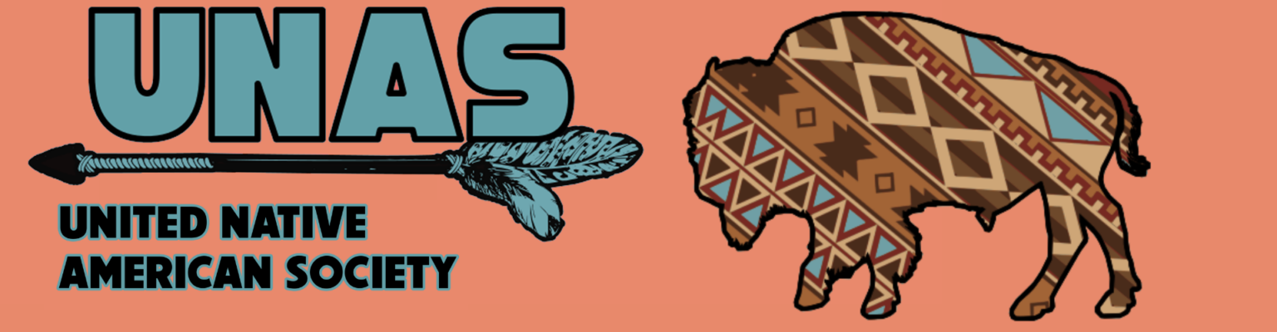
The United Native American Society seeks to educate the American Public on the current and past conditions of Native American Peoples. Today, a crisis exists for the Native American population of the United States, including the indigenous people of Alaska. Native American Peoples of North America are fighting for their survival against continued encroachment by corporate America.
Native Americans are victimized by powerful transnational corporations centered in Washington D.C. who seek the ruthless exploitation and destruction of their lands, natural resources, and traditional values. The U.S. Government's neo-colonial policies in the affairs of Native Americans are in direct cooperation with corporate interests. This results in the attempts to challenge past agreed-upon Treaty negotiations and resulted in a protracted epidemic of unemployment, unacceptable social and economic deprivation— a history of social and cultural genocide.

Slide 40
Discussion & Wrap Up

Slide 41
Announcements
PCUSA Cell Chairs need to call members of their cells to remind them about attendance.
The next issue of New Masses (2026) has begun production. If you have art you want us to feature, email it to info@partyofcommunistsusa.net.

Slide 42
Volunteers Needed!
We are in need of volunteers for the staff of the People’s School! Here’s a few roles we need filled:
People to help manage posting on our social media and podcast platforms
Video Editors, Audio Editors, Graphic Designers, Artists, Narrators
Web Controls, Moderators
Email info@peoplesschool.us if you’re interested and try to attend our next staff meeting if possible.

Slide 43
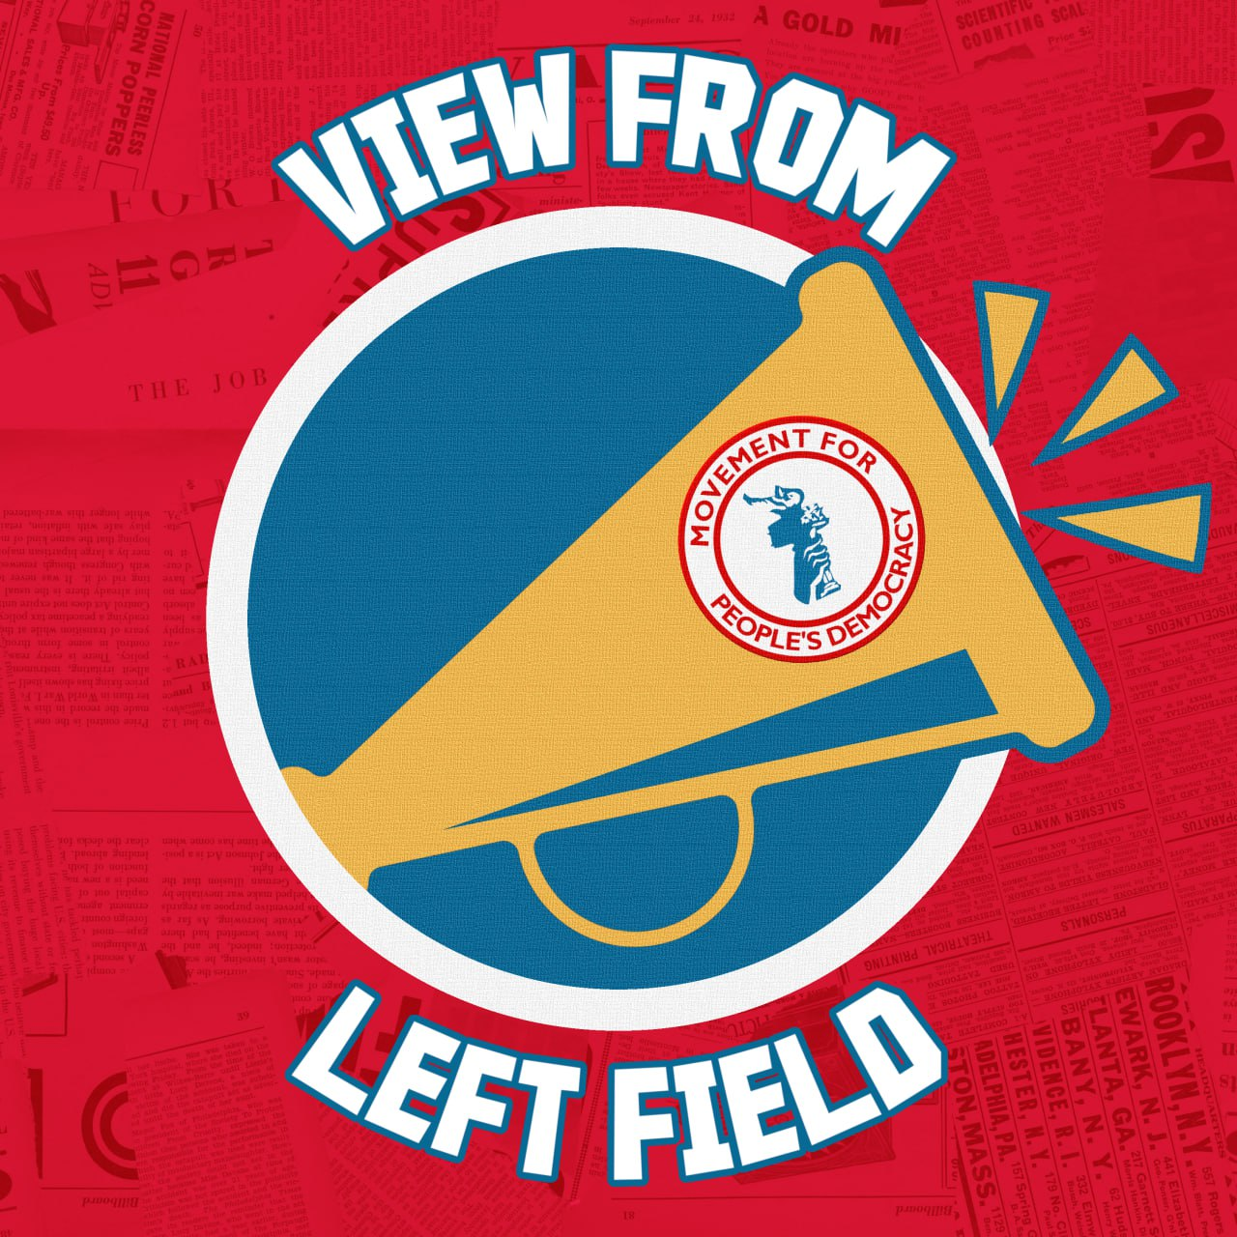
View From Left Field
https://viewfromleftfield.libsyn.com
The Old PSMLS Youtube is now the Youtube of View From Left Field, a podcast of analysis and discussion of current events from a progressive perspective.
Like the Youtube videos and subscribe with 5 star ratings on your podcast platforms.

Slide 44
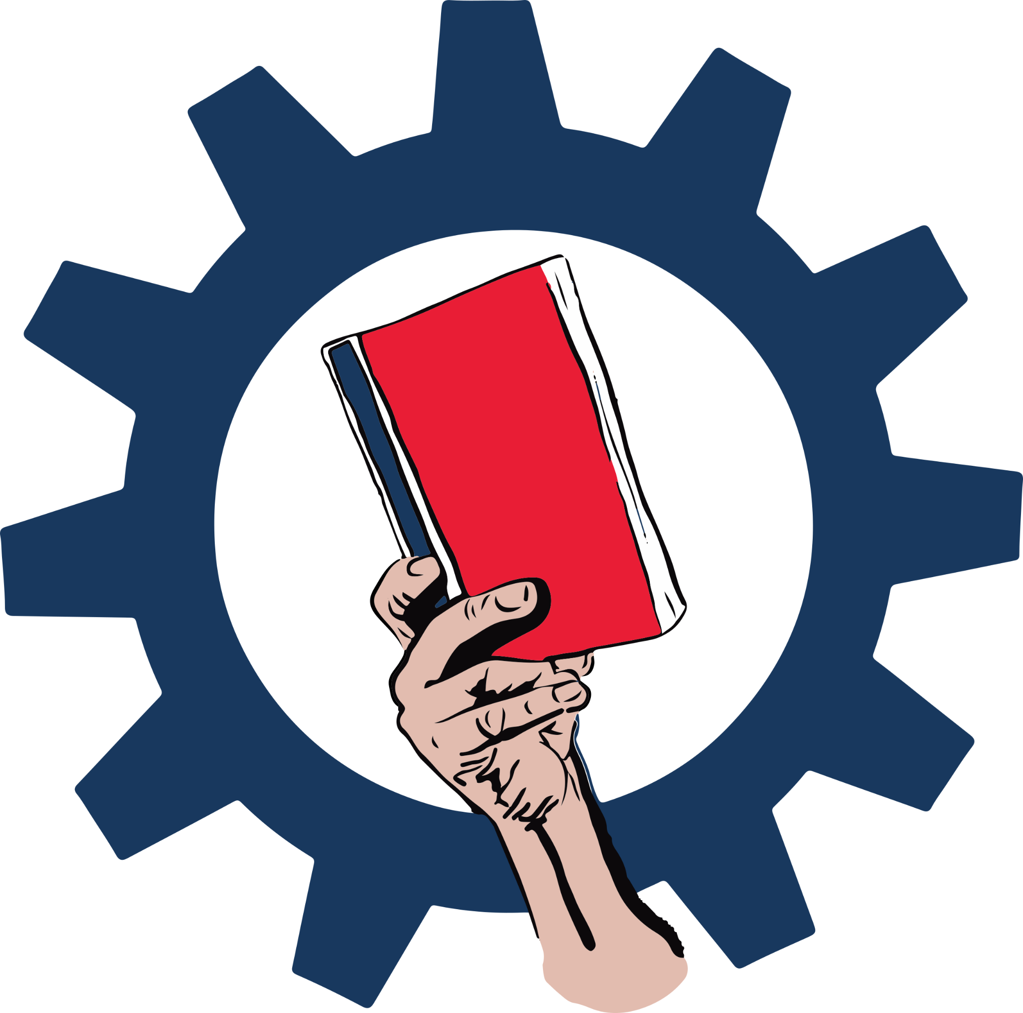
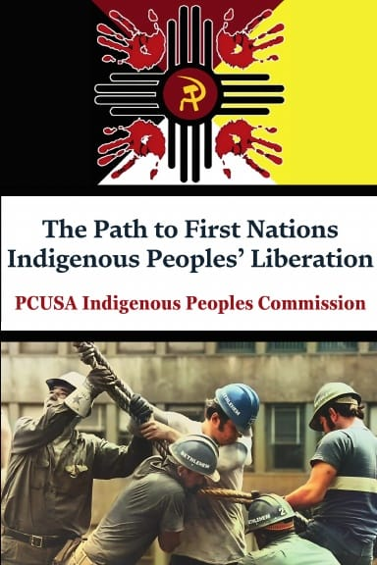
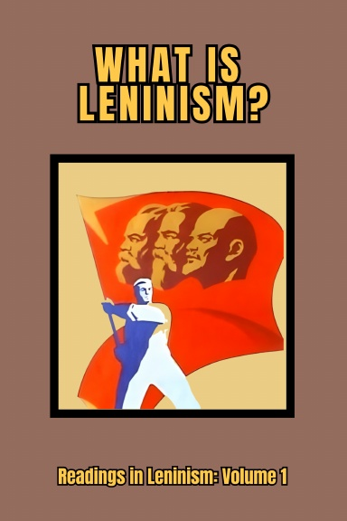

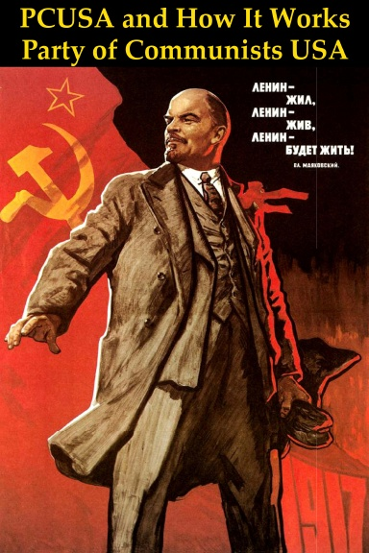
New Outlook Publishers
newoutlookpublishers.store
Relevant and Latest Releases

Slide 45
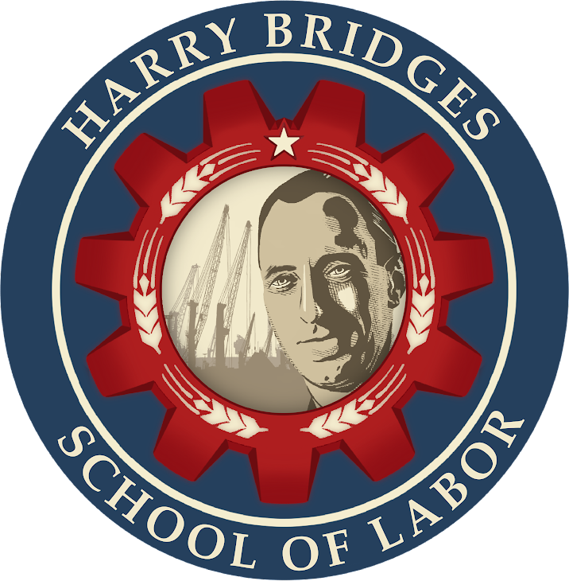
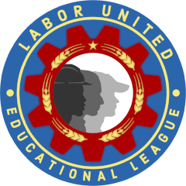
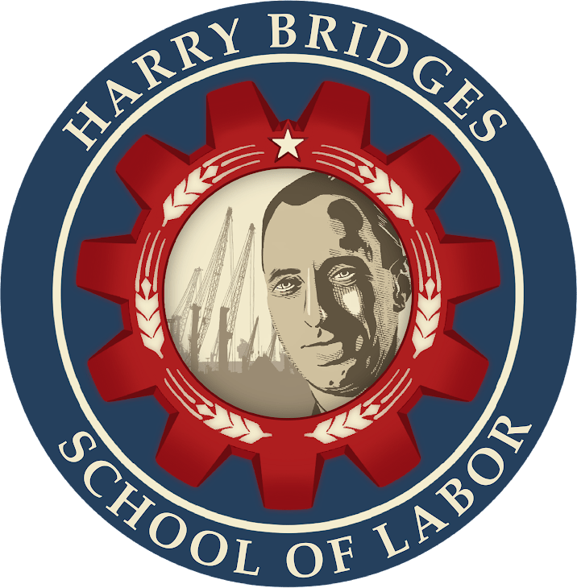
Harry Bridges School of Labor
luel.us/laborschool/
The Harry Bridges School of Labor is a monthly class covering a variety of topics aimed at building class consciousness among union members. For class schedule and other information, please visit the website at luel.us/laborschool.

Slide 46
Dancing to be Free - Clan/Destine

