Slide 1

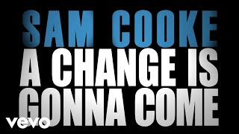
Click Insert -> Click Video -> Past Youtube link to song you want -> select song when it pops up
Sam Cooke - A Change Is Gonna Come

Slide 2
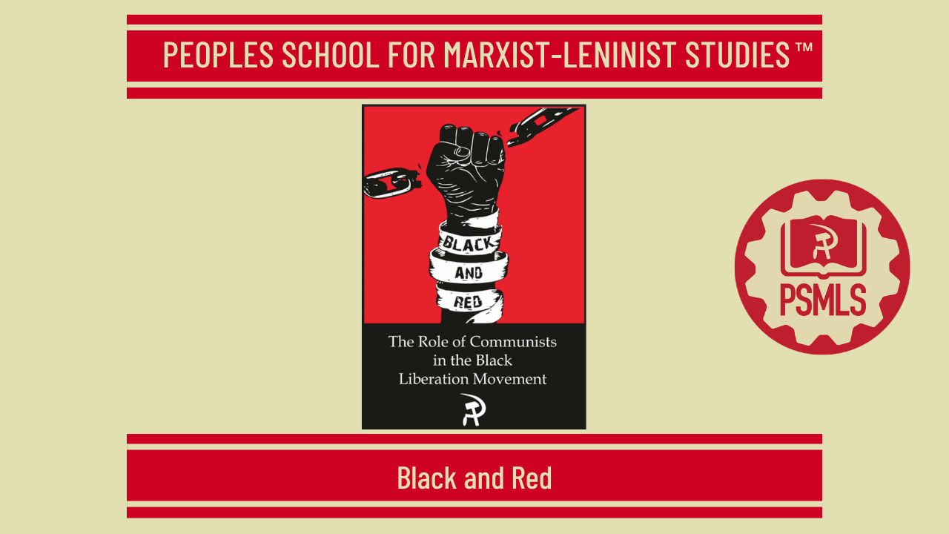
``
Insert Class Thumbnail Here
PSMLS MM/DD/YY

Slide 3
What we’ll be learning today:
Some of the Greats
Why I am a Communist
The Struggle Against Racism

Slide 4
Some of the Greats

Slide 5
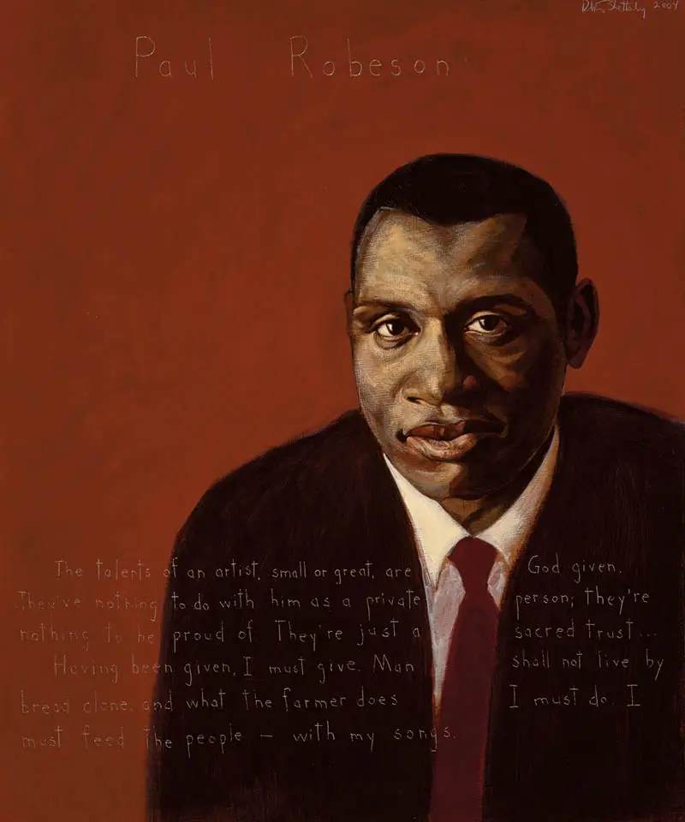
Paul Robeson
“How long, O Lohd, how long?”—that ancient cry of the oppressed is often voiced these days in editorials in the African-American newspapers whose pages are filled with word-and-picture reports of outrages against our people. A photograph of a African-American being kicked by a white mobster brings the vicious blow crashing against the breast of the reader, and there are all the other horrible pictures—burning cross, beaten minister, bombed school, threatened children, mutilated man, imprisoned mother, barricaded family—which show what is going on. How long? The answer is: As long as we permit it. I say that African-American action can be decisive. I say that we ourselves have the power to end the terror and to win for ourselves peace and security throughout the land. The recognition of this fact will bring new vigor, boldness and determination in planning our program of action and new militancy in winning its goals. The denials and doubts about this idea—the second part of the challenge which confronts us today—are even more evident than those I noted in regard to the first.
Paul Robeson 1898 - 1976 Singer, Writer, Civil Rights Activist
“The talents of an artist, small or great, are God given. They’ve nothing to do with him as a private person; they’re nothing to be proud of. They’re just a sacred trust. . . . Having been given, I must give. Man shall not live by bread alone, and what the farmer does I must do. I must feed the people—with my songs.”

Slide 6
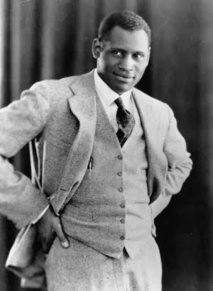
Paul Robeson (Excerpt from “Here I Stand”)
The diehard racists who shout “Never!” to equal rights, and the gradualists who mumble “Not now,” are quite convinced that the African-American is powerless to bring about a different decision. Unfortunately, it is also true that to a large extent the African-American people do not know their own strength and do not see how they can achieve the goals they so urgently desire. The basis for this widespread view is obvious. We are a minority, a tenth of the population of our country. In all the terms in which power is reckoned in America—economic wealth, political office, social privilege—we are in a weak position; and from this the conclusion is drawn that the Negio can do little or nothing to compel a change.

Slide 7
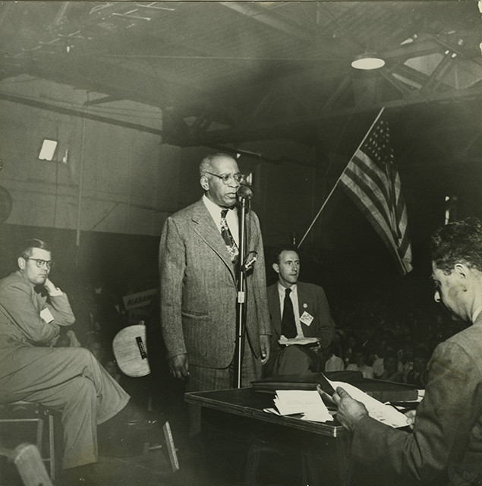
William Patterson
We maintain, therefore, that the oppressed African-American citizens of the United States, segregated, discriminated against and long the target of violence, suffer from genocide as the result of the consistent, conscious, unified policies of every branch of government. The Civil Rights Congress has prepared and submits this petition to the General Assembly of the United Nations on behalf of the African-American people in the interest of peace and democracy, charging the Government of the United States of America with violation of the Charter of the United Nations and the Convention on the Prevention and Punishment of the Crime of Genocide.
We believe that in issuing this document we are discharging an historic responsibility to the American people, as well as rendering a service of inestimable value to progressive mankind. We speak of the American people because millions of white Americans in the ranks of labor and the middle class, and particularly those who live in the southern states and are often contemptuously called poor whites, are themselves suffering to an ever-greater degree from the consequences of the Jim Crow segregation policy of government in its relations with African-American citizens.
We speak of progressive mankind because a policy of discrimination at home must inevitably create racist commodities for export abroad—must inevitably lead to war. We have not dealt here with the cruel and inhuman policy of this government toward the people of Puerto Rico. Impoverished and reduced to a semi-literate state through the wanton exploitation and oppression by gigantic American concerns, through the merciless frame-up and imprisonment of hundreds of its sons and daughters, this colony of the rulers of the United States reveals in all its stark nakedness the moral bankruptcy of this government and those who control its home and foreign policies.

Slide 8
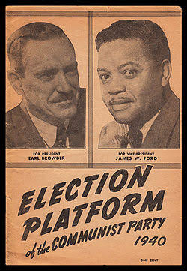
James Ford (Except from: “Party Building and Political Leadership”)
BUILDING THE PARTY AMONG THE African-American PEOPLE
In order to build the Party among the African-American people and to extend the united African-American People's Front, it is necessary to renew our struggle for the immediate and elementary needs of the African-American people. Our Party must stand out as the independent fighters for the African-American people.
Another factor necessary in building the Party among the African-American people is the question of training and retraining our personnel. This was a special point on the agenda of the African-American Commission of the plenum, Comrade Bassett made an excellent report and outlined a program of reading, study, self-study courses and schools for speedily overcoming a very great shortcoming in this field.

Slide 9
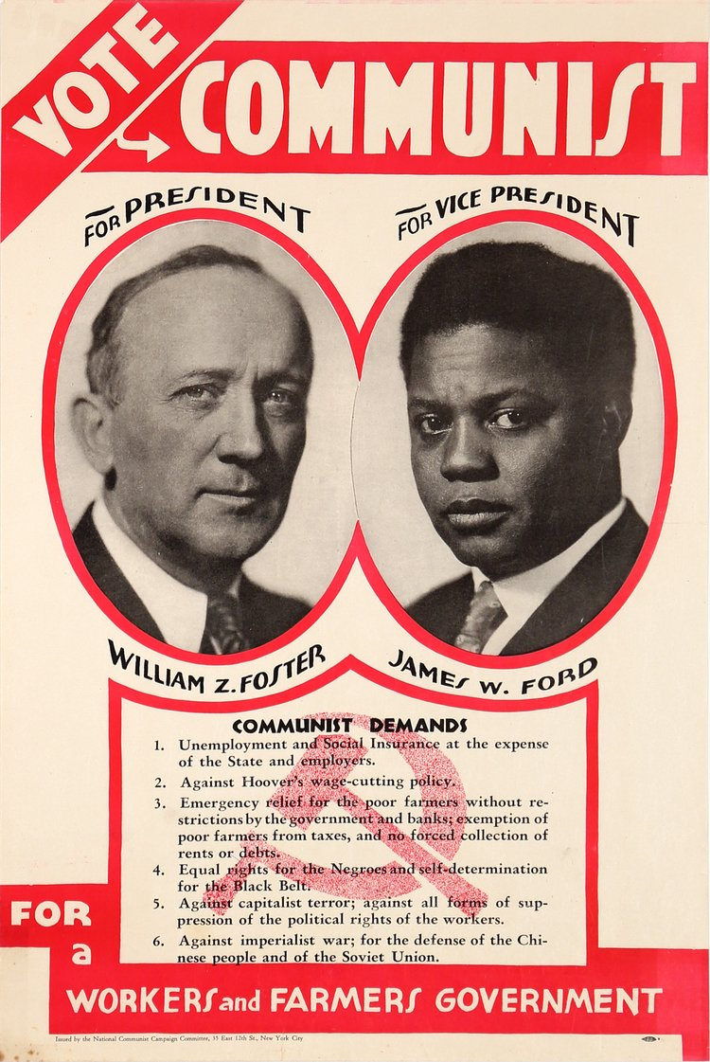
James Ford
If we make a careful analysis of our African-American personnel we find both among the leading forces as well as among
secondary leaders a woeful lack of systematic training in revolutionary theory and practice. We have, therefore, agreed to organize a national training school We have agreed to require of comrades in leading work, who are unable to attend these schools, to submit a plan of self-study and reading.
There is a great need for pamphlets on African-American problems. A number of comrades have been assigned to write popular pamphlets.
We are emphasizing again that special attention be given to the organization of the Party apparatus in those districts where there are large concentrations of African-Americans, The experiences in Harlem, Chicago and Cleveland should be extended. A special problem is daily attention on the part of the state or district bureaus to this work.

Slide 10
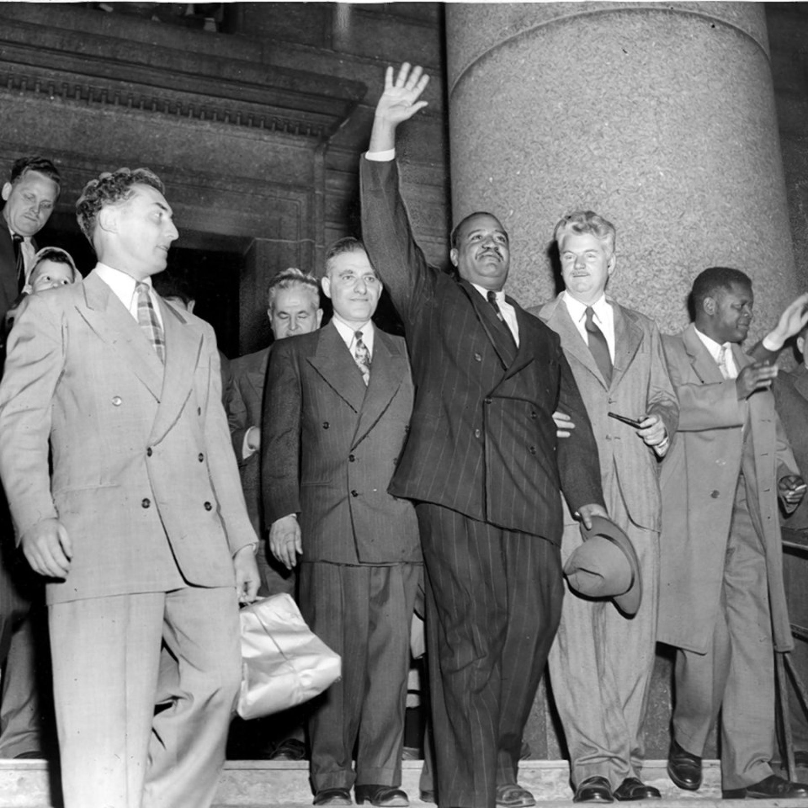
Benjamin Davis
“However, there was no contradiction between my being a Communist candidate and at the same time a people’s candidate. The two supplemented each other. Moreover, only such an approach could guarantee African-American representation on the city council. Besides, living Marxism is itself the broadest approach to the mass of people, encompassing all who work by hand and brain. Since my party was part of the people’s movement in its electoral coalition form, I could pledge the support of the Communists to this broad people’s platform.
Some of my wellmeaning supporters who were either Democrats or Republicans hoped I would stop there and go no further, fearing that an espousal of my views would frighten away voters. I rejected this view. Some agreed, others tried to reconcile themselves with my position; but none bolted. My campaigns were an excellent example of the united or people’s front, in which many forces work together on a common platform, even though they disagree on many other important questions. At the same time, the foundation of my victorious campaign was the alliance of the African-American people and important sections of the labor movement.
Upon this foundation was erected the structure of mass support among all sections of the population. The solid vote of Harlem was not enough to elect me; I needed the trade union and white progressive vote. That was shown clearly after the ALP candidate was counted out, when I received enough second-choice votes from him to assure my election by a comfortable margin.... My electoral victory rested upon years of conscientious and consistent work of the Communist Party in Harlem in the struggles of the African-American people.”

Slide 11
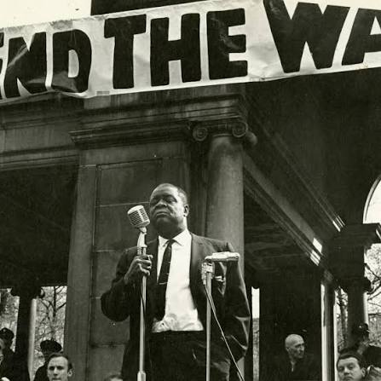
Henry Winston (Excerpt from “Strategy for a Black Agenda”)
For a Strategic Breakthrough
In Douglass' time, the strategy to break the slave power's control of Congress and the Federal Government was the precondition for the abolition of slavery. Today, the precon¬ dition for opening the path to the abolition of wage slavery and racist oppression through socialism is the strategy to defeat the threat of fascism and to break the monopolists' domination of Congress and the Federal Government. "Whoever does not fight the reactionary measures of the bourgeoisie and the growth of fascism [in its] preparatory growth of fascism, but on the contrary, facilitates that victory ." (> United Front Against Fascism, New Century Publishers, New York, 1950, p. 9.) The anti-coalition views of Carmichael, Forman, Boggs and others are nothing less than opposition to a united front against the "reactionary measures" with which monopoly prepares for its imposition of fascism.

Slide 12
Henry Winston
However, regardless of the disruptive nature of the views of such Black radicals, it must be recognized that the main obstacle to Black and white unity against the common enemy is the influence of racism on white workers. And it is the primary responsibility of white revolutionaries to lead the fight against racist ideology and to mobilize white workers in the struggle against racism and in support of Black liberation as indispensable to the advance of their class interests. The aim of monopoly is to force a reversal of every aspect of bourgeois democracy, limited as it is, in order to open the way for fascism. The aim of the anti-monopoly program, as advocated by the Communist Party, is to bring about a strategic breakthrough to a deeper and wider degree of democracy, one that would powerfully accelerate the revolutionary process, opening the way to Black liberation and socialism. Once this anti-monopoly strategy succeeds in breaking the control of state monopoly capital over Congress and the government, the forces exist, internally and internationally — in contrast to the anti-slavery period — that can prevent the betrayal of the struggle. There is such a perspective, and this is so, first of all, because the forces of class and national liberation, headed by the Soviet Union and the other socialist countries, have changed the world balance of power.

Slide 13
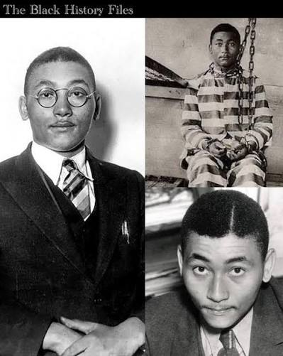
Angelo Herndon
In the summer of 1932, nineteen-year-old Angelo Herndon, a YCL member, was arrested in Atlanta, Georgia. Herndon was charged with “incitement to insurrection” under an old 1861 fugitive slave statute. Much of what I learned was from my brother Otto who was in Atlanta at the time and worked actively in the campaign.The Communist Party and the Unemployed Councils immediately took them up on their offer. They mobilized 1,000 people—Black and white—to come to the county courthouse and demand relief. The meeting itself was historic—the first time that such a large meeting of Black and white workers had taken place in the South.
Herndon described its significance in his autobiography: “It was a demonstration of the Southern worker’s power. Like a giant that had been lying asleep for a long time, he now began to stir.” Atlanta’s ruling circles were appropriately alarmed and the next day they found $6,000 for relief. One week later, Angelo Herndon was arrested. His trial was an example of Georgia lynch justice and the local rulers through their newspapers were to use it to sensationalize the “red Jew” scare for many years to come.
Before he was sentenced, however, young Herndon told the court: “You may succeed in killing one, two, even a score of working-class organizers. But you cannot kill the working class.” In the beginning stages of the case, the ILD had immediately taken charge of the defense, which was then in the hands of a young Black Atlanta attorney, Ben Davis, Jr. The case was linked up with the Scottsboro struggle as a symbol of the racist persecution of Blacks. A long legal battle ensued. Mass meetings and huge petition campaigns were launched as part of the defense effort. The case was fought through to the Supreme Court, which at first sustained the conviction, but ultimately reversed it by a five to four decision. Herndon, out on bail, was finally freed in 1937.

Slide 14
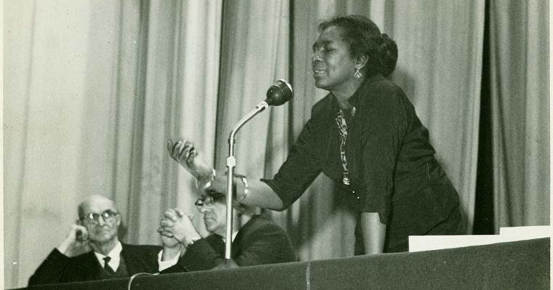
Claudia Jones
“Historically, the African-American woman has been the guardian, the Protector, of the African-American family. From the days of the slave traders down to the present, the African-American woman has had the responsibility of caring for the needs of the family, of militancy shielding it from the blows of Jim Crow insults, of rearing children in an atmosphere of lynch terror, segregation, and police brutality, and of fighting for an education for the children.
The intensified oppression of the African-American people, which has been a hallmark of the postwar reactionary offensive, cannot therefore but lead to an acceleration of the militancy of the African-American woman. As a mother, as African-American, and as a worker, the African-American woman fights against the wiping out of the African-American family, against the Jim Crow ghetto existence which destroys the health, morale, and the very life of millions of her sisters, brothers, and children.
Viewed in this light, it is not accidental that the American bourgeoisie has intensified its oppression, not only of the African-American people in general, but of African-American women in particular. Nothing so exposes the drive to fascination in the nation as the callous attitude which the bourgeoisie displays and cultivates toward African-American women. The vaunted boast of the ideologists of Big Business — that American women possess the “greatest equality” in the world is exposed in all its hypocrisy in the Soviet Union, the New Democracies and the formerly oppressed land of China, women are attaining new heights of equality. But above all else, Wall Street’s boast stops at the water’s edge where African-American and working-class women are concerned. Not equality, but degradation and super-exploitation: this is the actual lot of African-American women!”

Slide 15
Discussion & New Members Introductions

Slide 16
New Member Introductions
What is your name, pronouns and state (or country/territory)?
Where do you work? Is it unionized?
How did you find out about the People’s School?
What do you think about tonight's class?

Slide 17
“Why I Am A Communist”
By Ben Davis Jr.

Slide 18
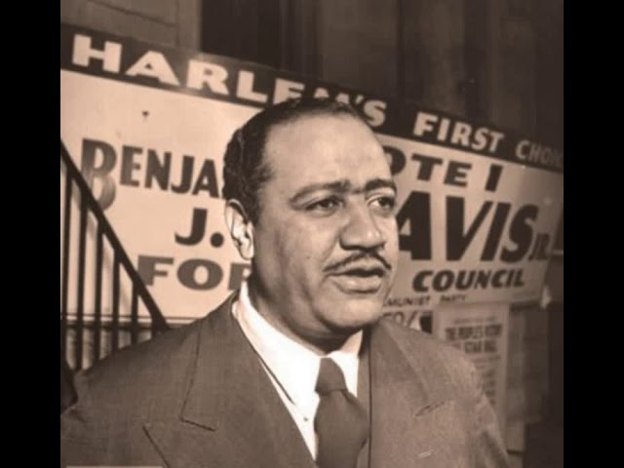
Why I am a Communist
In fact, the drive against the Communists is aimed, above all, against the labor
movement, against all anti-fascists, liberals, and progressives, against democracy─and against truth itself. Whether one agrees with the Communist Party or not, one must at least know the truth about it. One must not permit his ideas to be shaped by the hysteria which now passes as a "crusade against Communism."
Everywhere one turns today—over the big business controlled radio and the monopoly press—it is "Communist this" and "Communist that." In most cases, it is neither "this" nor “that.” Quite the contrary. The big gobs of mud thrown in the direction of the Communist inevitably splash their filth upon everything else decent and forward-looking in American life.
This, of course, is not difficult for the African-American people to understand. For, of all the minority groups, in the United States, none has been splashed with more mud than the African-American, at the hands of the monopoly press and other big-money controlled avenues of propaganda and information.
Benjamin Davis, Jr. (1903-1964)

Slide 19
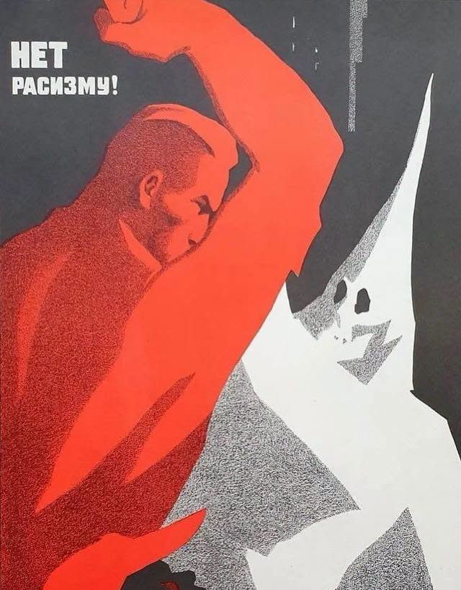
..why, as a African-American American, I am a Communist.
Anti-Communism has its source in the ruling circles of big Business and domestic fascism within our country. But it would be a major error to identify with these sinister circles the millions of workers and common people—African-American and white— who are not Communists or who do not accept the Communist program.
For they are, like the Communists, victimized by these same groups. There are many approaches to answering the question of "Why I am a Communist," all of which are interconnected, and which enter into my convictions.
Obviously, one cannot go into the whole range of them here. For purposes of this paper, I shall limit myself principally to explaining briefly, why, as a African-American American, I am a Communist.
Image: Soviet Anti-Racism Propaganda

Slide 20
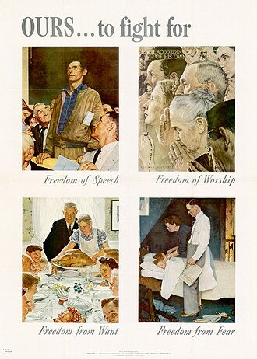
African-American AMERICANS WANT FIRST-CLASS CITIZENSHIP
As a African-American American, I want to be free. I want equal opportunities, equal rights; I want to be accorded the same dignity as a human being and the same status as a citizen as any other American. This is my constitutional right. I want first-class, unconditional citizenship. I want it, and am entitled to it, now. I want to be free of discrimination, Jim Crow, segregation, lynch law; I want to be free of second-class citizenship.
In short, I want, as an American citizen, to enjoy the four freedoms which were proclaimed by the late Franklin D. Roosevelt, and which the State Department is interested hypocritically in prating about for every place except America. This is the deepest and most determined desire of the fifteen million African-American citizens of America. All African-Americanes, in one form or another—or to one degree or another—are affected by Jim Crow, segregation and discrimination.
The African-American workers, that is, the great mass of African-Americanes, bear the heaviest brunt of the national Jim Crow system. But the relatively tiny African-American upper class, as well as the middle class, are also hit by discrimination. They have neither political, social nor economic equality, and they are confined almost exclusively to the African-American market, which they must share with the white ruling class, without being able to share equally the general market of white consumers over which Wall Street maintains undisputed sway.

Slide 21
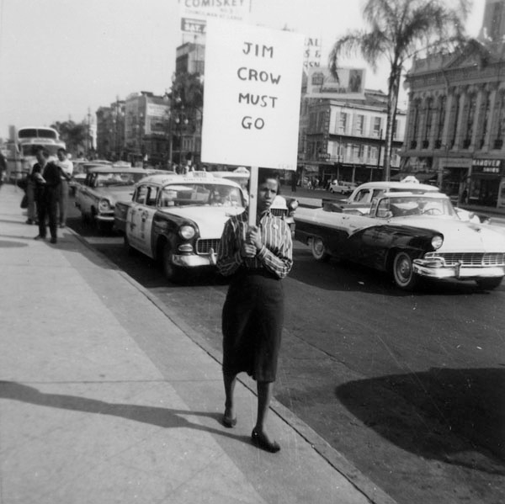
Discrimination
On the elementary issues of democracy in the deep South, where the great majority of the African-American people live, the white primary, injustice in the courts, lynch terror, lack of educational facilities, Jim Crow are endured by the African-American from top to bottom.
I, for example, through no virtue of my own, was born into a middle-class family, and received essentially the same educational advantages of one from a white middle class family. But when I board the trolley in Atlanta or Birmingham, I am not asked my class origin among the African-Americanes, nor are my university degrees inquired about. I must still sit in the Jim Crow section of the car.
Discrimination cuts across all sections and classes of the African-American people. So, with other walks of life. The white citizen of any class does not have that additional indignity to undergo, even though he may be exploited as a worker.

Slide 22
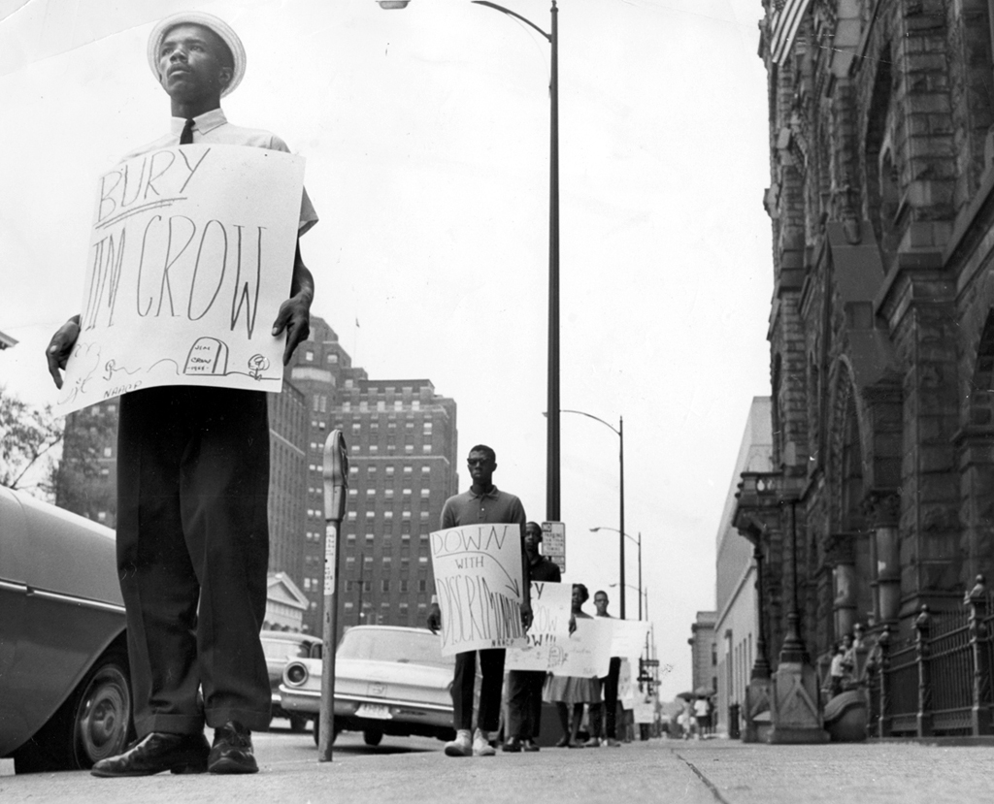
Jim Crow
The Jim Crow system has its sharpest expressions in the South. But it spreads its tentacles all over America, including New York, where I share in common with all other African-Americanes the denial of my constitutional right to live, for example, at 72nd Street and Fifth Avenue, an exclusive, lily-white area.
The restrictive covenant, against which the African-American people, their labor and progressive white allies are fighting, makes quite immaterial any African-American's ability to pay the high rent at 72nd Street. That, too, is Jim Crow à la New York, and it works its ways not only in housing but in jobs, civil rights, the slum-infested ghetto, education and in other fields—sometimes covertly and subtly, but, nevertheless, it is there.
My personal daily experience with Jim Crow—which experiences need no detailing because they are universally recognized as the basic experience of the African-American people— confronted me all the way from my native state of Georgia to Massachusetts, where I attended Amherst College and Harvard Law School.

Slide 23
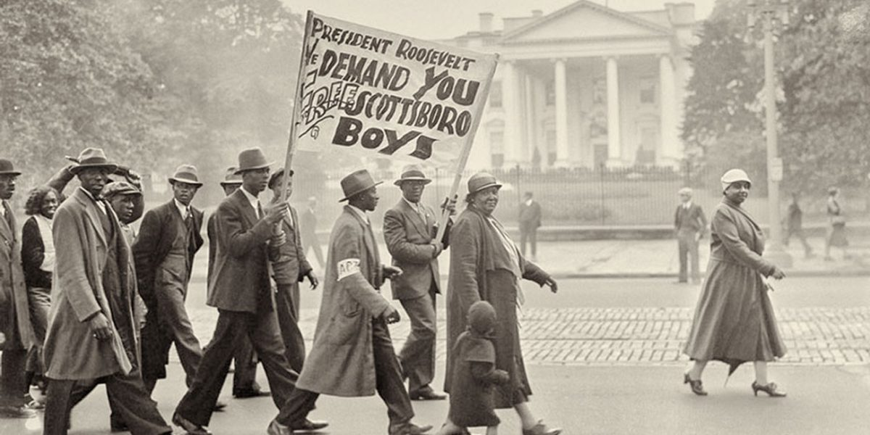
For Liberty
I am a typical American, who loves liberty and freedom—the same liberty and freedom that a Dewey and a Truman would sacrifice to the golden altar of American imperialism, in the name of "fighting Communism." Out of my personal experiences as a African-American American, and in quest of the liberty, freedom and equal rights proclaimed in the Constitution, the Bill of Rights, and the Declaration of Independence, I, like thousands of other African-Americanes—and white citizens ─ joined the Communist Party.

Slide 24
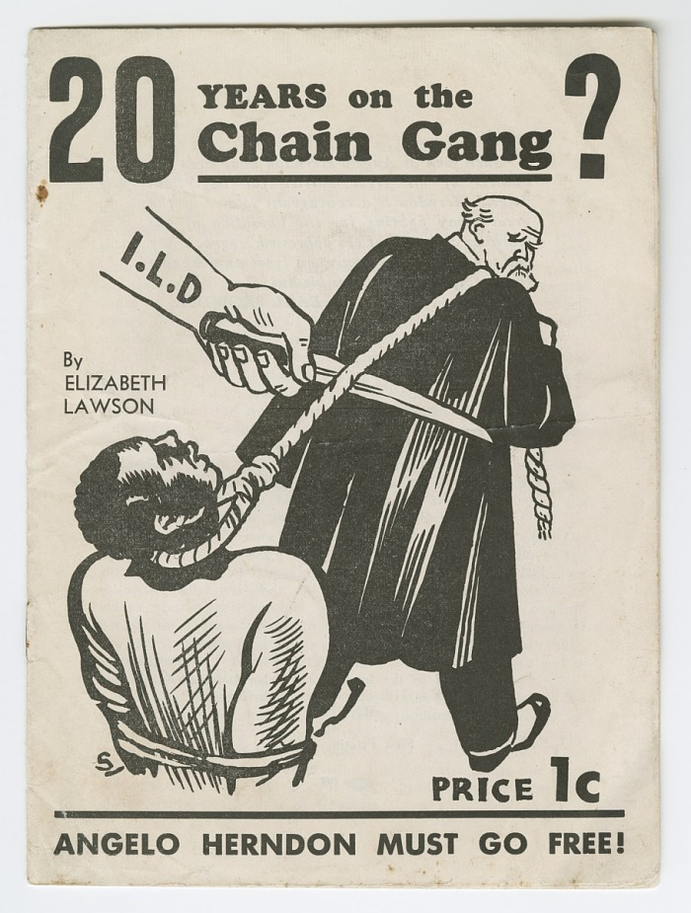
I JOINED IN THE HEAT OF BATTLE
I became a member of the Party in January 1933, in the heat of battle. At the time, I was serving as defense attorney for Angelo Herndon in Atlanta, Georgia, where Herndon, an eighteen-year-old African-American youth, had been framed on a charge of inciting to insurrection─a charge based on an antiquated and outmoded statute.
The charge carried with it the death penalty, but the jury "mercifully"—as I was given to understand by the judge—recommended twenty years for young Herndon on the Georgia chain-gang! Such "mercy," of course, meant a living death instead of an instantaneous death in the electric chair.
Of what was Herndon "guilty"? He had led a demonstration of unemployed African-American and white workers to City Hall, had been found with a couple of Communist pamphlets in his possession, and possessed a firm and inspiringly defiant advocacy of the freedom of African-Americanes and of the liberation of the white masses from exploitation. The "dangerous" policy he then espoused as a Communist, was the unity of the African-Americanes in the South with the impoverished white workers and poor farmers. His sentence was so raw that, after an extended campaign of mass pressure and public opinion led principally by the Communist Party and International Labor Defense, he was finally freed.

Slide 25
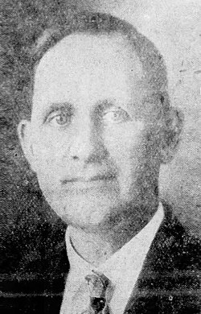
Arising from the Conditions, Country and Struggle
Credit for recruiting me into the Communist Party goes to Judge Lee B. Wyatt, who had been summoned from the backwoods hinterland of the state to hear the case. So crude and viciously unconstitutional and anti-African-American were his rulings (rulings which were negated when Herndon was freed), that my instant joining of the Communist Party was the only effective reply I could give.
It is fashionable among the lunatic elements of the domestic fascists to say that "the long arm of Moscow reaches into America and does the recruiting." But Judge Wyatt came from LaGrange, Georgia. He would resent, I am sure, any imputation that he came from Moscow and his resentment would be exceeded only by the protestations from Moscow. (As for me, I've never been to the Soviet Union, but I'm looking forward with great eagerness and pleasure to that experience.)
The point is that the Communist Party arises out of the conditions of life in the country where it exists and the struggle for a better life.
Judge Lee B. Wyatt

Slide 26
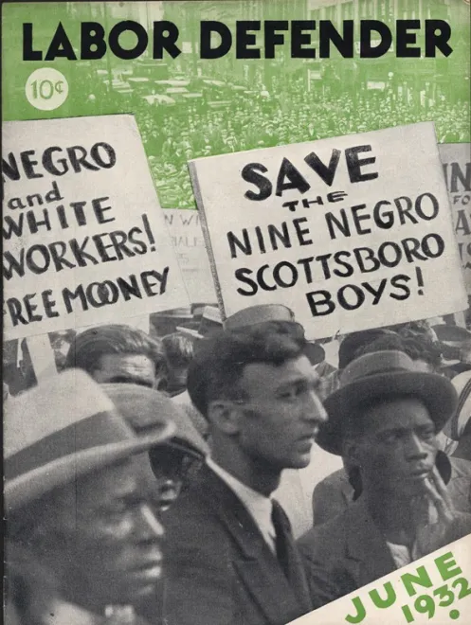
On the Ground Militancy
In joining the Communist Party, I was first impressed with the militant, uncompromising fight of its members for the freedom and equal rights of African-American Americans, with its devoted conduct of this fight in the Southern heart of Jim Crowism, with its practice of the equality it preaches, with its policy of unity between African-American and white on the lowest economic level, and with its scientific program of struggle for the immediate needs of the people, while simultaneously pursuing the goal of Socialism. It is folly to assume that either of the two major parties could make such an impression on an average African-American. My impression of the Communists was formed during the period of Scottsboro—the case which epitomized in all its horrible completeness the plight of the African-American and at the same time symbolized the zealously executed and correct policy of the Communist Party, in the struggle for the full political, economic, and social liberation of the African-American people.
My first impression was correct; but it didn't go far enough. Like the thousands of other members of the Communist Party, I was to learn further through activity, struggle, and personal application to the study of Marxism-Leninism as it relates to the specific conditions and historical development of our country. Above all, Communists learn from the people, of whom they are flesh and bone.

Slide 27
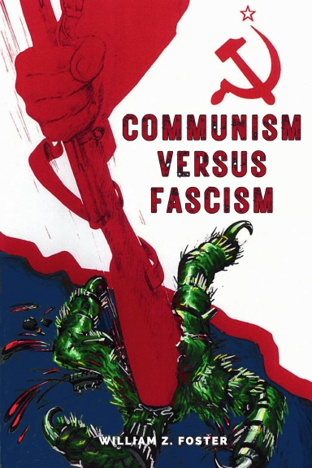
DEMOCRACY IN DANGER
The issue is not Communism versus capitalism or fascism. The fascists use this posing of the issue in order to confuse the people and to extinguish democracy, whether capitalist, as in our country, or the higher socialist form as in the Soviet Union. Hitler's anti-Communist crusade was a smokescreen behind which he extinguished democracy in the seventeen countries conquered by Nazism. None of these countries was Communist or Socialist. On the international front, the Soviet Union— because Wall Street, through the Truman Administration and its Republican backers, insists on bolstering world reaction as in Greece, Turkey, and China—is now leading the camp of democracy.
The Communists, in America, as all over the world, who gave their lives for the independence of their countries against the Hitler conquerors, are among the staunchest defenders of democracy in the present postwar period. The terrifying experience of minority groups under fascism, all over the earth, is but a comparatively mild example of what would happen to the African-American people in America, where capitalist reaction has already given fascism a head start by spawning the national system of Jim Crow and "white supremacy" upon the entire body politic of American democracy. The uprooting of the Jim Crow system is a part of the battle to turn back the danger of fascism in America. Conversely, the rights of the African-American people are the acid test of democracy.

Slide 28
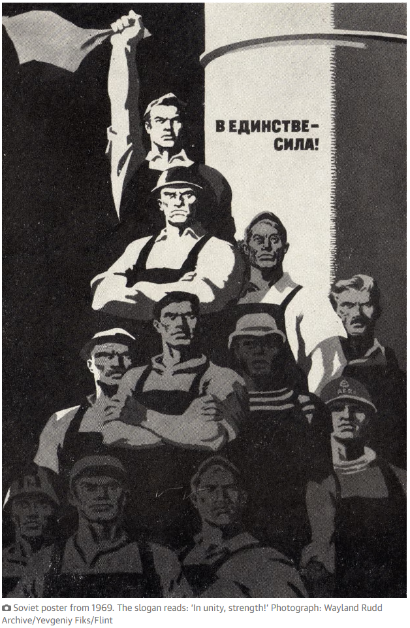
Alliance with Labor
The African-American people are an indispensable and long-term ally of the labor movement. Conversely, the African-American people must defend, build, and strengthen the labor movement as the apple of their eye; for the trade unions, the organized symbol of the working class, are the staunchest supporter and backbone of the struggle for African-American rights.
No section of the population has a greater interest in seeing one united labor movement in America than the African-American, who, like labor itself, has been constantly victimized by this split. While labor has the responsibility of taking the lead in wiping the stench of the slave market out of American life, the African-American workers have the job of combating the forces of disunity among certain African-American circles and winning the African-American people to a closer solidarity with labor.
"African-American and white, unite and fight the common oppressor" must be transformed into reality wherever man is exploited or oppressed.

Slide 29
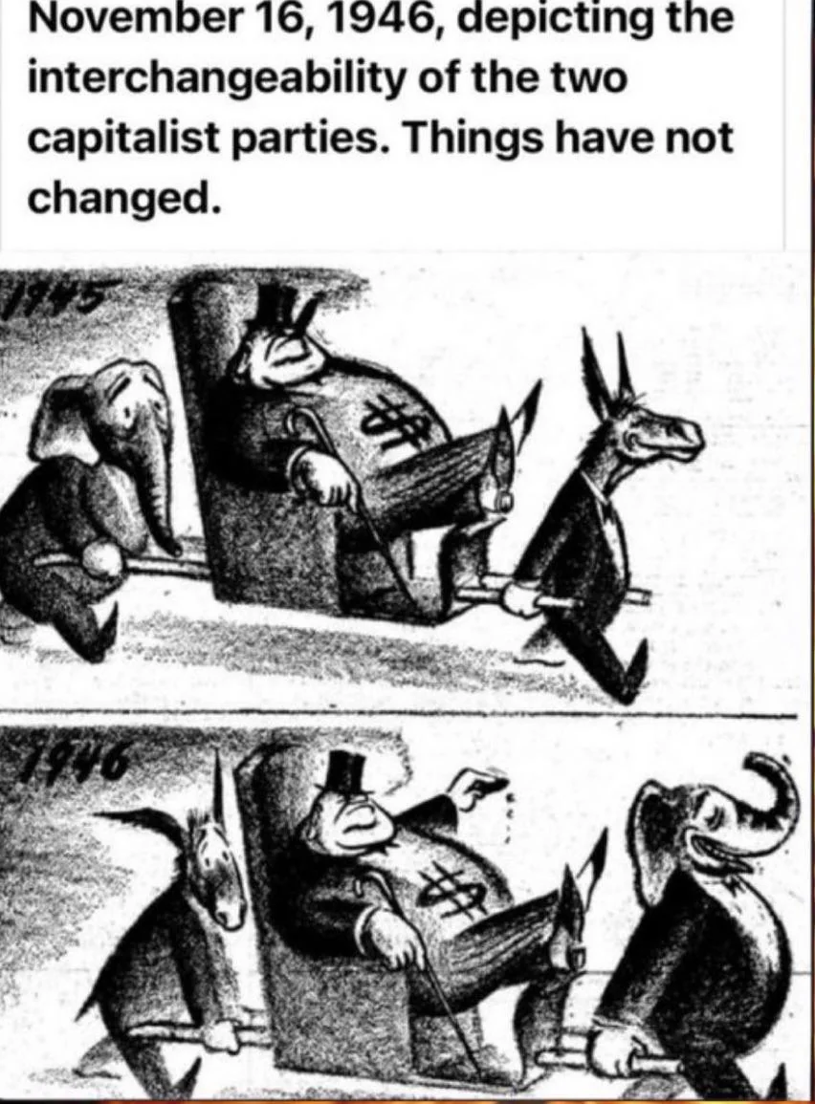
For a Worker’s Party
Finally, it is essential that the African-American people take their place on the basis of equality in the growing movement in America for independent political action—for the creation of a national third party, based upon the labor movement, the poor farmers, the middle class and the anti-fascist majority of the American people.
What this country needs is a new political party in which labor and the people—African-American and white—will be the dominant force in its policies, instead of the National Association of Manufacturers and the U. S. Chamber of Commerce and assorted Wall Street pirates. Not only can the African-American people make a vital and necessary contribution to such a new party, but only such a party, projected for the 1948 elections, can give full hope of fulfilling some of the promises which the Republican and Democratic national leadership has been hypocritically making since the Civil War.

Slide 30
THE COMMUNIST PARTY FIGHTS FOR African-American RIGHTS
It would be impossible to conclude this article without mentioning a couple of the main characteristics of the Communist Party itself in its structure and operation. First the Communists fight for the political, economic, and social equality of the African-American people now in all aspects of American endeavor. The Party's great contribution to American democracy was first dramatized in the celebrated Scottsboro case, where it not only burned the plight of the African-American into the conscience of America for the first time since the Civil War, but it did something entirely new. It brought for the first time the struggle for African-American rights to the labor movement and gave flesh and blood to the Marxist classic that "labor in a white skin can never be free while labor in a black skin is branded." On a thousand fronts the Communists at the side of the African-American people have battled and do battle daily for equal rights. The Communist Party places upon its white members, and seeks to convince all white workers, that they should be in the front ranks against white chauvinism, the main ideology and practice of the monopolist class, not only for enslaving the African-American people, but for exploiting the white masses. White chauvinism is not tolerated in the Communist Party.

Slide 31
The Party of the African-American People
The Communist Party is the Party of the African-American people, which it must, and can only, be by virtue of being the Party of the white workers. Examples of equal rights for the African-American set by the Communist Party inspire emulation among all organizations in the country. Communists are modestly proud of the warm regard of the African-American people and seek always to be ever more worthy of this honor. Can the struggle for peace, democracy, freedom, and security, be won in the postwar world?
Can the battle for the African-American's full citizenship be won? To be sure! And this requires, besides struggle, unity and correct political an abiding faith in the people of America, African-American and white, and of the world. It is the fear of this victory of the people that causes the frightened men of the trusts to wallow in an orgy of Red-baiting, laborbaiting, and African-American-baiting. They see the forces of democracy-of labor and the people-growing all over the world, including our own land. The future belongs to the people. Whether one is a member of the Communist Party or not—or agrees in toto with it-one must recognize that the future is not assured without a strong and ever-expanding Communist Party here, as in the other countries of the world. I want that future as quickly as possible— that's why I am a Communist.

Slide 32
Discussion

Slide 33
The Struggle Against Racism

Slide 34
Black Americans and the Soviet Union
Here is a speech by Paul Robeson delivered at a banquet sponsored by the National Council of American-Soviet Friendship in November 1949. It was first released as a pamphlet in 1950:
This 32nd anniversary of the Union of Soviet Socialist Republics is an occasion of joy and pride and thanksgiving not only for the eight hundred million people who live in the Soviet Union and the People's Democracies of Eastern Europe and China. True, these eight hundred million, as direct beneficiaries of the establishment of the Soviet Union and of its policies of struggle for peace and democracy, are rejoicing because of the new economic security and political liberty, the new promise of a fuller and richer life for all, which they enjoy because they live in the Soviet land or in countries of the People's Democracies. The feelings of all these people must be very like those of the President of the Chinese People's Republic, Mao Tse-Tung.
"If the Soviet Union did not exist,'' Mao wrote, "if there had been no victory in the anti-fascist second World War, if Japanese imperialism had not been defeated, if the various new democracies of Europe had not come into being, if there were no rising struggle of the masses of the people in the United States, Britain, France, Germany, Italy, Japan, and other capitalist countries against the reactionary cliques ruling over them, if this sum-total of factors did not exist, then the pressure of the international-reactionary forces upon us would surely be far greater than at present. Could we have been victorious under such circumstances? Certainly not."

Slide 35
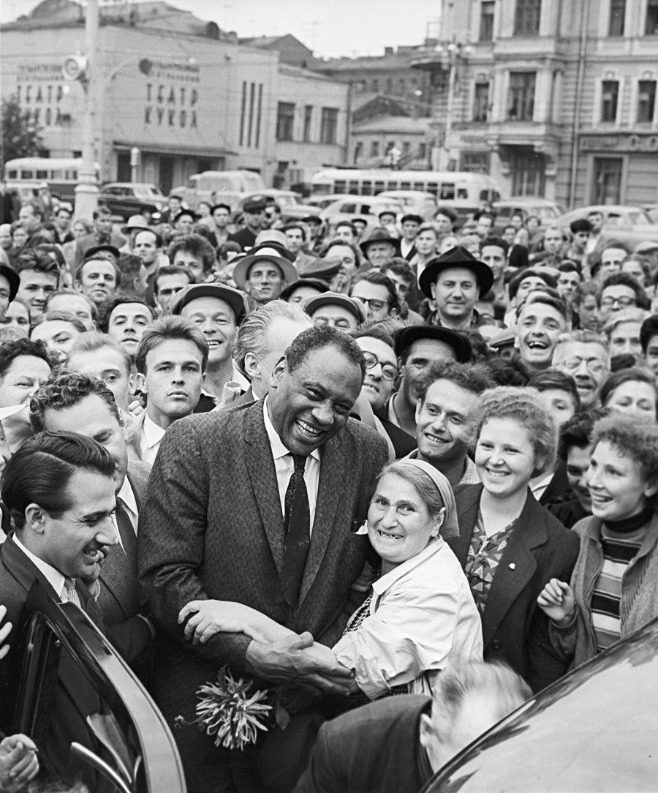
The Decisive Influence of the Soviet Union
That is the way Mao explains how much the liberation of China is indebted to the decisive influence of the Soviet Union in international affairs. And so, with the Romanians and Bulgarians, the Hungarians and Albanians, the Czechs, and the Polish people. It is because of this sum total of factors that they today are the masters of their own lands—a sum total which means that the world balance of power has shifted in favor of the forces of peace and democracy. And this portentous transformation, which has occurred within three decades, stems mainly from the mighty impact of the events of November 7, 1917. I traveled recently in Western Europe and Scandinavia. and I know from what I saw and heard in those countries, that there, too, the peoples are able to struggle against the total colonization of their countries by Wall Street principally because of this new balance of power. And if the Vietnamese and the Indonesians, if the Burmese and Malay people, indeed, if the people of long-suffering India have advanced to a higher stage of struggle for their independence, it is because of this sum-total of factors and the decisive influence of the Soviet Union.
The American singer Paul LeRoy Robeson, member of the World Peace Council, in Moscow. 01.06.1958

Slide 36
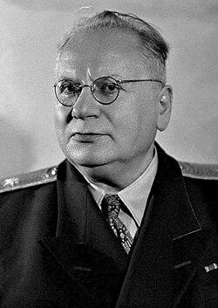
The Soviet Union is the Friend of the African and West Indian Peoples
All Africa remembers that it was Litvinov who stood alone beside Haile Selassie in Geneva, when Mussolini's sons flew with the blessings of the Pope to drop bombs on Ethiopian women and children. Africa remembers that it was the Soviet Union which fought the attempt of Smuts to annex Southwest Africa to the slave reservations of the Union of South Africa. Africa knows it was the Soviet Union who demanded at San Francisco that the Charter of the United Nations contain a guarantee of self-government for the peoples of so-called “trust” territories. Despite all the censorship and repression, the word has gotten around. The Soviet Union is the friend of the African and West Indian peoples. And no imperialist wolf disguised as a benevolent watchdog, and not Tito disguised as a revolutionary, can convince them that Moscow oppresses the small nations. Africa knows the Soviet Union is the defender and champion of the rights of all nations large and small—to control their own destinies. The Soviet Socialist program of ethnic and national democracy is precisely the opposite of the Nazi fascist, South African and Dixiecrat programs of racial superiority.
Maxim Litvinov was the Soviet People's Commissar for Foreign Affairs who famously championed "collective security" against the rise of global fascism

Slide 37
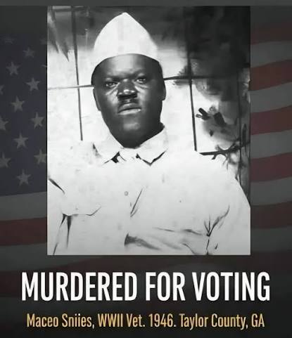
Three Hundred Years of Terror
In America today the African-American people are the core of the struggle against war and fascism. Three hundred years of oppression and terror have brought my people to the forefront in this struggle. There is no democracy for the masses of my people. The achievements of a few are no answer—in fact this is being used in reverse—to cover up the injustices to our millions. The millions of African-Americanes who are denied the right to vote are mountainous testimony. Unemployment is a constant specter. We are the last hired and the first fired. Five thousand African-Americanes have been lynched. Not one lyncher has been brought to justice. Not one lyncher has been made to pay for this horrible crime. Maceo Snipes, a World War II veteran, went to vote in Taylor County, Alabama. One hour later he was killed on the doorstep of his home, within sight of his wife and children. His murderers walked away saying, "We told you not to vote." But the widow of Maceo Snipes told her children “When you grow up, you’ll vote too.”

Slide 38
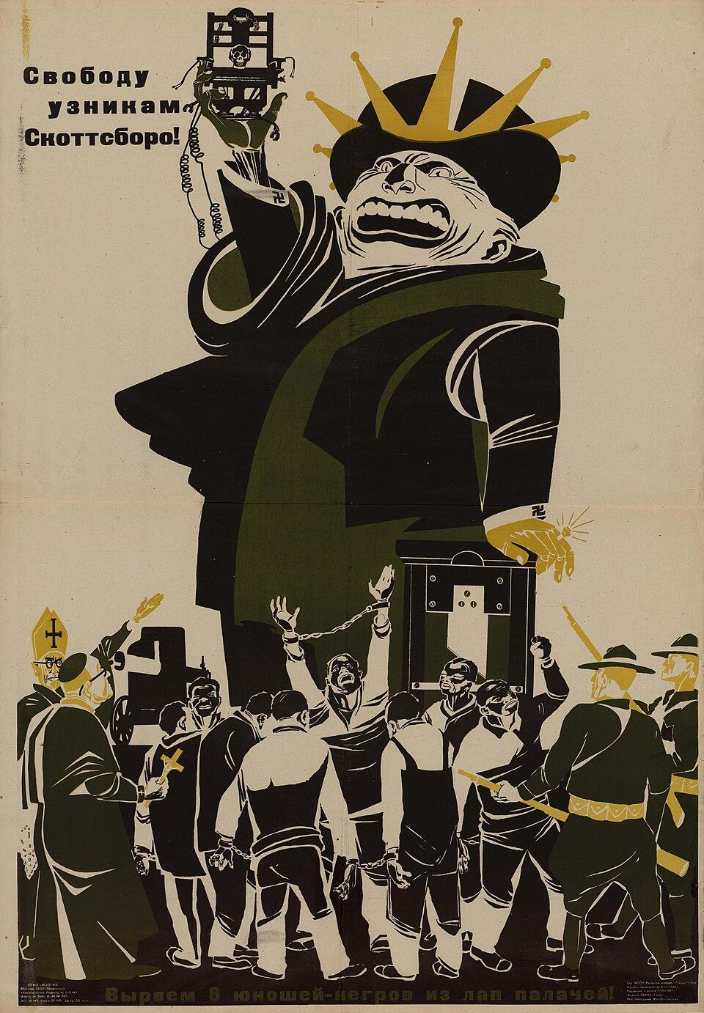
Abolishing All Discrimination
The African-American people know that they can expect no answer from American imperialism. American imperialism cannot relinquish its Jim Crow terror while it pursues its Marshall Plans and Atlantic Pacts and its drive toward war. But there is another side to this miserable picture. A hopeful side. It is the rising militancy of the African-American people's struggle for land, equality, and freedom. In meetings that I have had throughout the country with tens of thousands, this rising militancy has shown itself under a new leadership, a leadership made up of African-American trade unionists, veterans, working women and youth, ministers of our churches, fraternal leaders, and others. I have heard some honest and sincere people say to me, "Yes, Paul, we agree with you on everything you say about Jim Crow and persecution. We're with you one hundred percent on these things. But what has Russia ever done for us African-Americanes?" And in answering this question I feel that I go beyond my own personal feelings and put my finger on the very crux of what the Soviet Union means to me—a African-American and an American. For the answer is very simple and very clear: "Russia," I say, "the Soviet Union's very existence, its example before the world of abolishing all discrimination based on color or nationality, its fight in every arena of world conflict for genuine democracy and for peace, this has given us African-Americanes the chance of achieving our complete liberation within our own time, within this generation."
Soviet Poster “Freedom to the Prisoners of Scottsboro” by Dmitri Moor, 1932

Slide 39
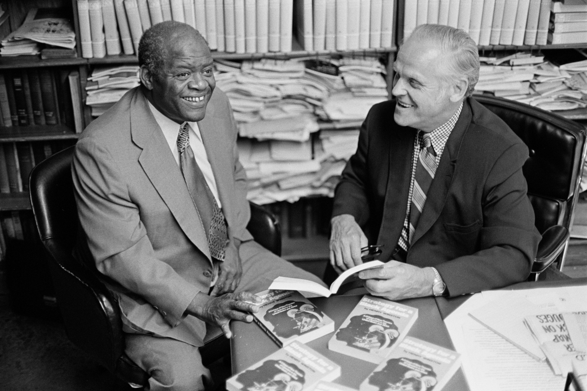
FIGHT RACISM —
FOR UNITY AND PROGRESS!
Presented here is the text of a lecture given by Henry Winston on February 23, 1971, to a seminar of Communist Party organizers:
The giant industrial monopolies, the big banks and insurance companies, the financiers and landowners, all spawn racism and use it as one of their chief class weapons to maintain and defend their regime of exploitation and oppression, of enmity between peoples, of imperialist wars of aggression. It follows that all democratic and anti-monopoly forces, with the working class and the Black liberation movement in the van, can effectively defend the interests of the vast majority of the people only when they actively further the struggle against racism. This is an essential precondition for the development of a fighting alliance which will unite all democratic and anti-monopoly forces in the country. Marxism-Leninism teaches us, and history has shown and continues to show, that if there is not a day-by-day struggle against racism, in the realms of both ideology and practice, unity will be more apparent than real. And such a formal appearance of unity, which is not based on substance only weakens the struggle against monopoly and for social progress.
Winston and Gus Hall look over Winston's new book, Strategy for a Black Agenda, August 6, 1973

Slide 40
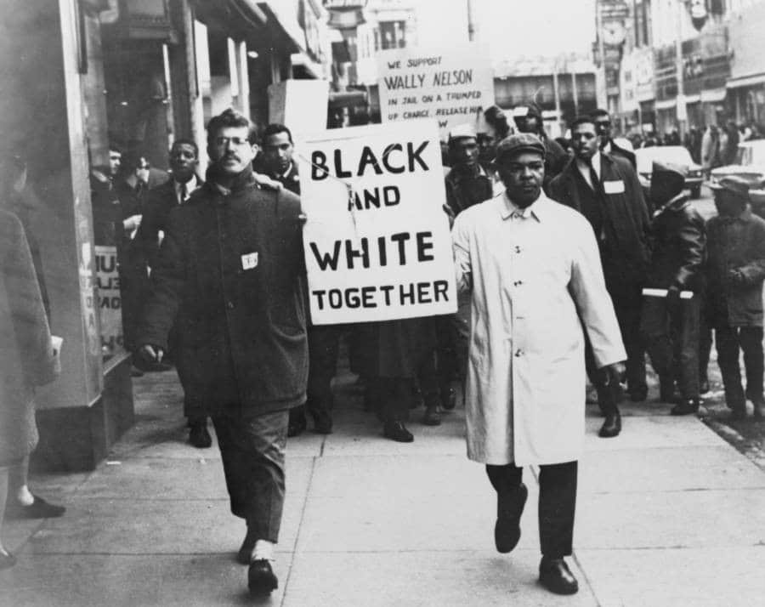
Racism is a Consciously Employed Weapon
Marx wrote long ago that "Labor in the white skin can never be free so long as labor in the black skin is branded.” This profound observation points up the fact that racism is a consciously employed weapon of the white imperialist oppressors who use it to create division in the ranks of the working class. And Marx correctly suggests that white workers must take the lead in the struggle against racism. This is the path which can lead to unity of Black and white workers in struggle, which can achieve Black equality and a real improvement in the conditions of all workers. The conclusion which Communists must draw with respect to this most important question is that it is mere chatter to talk about trade union consciousness developing into class consciousness and advancing to socialist consciousness if there does not exist a conscious, ending struggle against racism. No worker can be said to be class conscious who does not recognize the community of interests of all workers as a class. And for white workers this means first of all recognition of the community of their interests with those of Black workers and therefore of the need to fight for the rights of Black workers.
photo by an unknown photographer at an unknown location taken around 1965 during a rally in support of civil rights leader Wally Nelson after he was jailed

Slide 41
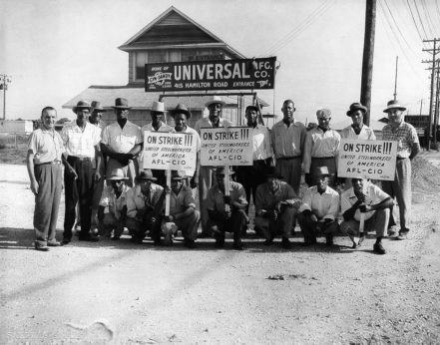
Capitalism Breeds Racism
If the working class is able to recognize the source of racism, then it will be able to find the cure that will benefit the workers and all oppressed peoples. I am certain that the Marxist-Leninist theory of our Party will help the masses of workers to find the answer to this question. When they do, when they find that it is the capitalist system which breeds racism, they will be led in their day-to-day struggles against the social oppression of the monopolies toward an understanding of the need for socialism. Racism in the labor movement in any form undermines working-class solidarity and weakens the blows of the rank and file in its struggle for its economic and social demands. On the other hand, it is a truism that the fight for class solidarity advances the level of consciousness whereby the independent position of the working class becomes solidly rooted among the rank and files. This is manifested mainly in a consistent fight for higher wages, shorter hours, an end to speedup, longer vacations with pay, better sanitary and safety, conditions, etc. It is manifested in the fight for trade union democracy which involves the rank-and-file in the determination of policy, and for an independent class position in the realm of politics.
Pay discrimination, hiring discrimination, and race-based promotions thwarted black steelworkers’ social mobility and their development as workers. The struggle against racism saw them build unity and power that radically altered how the steel industry worked. This photo shows the Steelworkers’ Universal strike, Tampa, Fla. | United Steelworkers of America, District 36

Slide 42
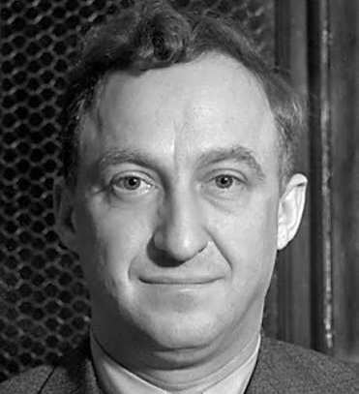
Fight Against Reformism and Class Collaborationism
The fight against racism must also include a battle against opportunism in all its forms. It entails a fight against the reformism and class collaborationism brought into the labor movement by Meany, Lovestone and Company, not only at the top but at every echelon of trade union structure. We are indeed living in a period of great turmoil and rapid change. On every side we find manifestations of social crisis: unemployment, housing, health, education, welfare, transportation, communications, etc. We suffer from high prices, high rents, and high taxes, from serious neglect of our children, and especially of Black, Puerto Rican, Chicano, and Indian children. The pollution of our environment has reached a critical, dangerous stage. And so, in every phase of life there is a growing social crisis. The economic problems of the people are being aggravated by the enormous and growing military budgets of the Nixon Administration, which is spending tens upon tens of billions every year to build the largest military machine the world has ever known, for the purpose of imperialist aggression. It is these policies of the Administration which explain the continuing deterioration of the conditions under which the masses live.
Lovestone was national/executive secretary of the CPUSA in 1927. During the 1920s power struggles inside the CPUSA, Lovestone championed the concept of "American Exceptionalism"—the idea that the U.S. capitalist economy did not follow Marxist revolutionary patterns. Stalin eventually denounced him as a renegade and he was expelled from the CPUSA.

Slide 43
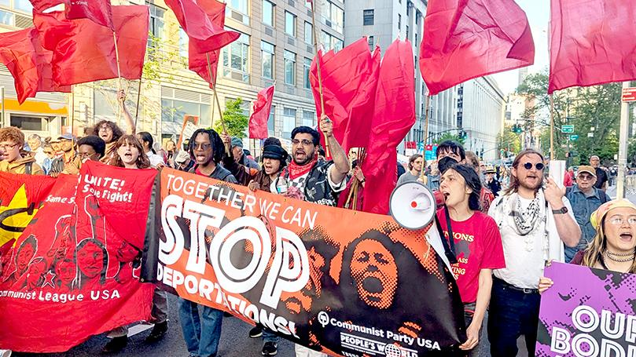
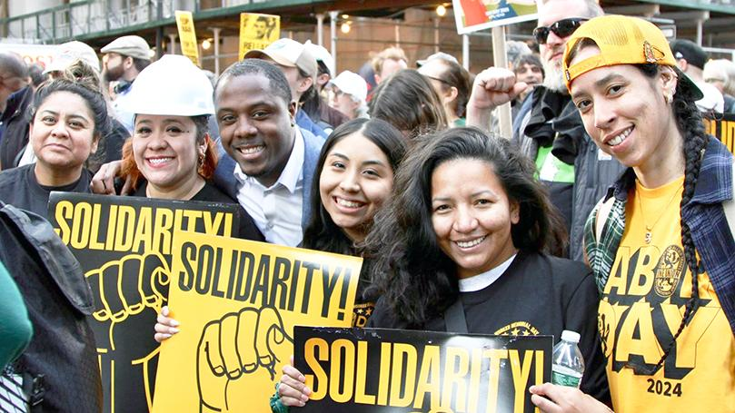
State Clearly the Position of Our Party
The fight against racism is a most important weapon in the struggle to save humanity from the dangers of a third world war and to advance the social interests of the peoples in all countries. The subject we are discussing is concerned not alone ·with the fate and the very lives of Black, Puerto Rican Chicano and Indian people; but with those of the whole, working class and of other social strata in our country. As you can see, comrades, the responsibility of our Party to bring these concepts to the millions is very great indeed. We must not, we cannot fail in this task. An analysis of the present moment and the immediate outlook shows that this state of affairs is one which the masses of our people will not take lying down. In fact, the people's resistance to monopolist reaction has already begun. In the period immediately ahead, we shall witness sharp clashes on all fronts. Great struggles will take place: on the one hand struggles of the working class against the giant monopolies, and on the other hand struggles of the Black people against repression and for survival. We must state clearly the position of our Party in respect to racism and our differences with other approaches to the question. But we must at the same time recognize the need for seeking unity with these different currents in order to win the fight against racism.

Slide 44
Discussion & Wrap Up

Slide 45
Announcements
PCUSA Cell Chairs need to call members of their cells to remind them about attendance.
The next issue of New Masses (2026) has begun production. If you have art you want us to feature, email it to info@partyofcommunistsusa.net.

Slide 46
Volunteers Needed!
We are in need of volunteers for the staff of the People’s School! Here’s a few roles we need filled:
People to help manage posting on our social media and podcast platforms
Video Editors, Audio Editors, Graphic Designers, Artists, Narrators
Facilitators, Web Controls, Moderators
Email info@peoplesschool.us if you’re interested and try to attend our next staff meeting.

Slide 47

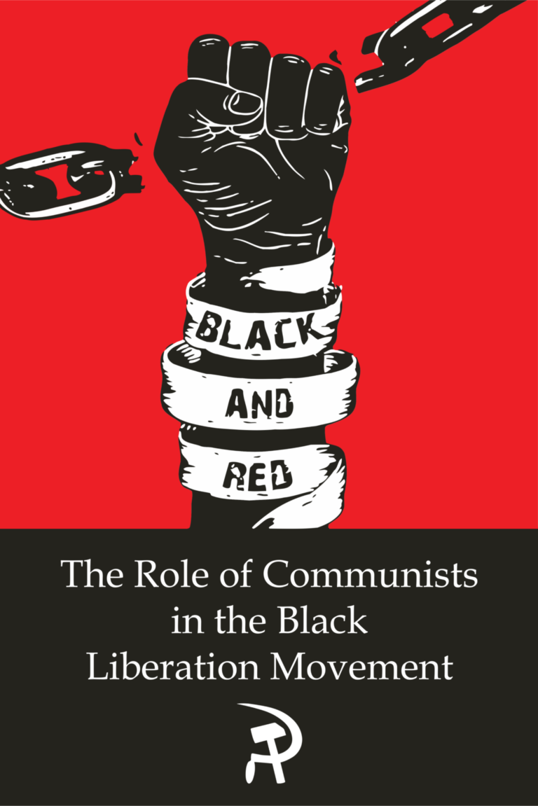
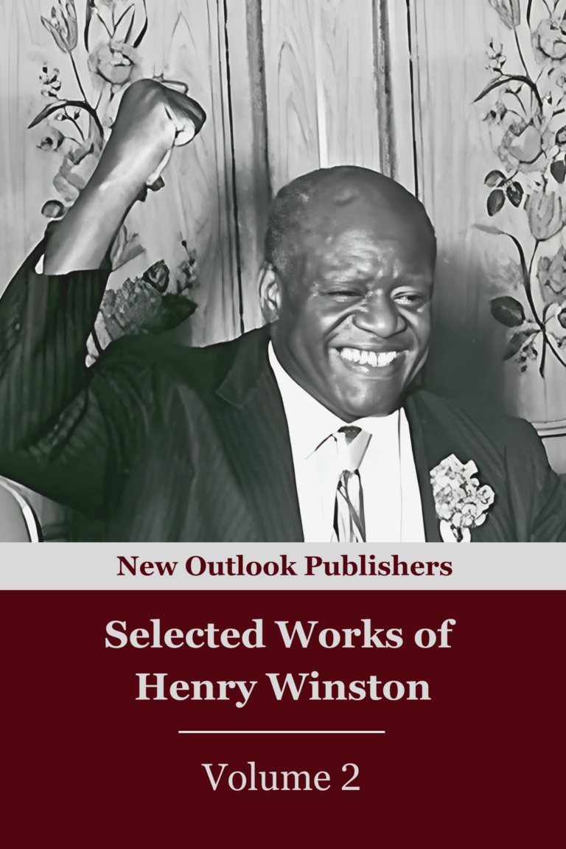
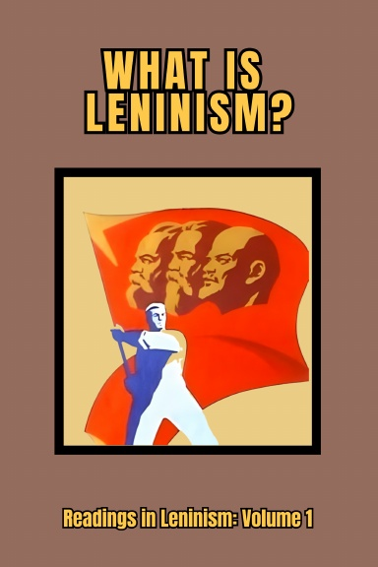
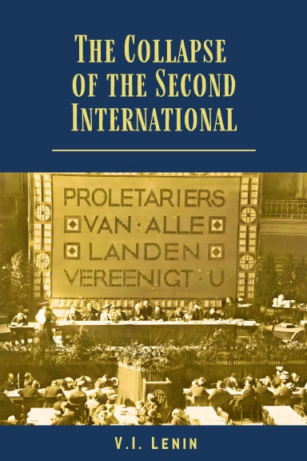
New Outlook Publishers
newoutlookpublishers.store
Latest Releases

Slide 48


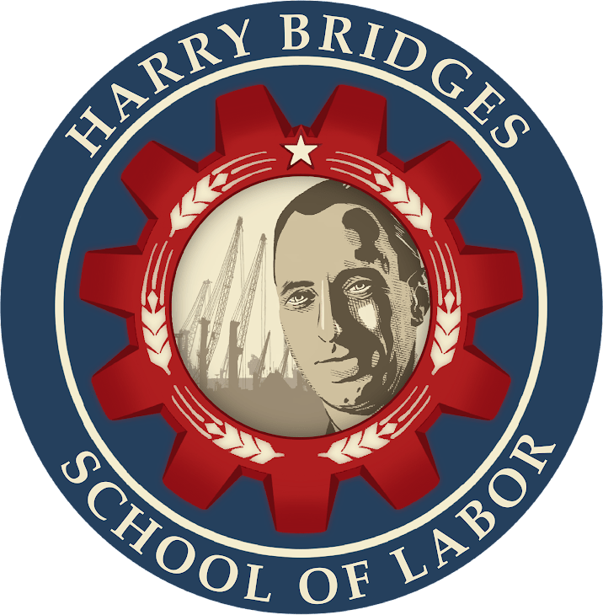
Harry Bridges School of Labor
luel.us/laborschool/
The Harry Bridges School of Labor is a monthly class covering a variety of topics aimed at building class consciousness among union members. For class schedule and other information, please visit the website at luel.us/laborschool.

Slide 49
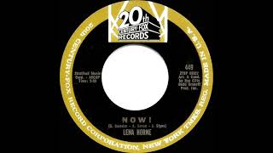
Click Insert -> Click Video -> Past Youtube link to song you want -> select song when it pops up
1963 Lena Horne - Now!

