Slide 1

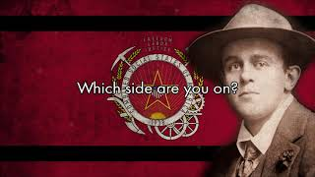
“Which Side Are You On” — American Socialist Song

Slide 2
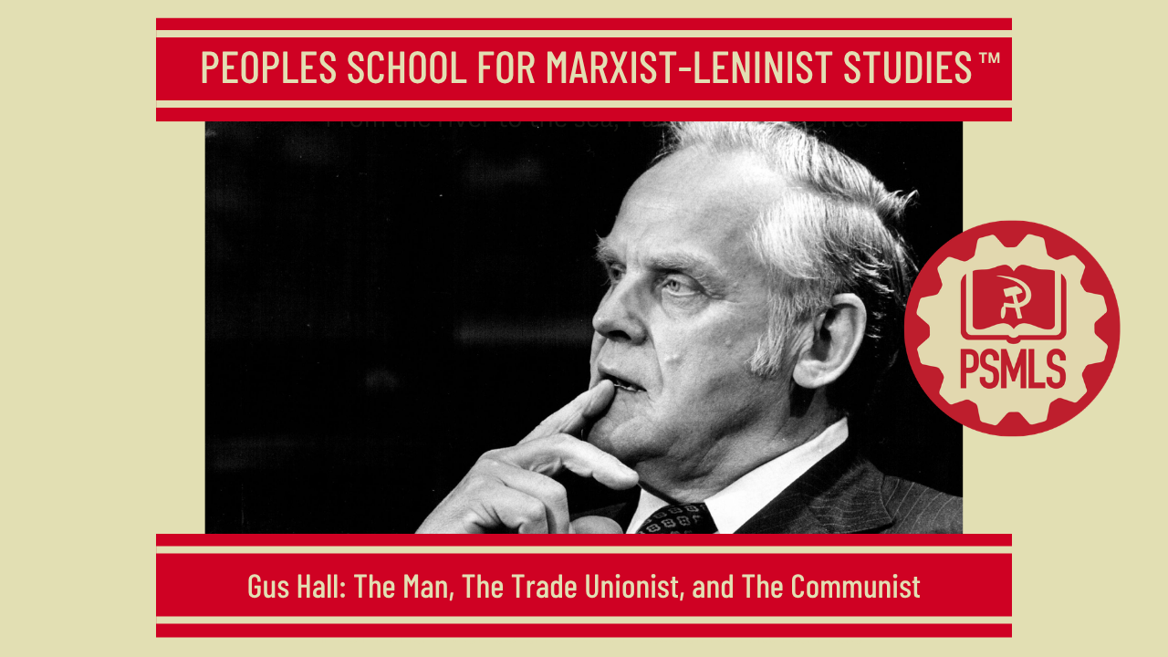
PSMLS 10/06/26

Slide 3
What we’ll be learning today:
Early life & background
Activism & serving in the navy
General Secretary of the CPUSA

Slide 4
Early Life & Background

Slide 5
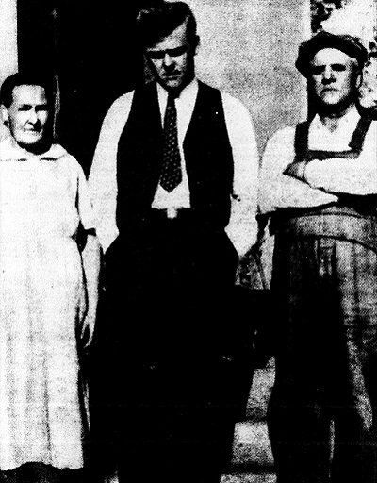
Early Life
The following section is Excerpted from Gus Hall: From Iron Range to America's top communist by Curt Brown and Minnesota, Moscow, Manhattan: Gus Hall's Life and Political Line Until the Late 1960s by Tuomas Savonen:
As a teenager, Arvo Kustaa Halberg faced harsh working conditions in lumber camps near his Iron Range roots — including once having to share his bunk with a dead logger.
By 1929, not yet 20, Halberg was hitching rides and hopping freights across the Upper Midwest, delivering revolutionary speeches about Marx, Lenin and working-class struggles as a Communist youth organizer.
He spent the early 1930s studying at the Lenin Institute in Moscow before returning home to find the United States gripped in the Great Depression, an abyss he believed could be escaped only through revolution.

Slide 6
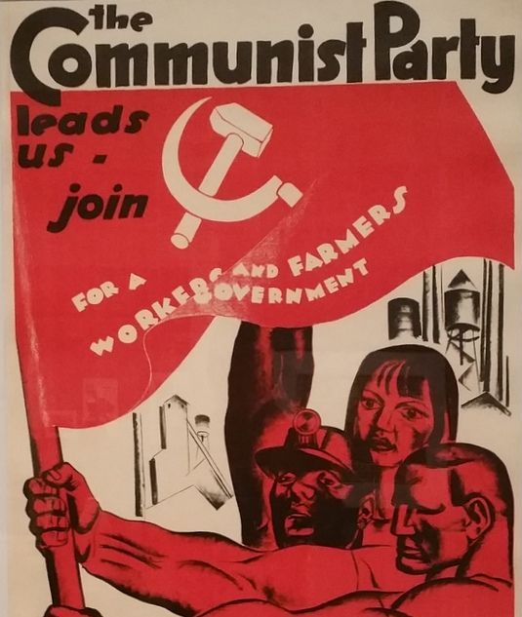
Early Life Cont.
Soon he decided to Americanize his Finnish name to Gus Hall — launching a long career that would lead him to become general secretary of the CPUSA and a four-time presidential candidate.
The fifth of 10 children, Hall quit school at 15 to work as a lumberjack to help feed his family. His Finnish-born father lost his job as a miner and was blacklisted after joining a strike led by the radical Industrial Workers of the World; he later ushered Hall into the CPUSA.
"When you work in the woods literally from sunup to sundown and it's 50 degrees below zero and you eat slop and you make $30 a month," Hall once said, "then what was said at home begins to make sense."

Slide 7
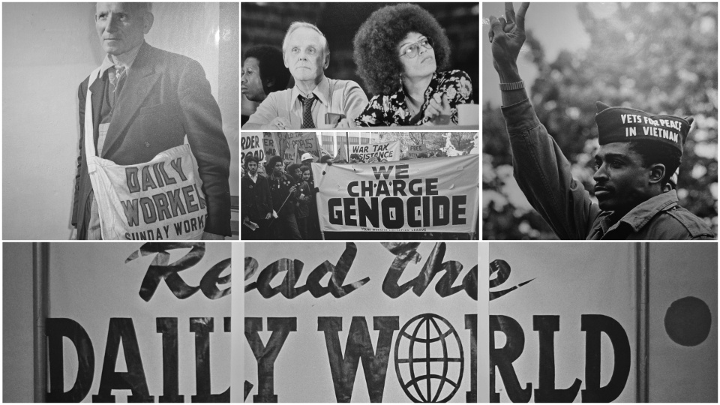
Gus Hall the Lumberjack
Life in the lumber camps was not easy since – as Arnold R. Alanen writes – “the hazardous nature of the lumberjacks’ work was exacerbated by isolation, lack of medical services and deplorable living conditions”. Gus Hall’s memories of his first job were somewhat similar to Alanen’s description. Hall reminisced his lumberjack days in CPUSA’s Daily World newspaper in 1977. According to Hall, the lumberjack’s worked for $1.00 per day with “no set hours of work, from dark-before-dawn to evening darkness, often in weather 40-50 degrees below zero”. Food in the lumber camps was appalling as maggots could be found in beef stew. The smell in the bunkhouse was horrible when 60 lumberjacks – who had not had a bath for several months – dried their clothes in a house with no ventilation of any kind. In the spring as the lumberjacks went back to cities they had to shave off all their hair and fumigate their clothes “to get rid of six-month crop of human lice, crabs and dirt”.

Slide 8
Life in a Lumber Camp
In a Newsweek interview published in 1984 Hall speaks about having to bunk with a dead man:
“The camps are tarpaper shacks, and you sleep two to a bunk, and the fella I slept with in the bunk died. He was out driving horses and he came in and he was dead, and they didn’t know what to do with him because there’s no way to get out of the camp – you know, you’re there. So they put him in his bunk and I slept with him for I don’t know how many days.”
In addition to above-mentioned grievances, Hall could not accept “the irresponsible destruction of the most beautiful virgin forests by the land by profit-hungry corporations” and the racism against even more poorly-paid Indian Americans. The young radical decided to act and tried to organize a union among the lumberjacks. This, however, was not well looked upon and Hall was fired for “disturbing the peace” in the woods. According to Hall, he left the lumber camp “determined to dedicate my adult life in the struggle to change the conditions of work and life”.

Slide 9
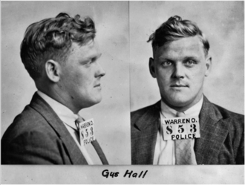
Early Encounter with Law Enforcement
In 1929 when he was still Halberg, the young Communist was a hot-tempered, barrel-chested teenager leading a farmers' hunger march from the Mesabi Range to Duluth, protesting farm foreclosures and facing off against cops with tear gas.
In Ely for an International Youth Day rally to defend the Soviet Union, he was arrested just one sentence into his speech and locked up with a dozen comrades. Halberg was a "husky, strapping youngster — never afraid of anything or anybody," a fellow revolutionary recalled.
When the Ely jailer loudly asked the next morning what they wanted for breakfast, Halberg shouted back: "Bacon and eggs and the Communist Manifesto."
A photo of Gus Hall circa 1929

Slide 10
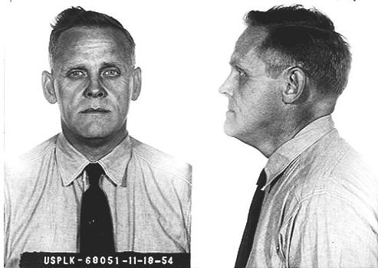
Leavenworth Prison
Gus Hall Spent 8 years in Leavenworth Maximum Security Prison in Kansas for “thought crimes.” He was charged with “conspiring to teach the violent overthrow of the federal government”
In an interview in April 1992, Comrade Gus Hall spoke of his prison time: ''I did what I believe in. I believe socialism is inevitable. Life cannot go on forever without that step (socialism), and setbacks don't change it.''
Mugshot of Gus Hall in Leavenworth Prison

Slide 11
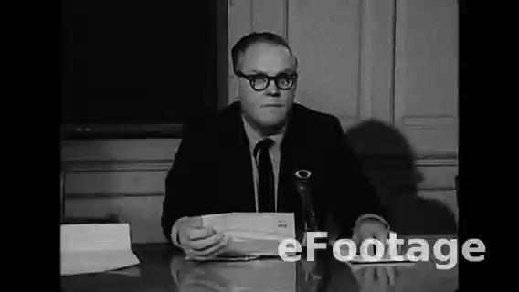
Gus Hall on the McCarran Act

Slide 12
Discussion & New Members Introductions

Slide 13
New Member Introductions
What is your name, pronouns and state (or country/territory)?
Where do you work? Is it unionized?
How did you find out about the People’s School?
What do you think about tonight's class?

Slide 14
Activism, Serving in the Army

Slide 15
All Material (except for first slide) for Section 2 comes from Comrade Gus Hall’s Autobiographical accounts in “Working Class USA”

Slide 16
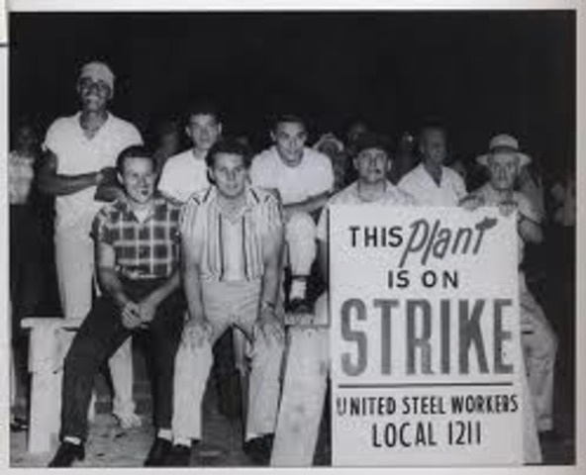
Little Steel Strike in a Nutshell
Beginning on May 26, 1937, the strike was named the Little Steel Strike because compared with US Steel Corporation, the four companies on strike were dwarfed. The companies on strike were Republic Steel Corporation, Bethlehem Steel Corporation, Youngstown Sheet & Tube Company, and Inland Steel Company, each ranked among the hundred largest firms in America.
Though the strike initially collapsed, in 1942, rumors of another strike were circulating which caused the Little Steel companies to give into NLRB pressure to accept the terms of unionization of the Steelworkers.

Slide 17
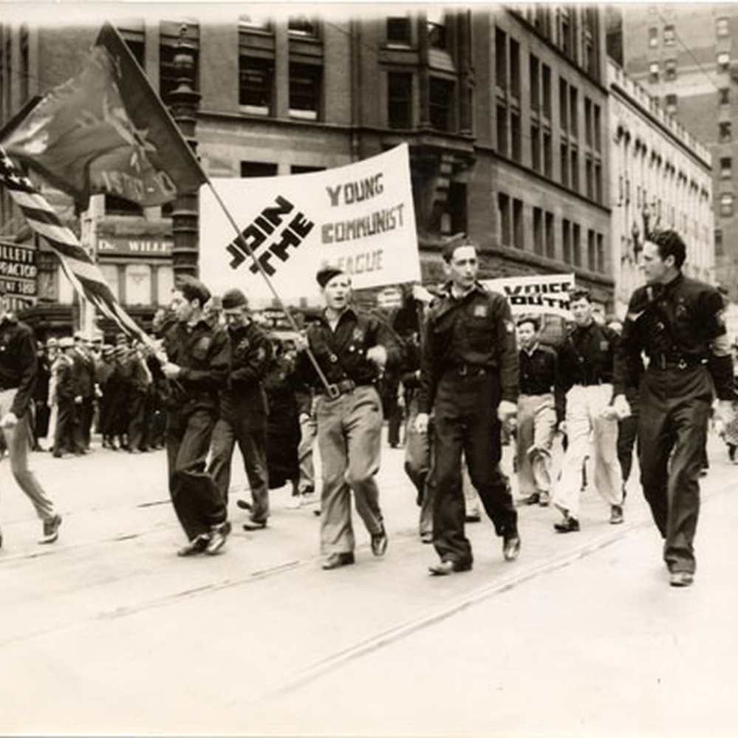
Becoming a Steelworker
THE NATIONAL OFFICE OF THE YOUNG COMMUNIST LEAGUE HAD decided to send me from Minnesota to work in the coal fields, both as an organizer for the YCL and to help the coal miners' drive for union organization. On the way to West Virginia we were to get together to discuss my work. I hitchhiked to Cleveland. On the same day there was a Party leadership meeting that included the leading comrades from Youngstown, Ohio. More than anyone else, Joe Dallet, a wonderful, enthusiastic comrade, who was later killed in Spain, convinced me to stop at Youngstown while awaiting further instructions from the National Office of the YCL.

Slide 18
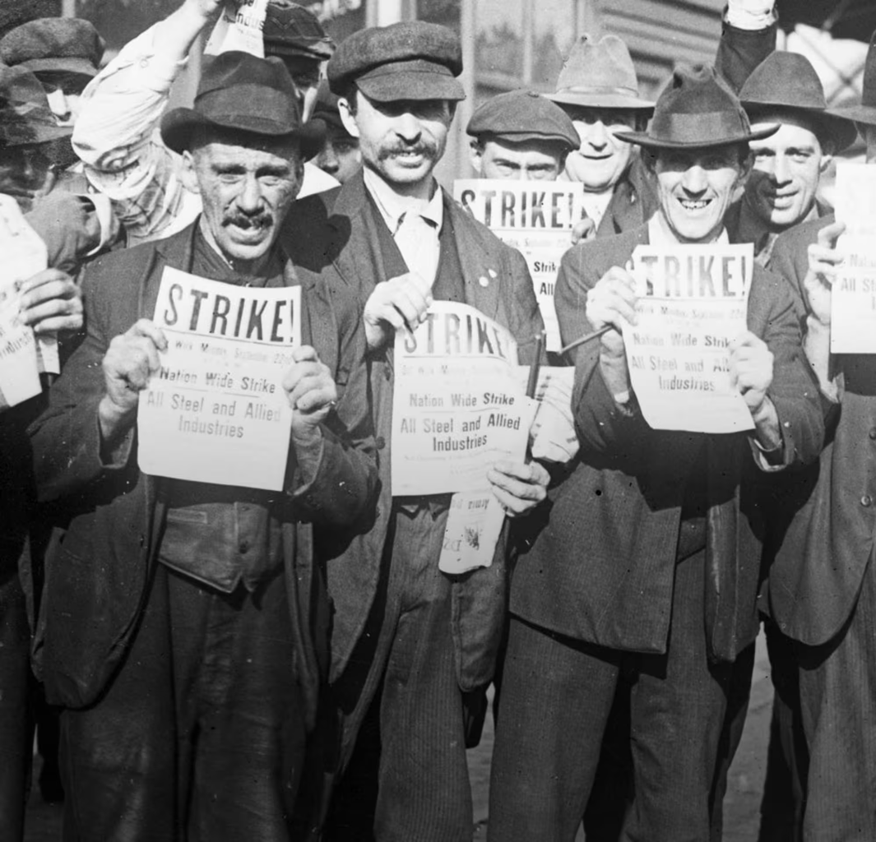
Becoming a Steelworker cont.
So I joined the comrades and went to Youngstown that night. Before I knew it I became fully involved in the struggles of Youngstown, and they were everywhere — the unemployed, the youth, the Black community, steelworkers — everything was in motion. There were continuous demonstrations. In a few weeks it became impossible to leave Youngstown. So the national office of the YCL and the Party agreed I should stay there. That's how I landed, by accident, in Youngstown. It became clear that in order to organize steelworkers some of us had to get jobs in the steel industry. That was not an easy task; there wasn't too much hiring going on.

Slide 19

How Arvo Halberg became Gus Hall
I knew that if I gave my real name, Arvo Gus Halberg, I would not last a day, because I had already run for the City Council of Youngstown on the Communist Party ticket. I made up my mind to try for the job and in desperation, just as I got to the glass building, I decided to cut both ends of my name and use what was left — Gus Hall. I was hired.

Slide 20
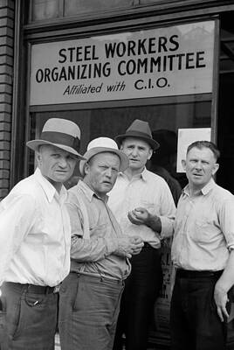
How Arvo Halberg became Gus Hall
So I became a steelworker and an organizer for the steel workers union. Before the union came into being I was fired twice from two different steel mills. But the activities I took part in were all as Gus Hall because I couldn't have two names — one in the mill, and the other as an organizer of the union. Then came the strikes and the name Gus Hall became widely known. So it became impossible to go back to my full name — Arvo Gus Halberg.

Slide 21
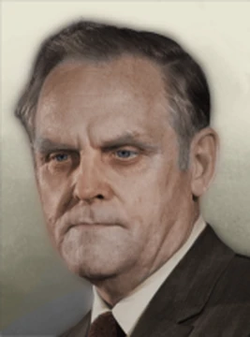
How Arvo Halberg became Gus Hall
A few years later I decided to make Gus Hall my legal name. However, I didn't know it would cost anything. So when the judge asked for the $5 fee there was again a headline —now Hall — had funds for change." How did it get into the papers so quickly? Because of a one in a mil reading, "Halberg lion shot. The clerk at the court was an old rat — a witness I think —in the Bridgman, Michigan case against our comrades. That's how Arvo Gus Halberg became Gus Hall the steel worker.

Slide 22
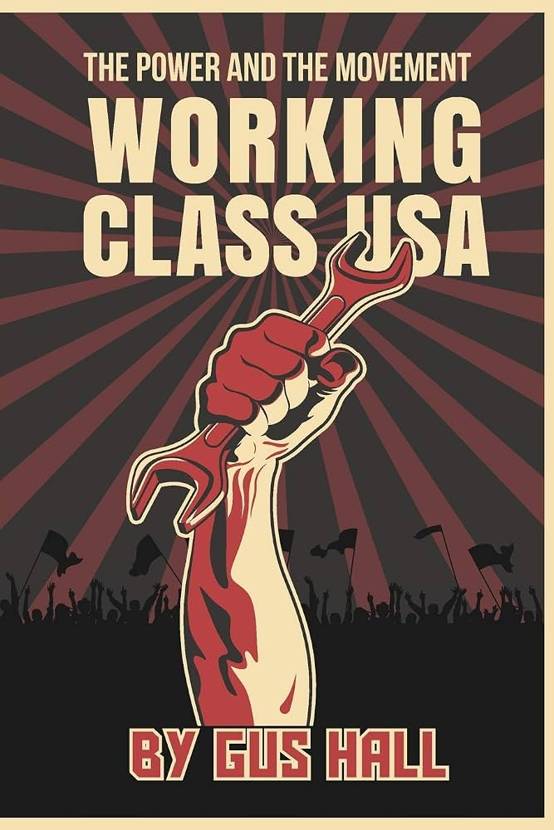
Gus Hall Transformed into a Labor Organizer
I HAVE NEVER STOPPED BEING AMAZED AT THE SELF-INITIATIVE OF workers during periods of struggle. It rises to the top in a way that is just unbelievable. This of course rises to its very highest level during revolutionary moments. And I, of course, have only seen it during strike struggles and the struggles of the unemployed —it gives one a sense of confidence of what workers will do during really serious revolutionary crises.

Slide 23
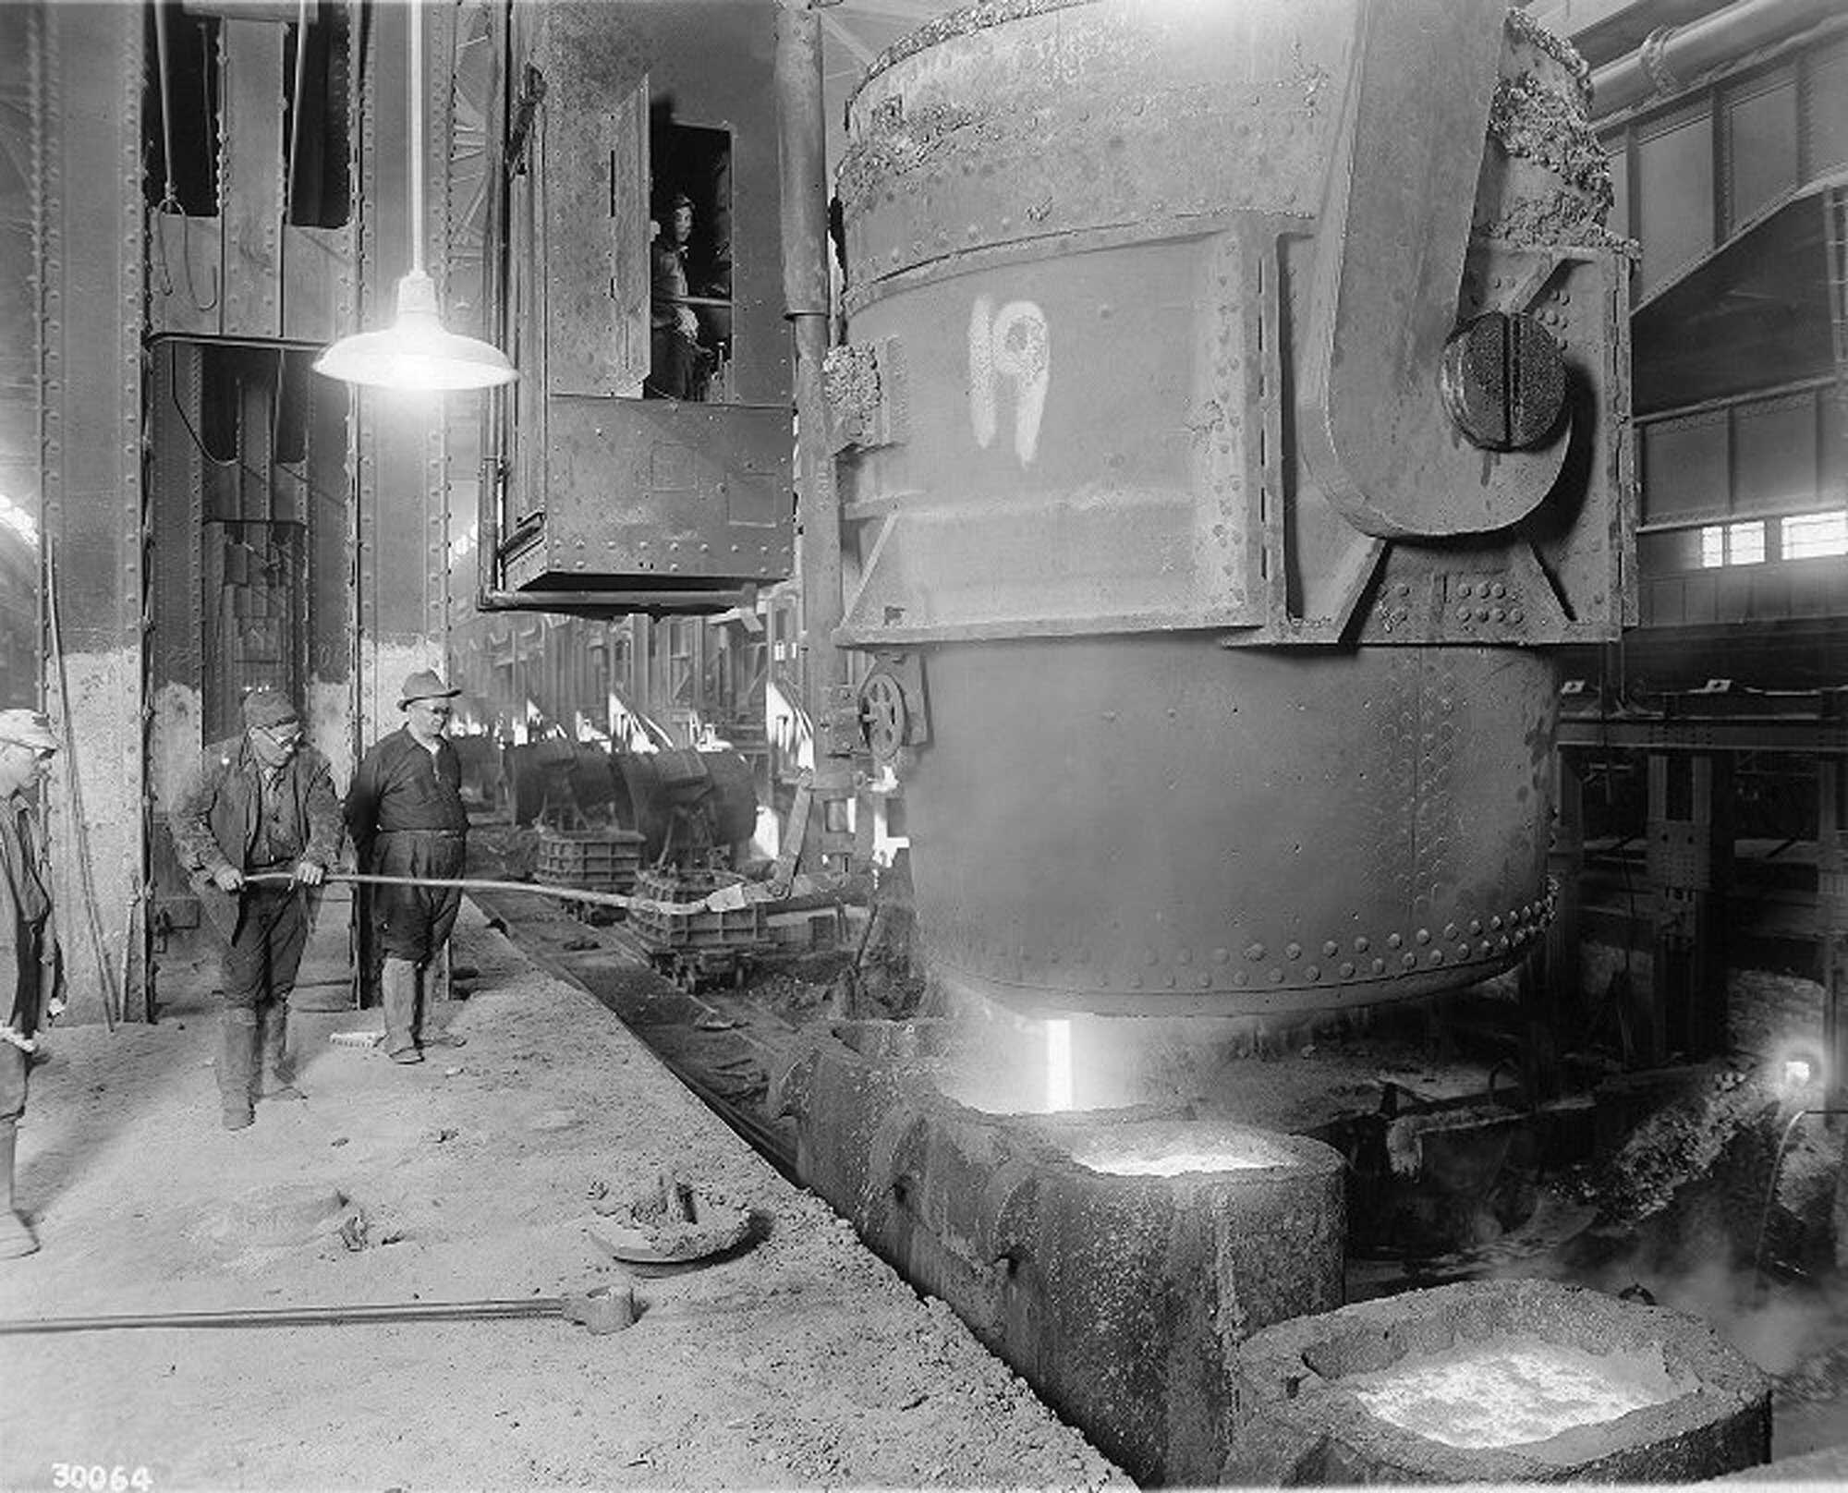
Prelude to the Strike
In 1937 the U.S. Steel Corporation, the biggest steel producer, decided to break class ranks and for the first time in the history of the industry recognized and signed a contract with a union. It became obvious then that the other steel corporations, led by Tom Girdler, the reactionary president of Republic Steel, would not deal with the union; there would have to be a strike in the rest of the steel industry, which was called Little Steel only because the biggest corporation, U.S. Steel, had already signed the contract.

Slide 24
Overcoming a Surmountable Barrier
The big factors holding back organization in the Warren plant was a company union — very common in those days — and the old organization of craft workers in the old class collaborationist Amalgamated Association of Iron, Steel & Tin Workers (AA). They refused to admit steelworkers into their ranks, but this craft union demanded jurisdiction over the whole steel plant. So it remained largely unorganized and the union had not come through, as was the case in many other areas. When the union organizing drives were in trouble, the leadership of the Steelworkers Organizing Committee would ask one of the Communists to take over the task. This happened a number of times. So I was asked to take over the task of organizing and preparing the Warren and Niles plants of Republic Steel for a strike that was only weeks away.

Slide 25
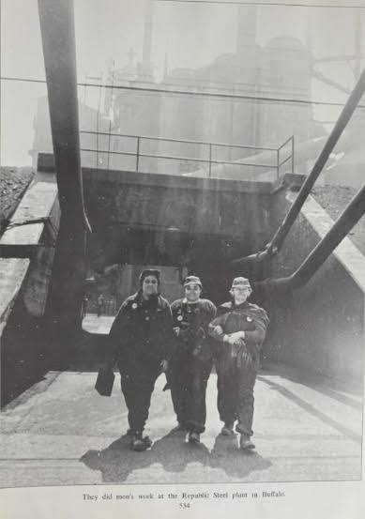
Decisive Strike
The basic industries had remained non-union industries. For Republic Steel, the Warren plant was the key plant. Because Warren had been a more conservative city, Republic went all out to defeat the strike. They prepared for war and this was especially true around the Warren plant.
One must keep in mind that this big corporation had made all its plans and the solid decision that this was one strike it was going to break — because if it did, the steel industry would remain unorganized.

Slide 26
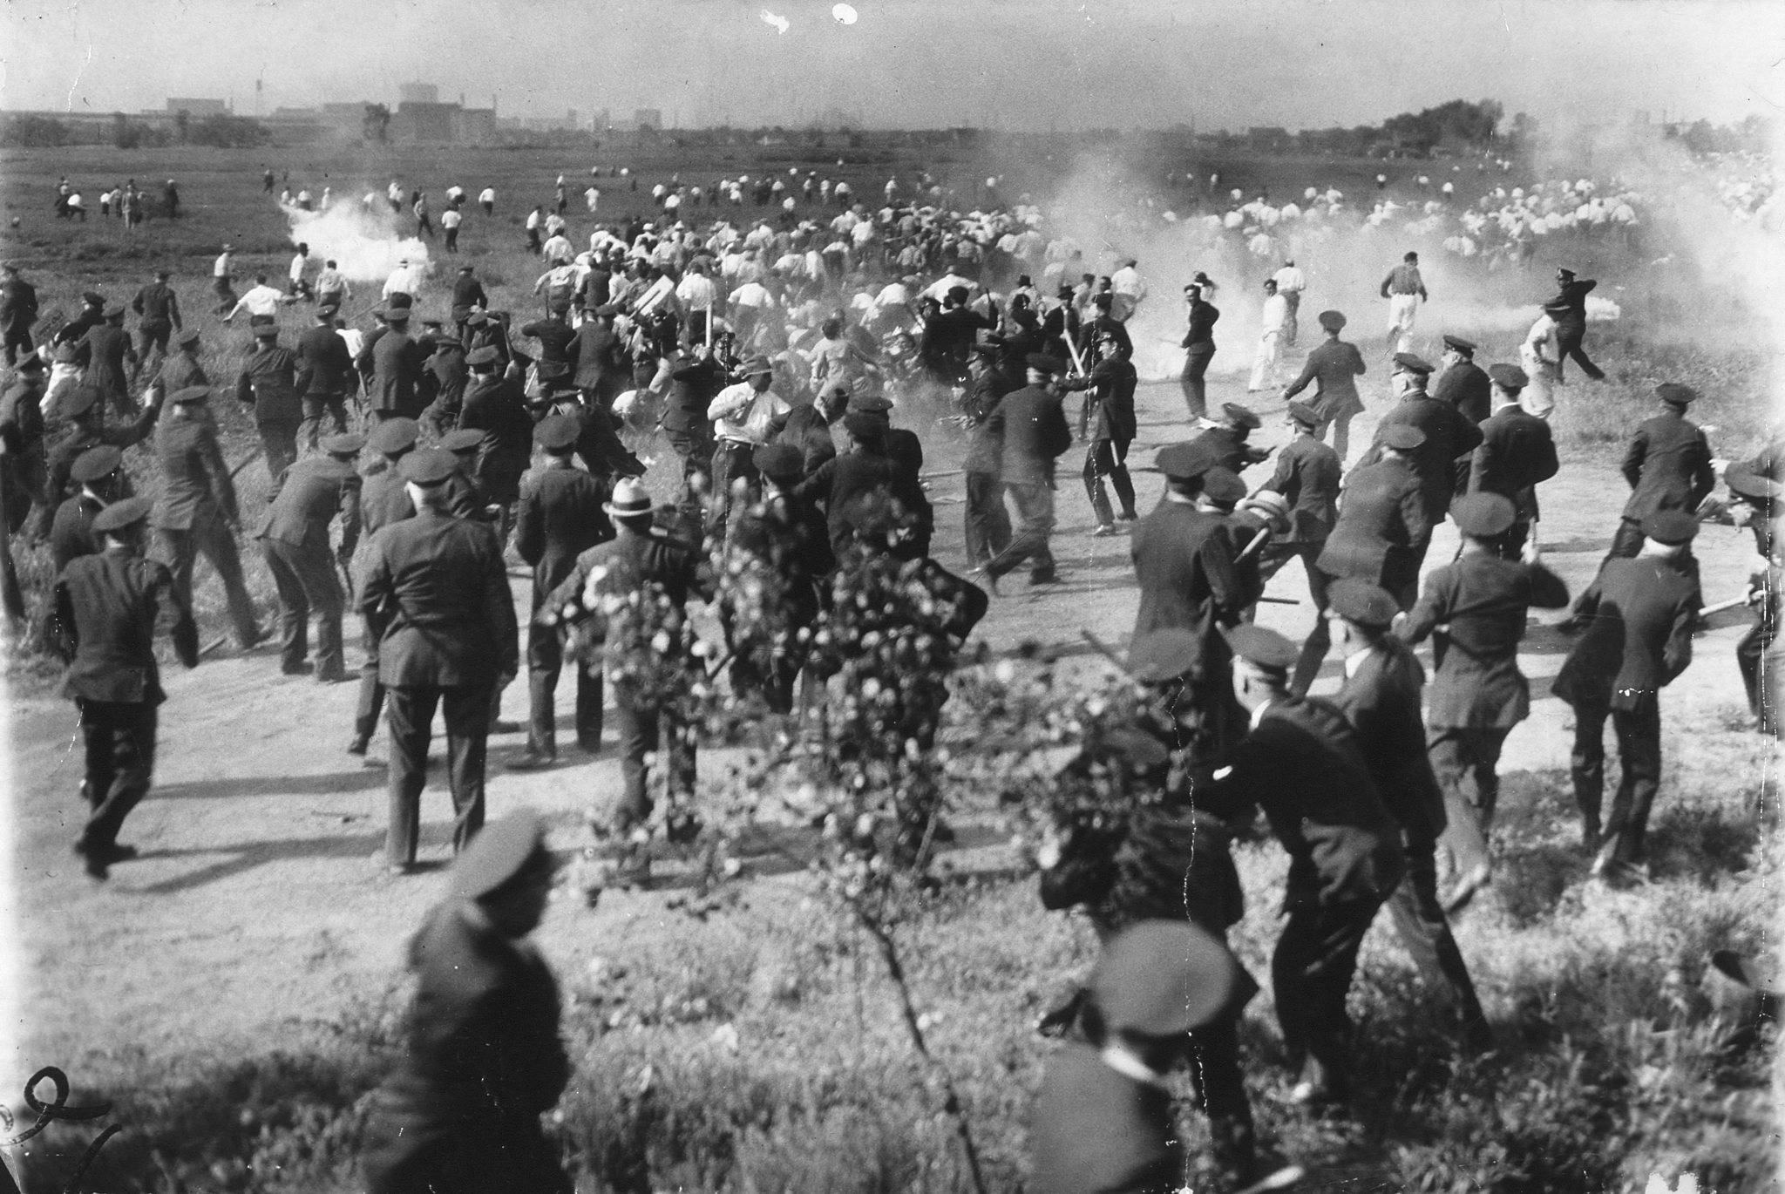
Strike Kicks-Off as Major Battle
Once the strike had started, I left the strike committee meeting the evening of the third day — when we had discussed the problems of the back side of the plant, the streets, etc. I was going to discuss these questions with the pickets, with the workers. It was hardly dark, and when I reached the pickets I didn't believe what I saw. The back side looked like a scene from the First World War — a battlefield.

Slide 27
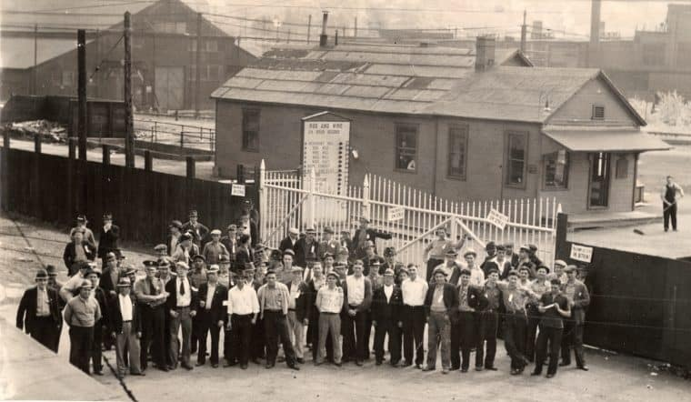
Strike Brings out Worker Ingenuity
There were barbed wire fences and floodlights lighting the place up from one end to the other. The idea itself was unique enough. But when I asked where they got the money to buy the materials, the answer was just as unbelievable. These workers —the rank-and-file workers —had organized themselves in teams and they canvassed the local business people and got materials donated for free and set up this warlike scene with floodlights and barbed wire fences.

Slide 28
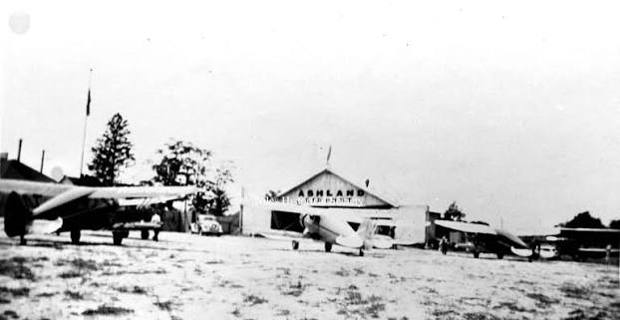
Keeping Scabs Away
The Republic Steel plant in Warren was big enough for landing planes. So Republic hired small planes filled with scabs and food from around the country. That's how they brought in strikebreakers. But Republic underestimated the determination and ingenuity of the workers. Here again, the initiative of the workers took hold. Many of them were deer hunters, so they got out their guns and placed themselves in the swamps waiting for the planes to come. They shot at the scab planes enough so that two of them crashed upon landing inside of the plant. This brought Republic's scab flights to an end.

Slide 29
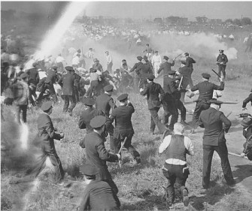
Developing a Reputation
Later the streets running into the plant became a problem. The action of the steelworkers was direct and simple. They simply closed the streets off, and only those with a pass signed by me, as chairman of the strike committee, could come and go. There were a number of crises about these street closings, especially when the Mayor and the Chief of Police were forced to get a pass signed by a known Communist, strike committee chairman. The police chief especially was very vindictive and to his last day he said to many people of the press that in his mind John Dillinger was not enemy number one, Gus Hall was.

Slide 30
The Striking Workers are Resourceful
It was difficult to get strike headquarters in this conservative Little Steel town. But here again the initiative of workers came to the rescue. Some workers knew a small underworld character who owned a large, fully-equipped nightclub and gambling place. It was closed at the time but with plans to open soon. These workers also knew that the owner had a grudge against steel companies in general because when he was a boy a steel company fired his father. As a result we had the most elaborate, well-equipped strike headquarters in all of labor history, and it didn't cost us a penny. These were actions by workers who lived in the traditional conservative Republic-controlled town, and who themselves had just joined the union. They were very new in the union. However, when the strike was over, because of the experiences many of the best of these workers joined the Communist Party, and many of them still remain in the Party.

Slide 31
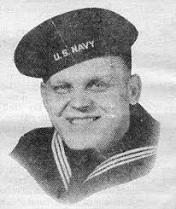
Service in the Navy
During World War II Hall served in the U.S. Navy as a machinist's mate on Guam. He was elected to the party's National Committee in 1944 while still overseas. Two years later he was elevated to the National Executive Board, one of several young veterans capable for national leadership who were not affected by the rancor over the ousting of Earl Browder as party leader in 1945. After demobilization in 1946, he was elected to the Secretariat of the National Committee of the American Communist Party.
He was honorably discharged March 6, 1946.

Slide 32
Discussion

Slide 33
General Secretary of the CPUSA

Slide 34
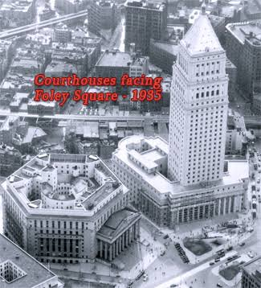
The Scourge of the Red Scare
The beginning of the “Red Scare” in post-war U.S. found Gus Hall and his comrades in the crosshairs of an anti-communist witch-hunt. On July 22, 1948, a federal grand jury indicted Hall and 11 other Party leaders under the Alien Registration Act, popularly called the Smith Act, for conspiring to teach and advocate the overthrow of the government by force. The dramatic 10-month trial, marked by loud confrontations between the defendants, their lawyers and the judge, Harold R. Medina, was held in the United States courthouse on Foley Square in downtown Manhattan and shared headlines with another celebrated trial underway in the same building—the perjury trial of Alger Hiss, a former State Department official accused of having spied for the Soviets.

Slide 35
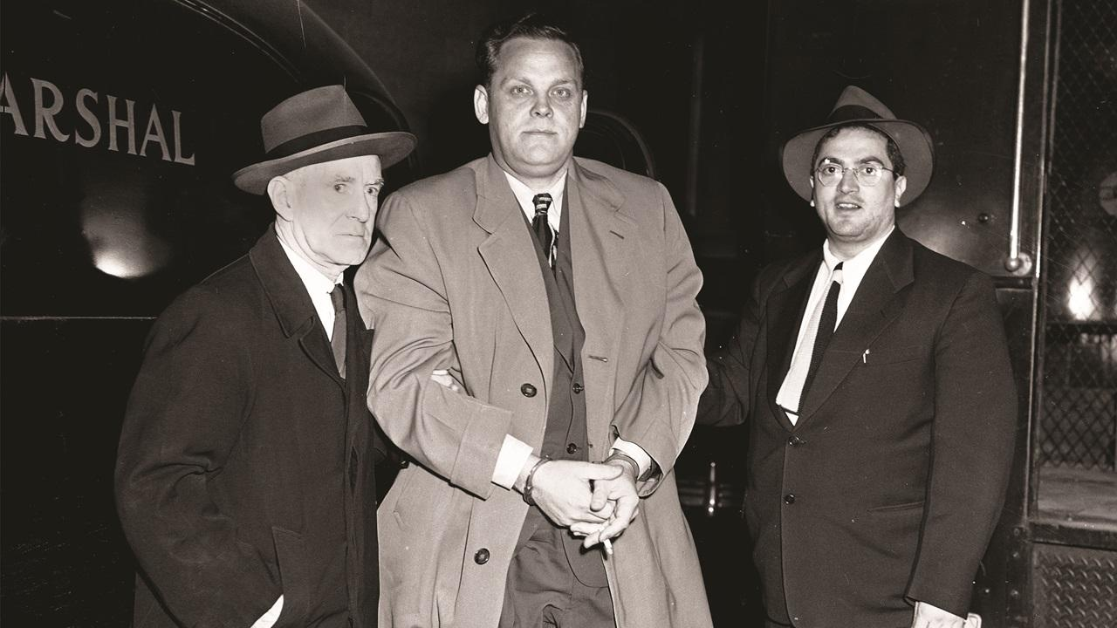
Political Persecution and Imprisonment
In October 1949, Hall and 10 others were found guilty of conspiracy to teach the overthrow of the U.S. government and sentenced to five years in prison. While the verdict was being appealed, Hall was elected to the party's second-highest position, national secretary, but after the Supreme Court upheld the convictions in 1951 he and three others jumped bail and crossed the border into Mexico, only to be captured three months later by Mexican Secret Service agents. Hall, his sentence lengthened to eight years, was confined to the Leavenworth Federal Penitentiary in Leavenworth, Kansas. A series of United States Supreme Court decisions in 1957 threw out numerous convictions under the Smith Act as unconstitutional. The statute remains on the books, however.
Gus Hall, center, one of the 11 Communist leaders convicted in 1949 Smith Act frame-up trial, arrives at Federal Court accompanied by U.S. Marshals, Nov. 26, 1951. | Tom Fitzsimmons / AP

Slide 36
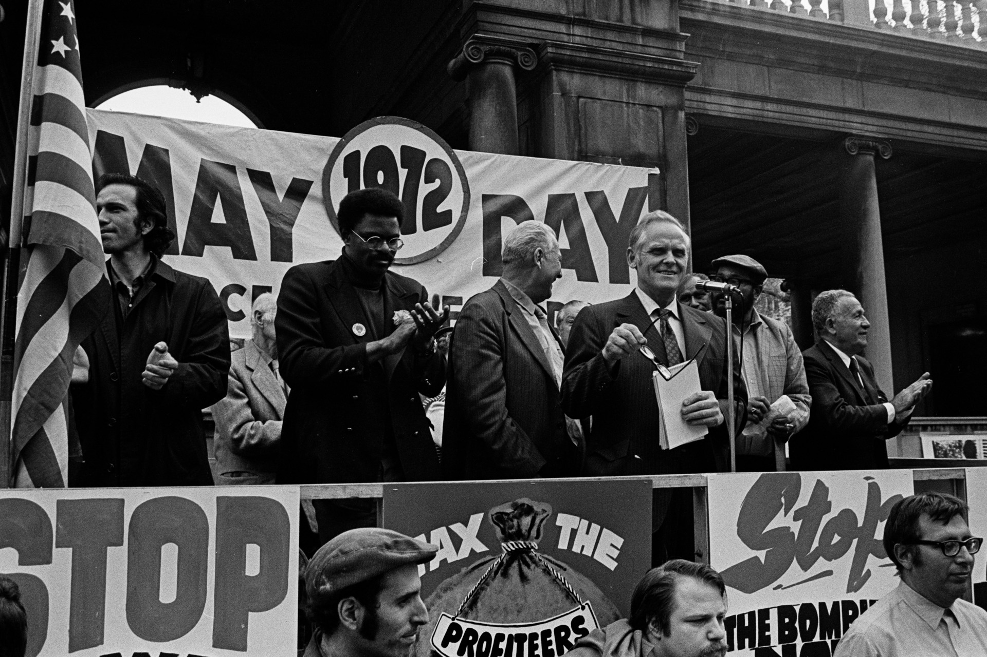
Rebuilding the Party and The Rise of the New Left
After his release, Hall continued his activities. In 1959, he was elected CPUSA General Secretary. But the Cold War era and McCarthyism had taken a heavy toll on the Communist Party. Hall, along with other Party leaders who remained, sought to rebuild it. He led the struggle to reclaim the legality of the Communist Party and addressed tens of thousands in Oregon, Washington and California. In a period of 40 years, Hall's name became synonymous with the U.S. Communist movement. He and his party faced multiple persecutions by the authorities, including restrictions of their civil rights. But apart from these difficulties, Gus Hall had to overcome a series of ideological and political issues that had been manifested within the communist movement itself. One of these issues was the rise of the so-called “New Left”, which included the promotion of opportunist theories, the rejection of Marxism-Leninism and even the open hostility towards the Soviet Union by leftist groups.
Hall speaks at a May Day demonstration in Manhattan's Union Square, May 1, 1972

Slide 37
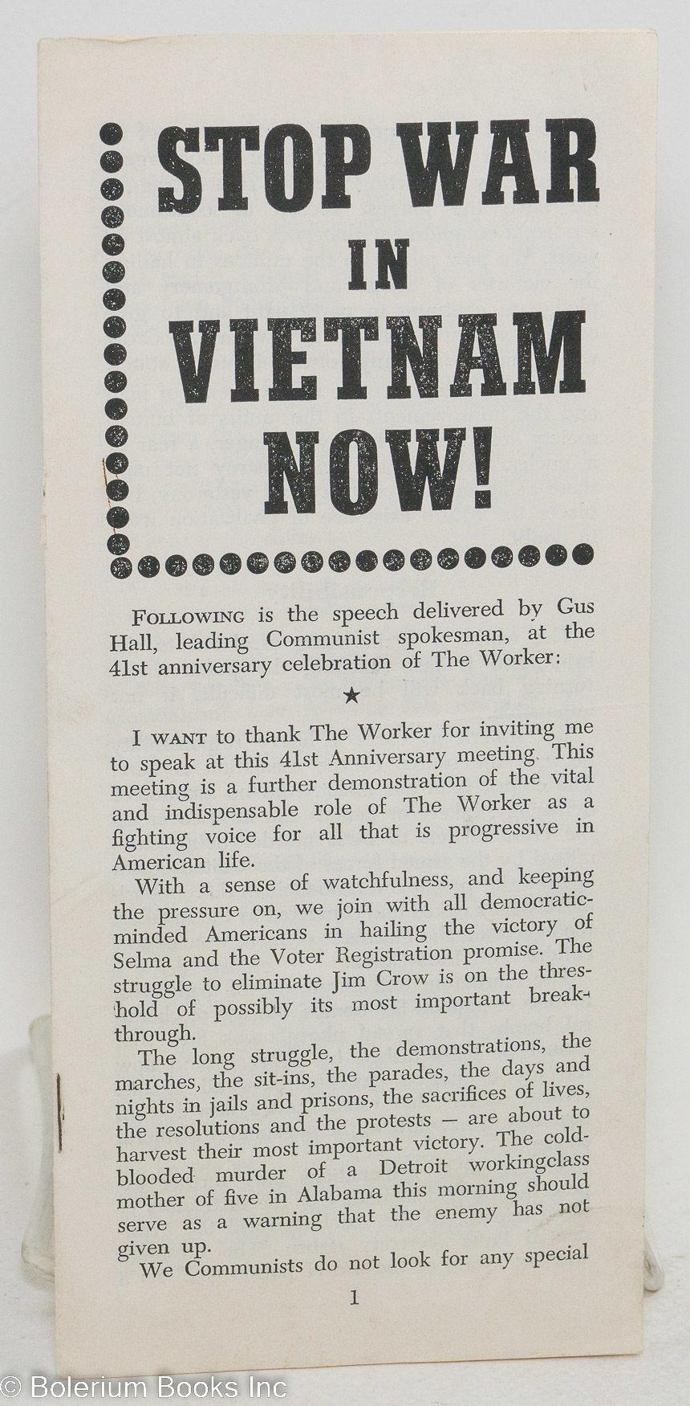
Defender of Marxism-Leninism
Gus Hall made a brave effort to reconstruct the Communist Party and forge a lasting alliance with the popular movements of the late 1960s and 1970s, such as, for example, the large anti-Vietnam War movement, the civil rights organizations and the young “baby boomer” generation of activists. His major vision was the creation of the broad popular front, on the basis of the Marxist-Leninist ideology, that would encompass the most progressive and radical elements of the U.S. society. His effort was ultimately unsuccessful, but he would always be remembered as a man of principle, integrity and honesty. Gus Hall remained a staunch defender of the Marxist-Leninist ideology, an enemy of opportunist deviations (e.g. Eurocommunism, liberalization of the Communist Parties) and a firm supporter of the Soviet Union. He never lost his confidence in the American working class, upon which socialism in the U.S. could be constructed.

Slide 38
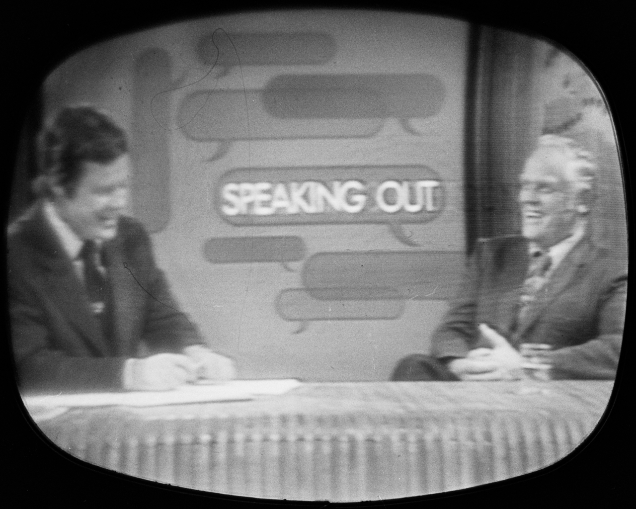
Fending off Left and Right Revisionism
During the 1960s and 1970s, Hall also made frequent appearances on Soviet television, always supporting the position of the Soviet regime. Hall guided the CPUSA in accordance with the party line of the Communist Party of the Soviet Union (CPSU), rejecting any revisionist efforts such as Eurocommunism. He also dismissed the radical new revolutionary movements that criticized the official Soviet party line of "Peaceful Coexistence" and called for a world revolution. After the Sino-Soviet split, Maoism likewise was condemned, and all Maoist sympathizers were expelled from the CPUSA in the early 1960s.
Hall (right) on the CBS talk show Speaking Out, October 6, 1972

Slide 39
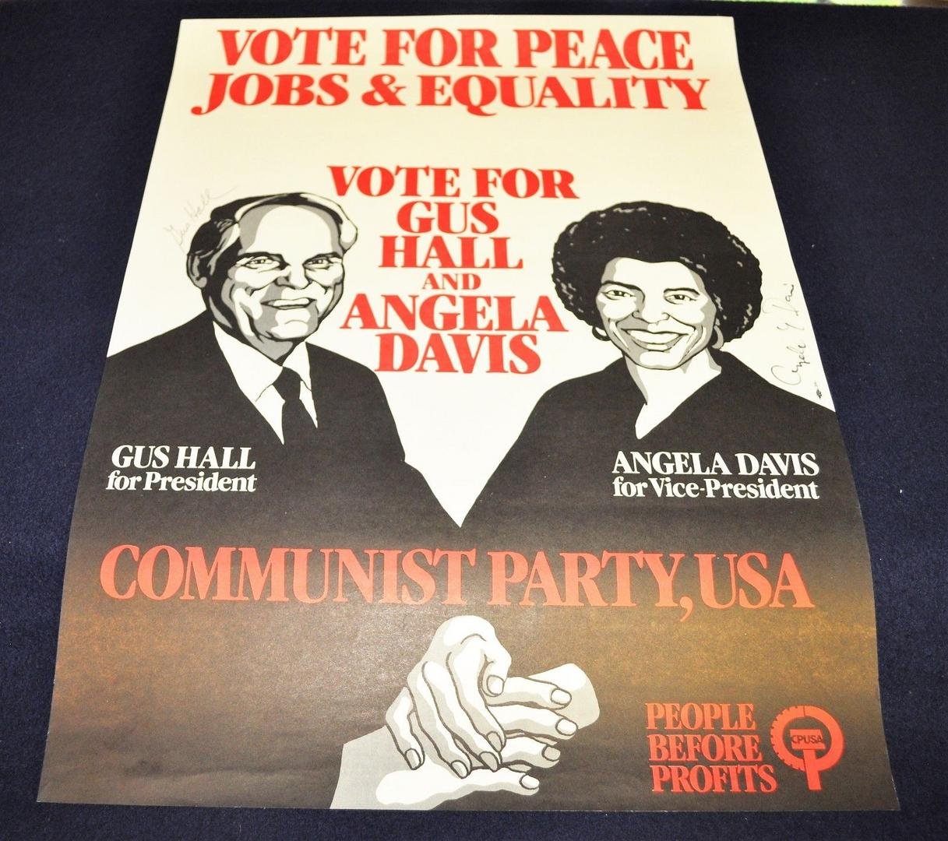
General Secretary for President
Hall ran for U.S. President four times: in 1972 and 1976 with Jarvis Tyner as his running mate and in 1980 and 1984 with Angela Davis. All these campaigns took place under conditions of very limited media coverage, low financial resources and multiple obstacles set by the bourgeois establishment. Hall and Davis ran in the presidential election for the last time in 1984 with the slogan “People before profits”. During the counterrevolutionary overthrows in the Soviet Union and Eastern Europe in 1989-1991, he remained an unwavering supporter of socialism. He once called Mikhail Gorbachev and Boris Yeltsin “a wrecking crew”. During an interview in April 1992 he said: “I did what I believe in. I believe socialism is inevitable. Life cannot go on forever without that step (socialism), and setbacks don't change it”.
1984 Vintage Campaign Poster - Gus Hall & Angela Davis - Communist Party President & Vice-President

Slide 40
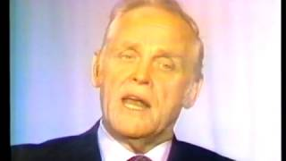
Gus Hall - 1972 Campaign Ad "Worker"

Slide 41
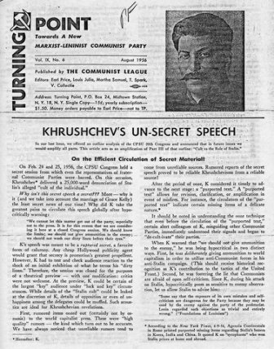
Standing Strong on Principles
In the late 1980s, when counter-revolution and dissolution were underway in the Soviet Union and Eastern Europe, Hall stood by his anti-revisionist Marxist-Leninist stance. Concerning Stalin, he admitted that even leaders of a socialist country might err sometimes, but suggested that the Soviet historians were exaggerating Stalin’s supposed “crimes” which began with the so-called “secret speech.” Hall declared that he had not become a member of CPUSA because of Stalin and would not leave because of him. After the dissolution of the Soviet Union in 1991, the party faced a crisis. Hall led a faction of the party that stood against Gorbachev and for the Communist Party of the Soviet Union. In the same year, Hall conducted a news conference at the party's Manhattan office, warning of a new wave of witch hunts and McCarthyism, but this time in the former Soviet Union.

Slide 42
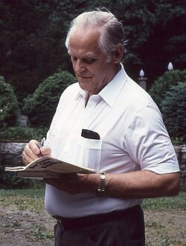
A Life Lived in the Movement
Gus Hall remained the General Secretary of the CPUSA until May 2000, just a few months before his death. He was the author of several books about Marxism and the communist movement, such as “Imperialism today” (1972), “The crisis of U.S. capitalism and the fight-back” (1975), “Basics: For Peace, Democracy and Social Progress” (1980), “Karl Marx: beacon for our times” (1983), “Fighting Racism” (1985) and “Working class USA: the power and the movement” (1987). Gus Hall died on October 13, 2000, at Lenox Hill Hospital in Manhattan from diabetes mellitus complications. He was buried in the Forest Home Cemetery near Chicago. He was honored with the Order of Lenin, the highest civilian decoration bestowed by the Soviet Union.
Hall signs a copy of For Peace, Jobs, Equality, 1984

Slide 43
Discussion & Wrap Up

Slide 44
Announcements
PCUSA Cell Chairs need to call members of their cells to remind them about attendance.
Reminder for PCUSA Cadre that attendance to the Jones-Foster continuing education class, which is the first Wednesday of every month is mandatory
The next issue of New Masses (2026) has begun production. If you have art you want us to feature, email it to info@partyofcommunistsusa.net.

Slide 45
Volunteers Needed!
We are in need of volunteers for the staff of the People’s School! Here’s a few roles we need filled:
People to help manage posting on our social media and podcast platforms
Video Editors, Audio Editors, Graphic Designers, Artists, Narrators
Web Controls, Moderators
Email info@peoplesschool.us if you’re interested and try to attend our next staff meeting if possible.

Slide 46
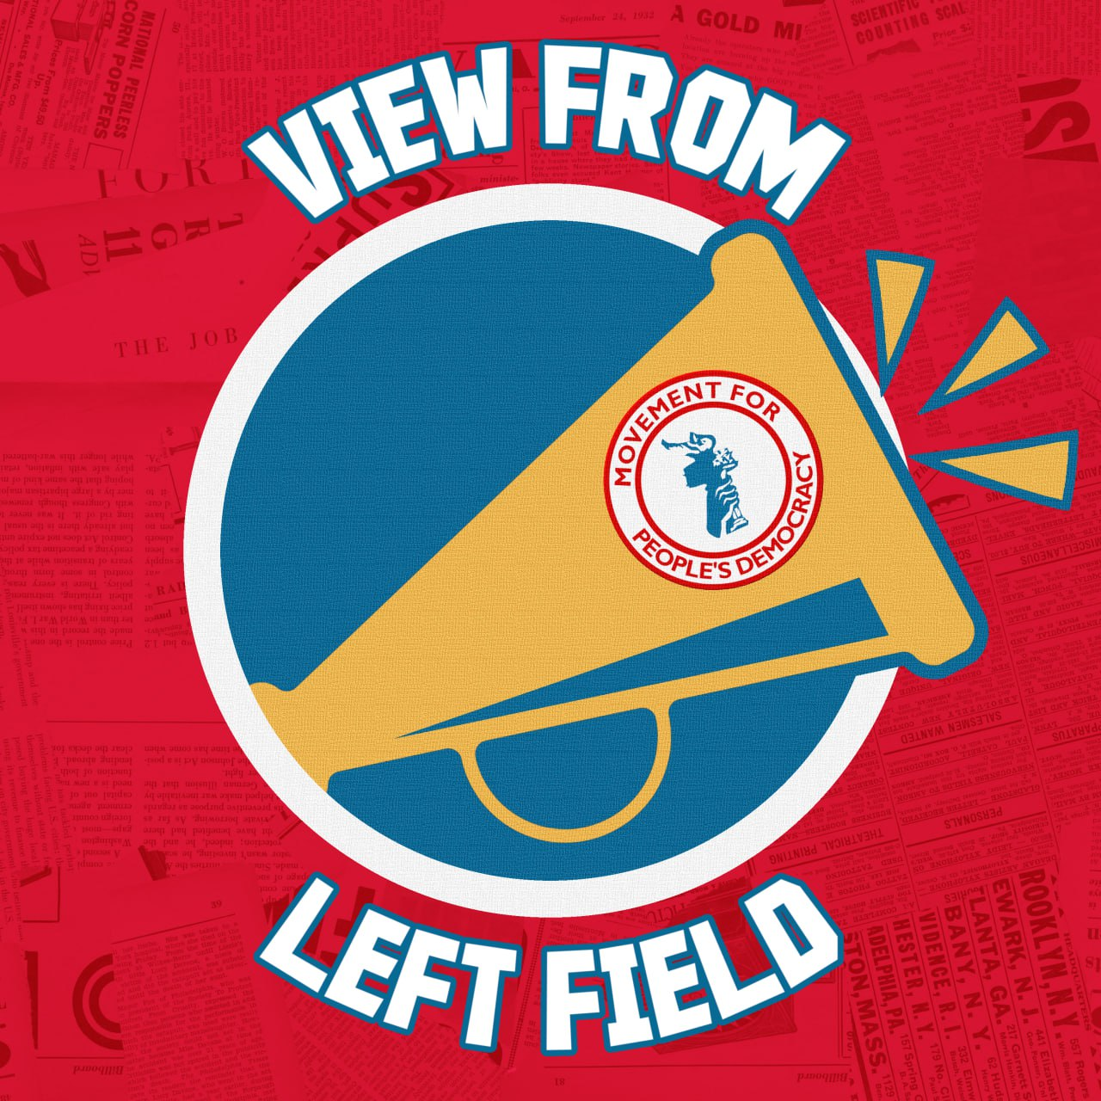
View From Left Field
https://viewfromleftfield.libsyn.com
The Old PSMLS Youtube is now the Youtube of View From Left Field, a podcast of analysis and discussion of current events from a progressive perspective.
Like the Youtube videos and subscribe with 5 star ratings on your podcast platforms.

Slide 47

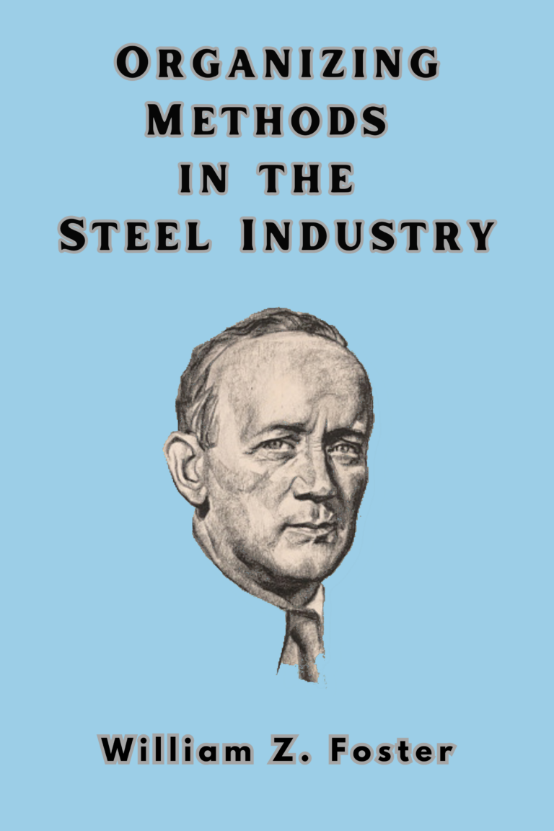
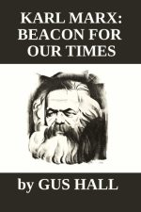
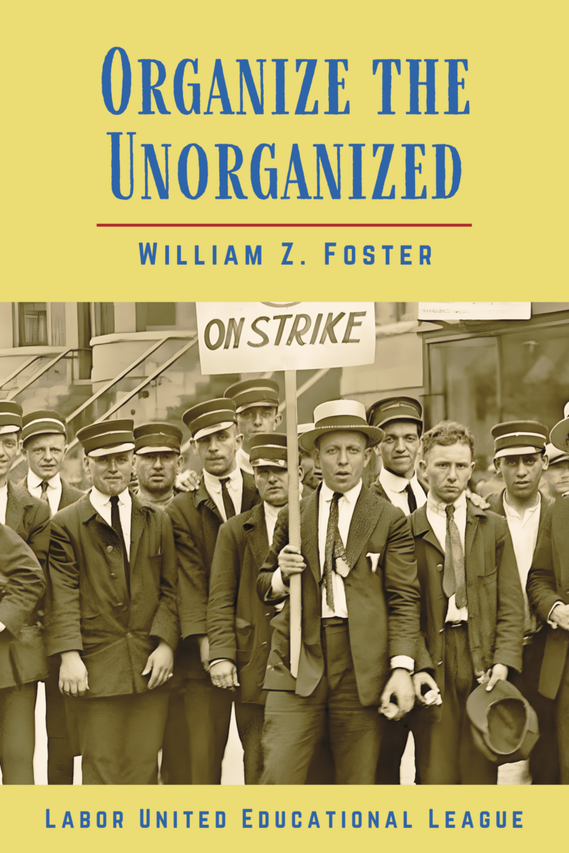
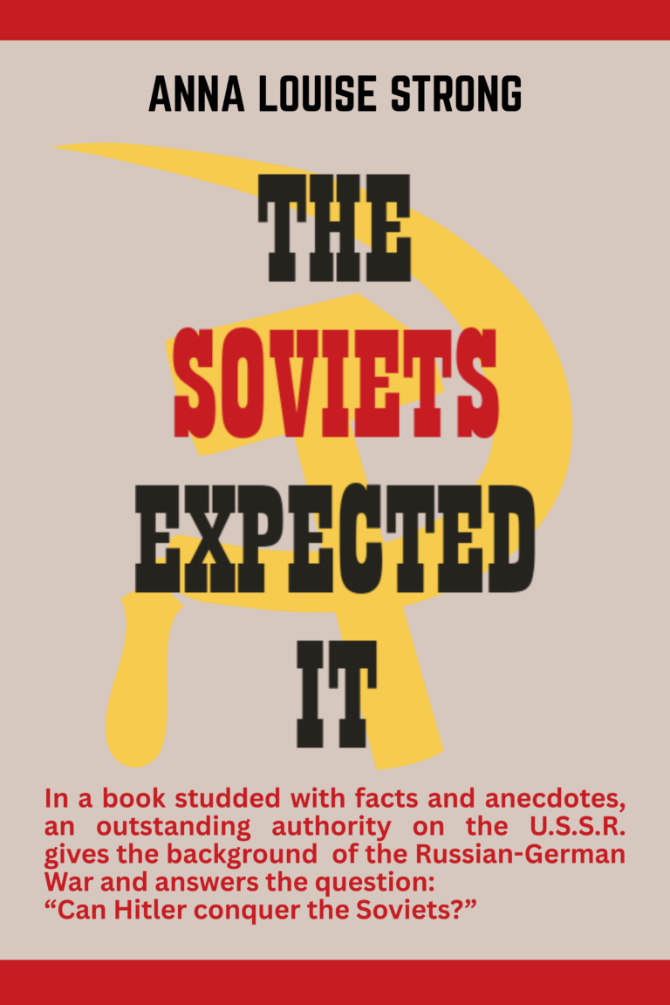
New Outlook Publishers
newoutlookpublishers.store
Relevant and Latest Releases

Slide 48
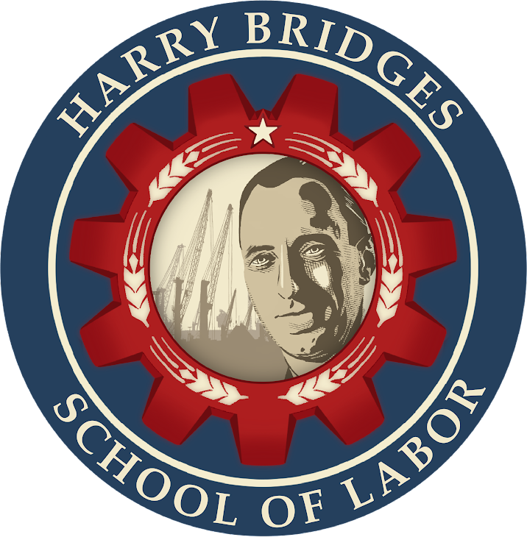
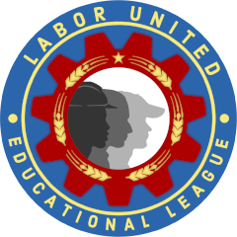
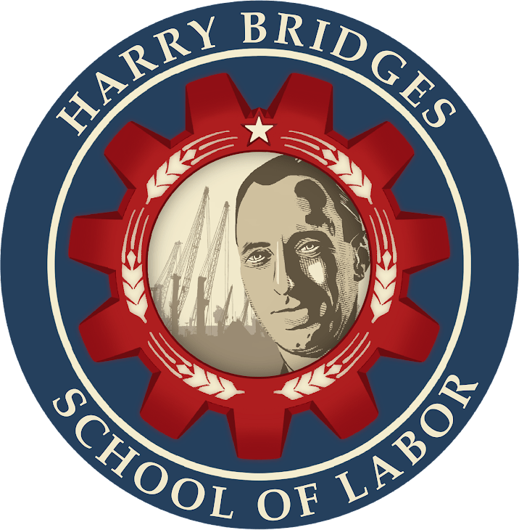
Harry Bridges School of Labor
luel.us/laborschool/
The Harry Bridges School of Labor is a monthly class covering a variety of topics aimed at building class consciousness among union members. For class schedule and other information, please visit the website at luel.us/laborschool.

Slide 49

The Internationale - English Jazz Version

